Slide 1
A Midsummer Night’s Dream
Act 1 Scene 1 part 2

Slide 2
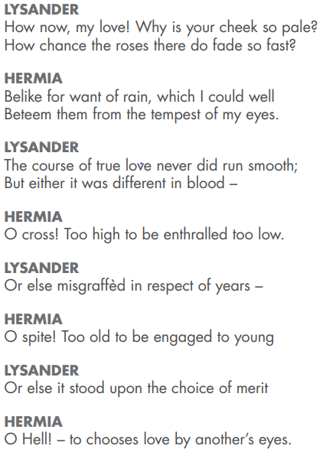
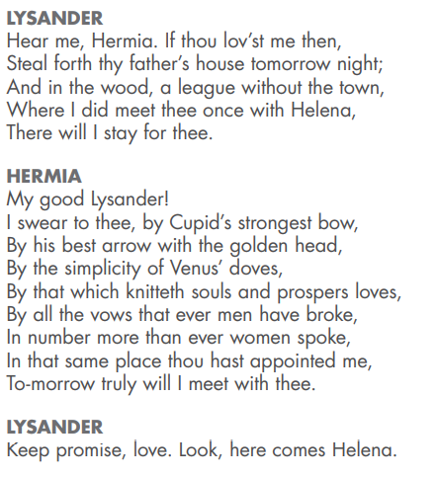
Here Hermia is close to tears. She is angry with her father and upset with the situation. So, Lysander tells her to run away from her father’s house and meet him in the woods where he had met her once before with Helena.

Slide 3
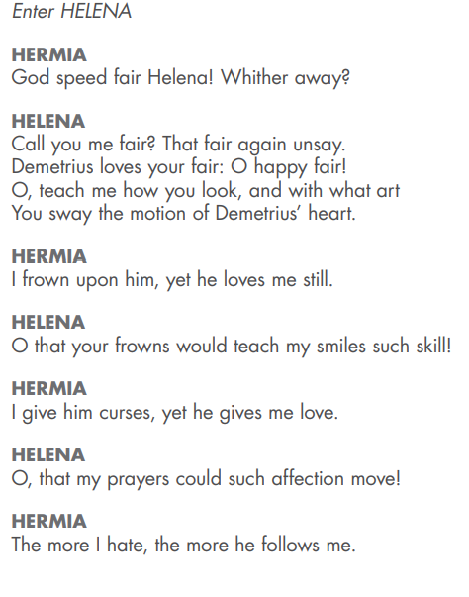
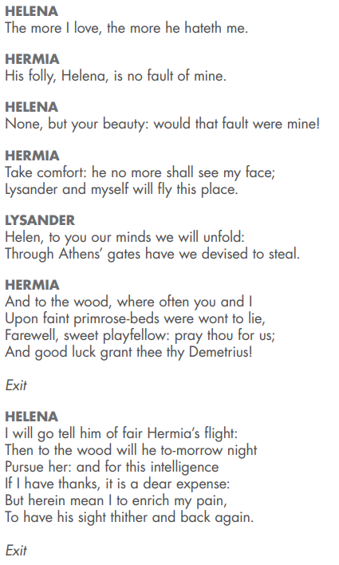
What do you notice about the ends of the lines of this part of the play?

Slide 4
In this scene, Hermia and Helena are talking about the situation. Hermia is trying hard to make Demetrius dislike her. Helena wishes he would look at her the same way he looks at Hermia.
“O, teach me how you look, and with what art
You sway the motion of Demetrius’ heart.”
Hermia then tells Helena that it won’t matter anymore as he will no longer see her. Lysander and Hermia tell her of their plan to run away together to the woods. After they leave, Helena says to herself that she will tell Demetrius of the plan. He will then follow them to the wood, as will Helena, in the hope that he will be thankful to her and start to love her instead.

Slide 5
This diagram shows you who loves who!
Helena
Loves
Demetrius
Must marry
Loves
Loves
Hermia
Lysander

Slide 6
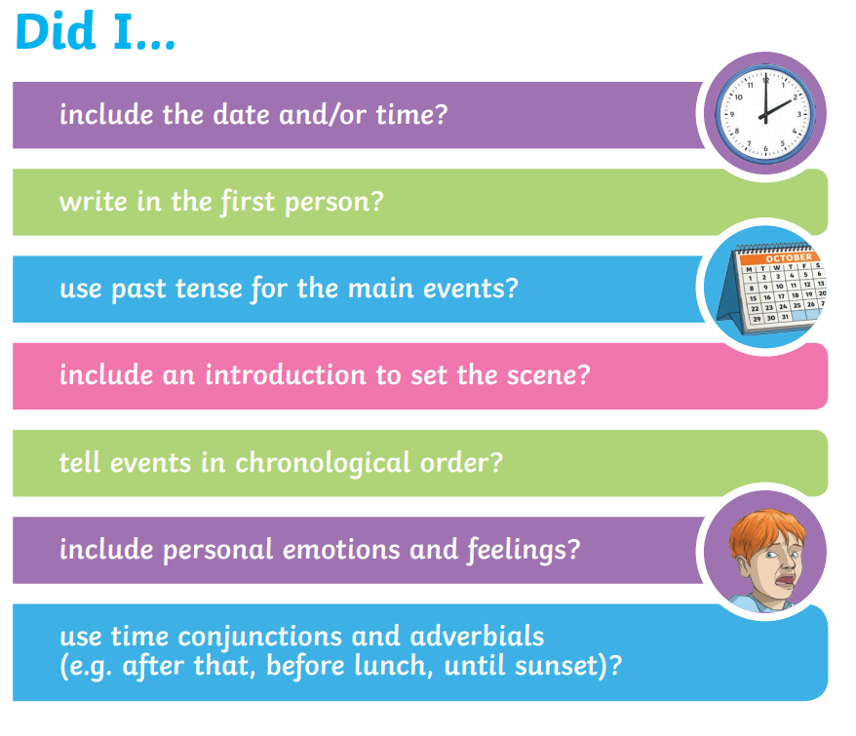
Hermia is loved by two men. Helena isn’t loved by anyone! How do you think she feels?
Write another diary entry, this time as Helena on the day she discovers Hermia and Lysander’s plan to run away.

