Slide 1
A Midsummer Night’s Dream
Act 1 Lesson 2.

Slide 2
On the next slide you will hear Mrs Baldry reading part of the play. Listen carefully as many times as you like.
There is also a brief written explanation too, which should help your understanding. Don’t worry if you don’t understand all of the words.
Answer the questions in full sentences.

Slide 3
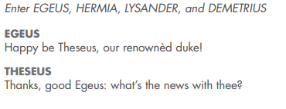
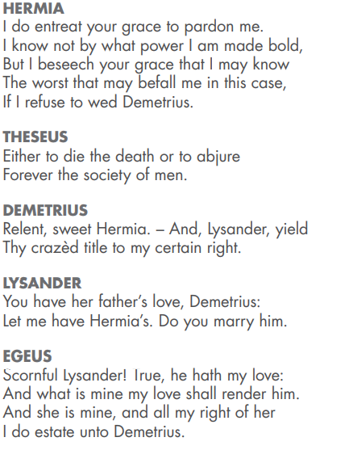
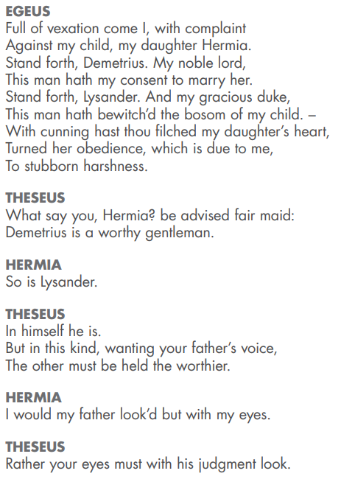
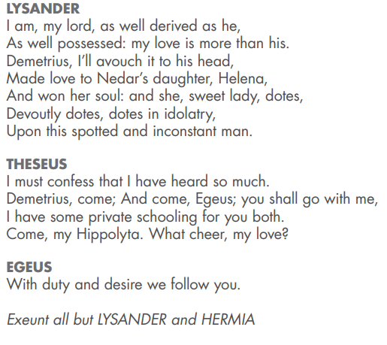
Listen to the recording of the text.
What do you think is happening?
Who is Egeus and why is he angry?
Who is he angry with?
Who does Egeus want Hermia to marry, Lysander or Demetrius?
Who does Hermia love?
What do you think will happen next? How have you made this decision?
Write your answers to these questions.

Slide 4
In this scene, Egeus has come to complain to Theseus about his daughter Hermia. She won’t do as she is told and marry Demetrius – chosen for her by her father. She is in love with Lysander. At the time Shakespeare wrote this play a father had the right to choose who his daughter would marry. In this scene Hermia asks Theseus what will happen to her if she refuses. He tells her she could be executed or sent to a nunnery.
“Either to die the death or abjure
Forever the society of men.”
Lysander stands up for himself and tells Theseus that he is as worthy a husband as Demetrius, but he is reminded that Egeus prefers Demetrius. Hermia also stands up for herself,
“I know not by what power I am made bold.”
The two men make their own case for marrying Hermia, Lysander tells Theseus that Demetrius has been seen with Helena and that she loves him. Thesues takes Egeus and Demetrius away for a private discussion of the problem..

Slide 5
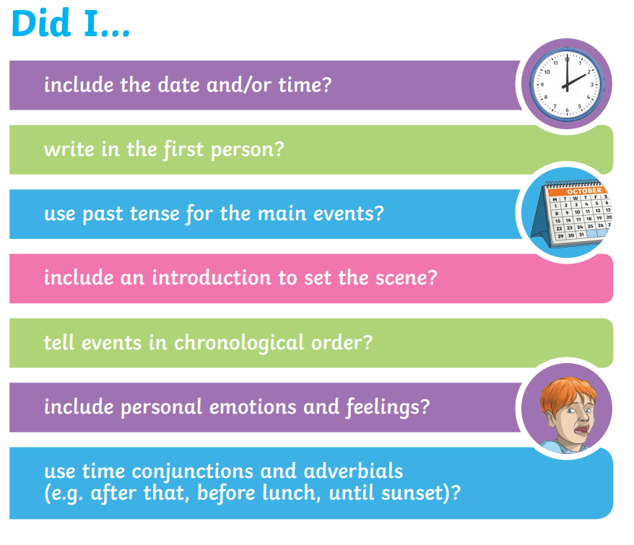
Your task
Imagine you are Hermia. Write a diary entry describing this day. You need to include all the details you can. Remember to include the following:
Think about how you would feel if your father forced you to marry someone you didn’t love. How would you feel? How would you feel about your father? What would you want to happen? How would you feel about the consequences if you didn’t do as you were told?

