Slide 2
Diving into Mastery Guidance for Educators
Each activity sheet is split into three sections, diving, deeper and deepest, which are represented by the following icons:
These carefully designed activities take your children through a learning journey, initially ensuring they are fluent with the key concept being taught; then applying this to a range of reasoning and problem-solving activities.
These sheets might not necessarily be used in a linear way. Some children might begin at the ‘Deeper’ section and in fact, others may ‘dive straight in’ to the ‘Deepest’ section if they have already mastered the skill and are applying this to show their depth of understanding.
Diving
Deeper
Deepest

Slide 3
Aim
Multiply numbers up to 4 digits by a one- or two-digit number using a formal written method, including long multiplication for two-digit numbers.

Slide 4
Multiply 3 Digits by 2 Digits
Diving
Complete these calculations using long multiplication.
328 × 73 =
23 944
357 × 21 =
7497
 |  | 3 | 2 | 8
 | × |  | 7 | 3
 | 3 | 5 | 7
× |  | 2 | 1
9
8
4
(328 × 3)
3
5
7
(357 × 1)
2
2
2
9
6
0
(328 × 70)
7
1
4
0
(357 × 20)
1
5
1
1
2
3
9
4
4
7
4
9
7
1
1

Slide 5
Multiply 3 Digits by 2 Digits
Diving
Ms Green, the Twinkl School site manager, is working out the area of the class flowerbeds ready for the children to plant some seeds.
805cm
35cm
What is the area of each flower bed?
Green =
Blue =
Yellow =
56cm
Blue
18 788cm²
Yellow
567cm
45 080cm²
Green
44cm
19 845cm²
427cm

Slide 6
Multiply 3 Digits by 2 Digits
Deeper
Alex has been practising long multiplication. For each question, spot the mistake he has made and explain where he has gone wrong. Then, complete the calculation and work out the correct answer.
 |  | 4 | 3 | 5
 | × |  | 2 | 6
 | 2 | 6 | 1 | 0
 |  | 8 | 7 | 0
 | 3 | 4 | 8 | 0
 |  | 4 | 3 | 5
 | × |  | 2 | 6
 | 2 | 6 | 1 | 0
 | 8 | 7 | 0 | 0
1 | 1 | 3 | 1 | 0
 |  | 2 | 4 | 5
 | × |  | 7 | 3
 |  | 7 | 2 | 5
1 | 7 | 1 | 5 | 0
1 | 7 | 8 | 7 | 5
 |  | 2 | 4 | 5
 | × |  | 7 | 3
 |  | 7 | 3 | 5
1 | 7 | 1 | 5 | 0
1 | 7 | 8 | 8 | 5
2
2
3
3
2
1
1
1
1
3
3
3
3
1
1
Alex has not used zero as a placeholder when calculating 5 × 20, so the answer to this has been recorded as 10 rather than 100.
Alex did not record the regrouped ten from 5 × 3.

Slide 7
Multiply 3 Digits by 2 Digits
Deeper
Twinkl Primary School is ordering stationery ready for September.
357 boxes of pencils and 223 boxes of pens are ordered. Pens come in boxes of 26 and pencils come in boxes of 34.
How many pencils have they ordered altogether?
357 × 34 = 12 138
What is the total number of pens that they ordered?
223 × 26 = 5798

Slide 8
Multiply 3 Digits by 2 Digits
Deepest
Identify the missing digits in these calculations.
 |  | 4
× |  | 3 | 6
1 | 4 |  | 0
7 |  | 5 | 0
 | 8 |  | 0
 |  |  | 2 | 7
 | × |  | 4
 | 1 |  | 5 | 4
 | 5 | 0 |  | 0
2 |  | 3 | 3
2
5
6
2
7
2
2
3
1
3
2
8
1
1
1
2
8
2
6
4
1

Slide 9
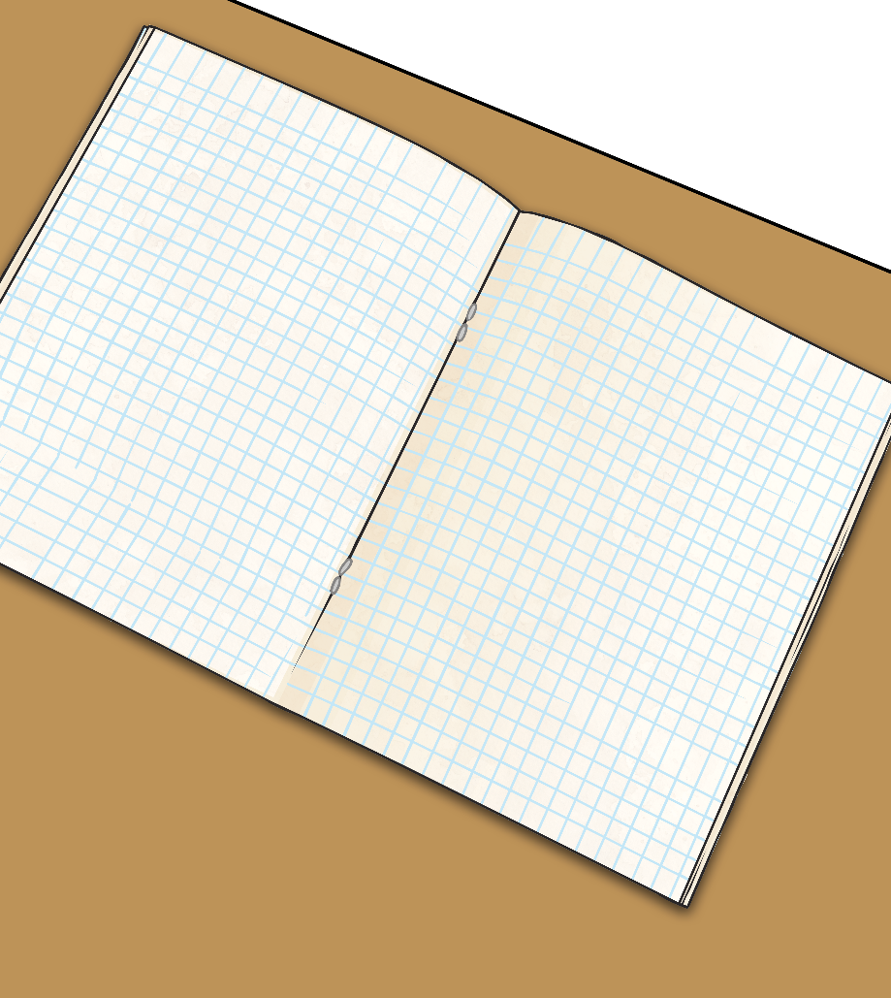
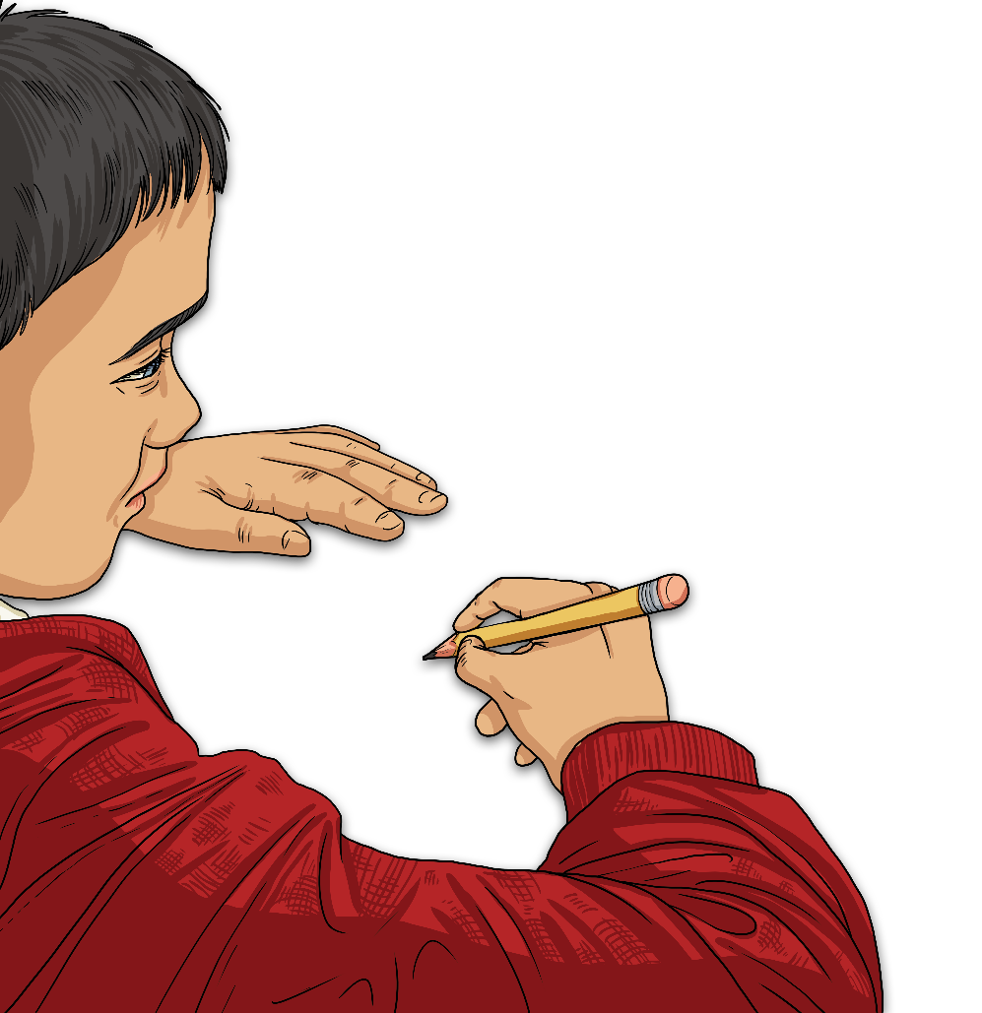
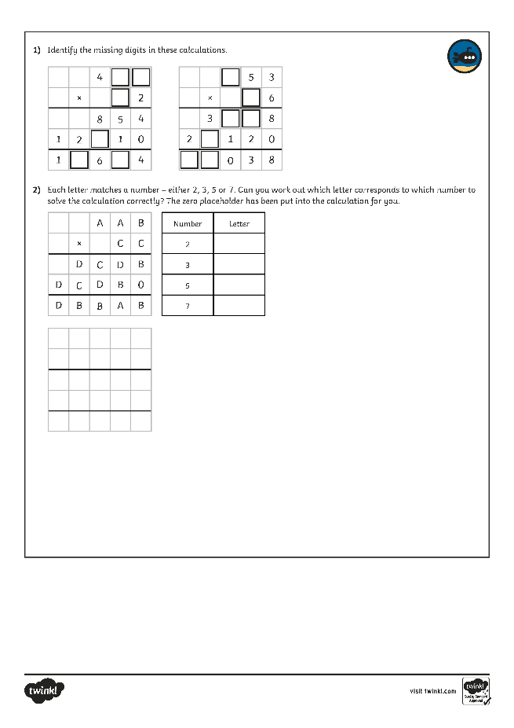
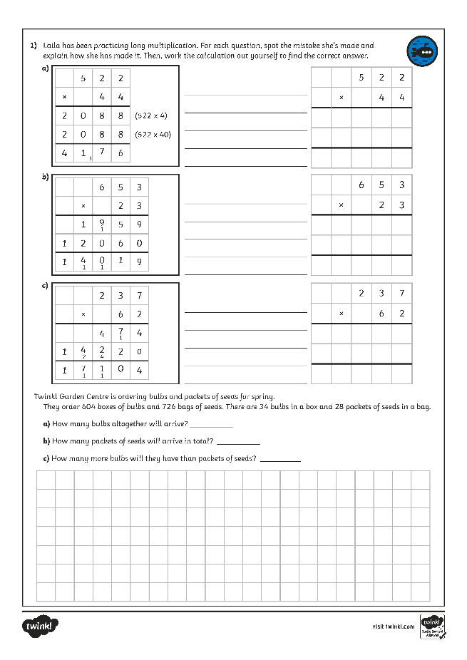
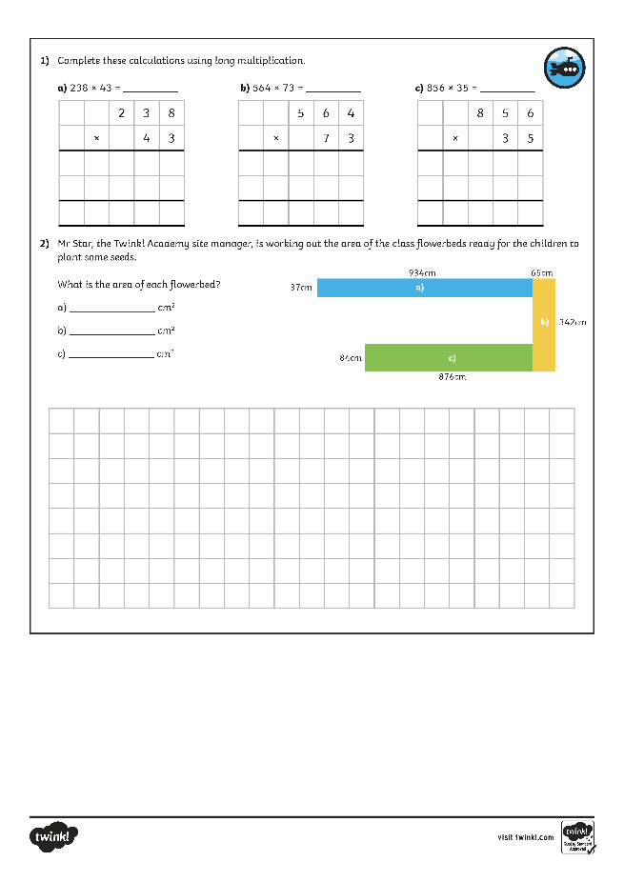
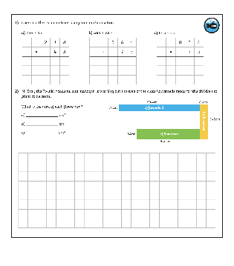
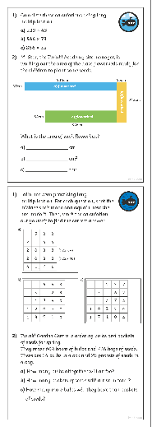
Multiply 3 Digits by 2 Digits
Dive in by completing your own activity!

Slide 10
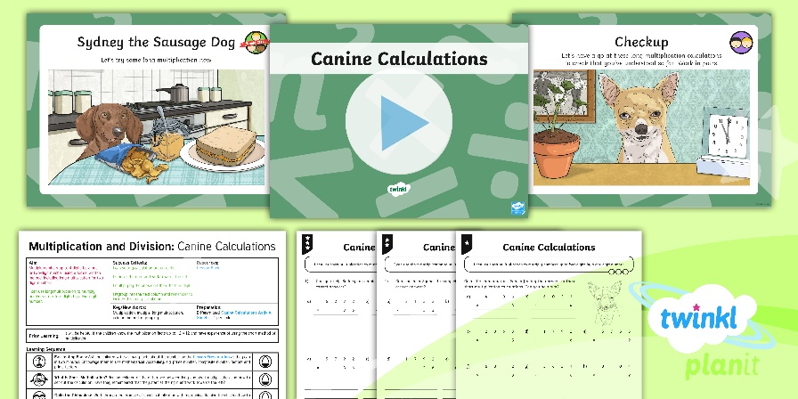
Need Planning to Complement this Resource?
National Curriculum Aim
Multiply numbers up to 4 digits by a one- or two-digit number using a formal written method, including long multiplication for two-digit numbers.
For more planning resources to support this aim, click here.
Twinkl PlanIt is our award-winning scheme of work with over 4000 resources.

