Slide 2
Diving into Mastery Guidance for Educators
Each activity sheet is split into three sections, diving, deeper and deepest, which are represented by the following icons:
These carefully designed activities take your children through a learning journey, initially ensuring they are fluent with the key concept being taught; then applying this to a range of reasoning and problem-solving activities.
These sheets might not necessarily be used in a linear way. Some children might begin at the ‘Deeper’ section and in fact, others may ‘dive straight in’ to the ‘Deepest’ section if they have already mastered the skill and are applying this to show their depth of understanding.
Diving
Deeper
Deepest

Slide 3
Aim
Multiply two-digit and three-digit numbers by a one-digit number using formal written layout.

Slide 4
Multiply 2 Digits by 1 Digit
Diving
Complete the missing parts of each calculation.
52 × 3 = 156
156
Place Value Counters
Expanded Multiplication
Short Multiplication
H | T | O
 | H | T | O
 |  | 5 | 2
× |  |  | 3
 |  |  |  | (3 × 2)
+ |  |  |  | (3 × 50)
 | H | T | O
 |  | 5 | 2
× |  |  | 3
10
10
10
10
10
1
1
10
10
10
10
10
1
1
100
10
10
10
10
10
1
1
6
1
5
6
1
5
0
¹
1
5
6

Slide 5
Multiply 2 Digits by 1 Digit
Diving
Use short multiplication to solve these calculations.
62 × 8 = 496
496
55 × 6 = 330
330
H
T
O
H
T
O
6
2
5
5
×
8
×
6
4
9
6
3
3
0
⁴
¹
³
³

Slide 6
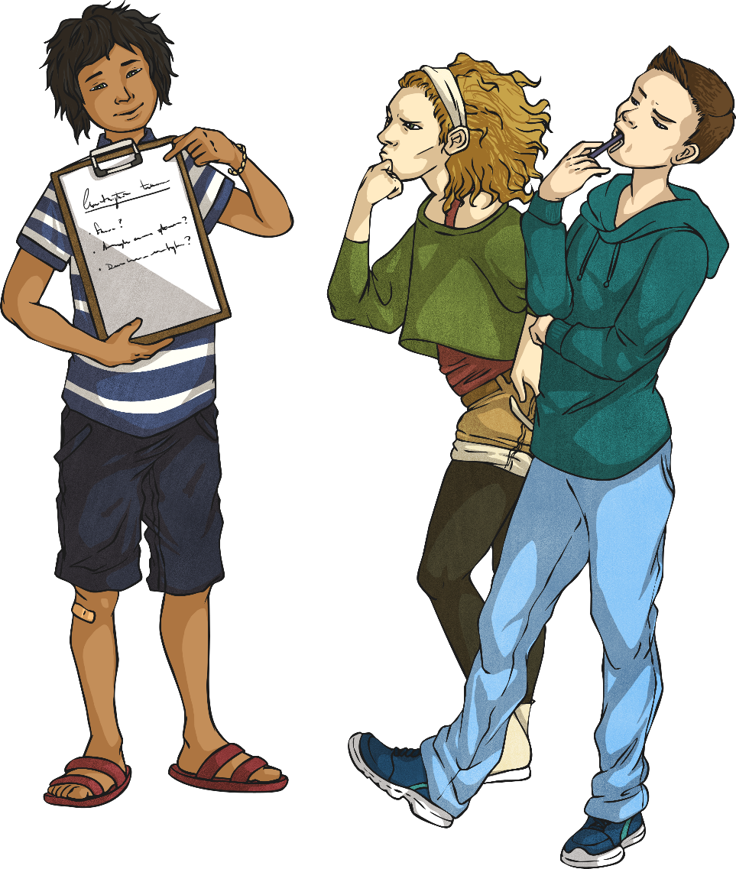
Multiply 2 Digits by 1 Digit
Deeper
Read the statement below. Is it true or false? Explain your answer.
When multiplying a 2-digit number by 2, you will never need to exchange.
False. If the 2-digit number contains digits that are 5 or larger, you will need to exchange because you will get an amount higher than 9 when multiplying by 2.
Therefore, you will need to regroup, e.g.
 | 2 | 6
× |  | 2
 | 5 | 2
 | ¹

Slide 7
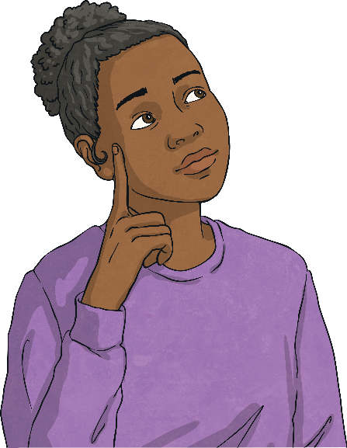
Multiply 2 Digits by 1 Digit
Deeper
Which of these methods is the odd one out? Explain your reasoning.
A
B
C
 | H | T | O
 |  | 7 | 2
× |  |  | 3
 | 2 | 1 | 6
 | ² | ¹
 | H | T | O
 |  | 5 | 6
× |  |  | 4
 |  | 2 | 4 | (4 × 6)
+ | 2 | 0 | 0 | (4 × 50)
 | 2 | 2 | 4
 | H | T | O
 |  | 9 | 7
× |  |  | 2
 | 1 | 9 | 4
 | ¹ | ¹
B is the odd one out because it is the only calculation that has been completed using the expanded multiplication method. A and C have both been solved using the short multiplication method.

Slide 8
Multiply 2 Digits by 1 Digit
Deeper
Identify and explain the mistake in Carrie’s work. Then, work out the correct answer.
8 7
× 3
2 6 8
^{2x}
Carrie has incorrectly calculated 3 × 7 as 28 instead of 21.
The correct answer for this calculation should be:
8 7
× 3
2 6 1
^{2x}

Slide 9
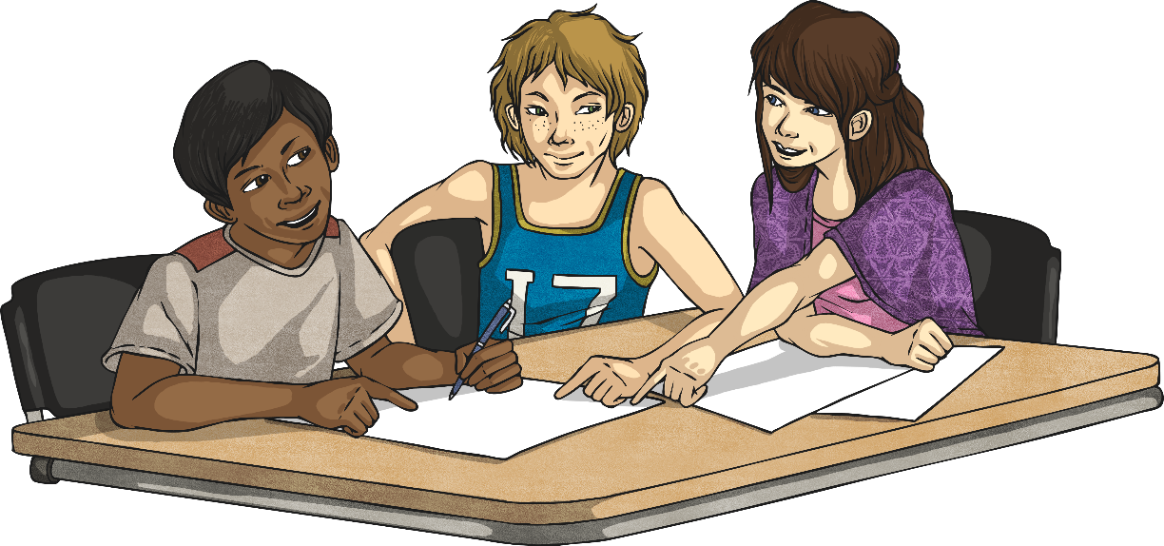
Multiply 2 Digits by 1 Digit
Deepest
Can you identify the missing digits in this calculation?
 |  |  | 9
×
 | 5 | 5 | 3
 |  | ⁶
7
7
⁵

Slide 10
Multiply 2 Digits by 1 Digit
Deepest
Each letter stands for a number - either 2, 4, 5 or 8. The 0 has already been identified.
Can you identify which letter represents each number to solve the calculation?
 |  | A | B
× |  |  | C
 | D | A | 0
 | ^{D} | ^{A}
4
8
5
2
4
²
⁴
A = 4
B = 8
C = 5
D = 2

Slide 11
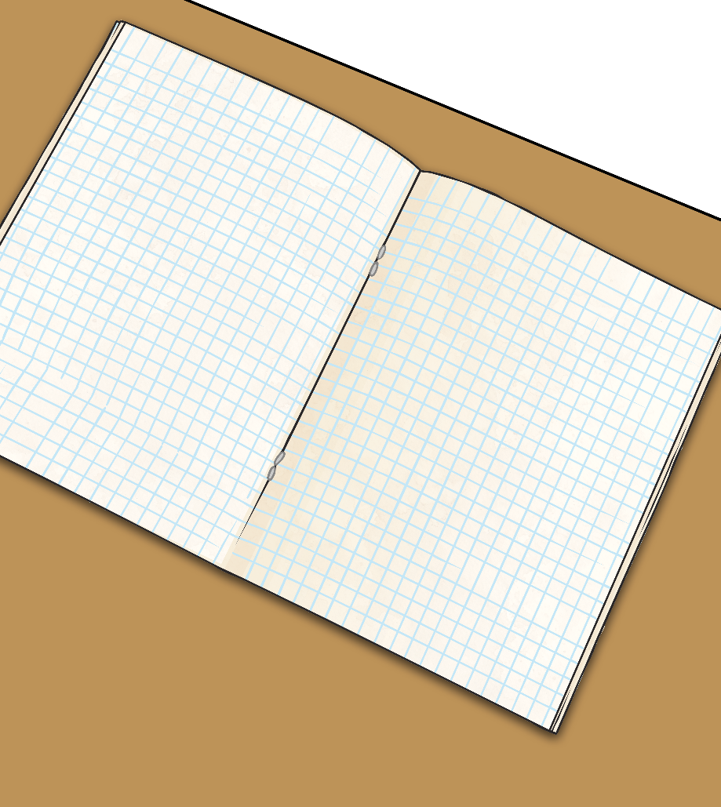
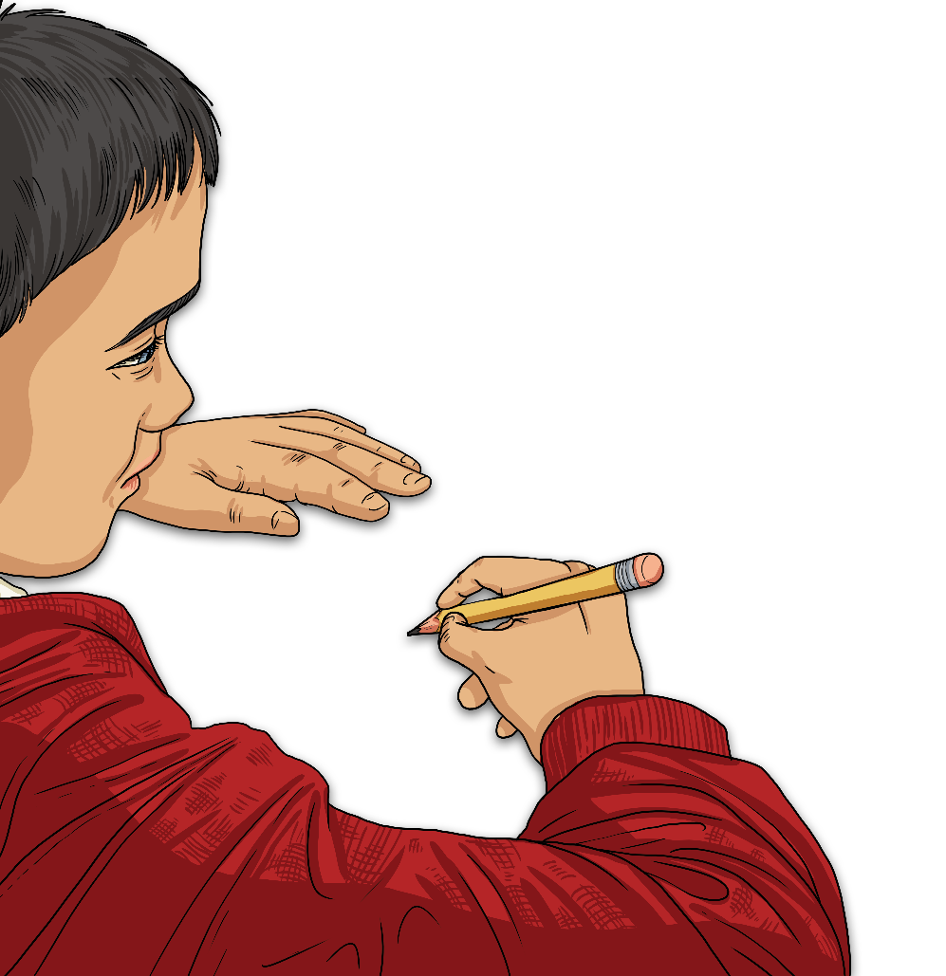
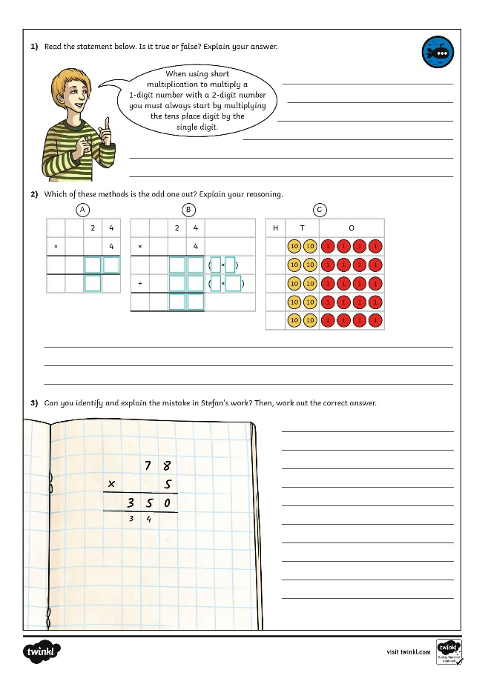
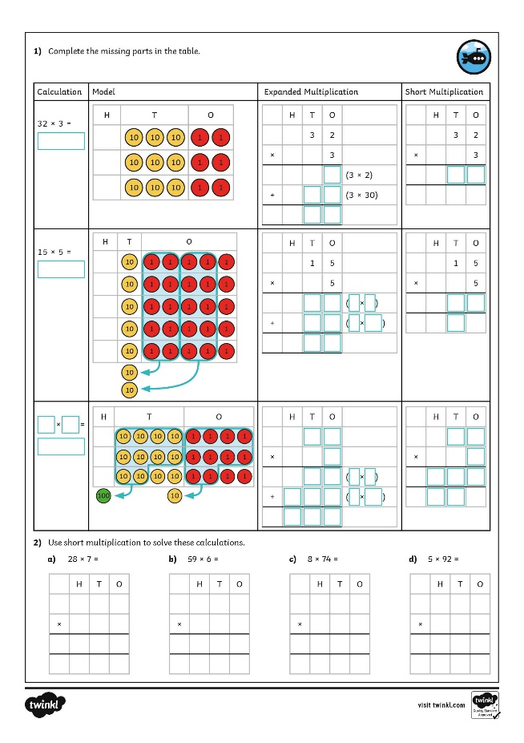
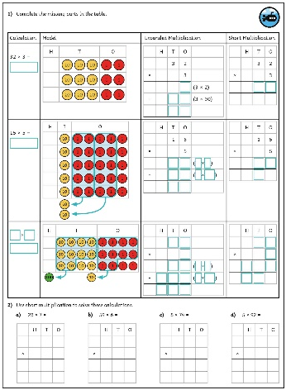
Multiply 2 Digits by 1 Digit
Dive in by completing your own activity!

Slide 12
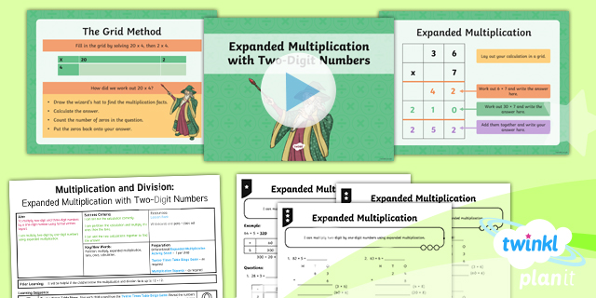
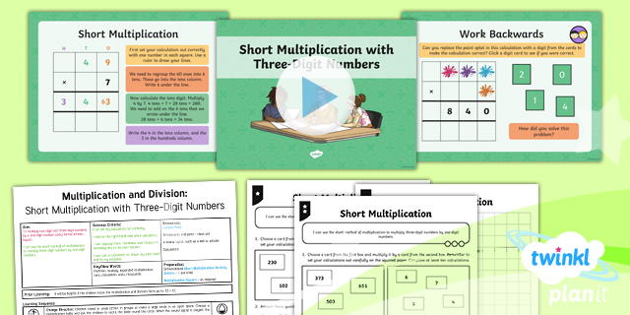
Need Planning to Complement this Resource?
National Curriculum Aim
Multiply two-digit and three-digit numbers by a one-digit number using formal written layout.
For more planning resources to support this aim, click here.
Twinkl PlanIt is our award-winning scheme of work with over 4000 resources.

