Slide 1
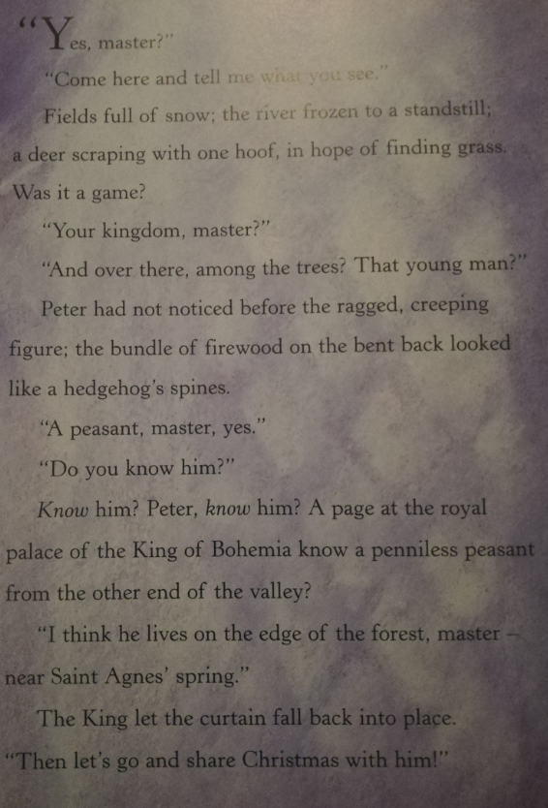
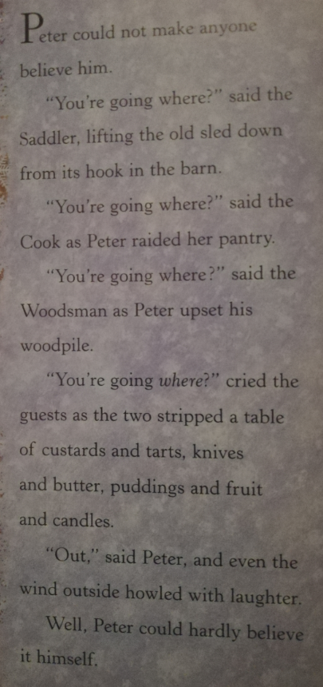

Slide 2
How does the story make you feel? Which words make you feel that?
What do you think will happen next? What makes you think that?

Slide 3
Ragged- old and torn
Cobbles-small round stones used to cover roads
Blizzard-a very bad snow storm with lots of wind
Waded-walked with difficultly through water or a sticky substance
Swags- a drooping curve- usually of fabric
Keener-sharper
Peasant- a poor person who did not own their own land
Postern gate- a secret gate to a city.

Slide 4
