Slide 1
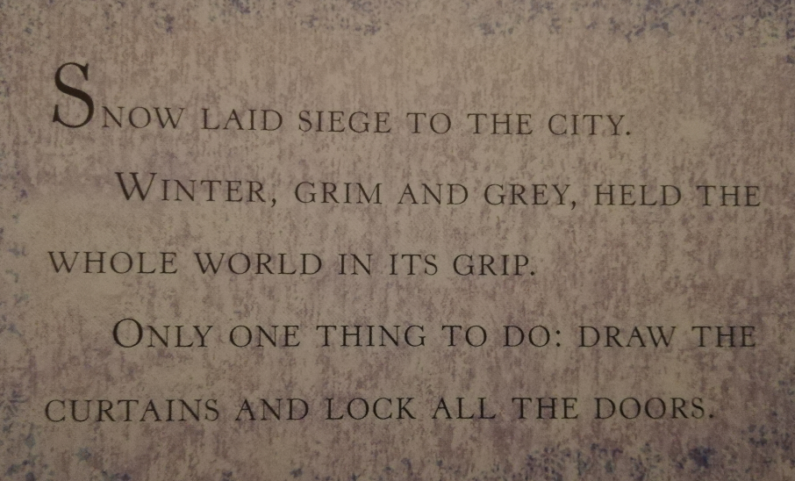
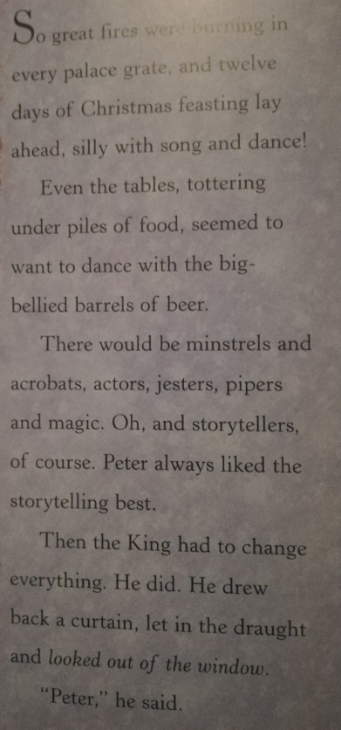

Slide 2
What do the author use words like siege, grim, grey, grip make you feel?
Why do you think the author chose these words for the first page?
Why do the tables want to dance with the barrels?
Why do you think the penultimate line is in italics?

Slide 3
