Slide 1
Lesson 6
What is Space?

Slide 2
Retrieval Quiz
What is a year?
Why does our view of the Moon change?
Which is the largest planet in our Solar System?
Give two pieces of evidence that suggest the Earth is spherical.
Which planet is furthest from the Sun?
Name two parts of the International Space Station.
Which planets are Earth’s neighbours?
Name the two main types of satellite and provide an example of each.
What is the name given for the path taken by objects around the Sun.
Uranus is a gas planet. True or False. Explain your answer.
What is the difference between an asteroid and a meteoroid?
There is only one Earth, one Sun and one Moon. True or False. Explain.
Come up with a question for the rest of the teams based on our learning this term

Slide 3
Retrieval Quiz – Answers
What is a year? The amount of time it takes for a planet to orbit the Sun.
Why does our view of the Moon change? As the Moon orbits the Earth, we only see part of the surface of the Moon which is facing the Sun (except when we see a Full Moon – here we see all of the surface being illuminated by the light of the Sun).
Which is the largest planet in our Solar System? Jupiter.
Give two pieces of evidence that suggest the Earth is spherical. Aeroplanes have never seen the edge of the world; photographs of Earth taken from space; Aristotle’s evidence of a ship’s hull disappearing from view first; sailors who circumnavigate the world have never reached the edge; different constellations are seen from different parts of the Earth; 'round' shadows cast on the Moon during a lunar eclipse; Ancient Greeks explaining that the Sun was not above them.
Which planet is furthest from the Sun? Neptune.
Name two parts of the International Space Station. Module, node, solar
panels/array, robot arm, airlock or docking ports.

Slide 4
Retrieval Quiz - Answers
Name two parts of the International Space Station. Module, node, solar
array, robot arm, airlock or docking ports
Which planets are Earth’s neighbours? Venus and Mars
Name the two main types of satellite and provide an example of each. Natural – the Moon and Earth; artificial – the ISS
What is the name given for the path taken by objects around the Sun? Orbit
Uranus is a gas planet. True or False. Explain why? False. Although it does have a thick atmosphere of gas, it is mostly made up of icy materials flowing on a solid core.
What is the difference between an asteroid and a meteoroid? A meteoroid is smaller than an asteroid. (Note: a meteoroid is known as a meteor if it enters the Earth's atmosphere and a meteorite if it strikes the Earth's or Moon's surface).
There is only one Sun, one Earth and one Moon. False. There is only one Earth but if other stars have planets orbiting them then they can also be described as 'suns'; likewise, there are lots of moons orbiting different planets.

Slide 5
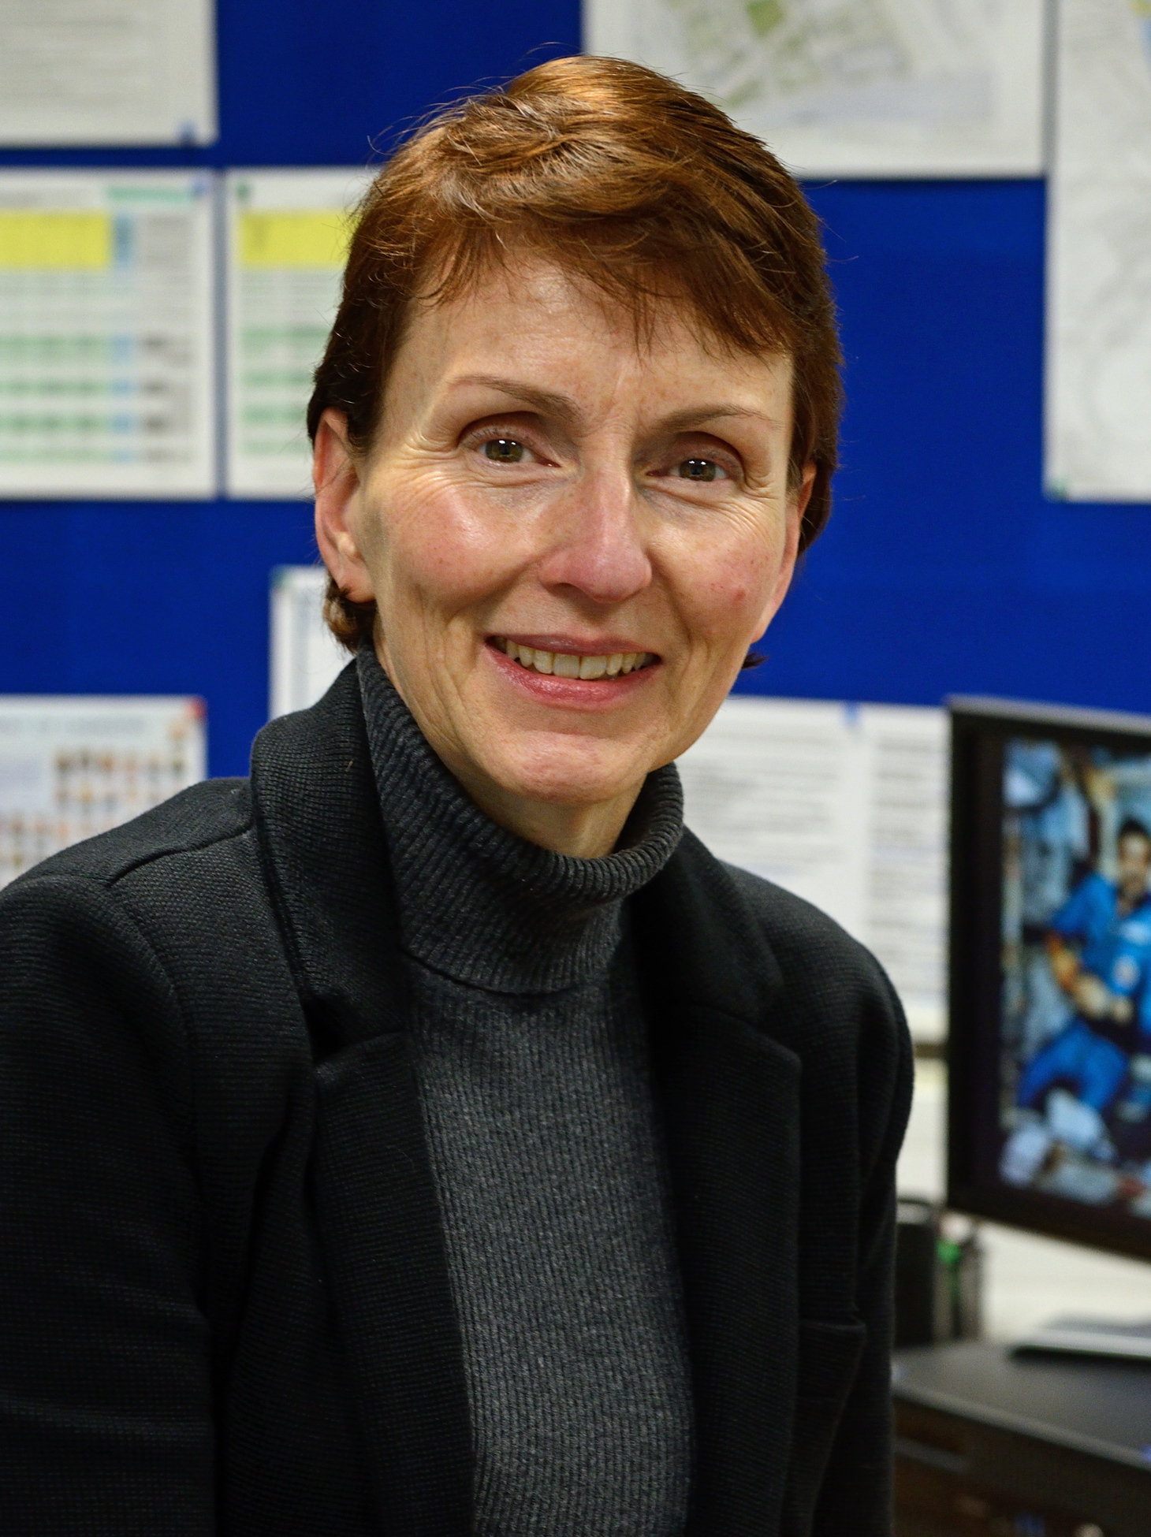
Helen Sharman
“There’s no greater beauty than seeing the Earth from up high - and I’ll never forget the first time I saw it.”
Helen Patricia Sharman (born 30th May 1963) was a British engineer and chemist who became the first British citizen to go into space. While working as a research chemist for Mars Confectionary Ltd, Sharman responded to a radio advertisement for astronauts and was selected from more than 13,000 applicants to be part of Project Juno – a commercial cosmonaut mission. The mission was a partnership between the United Kingdom and Russia; at that time, the UK didn’t have a space flight programme so extra money was raised to pay for a seat on one of the Russia’s space missions.
Helen was initially unsure whether to apply for the advert because she had no previous experience of space but the advertisement stated that no experience was necessary. She did, however, have to meet certain criteria: she had to be British, aged between 21-40, be a certain weight, come from a scientific background and have a high level of fitness and strong linguistic (language) skills.
Helen applied for the job and was one of two candidates selected to train in the Soviet Union. She underwent months of rigorous training at the Yuri Gagarin training centre in Star City - a Russian state-of-the-art cosmonaut training facility named after the first human to journey into outer space. The selection process

Slide 6
involved tough physical and psychological tests. For instance, she was tested to see if she could live in a cramped and confined environment and to see how well she would cope with weightlessness and motion sickness. Helen was even tested on her ability to pilot rocket systems.
Helen was the only successful candidate to complete the training and was finally launched into space aboard Soyuz TM-12 on 18th May 1991.
“After take-off, we left the atmosphere and suddenly light streamed in through the window. We were over the Pacific Ocean. The gloriously deep blue seas took my breath away.”
Helen Sharman, The Guardian 5th Jan 2020
Helen spent a total of eight days on the Mir Space Station. During her time on board, Helen carried out a range of scientific experiments focusing on agriculture and medicine. The weightless conditions in space enabled her to investigate and grow things she couldn’t grow on planet Earth. She was also responsible for photographing the British Isles and communicating with children in British schools by radio transmission.
Helen Sharman went from working in a chocolate factory to becoming the youngest ever person to go into space and is one of only 39 women to do so. She was awarded an OBE in 1993 and has since had several school buildings named after her in the UK and throughout Europe. Sharman’s story shows that if you choose a life in Science there is no limit to what you can achieve - it took Helen Sharman to the stars!

Slide 7
Helen Sharman: Questions
What was Helen’s original job before being selected for astronaut training?
She was chosen to be part of Project Juno. This was a partnership between which two countries?
To apply for the job, Helen had to prove she could meet certain criteria. What were they?
How long did Helen spend on the Mir Space Station?
What evidence in the text suggests that Helen was amazed by what she saw whilst in space?
How do you think Helen felt when she was told that she’d successfully completed the training and selection to be part of Project Juno?

Slide 8
Jobs associated with Space
What types of jobs could you do that are associated with space or the study of space and the universe?
Why are people fascinated by space?
Create a mind map/ list of jobs in or to do with space.

