Slide 1
Lesson 5
Why have people settled in Northampton?

Slide 2
Retrieval
1. What continent is the USA part in?
2. What continent is the UK part of?
3. What county is Northampton (UK) in?
4. What type of biome is Northampton? (UK and USA)
5. What is the climate like in Northampton, Massachusetts?
Notes:
North America
Europe
Northamptonshire
Deciduous forest biome
Cold and temperate

Slide 3
Vocabulary
Suburban - a small area, which is part of a city or large town, but is outside its centre.

Slide 4
Reading
Northampton is a bustling town in the East Midlands region and is surrounded by peaceful countryside. Due to its location between both London and Birmingham, Northampton is ideally situated for those who would like to live outside of these cities and travel to work. The house prices are cheaper in Northampton which makes it more desirable for people to want to live there. The town has good road and rail links with London and Birmingham. In Northampton there are lots of independent restaurants, coffee shops and bars. It has lots of open spaces and parks to enjoy. It has a well-known university which attracts students to the town.
Northampton is a city in the New England region and is one of the best places to live in Massachusetts. It is known as Paradise City due to its beautiful setting, nestled within mountains, farmland and forests. Living in Northampton offers people a suburban feel and most residents own their homes. In Northampton there are a lot of restaurants, coffee shops, and parks. Many young professionals live in Northampton and residents believe people should have a lot of freedom in deciding how to behave and think. The schools in Northampton are highly rated.

Slide 5
Grab the readers attention.
Short, snappy sentences/phrases
Write about what you have to offer.

Slide 6
Direct your advert at the audience
Remind the reader about what you are offering.

Slide 7
Los colores
Notes:
The colours.

Slide 8
azul
Notes:
blue

Slide 9
rojo
Notes:
red

Slide 10
amarillo
Notes:
yellow

Slide 11
verde
Notes:
green

Slide 12
rosa
Notes:
pink

Slide 13
marrón
Notes:
brown

Slide 14
negro
Notes:
orange

Slide 15
gris
Notes:
grey

Slide 16
naranja
Notes:
orange

Slide 17
Which colour will the ball land on – guess in Spanish!

Slide 18
Me gusta
Notes:
I like

Slide 19
No me gusta
Notes:
I don’t like

Slide 20
¿Cuál es tu opinión?
el azul
Me gusta
No me gusta
Notes:
What is your opinion? Blue I like I don’t like

Slide 21
Listening activity
Listen to these opinions about different colours. Write the colour and the opinion (draw ☺ or ☹) next to each one. The first one is done for you.
 | Color | ☺ o ☹
1 | marrón | ☹
2
3
4

Slide 22
Listening activity Answers
 | Color | ☺ o ☹
1 | marrón | ☹
2 | rosa | ☺
3 | azul | ☺
4 | verde | ☹
Notes:
Red grey blue pink

Slide 23
¿Cuál es tu opinión?
el rojo
Me gusta
No me gusta
Notes:
What is your opinion? red I like I don’t like

Slide 24
¿Cuál es tu opinión?
el verde
Me gusta
No me gusta
Notes:
What is your opinion? Green I like I don’t like

Slide 25
¿Cuál es tu opinión?
el amarillo
Me gusta
No me gusta
Notes:
What is your opinion? yellow I like I don’t like

Slide 26
¿Cuál es tu opinión?
el rosa
Me gusta
No me gusta
Notes:
What is your opinion? Pink I like I don’t like

Slide 27
¿Cuál es tu opinión?
el marrón
Me gusta
No me gusta
Notes:
What is your opinion? Brown I like I don’t like

Slide 28
¿Cuál es tu opinión?
el gris
Me gusta
No me gusta
Notes:
What is your opinion? Grey I like I don’t like

Slide 29
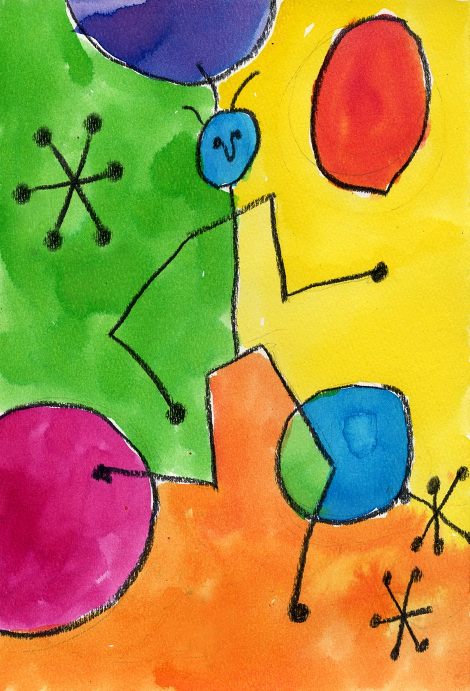
Aquí hay un cuadro del artista español, Miró.
¿Qué colores ves?
Notes:
Here is a painting by the Spanish artist, Miró. What colours do you see?

Slide 30
¿Cuál es tu opinión?
Me gusta
No me gusta
Notes:
What is your opinion? I like I don’t like

Slide 31
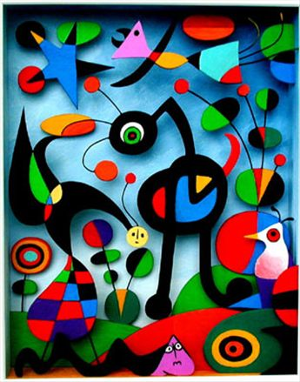
Aquí hay otro cuadro del artista español, Miró.
¿Qué colores ves?
Notes:
Here is another painting by the Spanish artist, Miró. What colours do you see?

Slide 32
¿Cuál es tu opinión?
Me gusta
No me gusta
Notes:
What is your opinion? I like I don’t like

