Slide 1
snow laid
siege
to the city .

Slide 2
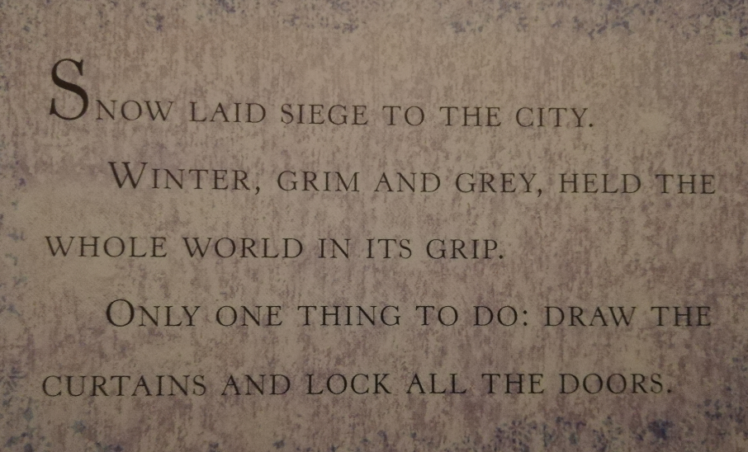
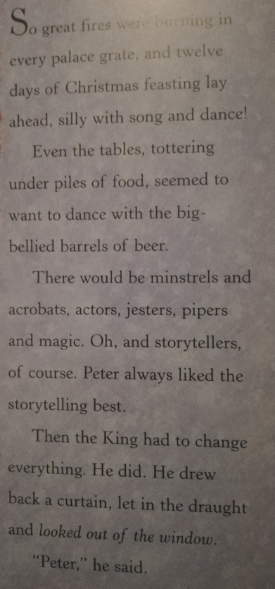

Slide 3
Siege- when an enemy surrounds a town cutting off all supplies

Slide 5
Grim- very serious or gloomy

Slide 7
Grate- iron bars for holding wood

Slide 9
Tottering- shaking or swaying as if about to collapse

Slide 10
Siege- when an enemy surrounds a town cutting off all supplies
Grim- very serious or gloomy
Tottering- shaking or swaying as if about to collapse
Grate- iron bars for holding wood

Slide 11
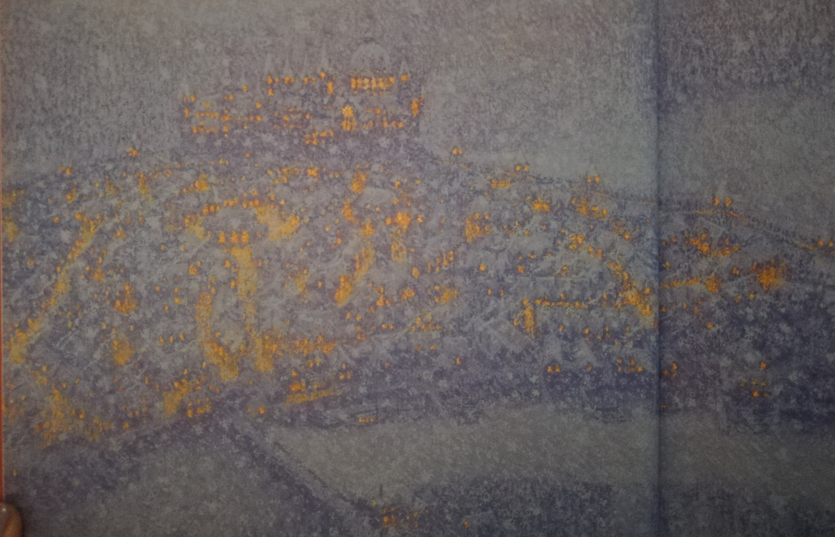

Slide 12
Imagine!
How to make descriptions more vivid and colourful.

Slide 13
Similes
When we say something is like something else we are using a simile.
Similes contain the words ‘like’ or ‘as’.
They can be used to make our writing more interesting or humorous.

Slide 14
Can you complete these Similes?
As keen….
as mustard.
As bold….
as brass.
As quick….
as lightning.
As cool….
as a cucumber.

Slide 15
Can you link the ideas below to make similes'?
Her face was like a runaway horse.
Ella’s eyes gleamed like pearls.
He bolted out of the room as round as the full moon.
Grandmother’s false teeth like charging bulls.
The children ran sparkled like diamonds.

