Slide 2
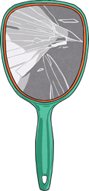
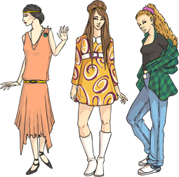
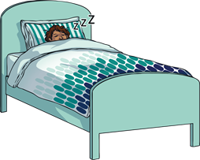
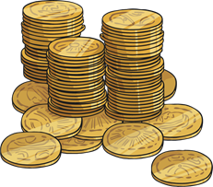
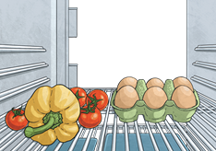
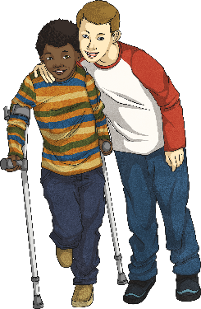
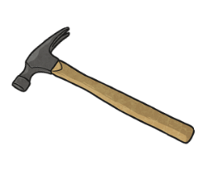
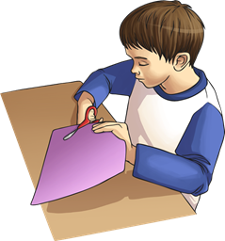
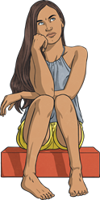
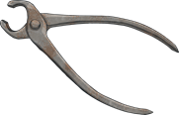
This week, we are going to be looking at words ending in the suffix –able. Can you think of any –able words?
comfortable
perishable
considerable
breakable
fashionable
£20
£2
dependable
applicable
tolerable
operable
reasonable

Slide 3
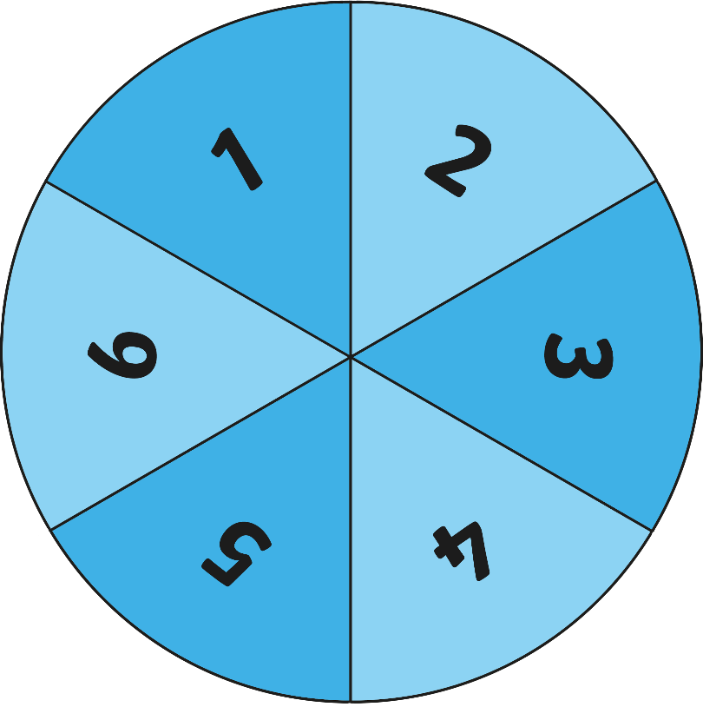
Let’s choose a word together and play spin the word!
Work in pairs on your whiteboards. If the spinner lands on a…
1
Find any smaller words within the word.
2
Write a synonym for the word.
3
Sky-write the word in the air with your finger.
4
Speed-write the word as many times as you can in a minute.
5
Break the word into syllables.
6
Use the word in a sensible sentence.
Click here to spin

Slide 4
Here are this week’s spellings to practise.
applicable tolerable operable considerable dependable
comfortable reasonable perishable breakable fashionable
miss
less

