Slide 1
Lesson 3
What are the similarities and differences between the two locations?

Slide 2
Retrieval
Time zones give a specific area on the Earth a time of day, that is earlier or later than the neighboring time zones.
A biome is a large area of land that has a certain climate and certain types of living things.
Northampton UK and Northampton USA are both desert biomes
Deciduous forests are most notable because they go through four seasons
Notes:
True
True
False- they are deciduous forest biomes
True

Slide 3
Vocabulary
Vegetation belt - plant life that can be found in a certain area, according to its weather conditions.

Slide 4
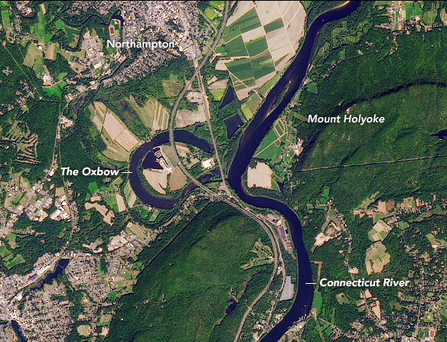
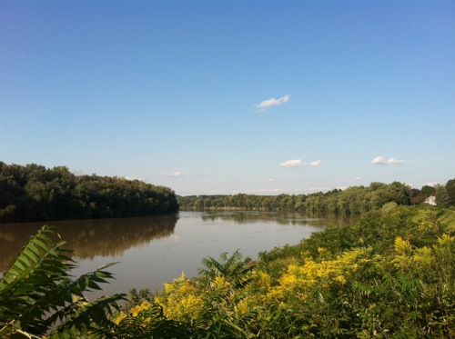
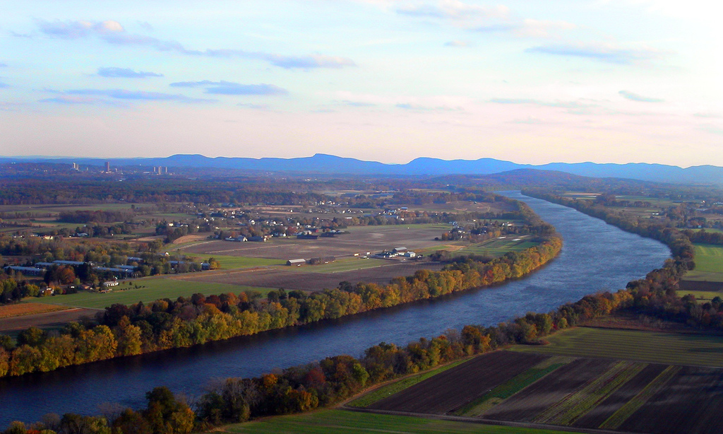
Physical Features
Notes:
Northampton USA- physical features: mountains, vegetation, river
Mount Holyoke borders Northampton (map available on link https://www.mountain-forecast.com/peaks/Mount-Holyoke)
Vegetation along the river
Connecticut River- the Connecticut River's Oxbow (which is an extension of the Connecticut River is within Northampton's city limits)

Slide 5
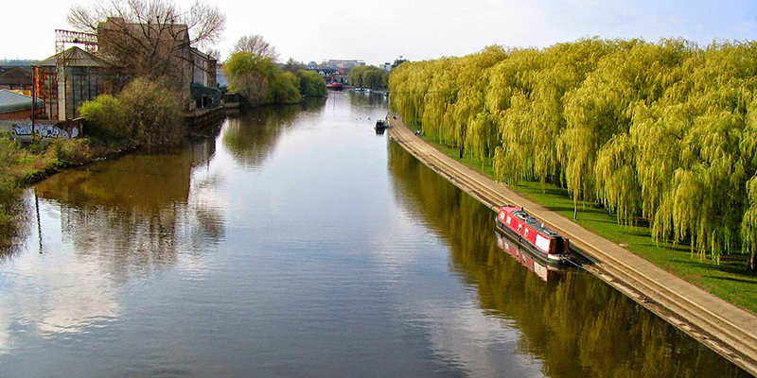
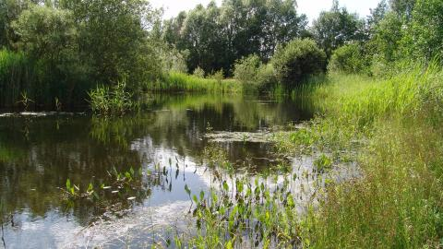
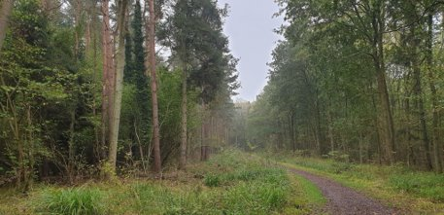
Physical Features
Notes:
Northampton UK- physical features: river, forest, vegetation
River Nene- runs through Northampton (map available on link https://www.visitanglianwaterways.org/nene-navigation)
Salcey Forest
Abington Meadows- marshy grassland surrounded by vegetation that grows in moist soil at the edge of a pond or stream.

Slide 6
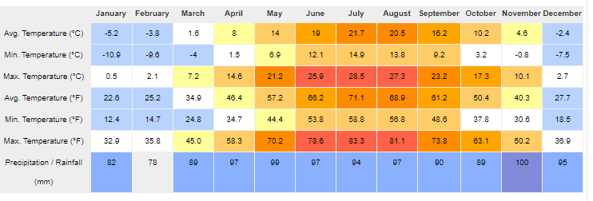
Weather averages
Northampton, Massachusetts
Northampton, England

Slide 7
What are the similarities and differences between the two locations?
Similarities | Differences
Notes:
The physical features of both locations are similar. However, Mount Holyoke borders Northampton (USA) Northampton UK has no mountain ranges.
The River Nene runs directly through Northampton UK but the Connecticut River's Oxbow (within Northampton's city limits) is an extension of the River.

