Slide 1

Lesson 5
What is it like to live in space?

Slide 2
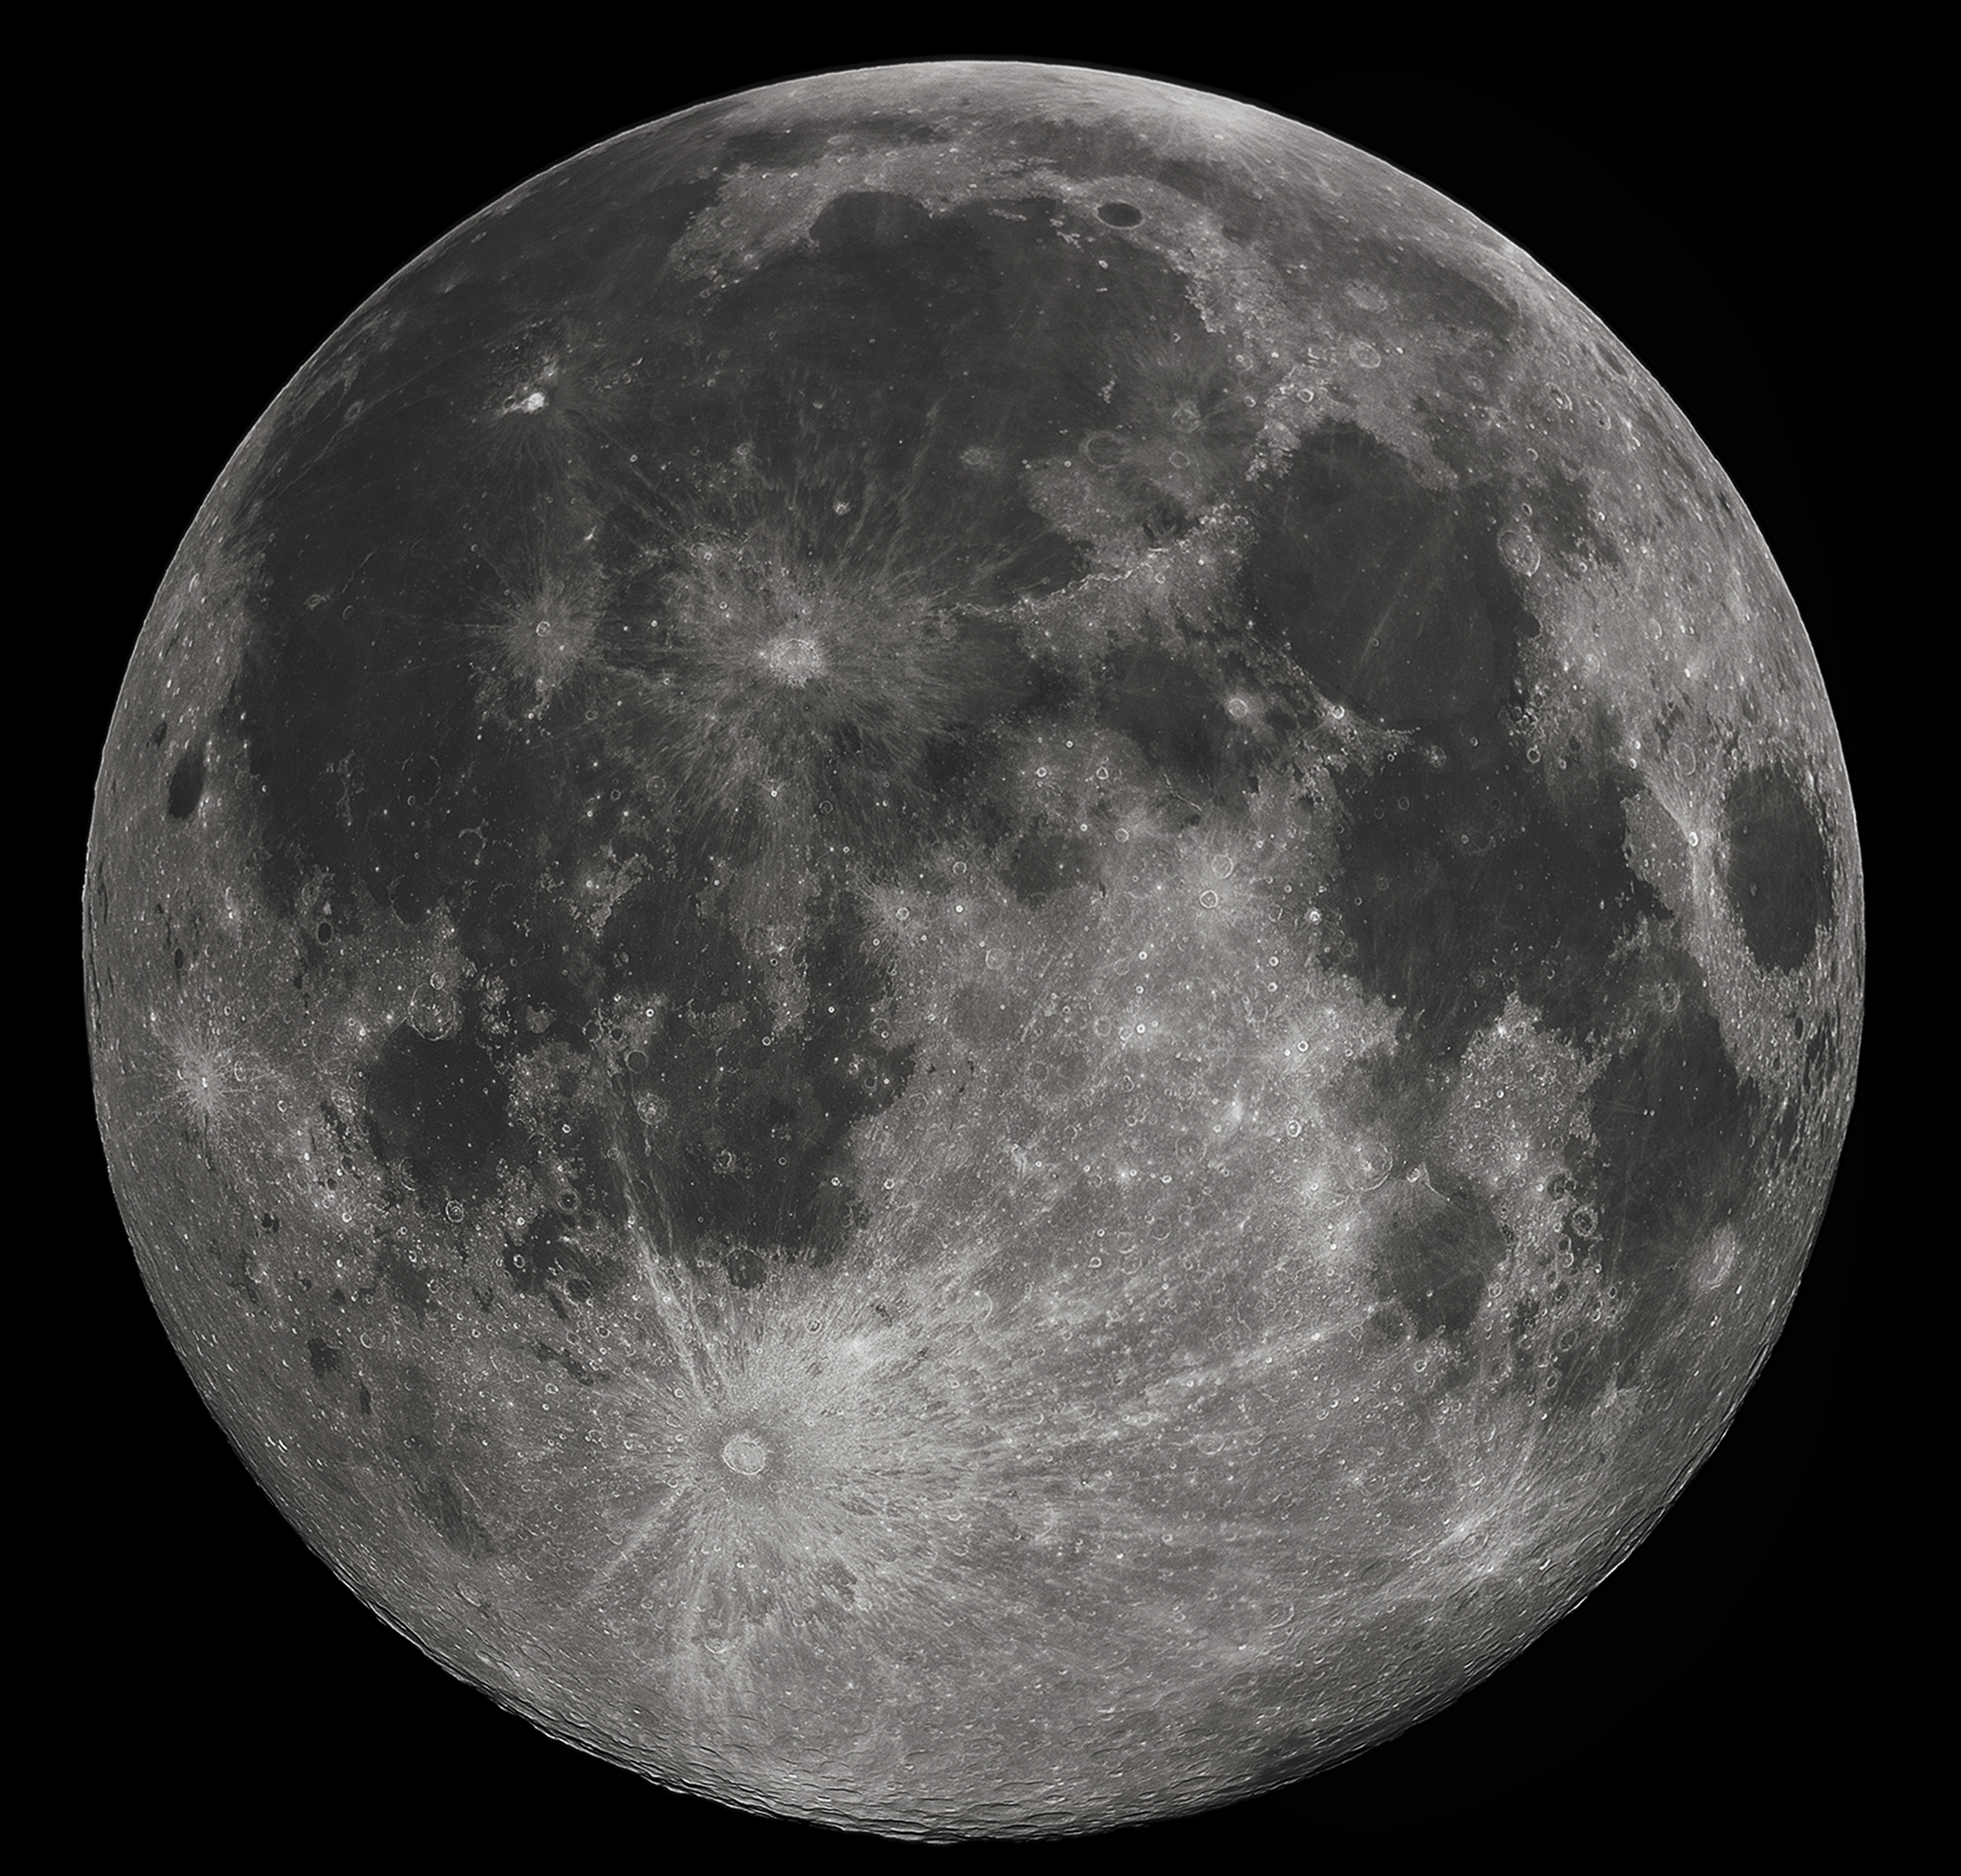
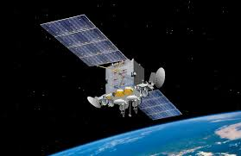
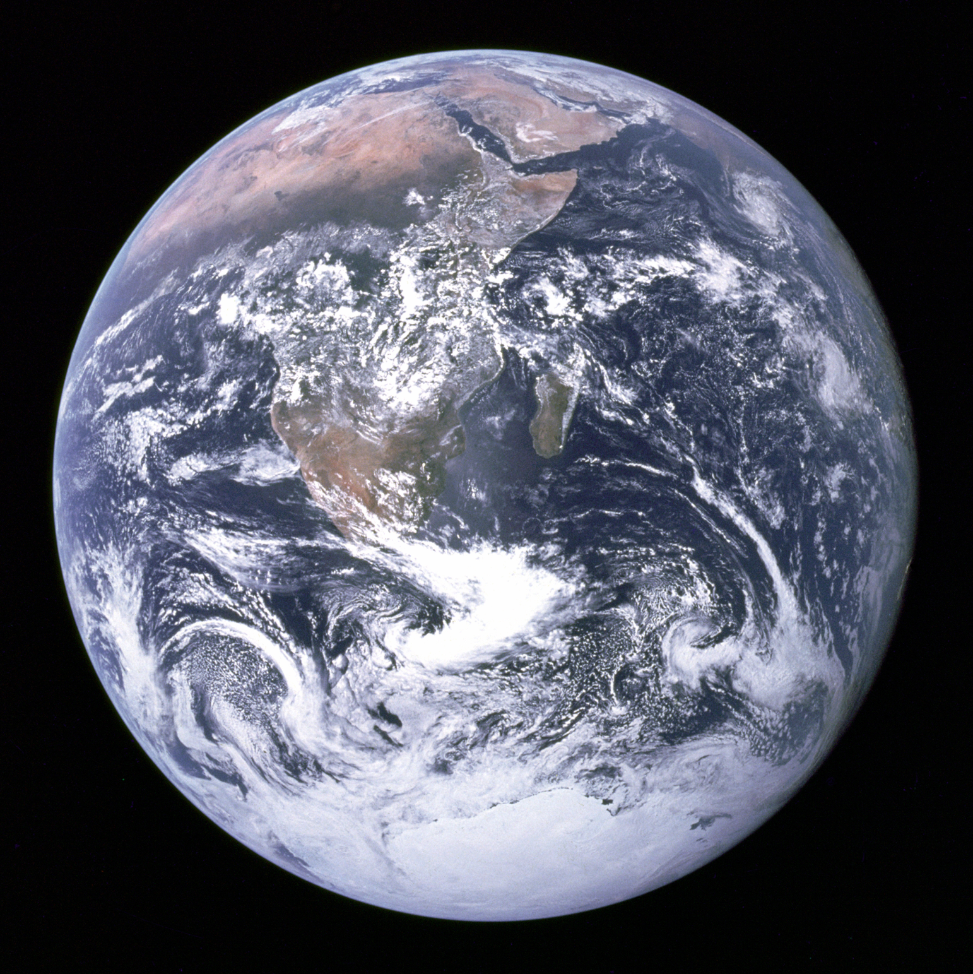
Retrieval – 1 minute recall
What do you know about satellites?

Slide 3
https://www.bbc.co.uk/bitesize/clips/zcxpcwx
The International Space Station is a laboratory in space where astronauts of different nationalities live and work together for a period of time. They carry out experiments and research whilst orbiting the Earth.

Slide 4
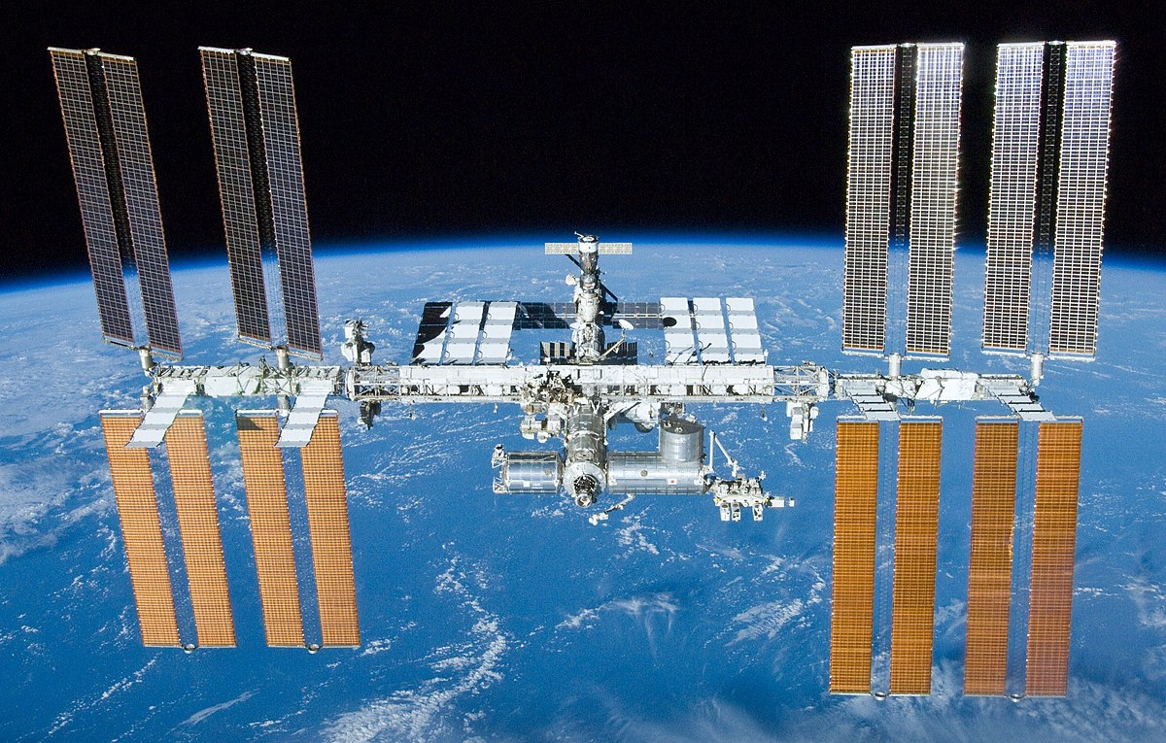
Where is the International Space Station now?
https://climate.nasa.gov/earth-now/#/spacecraft?vitalsign=satellites&spacecraft=sc_iss

Slide 5
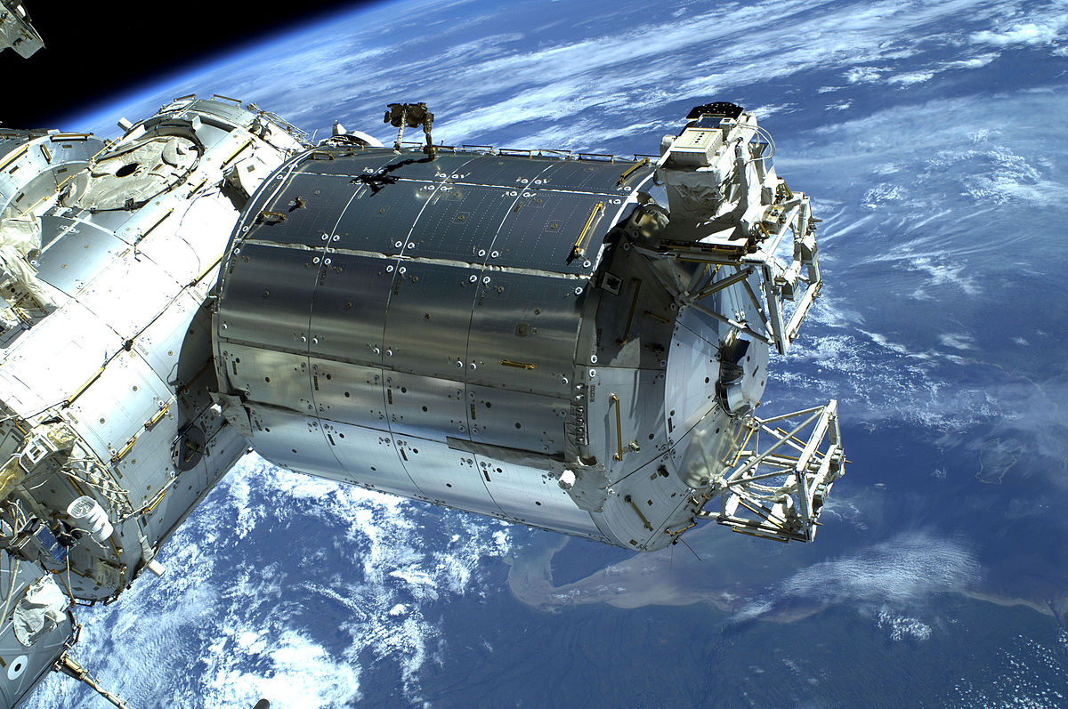
What are the different parts of the International Space Station?
The International Space Station is a habitable human-made satellite that orbits the Earth and is a joint project between several international partners: USA, Russia, Europe, Japan and Canada. Building of the ISS began in November 1988 when a Russian rocket placed Zarya, the first functional module (a section of space craft used for a particular task), into orbit. Since then, its assembly has progressed steadily as various other components have been manufactured in factories all over the world, launched into space from the Kennedy Space Centre in America and attached to the original module.
Maintaining a habitable temperature on the ISS is a big concern for the astronauts - the ISS has to withstand temperatures of between -128⁰C and 93⁰C on the dark and sunlit sides of our planet, respectively. To combat this, astronauts live in pressurised modules attached to the centre of a truss (the largest part of the ISS) and use a combination of heaters and specialised insulation to regulate internal temperatures.
Parts of the ISS
Modules - pressurised sections of the space craft which provide a breathable, warm environment for astronauts to live in. These include living quarters, equipment rooms and laboratories where the astronaut crews work and live. Small modules called nodes link the bigger modules together and enable the crew to travel around the space station and move equipment around.

Slide 6
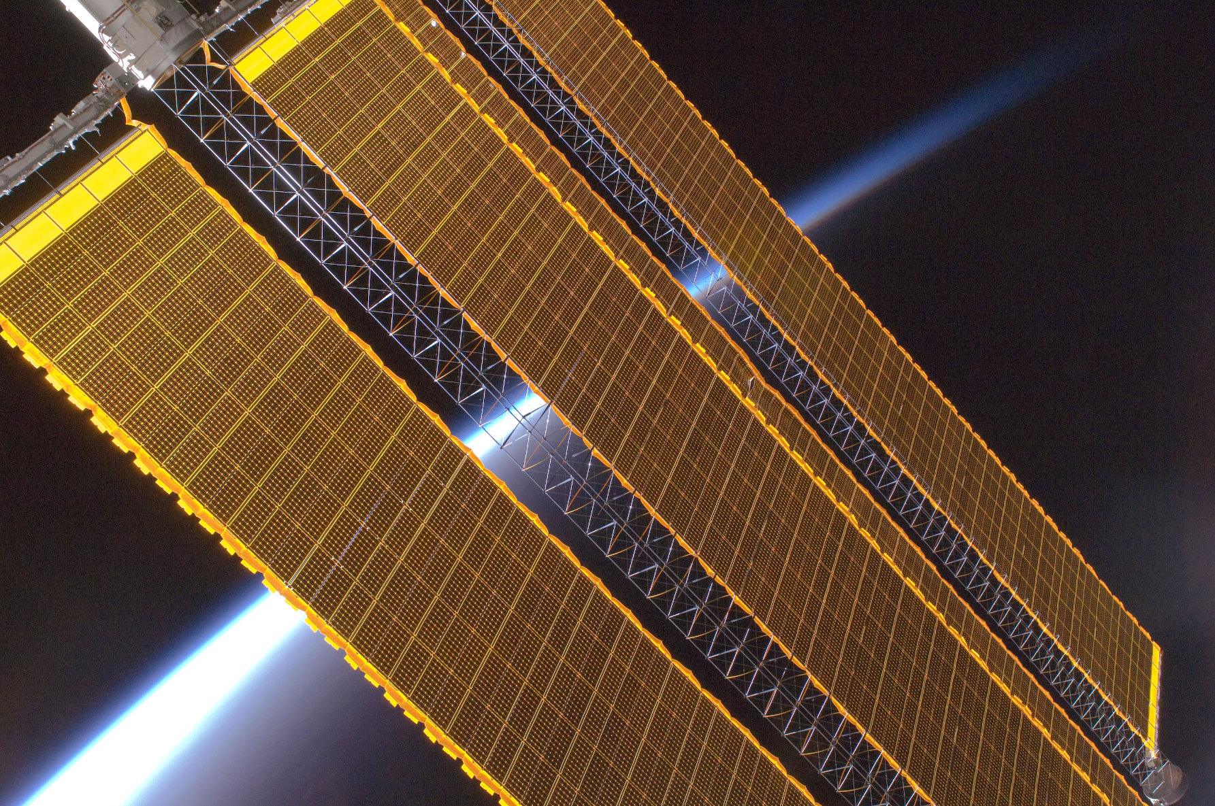
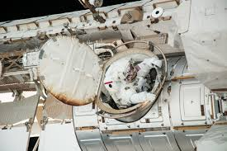
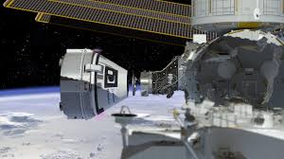
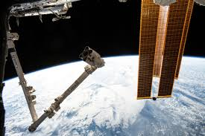
Solar Panels – The best source of energy for the space station is the Sun. There are four sets of solar panels which cover 2500 square meters. When they are in sunlight, they produce more electricity than is needed. The excess is stored in batteries to use when the solar panels are in the Earth's shadow.
Air Lock – an airtight room with two entrances that allows an astronaut to go on a
spacewalk without letting the air out of the spacecraft.
Docking Port – allows spacecraft to join with the International Space Station. Both astronauts and supplies enter the space station via a docking port.
Robotic Arm – move astronauts and equipment outside the space station. They have similar movements to a human arm with joints that allow it to bend and turn.

Slide 7
What is it like to be an astronaut aboard the ISS?
Life in space is very different to living on Earth. Astronauts have to undertake extensive training in order to cope with living aboard the ISS. Even simple things like sleeping can be difficult.
https://www.nasa.gov/stemonstrations-sleep-science.html
https://www.nasa.gov/stemonstrations-water-filtration.html
https://www.nasa.gov/stemonstrations-nutrition.html
https://www.nasa.gov/stemonstrations-exercise.html
This clip explains how astronauts train for and complete a space walk
https://www.nasa.gov/stemonstrations-spacewalking.html

Slide 8
Writing Opportunity
What is life like aboard the International Space Station?
Create a concept map.
Think about:
eating
sleeping
exercising
filtering water
working

Slide 9
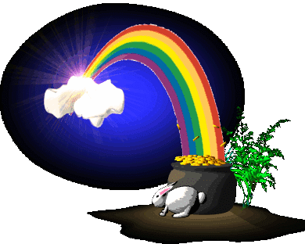
Los colores
Notes:
The colours

Slide 10
azul
Notes:
blue

Slide 11
rojo
Notes:
red

Slide 12
amarillo
Notes:
yellow

Slide 13
verde
Notes:
green

Slide 14
rosa
Notes:
pink

Slide 15
marrón
Notes:
brown

Slide 16
gris
Notes:
grey

Slide 17
naranja
Notes:
orange

Slide 18
negro
Notes:
orange

Slide 19


Which colour will the ball land on – guess in Spanish!

Slide 20

Soy gris.
Notes:
I’m grey.

Slide 21

Soy
marrón.
Notes:
I’m brown.

Slide 22
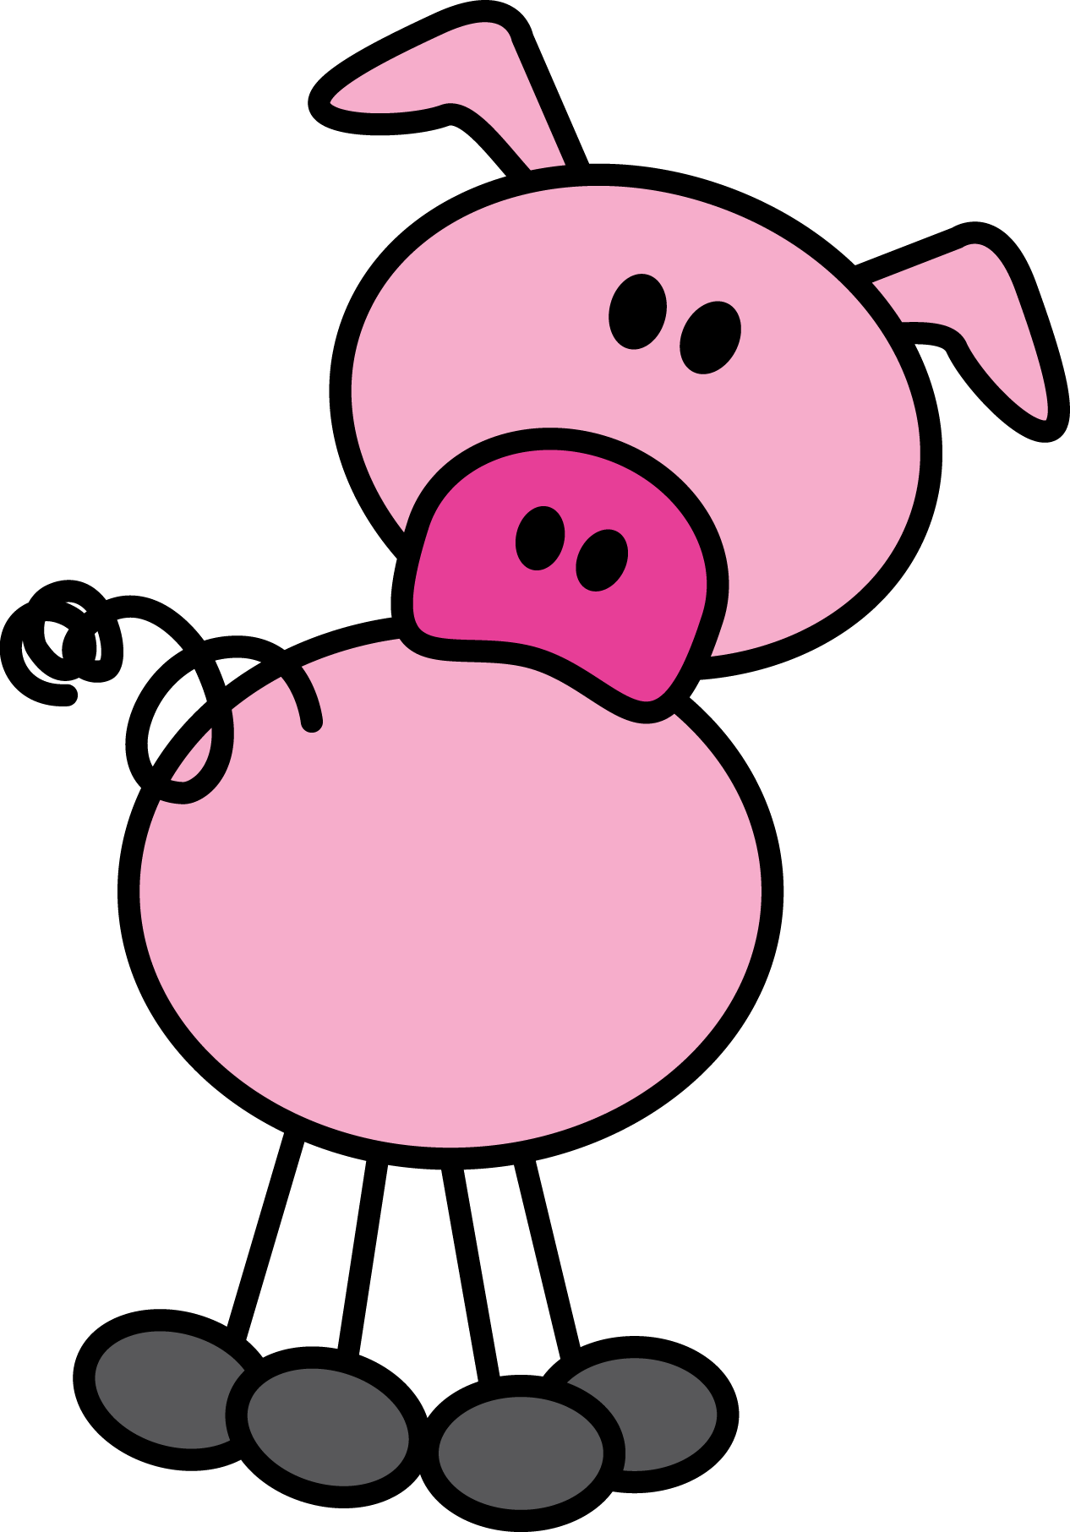
Soy rosa.
Notes:
I’m pig.

Slide 23

Soy verde.
Notes:
I’, green.

Slide 24
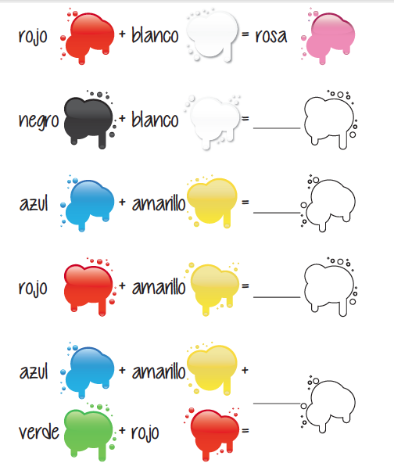
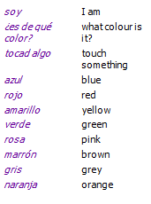
gris
verde
naranja
marrón
Notes:
Answers to the workbook activity on pg 13.

Slide 25
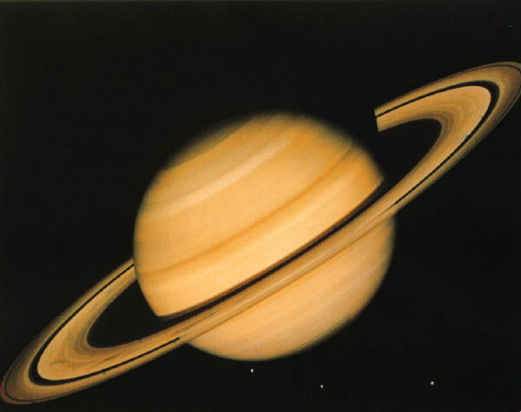

Los extraterrestres del planeta Saturno
Notes:
The aliens from the planet Saturn.

Slide 26
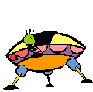
¡Llegamos!
Notes:
We are arriving!

Slide 28
Me llamo Antonio. Soy amarillo.
Me llamo Carlos. Soy azul.
Notes:
I’m called Antonio. I’m yellow. I’m called Carlos. I’m blue.

Slide 29
Me llamo
Marta. Soy marrón.
Me llamo
Ricardo. Soy rojo.
Notes:
I’m called Marta. I’m brown. I’m called Ricardo. I’m red.

Slide 30
Y me llamo Vicente. Soy verde.
Notes:
And I’m called Vicente. I’m green.

Slide 31
Aquí está mi mamá.
¡Hola Vicente!
¡Hola mamá!
Notes:
Here is my mum.
Hi mum! Hi Vicente!

Slide 32
Mamá es de color rosa.
Notes:
Mum is pink.

Slide 33
Aquí está mi papá.
¡Hola Vicente!
¡Hola papá!
Notes:
Here is my dad.
Hi dad! Hi Vicente!

Slide 34
Papá es gracioso.
Notes:
Dad is funny.

Slide 35
Aquí está mi profe, Cristina.
¡Buenos días Vicente!
¡Buenos días Cristina!
Notes:
Here is my teacher, Cristina.
Good morning, Cristina! Good morning Vicente!

Slide 36
Cristina es muy estricta.
Notes:
Cristina is very strict.

Slide 37
Juego al escondite.
Notes:
I play hide and seek.

Slide 38
Bailamos.
Notes:
We dance.

Slide 39
Miro los planetas.
¡Adiós!
Notes:
I look at the planets. Goodbye!

Slide 40
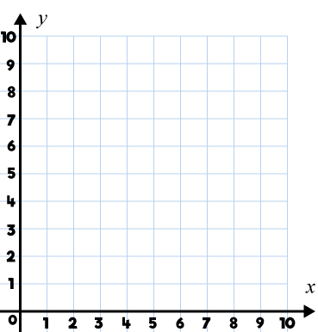
Year 5 | Week 2 | Day 4

Slide 41
Lesson 4
Which Northampton has the most rainfall?

Slide 42
Retrieval
Region
Biome
Vegetation belt
Time zone
 | plant life that can be found in a certain area, according to its weather conditions.
 | an area of land that is part of a country and is not the capital city.
 | a large area of land that has a certain climate and certain types of living things.
 | a specific area on the Earth that is earlier or later than the neighbouring zone

Slide 43
Retrieval
Vegetation belt | plant life that can be found in a certain area, according to its weather conditions.
Region | an area of land that is part of a country and is not the capital city.
Biome | a large area of land that has a certain climate and certain types of living things.
Time zone | a specific area on the Earth that is earlier or later than the neighbouring zone

Slide 44
Vocabulary
Average - is a typical amount of something.
Temperate - used to describe a place which is never extremely hot or cold.

Slide 45

Reading
Northampton (England)
Northampton's climate is warm and temperate. It has significant rainfall and even in the driest month there is still a lot of rain. The average annual temperature is 12 °C in Northampton. The rainfall here averages at 456.7 mm per year.
Northampton (Massachusetts)
The climate in Northampton is cold and temperate. There is significant rainfall throughout the year in Northampton. Even the driest month still has a lot of rainfall. The temperature here averages 10 °C. The average annual rainfall is 662.7 mm per year.

Slide 46
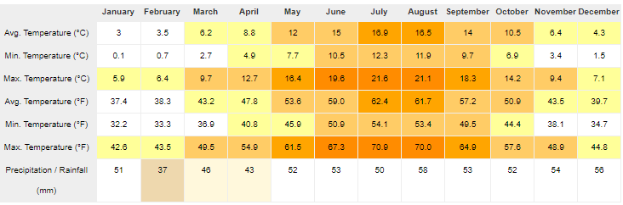
Northampton, England
Notes:
Northampton's climate is warm and temperate.

Slide 47
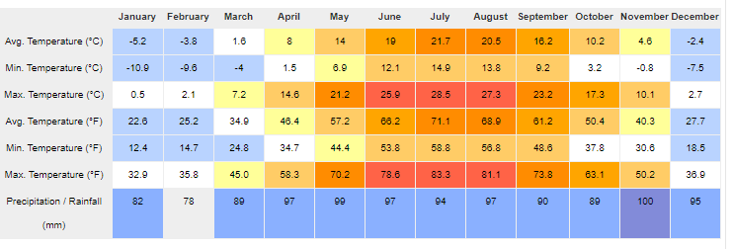
Northampton, Massachusetts
Notes:
The climate in Northampton is cold and temperate.

Slide 48
Year 5 | Week 2 | Day 5

