Slide 1
Lesson 4
What is a satellite?

Slide 2
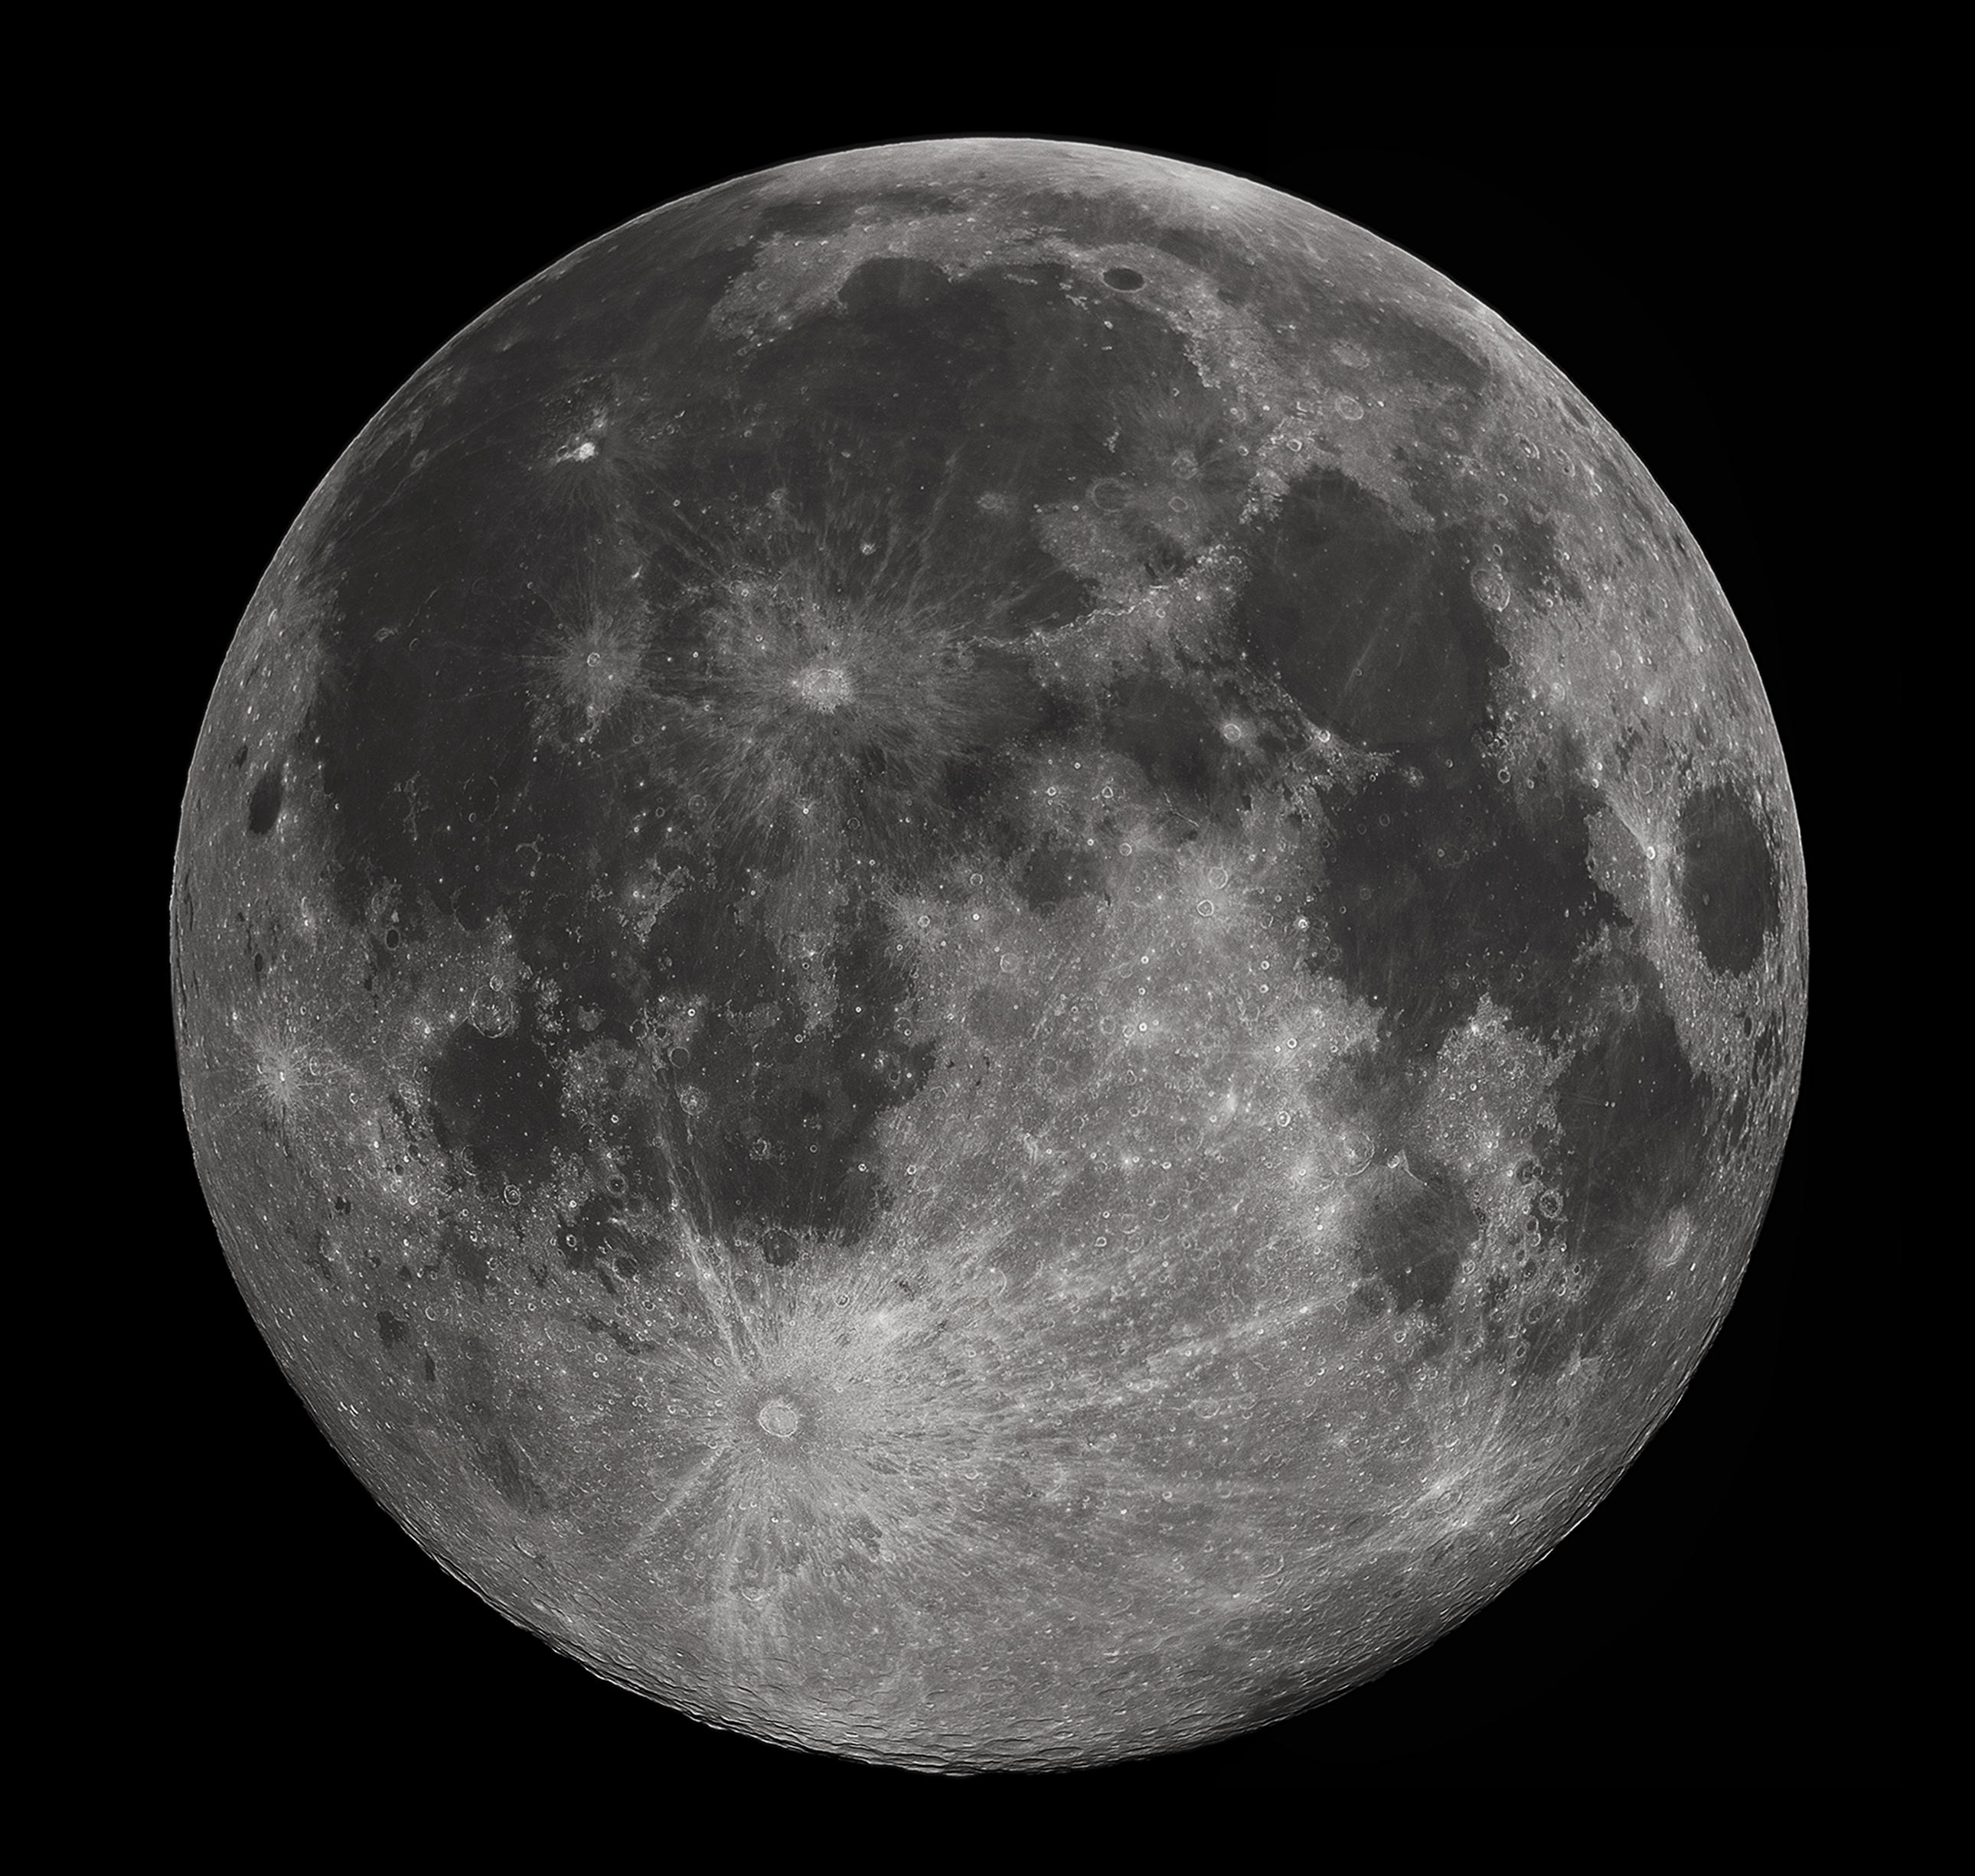
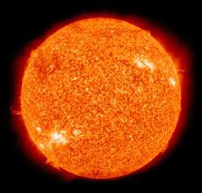
Retrieval – Odd one out

Slide 3
Vocabulary
Satellite | A small object that orbits around a larger object in space. They can be natural or artificial.

Slide 4
What are satellites used for?
A satellite is any object that orbits around a larger object in space. Earth is an example of a natural satellite as it orbits the Sun. Many of the planets in our solar system have natural satellites: our moon is an example of a natural satellite.
Artificial satellites have been made since the 1950s when the Soviet Union successfully launched Sputnik 1 into the Earth’s atmosphere. On October 4th 1954, the satellite - which was only the size of a beach ball - was sent into space on a rocket and carried a radio transmitter which relayed a series of beeps back to Earth. Following this success, the United States responded by investing lots of money into their own space program. This marked the beginning of ‘The Space Race’ in which both countries tried to show their superiority in space flight.
These days, great numbers of satellites are launched into the Earth’s orbit every year. They have numerous purposes and have become increasingly important in the modern world. Scientists use data collected from satellites to study the universe. The Hubble Telescope - which has been in space since April 1990 - has sent back many new images of space, capturing the most distant stars and galaxies.

Slide 5
Artificial satellites have played a huge role in improving the communication between places on Earth. They help to send telephone calls, radio and television programmes across the world. Despite varying in size and shape, they all have a power source and an antenna to send and receive signals from Earth. Many satellites have cameras and sensors to measure things such as heat.
In the past, people have looked to the stars and the constellations in the night sky to help them navigate their way; however, they can now use GPS (Global Positioning Satellites) to assist them. GPS uses over 30 satellites to pinpoint exact locations on Earth. In order to work, a GPS receiver is needed - these can be found in many items such as mobile phones and satellite navigation (sat nav) devices. The United States military originally developed the GPS tracker to help them spy on others, but they shared their technology with the world to improve safety, especially for aircraft.
Satellites have been immensely beneficial to weather forecasters. Images of the Earth, along with other data collected from satellites, can help predict the weather as well as track changes in the climate. They have helped meteorologists (weather forecasters) to make more accurate predictions.

Slide 6
Explore
Find the oldest satellite.
Find the newest satellite.
What is the most tracked satellite?
Can you find a satellite that is currently overhead?
How many satellites are currently in orbit?
Find a satellite that is active and one that is inactive.
https://www.n2yo.com/?s=45657

Slide 7
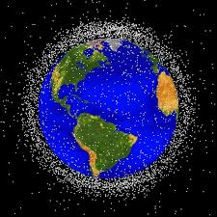
What do you think?
There are approximately 2000 active satellites in orbit around the Earth. In addition, there are around 3000 satellites that are no longer used but are still orbiting the Earth.

Slide 8
What happens to satellites when they are no longer needed?
Over time, satellites grow old, wear out or occasionally malfunction - meaning they are no longer suitable for use. So what happens when they come to the end of their life? In current times, there are two options depending on how far the satellites are from Earth:
1. If the satellite’s orbit is close enough to Earth, they will be slowed down so they can fall back into the Earth’s atmosphere. As they fall through the atmosphere, they will burn up leaving no debris behind. However, larger satellites can pose a problem as they do not entirely burn up. In these cases, the operator of the satellite can plan where they will land, making sure that debris falls in a remote area away from people. They usually aim for a location in the Pacific Ocean known as the ‘spacecraft cemetery’ which is the furthest point from human civilisation.
2. Falling back to Earth is not an option for satellites that have a higher orbit: too much fuel is needed to slow them down to such an extent that they can fall back through the atmosphere. These satellites have to be ‘blasted’ further away from Earth sending them into a ‘graveyard orbit’ 200 miles further away than any active satellite. Although these satellites are out of the way, they still remain in orbit for an extremely long time.

Slide 9
Space Junk
Along with the inactive satellites, there is a huge amount of other ‘space junk’ (debris from launching objects into space) orbiting our planet. This is becoming an increasing concern as satellites must make many avoidance manoeuvres every year to prevent them from colliding with the debris. In the near future, some companies are planning to launch an additional 50,000 satellites into orbit in order to beam the Internet down to Earth. Although this will provide global Internet coverage, there is a question over what will happen with all the additional objects orbiting the Earth. It is expected that this will increase the likelihood of collisions resulting in the need for a higher rate of collision avoidance manoeuvres.
The Kessler Syndrome is an idea put forward in 1978 by NASA scientist Donald Kessler. He suggested that if there was too much space junk in orbit, it could result in a chain reaction where more and more objects collide and create new space junk in the process. Eventually, Earth's orbit will become unusable. The United Nations has asked companies to remove satellites from the Earth’s orbit after 25 years in order to combat this; however, this is difficult for them to enforce.
So, taking all this into consideration, should we keep sending even more satellites into orbit?

Slide 10
Writing Opportunity
Should we keep sending satellites into orbit?
Think about the positive and negative impact of sending satellites into orbit.
Use these to help you write your response to the question.

Slide 11
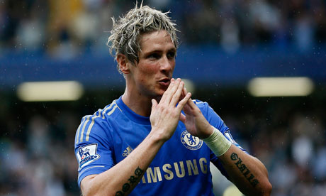
Soy
Futbolista.
Notes:
I’m a footballer.

Slide 12
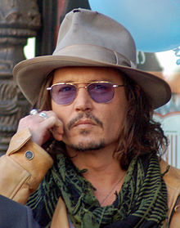
Soy actor.
Notes:
I’m an actor.

Slide 13
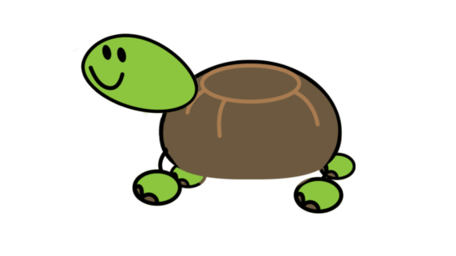
Soy una tortuga.
Notes:
I’m a tortoise.

Slide 14
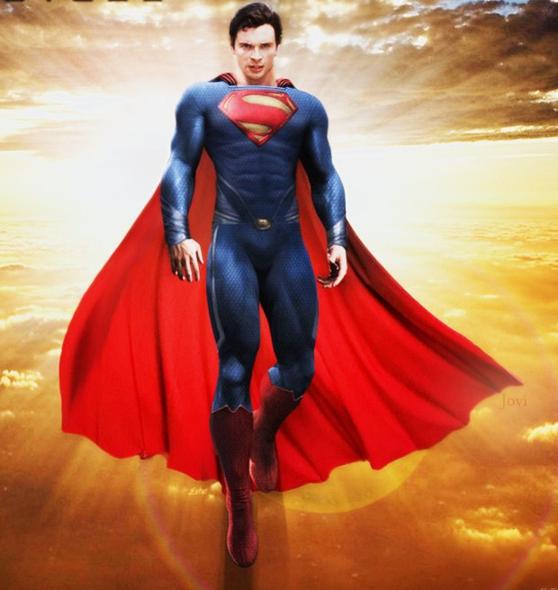
Soy un superhéroe.
Notes:
I’m a superhero.

Slide 15
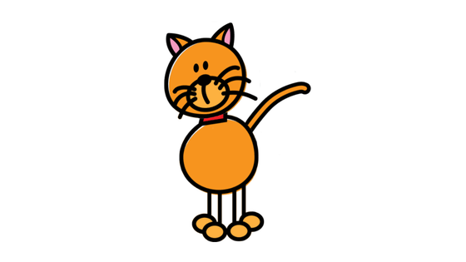
Soy un gato.
Notes:
I’m a cat.

Slide 16
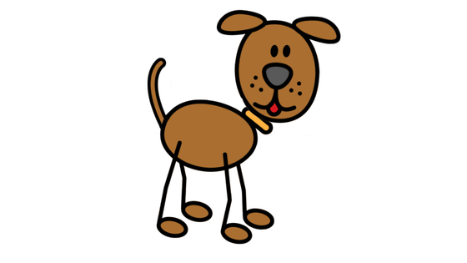
Soy un perro.
Notes:
I’m a dog.

Slide 17
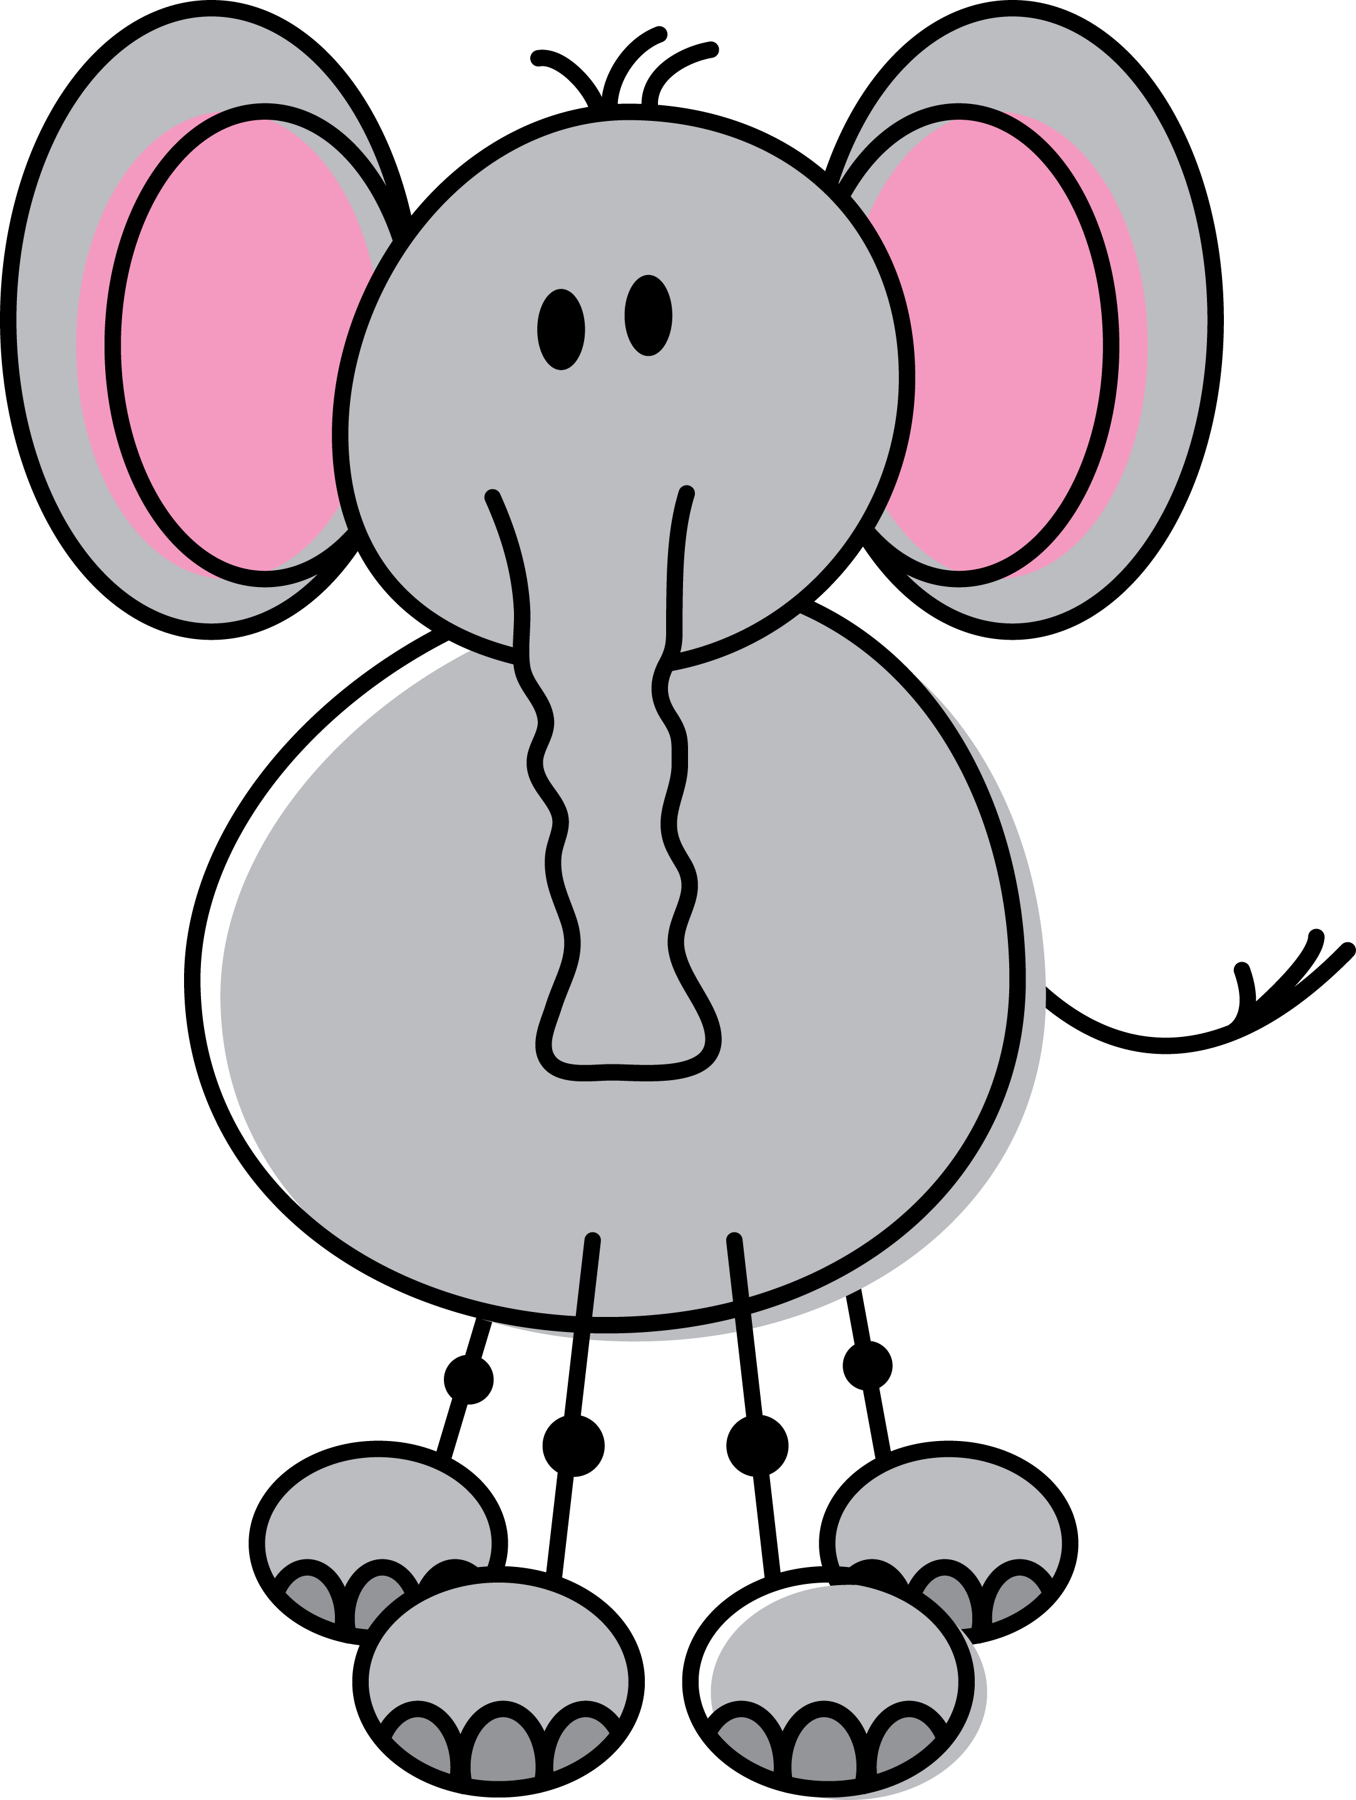
¡Mamá! ¡Mamá! ¿Dónde está mi mamá?
Notes:
Mum, mum. Where is my mum?

Slide 18
No, no soy tu mamá. Soy un león.
Buenos días. ¿Eres mi mamá?
Notes:
Hello. Are you my mum?
No, I am not your mum. I am a lion.

Slide 19
Gracias. Adiós.
Notes:
Thank you. Good-bye.

Slide 20
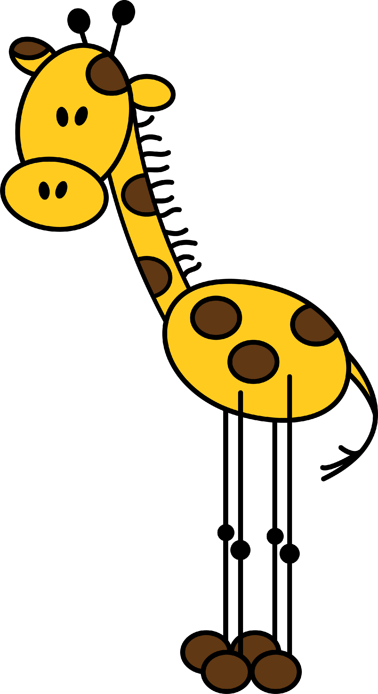
No, no soy tu mamá. Soy una jirafa.
Buenos días. ¿Eres mi mamá?
Notes:
Hello. Are you my mum?
No I am not your mum. I am a giraffe.

Slide 21
Gracias. Hasta pronto.
Notes:
Thank you. See you soon.

Slide 22
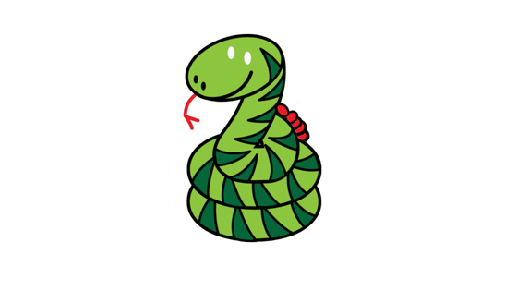
No, no soy tu mamá. Soy una serpiente.
Buenos días. ¿Eres mi mamá?
Notes:
Hi. Are you my mum?
No, I am not your mum. I am a snake.

Slide 23
Gracias. Adiós.
Notes:
Thank you. Good-bye.

Slide 24
No, no soy tu mamá. Soy un
tigre.
Buenos días. ¿Eres mi mamá?
Notes:
Hello. Are you my mum?
No, I am not your mum. I am a tiger.

Slide 25
Gracias. Adiós.
Notes:
Thank you. See you later.

Slide 26
Sí, ¡soy tu mamá! ¡Mi bebé!
Buenos días. ¿Eres mi mamá?
Notes:
Hello. Are you my mum?
Yes, I am your mum! My baby!

Slide 27
¡Mi mamá!
Notes:
My mum!

