Slide 1
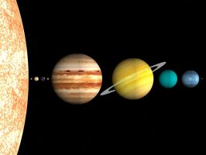
What is the solar system?
The force
Gravity is the force that holds the universe together. The gravity of the sun is what holds the planets in orbit around it. Every object in the universe has gravity, the larger or more dense an object the more gravity it has.
Our solar system is the sun (a star) and all the planets and other objects which orbit (circle) around it. It was formed around 4.6 million years ago from a giant cloud of dust and gas. Gravity began pulling the dust and gas into clumps. As each clump grew more dense it had more gravity and therefore grew quicker, forming planets.
Did you know?
Between the orbits of Mars and Jupiter there is an asteroid belt that has millions of asteroids (space rocks)
Mercury
Mercury, which is the smallest planet, is also closest to the sun. It consistssof rock and metal. Taking just 88 days to orbit the sn,means it has the shortest year of all the planets. It’s orbit is 35.98 million miles from the sun. Mercury is one of only 2 planets that do not have a satellite (a moon that orbits around it)..
Venus
Venus is the second of the four rocky planets. Despite being the second planet out, it is the hottest of all the planets with a temperature of 480 degrees celsius. Venus has a thick atmosphere, which means it reflects back 76% of the sunlight that hits it, making it the brightest object in the sky (after the moon and sun). However as its’ atmosphere is 96% carbon dioxide, it would be fatal to humans.
Mars
The final rocky planet. Mars is a rusty red colour due to the presence of a vast amount of iron on or near its surface.
Mars’ surface is currently dusty and dry- we know this from probes, which scientists have sent to orbit and photograph the planet- but it is believed that in the past the planet may have had water on its surface. Presently, all the water on the planet is frozen as ice, although there is enough ice to cover the planet in water up to 35 metres deep.
Earth
The third planet from the sun, earth is the only planet that we know of that is inhabited. Scientists believe this is due to the presence of water and the breathable atmosphere. With a diameter of 12, 756km, Earth is the largest of the four rocky planets.

Slide 2
presence- being there
reflects- bounces back
fatal- deadly
inhabited- live in or on
diameter- a measurement from one side to the other across the middle, of a sphere or circle
dense- how much stuff there is in an object
probe- an unmanned spacecraft that takes scientific measurements and photos

Slide 3
Aim
I can recognise and use subordinating conjunctions.
Success Criteria
I can recognise that subordinating conjunctions are used to create subordinate clauses.
I know that subordinate clauses are used within complex (multi-clause) sentences.
I can use ‘I SAW A WABUB!’ to remember the main subordinating conjunctions.
I can write my own complex (multi-clause) sentences using different subordinating conjunctions.

Slide 4
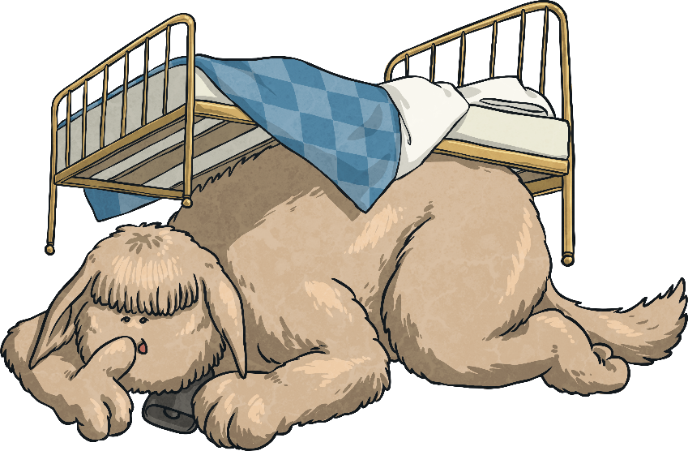
…is an acronym to help you remember the first letters of some of the most important subordinating conjunctions.
I Saw a Wabub…
If
Since
As
When
Although
While
After
Before
Until
Because
I
S
A
W
A
W
A
B
U
B!

Slide 5
So, how do we use subordinating conjunctions?
Next Steps
Subordinating conjunctions are the first words within a subordinate clause. Subordinate clauses do not make sense on their own but, when they are used with a main clause, they create a complex (multi-clause) sentence.
Subordinate clauses will always have a subject and verb within them, e.g.
after she smiled
after Christmas
subordinating conjunction
subject
verb
Here ‘after’ is being used as a preposition.
is a subordinate clause
is not a subordinate clause

Slide 6
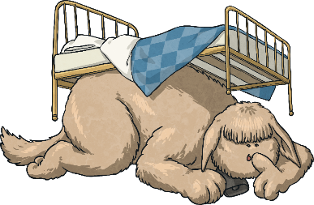
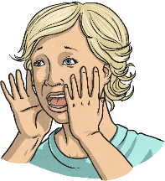
Subordinating conjunctions can also be used as the first word in a sentence. When the subordinate clause comes before the main clause, make sure you remember to use a comma to mark where the subordinate clause ends.
Next Steps
I SAW A WABUB!
When the bell rang, the eager pupils sped into school.

Slide 7
Can you spot the subordinating conjunctions in this piece of text? Where have they been used in these sentences?
I SAW A WABUB!
Subordinating Conjunction Hunt
As he walked closer, Cleo could see the crocodilius in the cave entrance. The beast was hurriedly eating the remains of its last unlucky victim because it was ravenous. Cleo examined its bright red eyes, huge smoking nostrils and razor-sharp teeth while the beast was occupied. Although Cleo was standing quite a distance away, the terrible stench of the gruesome beast was still making him feel nauseous. Cleo took a deep breath before he tiptoed bravely forward. It was time for battle.
As he walked closer, Cleo could see the crocodilius in the cave entrance. The beast was hurriedly eating the remains of its last unlucky victim because it was ravenous. Cleo examined its bright red eyes, huge smoking nostrils and razor-sharp teeth while the beast was occupied. Although Cleo was standing quite a distance away, the terrible stench of the gruesome beast was still making him feel nauseous. Cleo took a deep breath before he tiptoed bravely forward. It was time for battle.

Slide 8
Now, it’s your turn. Which subordinating conjunction would fit best at the start of this subordinate clause? Is there more than one possibility?
I SAW A WABUB!
Practise Your Skills
I eat lunch, I am going
to an important meeting.

Slide 9
Now, it’s your turn. Which subordinating conjunction would fit best at the start of this subordinate clause? Is there more than one possibility?
I SAW A WABUB!
Practise Your Skills
he was thrown from his saddle,
Henry was wary of riding his horse.

Slide 10
Can you spot the subordinating conjunctions in these sentences?
I SAW A WABUB!
Quick Quiz:
Question 1
a)
b)
c)
Until she tried, Daphne didn’t know that she could whistle.
Heavy snow poured from the skies while the children made a snowman.
Although it was expensive, the couple enjoyed their meal at the award-winning restaurant.
Until she tried, Daphne didn’t know that she could whistle.
Heavy snow poured from the skies while the children made a snowman.
Although it was expensive, the couple enjoyed their meal at the award-winning restaurant.

Slide 11
Complete the sentences below by writing the subordinating conjunctions from the box in the correct places to form complex sentences. Use each conjunction only once.
I SAW A WABUB!
Quick Quiz:
Question 2
a)
b)
c)
The greenhouse got smashed the boys were playing football.
they were in trouble, they had to go inside the house.
they were well-behaved, they could have their ball back next week.

Slide 12
Can you begin each sentence using a subordinate clause? Start with a conjunction.
If
Since
As
When
Although
While
After
Before
Until
Because
…..Mars has a red colour.
…..Mercury has the shortest year of all the planets.
….. Venus is the brightest planet.
….

