Slide 3
1) What is the difference between 2 and 15?
2) What number is the arrow pointing to?
3) What number is halfway between 2 and 20?
0
10

Slide 4
1) What is the difference between 2 and 15?
2) What number is the arrow pointing to?
3) What number is halfway between 2 and 20?
13
6
0
10
11

Slide 6
-10
-8
-6
-4
-10
0
-2
2
4
6
8
10
Have a think
-50
-40
-30
-20
-10
0
10
20
30
40
50

Slide 7
-2
-10
20
-5
0
5
10
15
20
20 ÷ 4 =
5
-6
Have a think
0
9
9 ÷ 3 =
3

Slide 8
Have a go at questions 1 and 2 on the worksheet

Slide 9
-5
-4
-3
-2
-1
0
1
2
3
4
5
What is the difference between 2 and 5?
3
Have a think
What is the difference between -3 and -1?
2
-2
-5
-4
-3
-2
-1
0
1
2
3
4
5

Slide 10
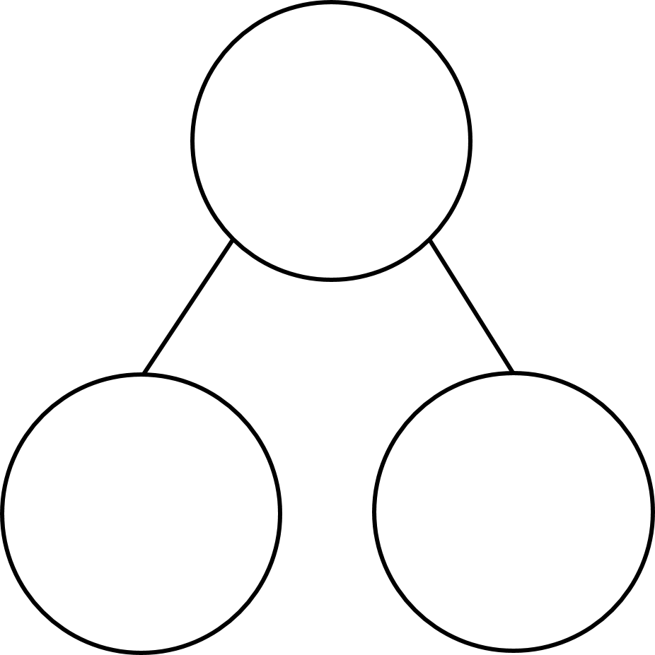
At 2 p.m. it is 5 degrees Celsius.
At 2 a.m. it is 7 degrees colder.
What is the temperature at 2 a.m.?
Have a think
-2$°$C
-5
-4
-3
-2
-1
0
1
2
3
4
5
7
2 p.m.
2
5

Slide 11
Rosie and Eva are on a cruise holiday.
Rosie is on the bottom deck of the ship, 5 m below the sea.
Eva is on her cabin’s balcony, which is 23 m above the sea.
How far apart (vertically) are they?
23
Have a think
23
23 + 5 =
28 metres apart
0
5
- 5

Slide 12
Have a go at questions 3 – 6 on the worksheet

Slide 13
What number is halfway between 10 and 20?
10
5
5
15
10
?
20
What number is halfway between 8 and -4?
12
-2
-3
-1
0
1
6
6
2
-4
0
?
8
4
8
4 + 8 =
12

Slide 14
Have a go at the rest of the worksheet

