Slide 2
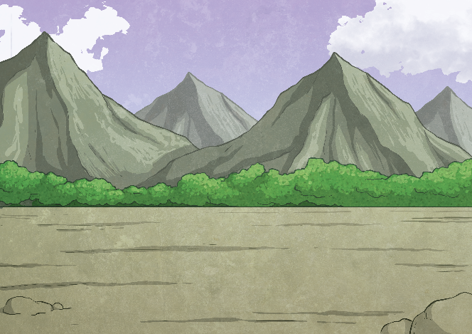
What is a mountain?
A mountain is usually defined as a part of the landscape with steep slopes that rise over 300m. Some geographers define a mountain as a summit of at least 600m high.
Some mountains are found in groups called ranges such as the Lake District in England and Snowdonia in Wales. Others are isolated summits.
When mountain ranges are found together they make up mountain chains. The Alps in Europe, the Rocky Mountains in North America and the Andes in South America are all mountain chains.

Slide 3
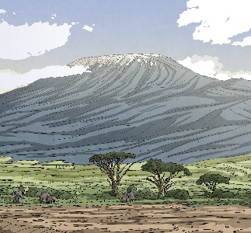
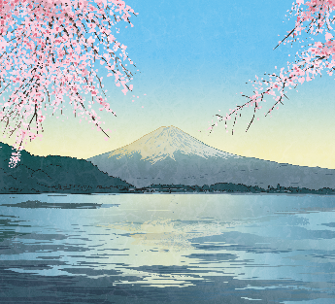
Famous Mountains
Mount Everest is the highest mountain in the world. It is in the Himalayas, or the border of Nepal and China, and is 8,848 metres high.
Kilimanjaro is the highest mountain in Africa.
It is a volcanic mountain that is 5,895 metres high.
Mount Fuji is a volcano in Japan. It is 3,776 metres high.
Mount McKinley is the highest peak in the USA. It is 6,294 metres high.

Slide 4
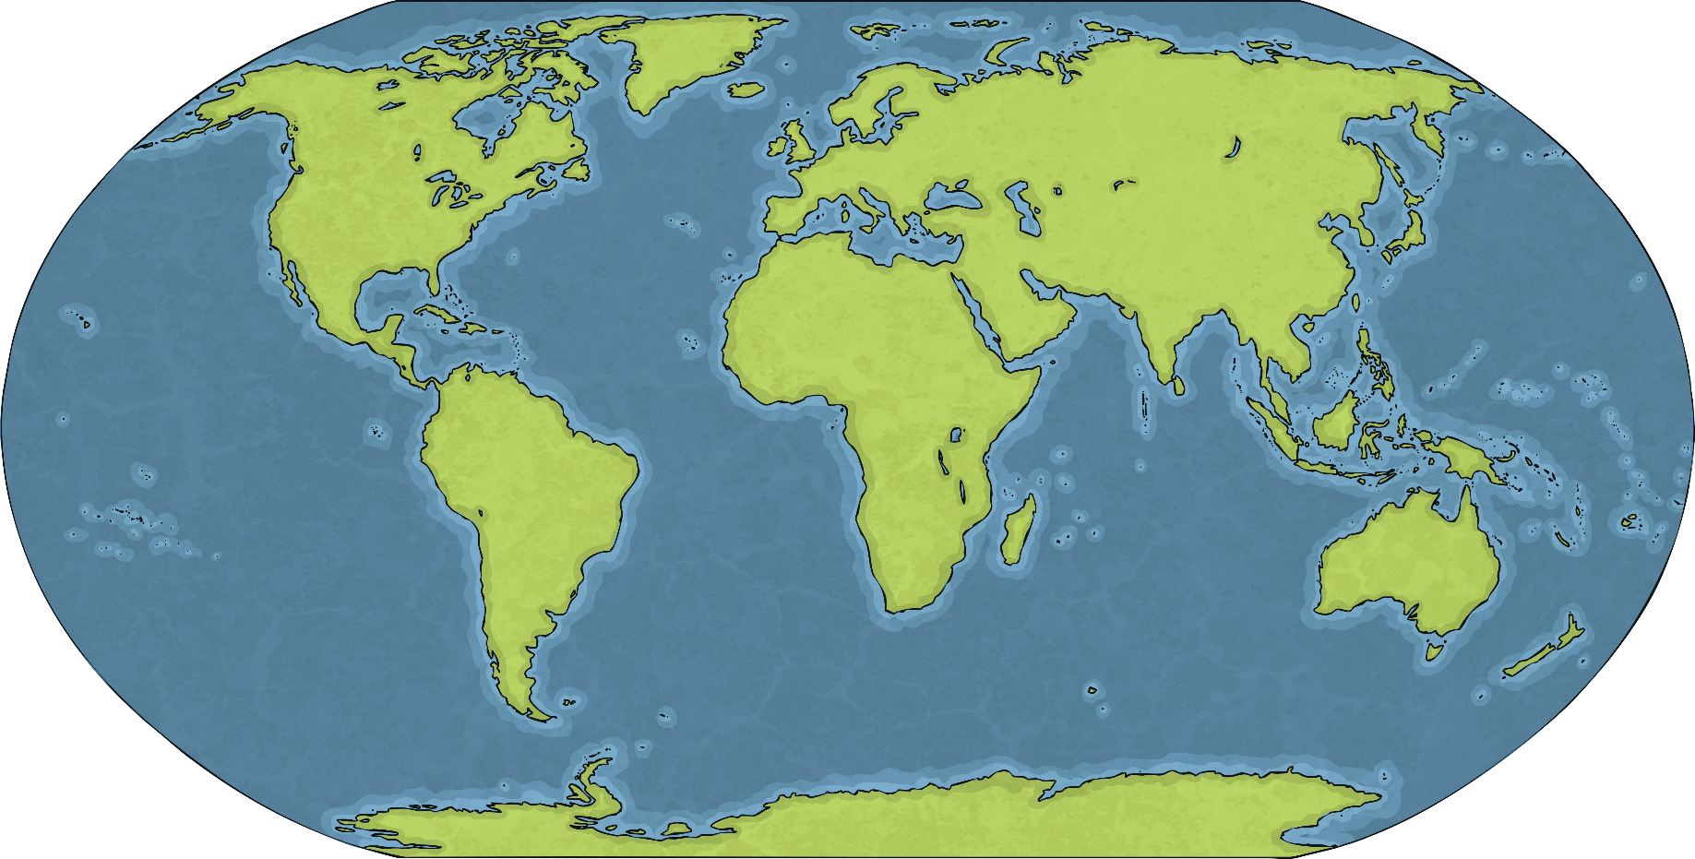
Famous Mountains
Rocky Mountains
Mount Fuji
Mount Everest
Andes
Kilimanjaro

Slide 5
Mountains
Temperature on a Mountain
Ice on a Mountain
Glaciers on a Mountain
Mountains are colder at their peak because as the warm air rises, it expands and cools down.
Mountains have shiny white surfaces because of the ice and snow. It reflects the sun, keeping the temperature freezing during summer.
Many mountains have sharp peaks, ridges
and valleys. These are formed by frost, ice and glaciers.
In the summer, the rain gets trapped in the cracks. During winter it freezes causing rocks to split from the mountain, leaving sharp, jagged edges.
Glaciers are made from ice and snow that has never been melted. As it moves down a mountain, it takes rocks with it and erodes away the mountain. Glaciers can leave large U-shaped valleys carved out of the rocks.

Slide 6
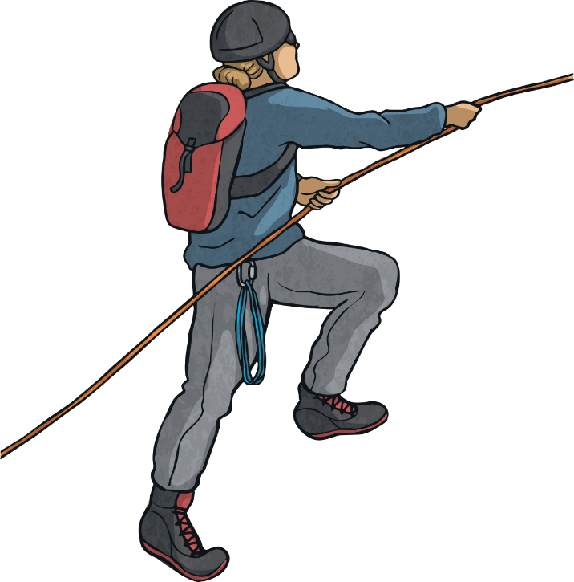
Danger on the Slopes
Avalanche
Altitude Sickness
Cold Kills
Is a huge mass of moving snow, they can contain millions of tonnes of snow and move over 300 kilometres an hour. They are normally triggered by a small shock. The snow will destroy everything in its path.
The higher up the mountain you are, the thinner the air is. This means that a climber will have to take more breaths to get the same amount of oxygen as they would get if they were on the ground. Climbers can become dizzy, short of breath and tired when walking in high altitudes; this is known as altitude sickness.
Climbers can get frost bite and hypothermia from the severe cold on a mountain. Both of these illnesses can kill if not treated quickly.

