Slide 1
Geography
Magnificent Mountains
Year One
Geography | Year 5 | Magnificent Mountains | Features of Mountains | Lesson 3

Slide 3
Aim
I can describe the key features of a mountain range.
Success Criteria
I can tell you that not all mountains look the same.
I can identify a valley and the summit, foot and slope of a mountain.
I can identify an outcrop, a ridge, the tree line and the snow line.
I can identify a plateau.
I can draw a mountain range including the key features I have identified.

Slide 4
Draw It!
Draw a mountain.
Show your picture to your partner.
How are your drawings similar?
What differences are there?
Do all mountains look the same?

Slide 5
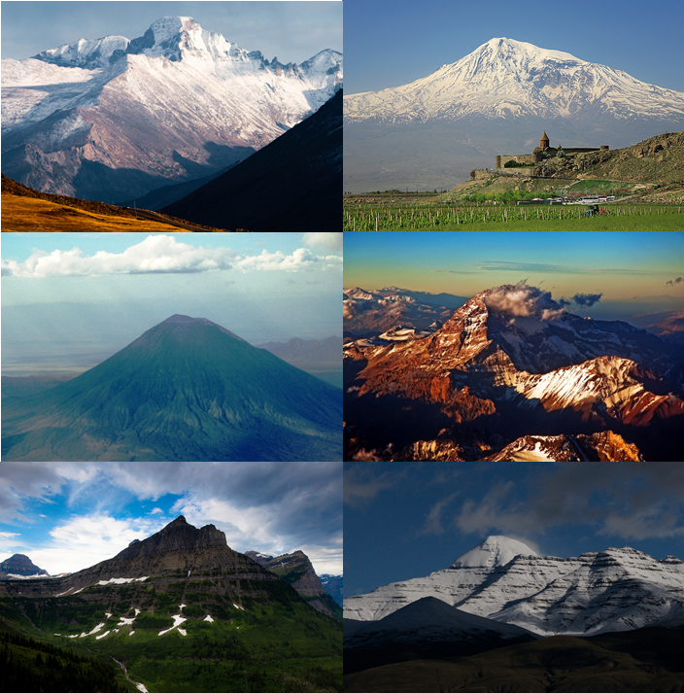
Different Shapes
Watch this video clip.
Did the mountains look like your drawing?
How are your drawings similar?
What differences are there?
Were all the mountains the same?
Some were single summits, some were in groups.
Some were smooth-edged and some were rockier.
Photo courtesy of MaxGag, Alexander Mkhitaryan, Cessna 206, PhillipC, eleepphotography, vijaykiran (@flickr.com) - granted under creative commons licence - attribution

Slide 6
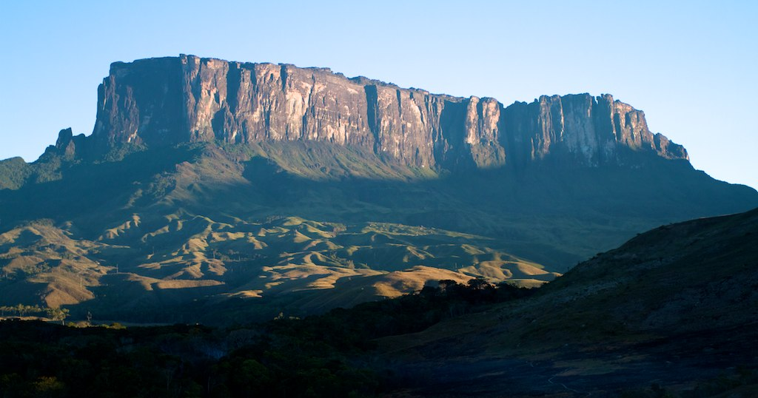
Different Shapes
Watch this video clip.
What is different about this mountain?
Photo courtesy of MaxGag, Alexander Mkhitaryan, Cessna 206, PhillipC, eleepphotography, vijaykiran, Paulo Fassina (@flickr.com) - granted under creative commons licence - attribution

Slide 7
Key Features
summit
The top of a mountain.
outcrop
A rock formation visible from the surface.
slope
An area of ground increasing in height.
snow line
Above here snow and ice cover the mountain all year.
plateau
An area of flat, high ground.
valley
The area of low land between mountains.
tree line
The highest point forests are found.
ridge
A long, narrow, high section of land.
foot
The bottom of the mountain.
face
The “side” of a mountain.

Slide 8
What Part is It?
Can you draw an accurate diagram of some mountains including all the features?

Slide 9
Draw It… Again!
Draw a mountain.
Compare it to the picture you drew at the start of today’s lesson.
How are your drawings similar?
What differences are there?
Did you include some of the key features you have learnt about today?

Slide 10
Aim
I can describe the key features of a mountain range.
Success Criteria
I can tell you that not all mountains look the same.
I can identify a valley and the summit, foot and slope of a mountain.
I can identify an outcrop, a ridge, the tree line and the snow line.
I can identify a plateau.
I can draw a mountain range including the key features I have identified.

