Slide 1
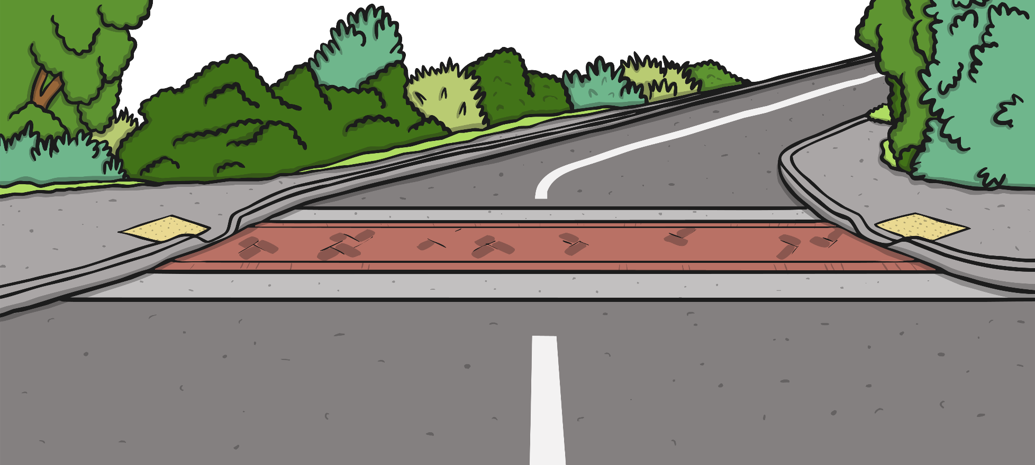
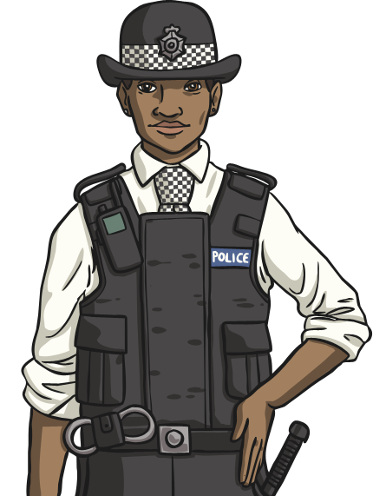
Task 4: The Island Rules
Why do countries have rules and laws?
If your island is going to start to have inhabitants who live there, do you need to set some laws for them to live by?

Slide 2
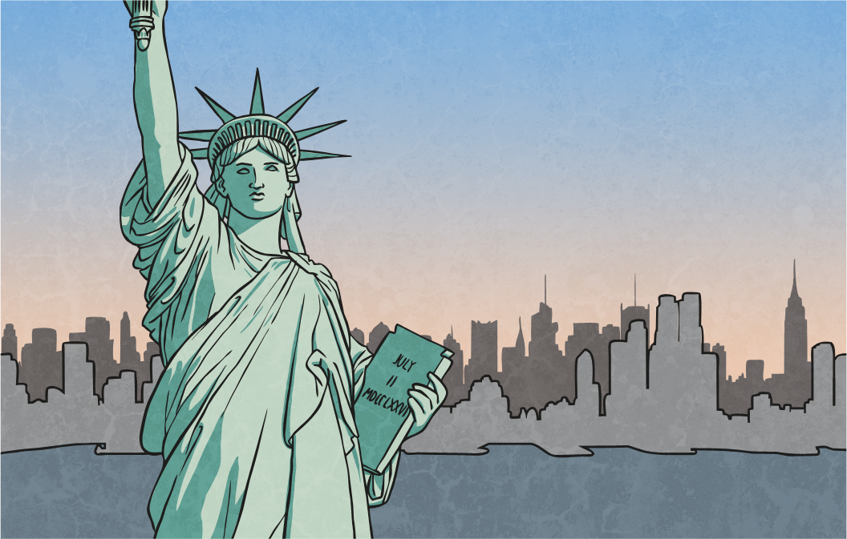
Why Do You Need a Legal System?
There are many reasons why countries need laws. These include:
To prevent anti-social and unacceptable behaviour.
To identify who should rightfully own items and property.
To regulate family and personal relationships e.g. getting married, inheritance etc.
To provide a means for citizens to resolve disputes with other citizens.

Slide 3
Setting the Rules
What rules and laws will your people live by?
Will people have ‘freedom of speech’?
Will there be age restrictions on doing certain activities?
Will children be required to go to school?
How will people be punished for breaking the law?
Will people be allowed to own weapons?

Slide 4
Your Nation’s Identity
Design a poster that gives details of the most important laws on your island.
How will breaking the laws be punished?

Slide 5
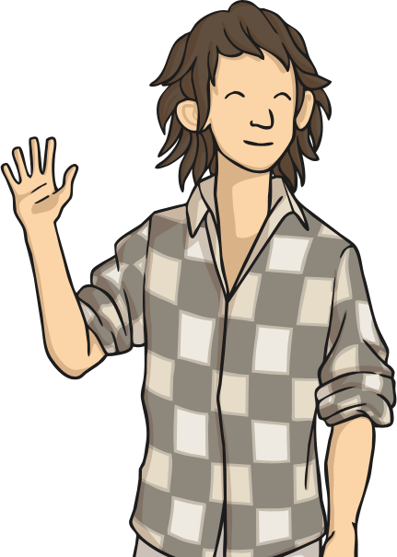
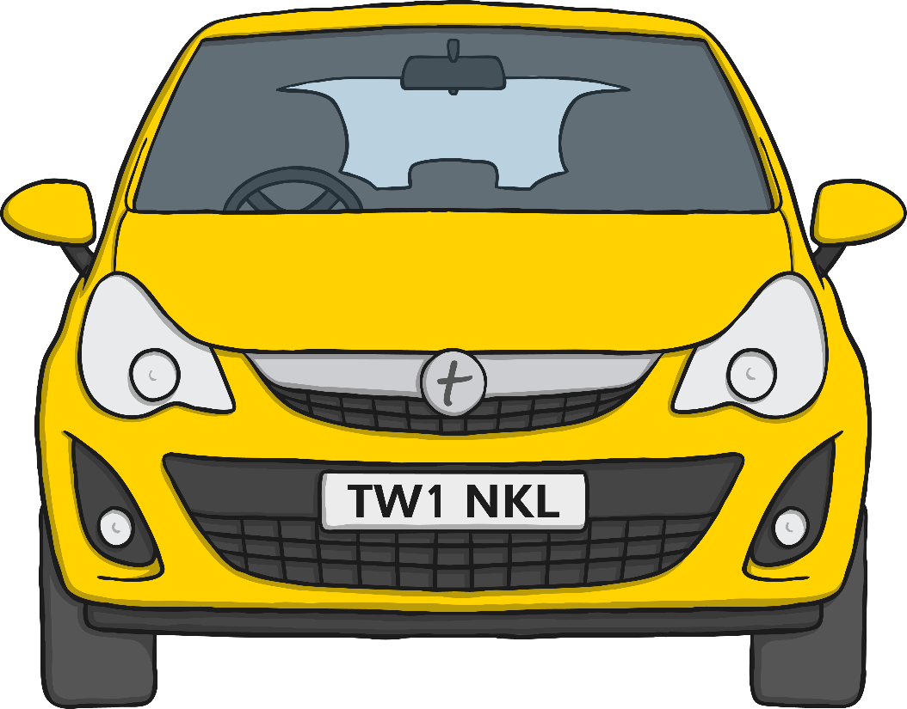
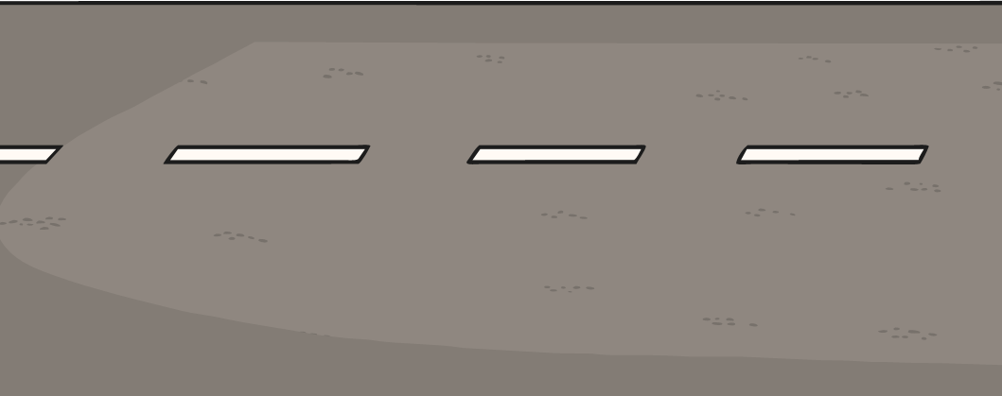
Scenario 1: Are They a Law-Breaker?
Would this person be committing a crime on your island?
How would they be punished?
Danny is just 14 years old.
He has been driving a car on a public road with no one else in the car.

Slide 6
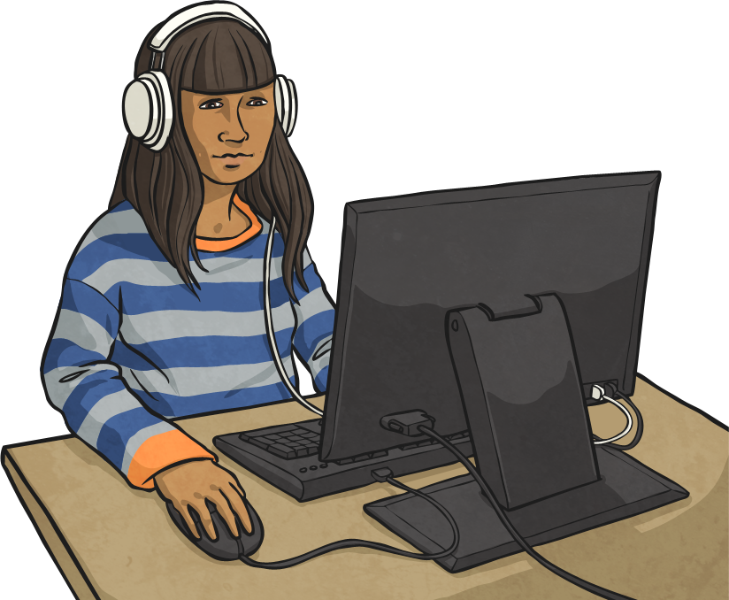
Scenario 2: Are They a Law-Breaker?
Would this person be committing a crime on your island?
How would they be punished?
Sidney posts a malicious and offensive message on a social media site directed at another islander.

Slide 7
Scenario 3: Are They a Law-Breaker?
Would this person be committing a crime on your island?
How would they be punished?
Rita owns a hand gun without a license.
She believes it is her right to protect her family and possessions.

