Slide 2
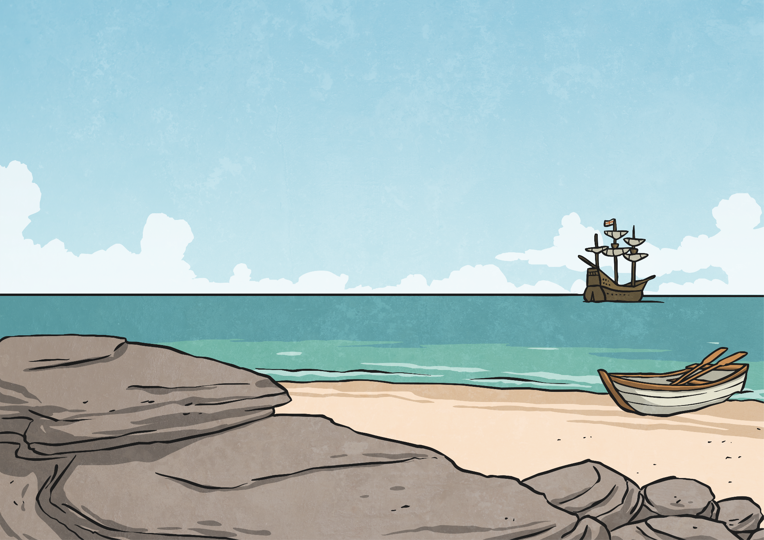
Introduction: The Discovery
Whilst out exploring, you have found an uninhabited, undiscovered island, which you can now claim as your own kingdom!

Slide 3
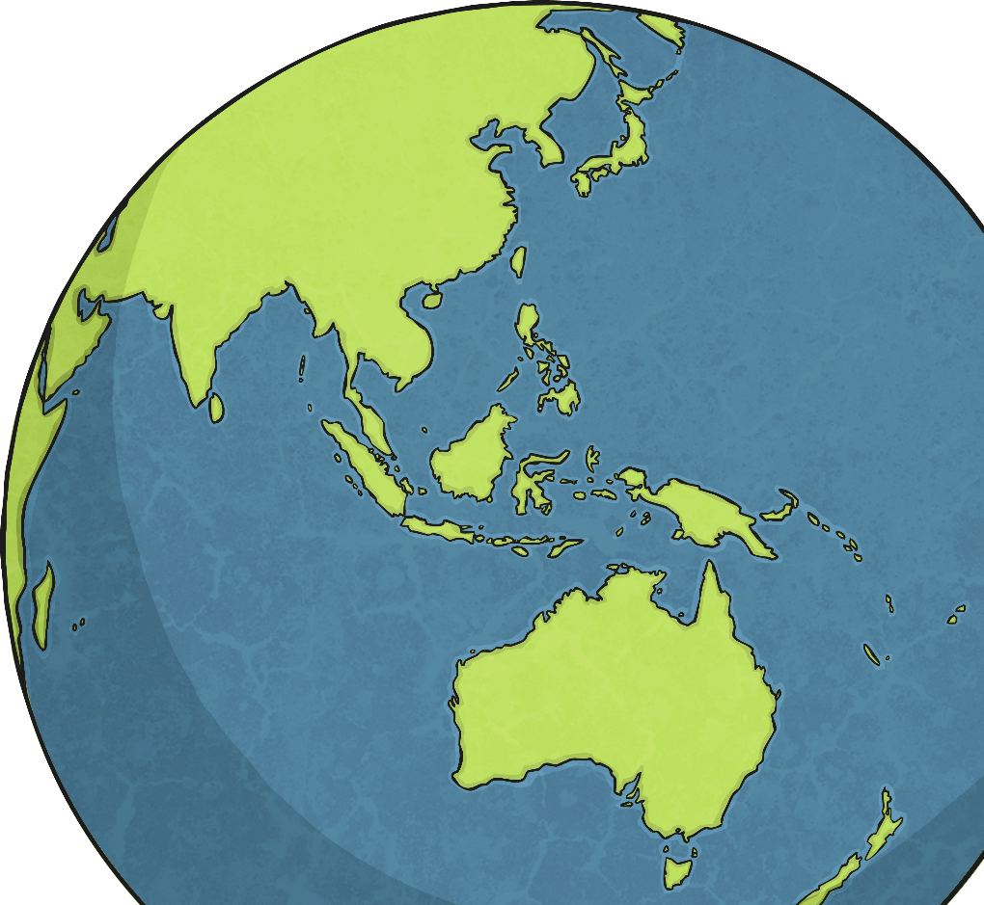
Task 1: Where in the World Are You?
So where were you sailing when you made this astonishing discovery?
Where in the world would you like your island to be?
Use atlases, to decide where you’d like your newly discovered island to be.
Which sea or ocean does your island lay in?
Is it in the Southern or Northern Hemisphere?
Which countries and other islands are closest to it?
How close?
Which Continent may claim it?

Slide 4
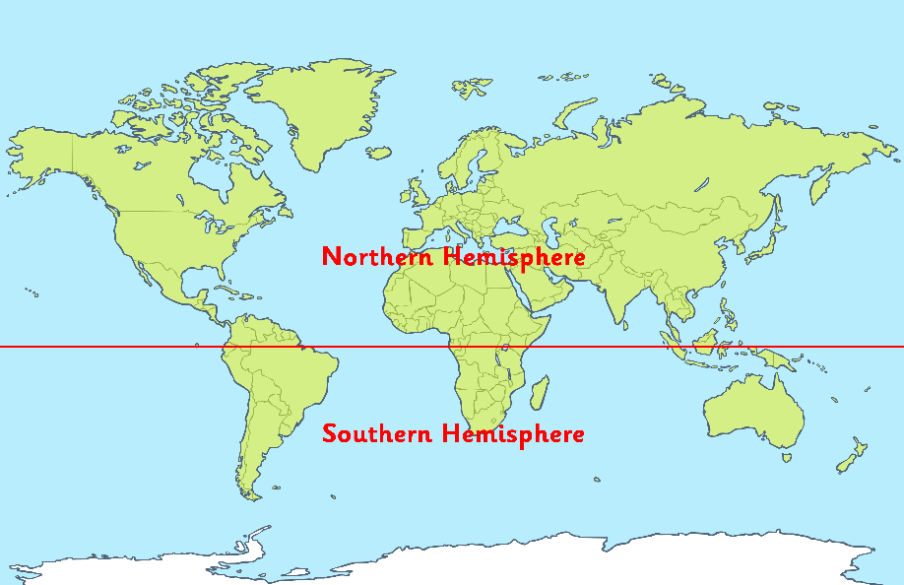
X Marks the Spot!
Mark an x on your world map to show where your island is located.
The Location of My Island
e.g.
My island lays just off the west coast of…
To the south of my island is the country of…
It is in the ________ ocean/sea.
Which countries and other islands are closest to it?
How close?

Slide 5
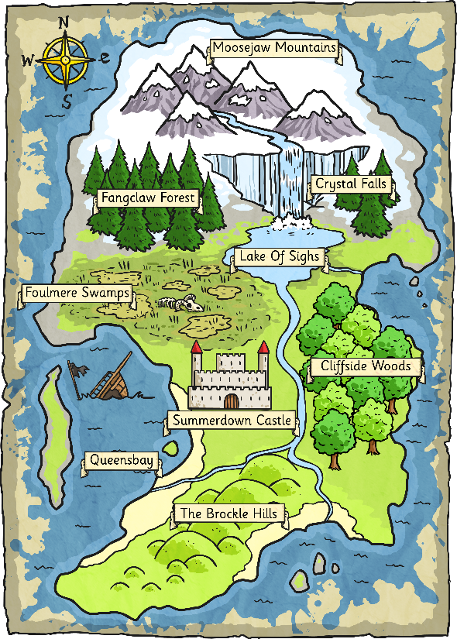
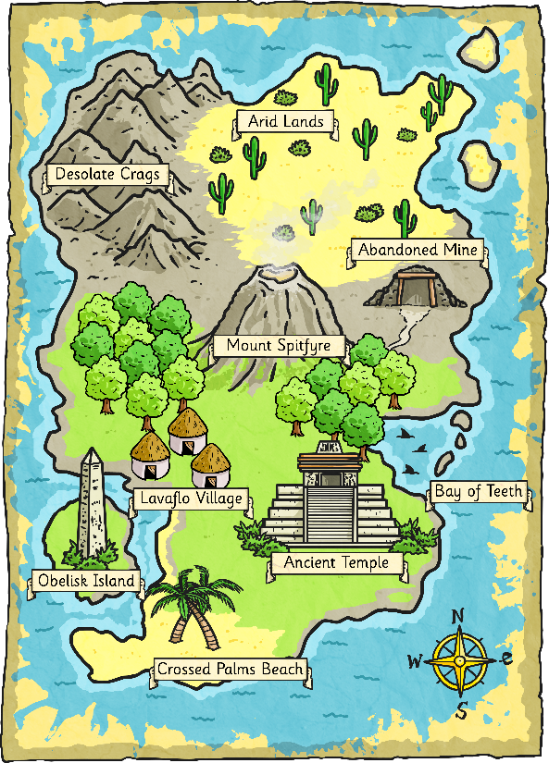
Designing Your Island
Now is your chance to design your island.
What will it be called? What geographical features will it have?
Look at these maps and the pictures of islands for some inspiration…

Slide 6
Task 2: First Impressions
You are approaching your new kingdom for the first time.
Whereabouts on your island would your boat dock? Which coast is that on?
Close your eyes and imagine…

Slide 7
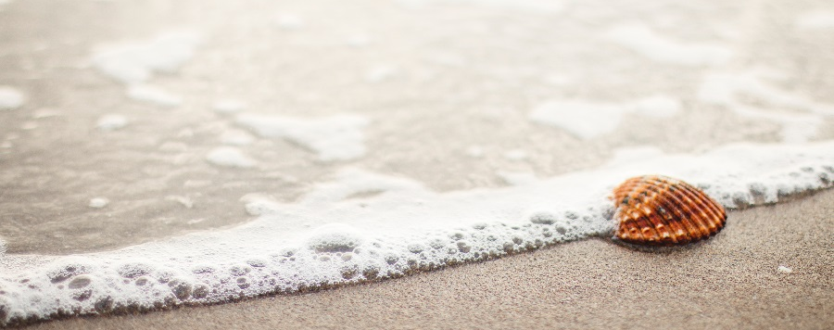
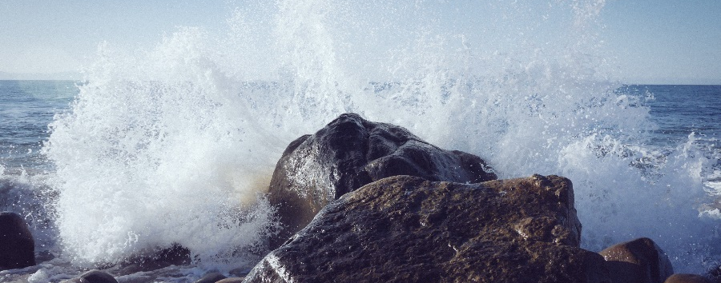
Use Your Senses
What can you see around you?
What can you smell?
What can you feel – With your fingers? Under your feet? Against your cheeks?
What can you hear?
How would you actually feel…
a sense of excitement? Nervousness? Accomplishment?

Slide 8
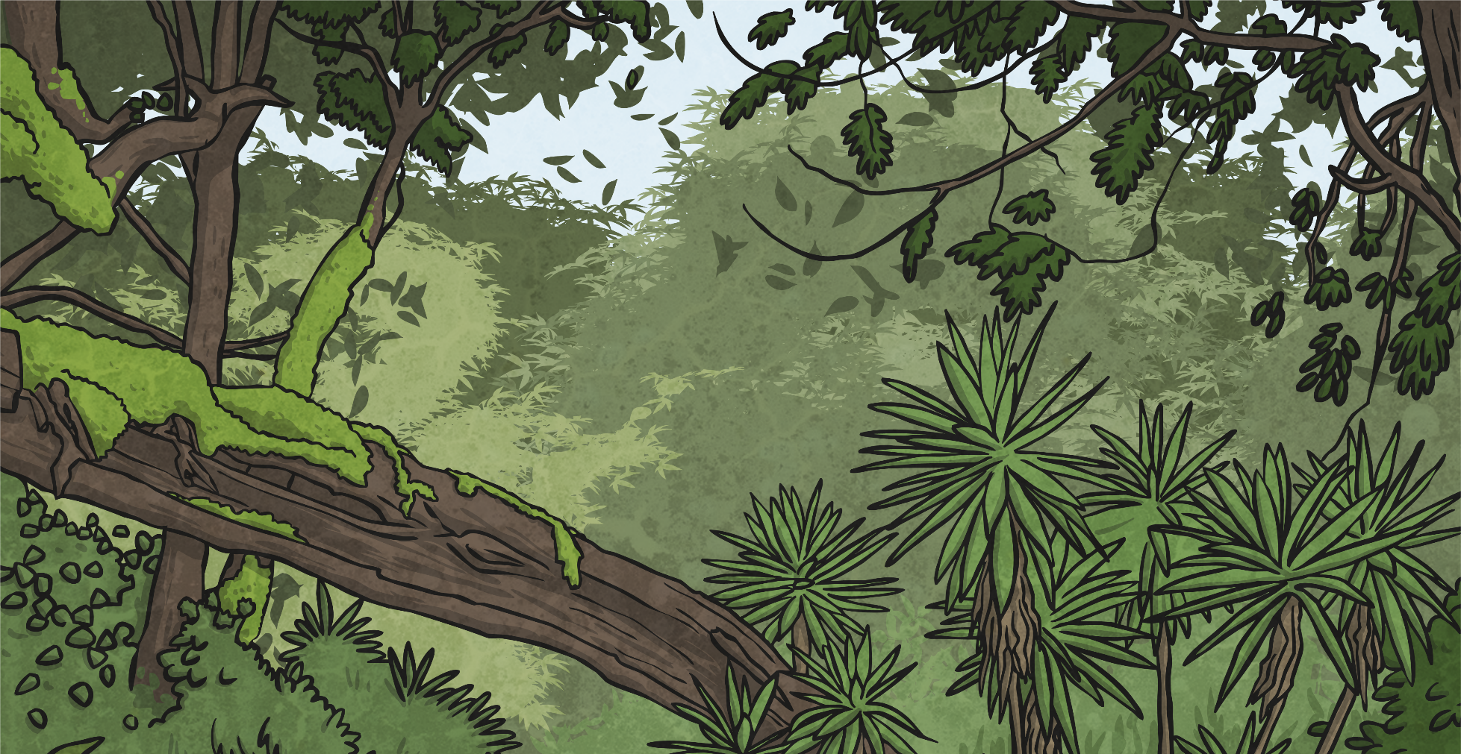
Collect Ambitious Vocabulary
Use the First Impressions: Use Your Senses Idea Collection Activity Sheet to write down all the words and phrases you can think of.
Use thesauruses and dictionaries to try and collect rich and ambitious vocabulary.
Share your ideas as a class.

Slide 9
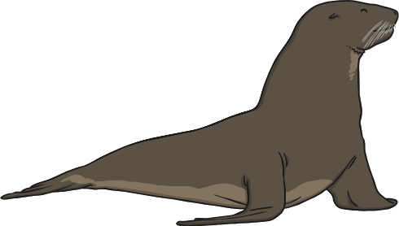
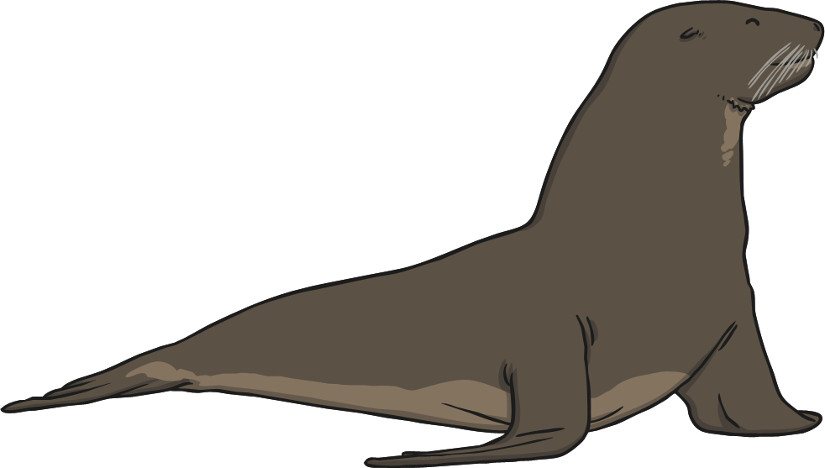
Use Your Ideas!
Now turn your ideas into a painting of your island. Remember to include extra details such as landmarks, animals etc.

Slide 10
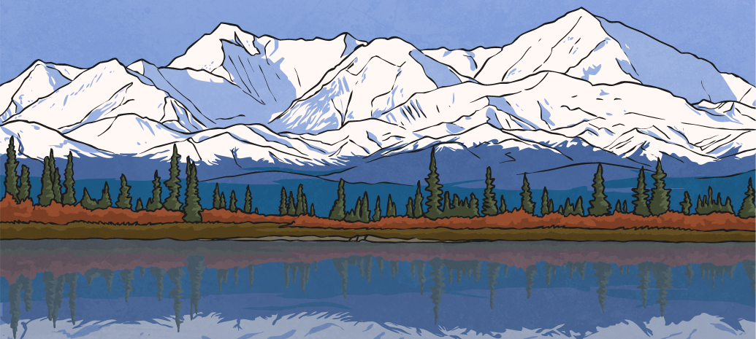
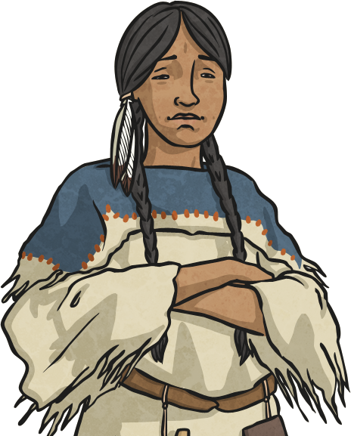
Task 3: Creating a National Identity
Every country in the world has its own distinctive traditions, culture and language. Your island currently has no identity, and now’s the time to start creating one.
In this lesson, you will design a national flag and a national anthem.

Slide 11
National Flags
The national flag of a country can often have a deep meaning and hold symbolic significance for the people of a nation.
Let’s test your flag knowledge – can you name the country that these national flags belong to?
Could you guess the meaning behind each one’s colours, symbols or shapes?

Slide 12
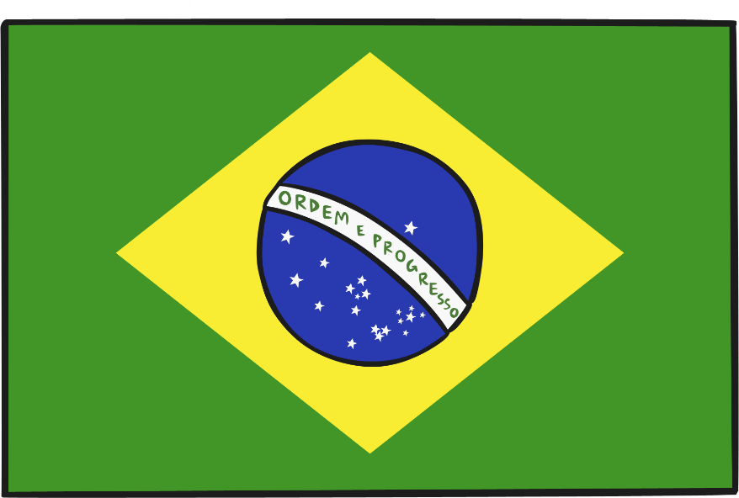
The National Flag of…
Do you know which country this flag belongs to?
Do you know the meaning behind it?
Each colour of the Brazilian flag symbolises something very important to Brazilian culture. The yellow represents the country’s gold reserves, the green represents the country’s tropical landscape and the blue is a globe with 27 white stars upon it (one for every district in Brazil).
Across the glove, the banner reads ‘Ordem E Progresso’, which is a Brazilian motto meaning ‘Order and Progress’.
Brazil

Slide 13
The National Flag of…
Do you know which country this flag belongs to?
Do you know the meaning behind it?
Again, the colours of this flag are significant to their people. The red is said to represent their brave soldiers, the green – their fertile land and the yellow – the country’s mineral deposits.
The ‘coat of arms’ in the middle of the flag is the country’s national symbol. It contains many other symbolic images, including their national animal (the llama), and laurel leaves to bring peace.
Bolivia

Slide 14
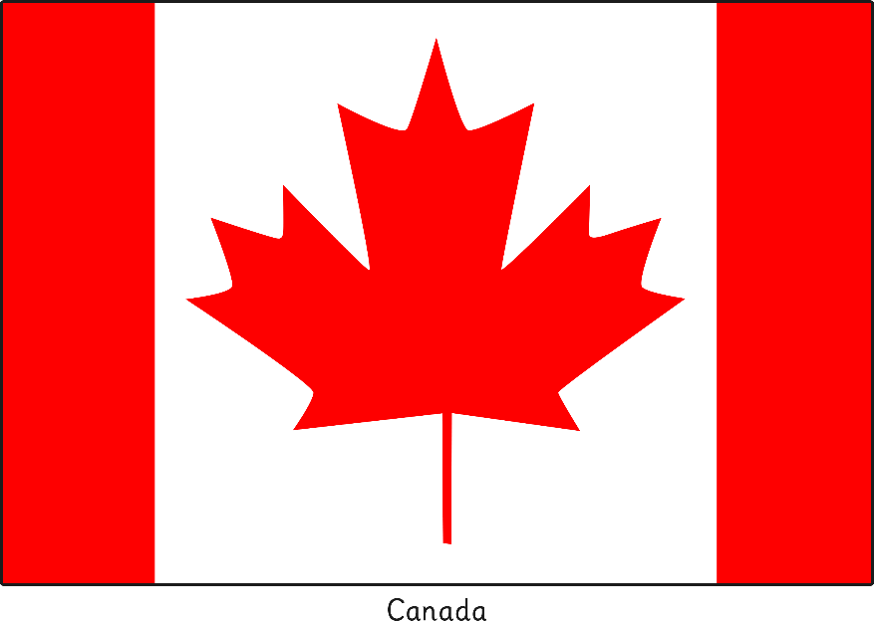
The National Flag of…
Do you know which country this flag belongs to?
Do you know the meaning behind it?
The red maple leaf has been the national symbol of Canada for over 150 years. For Canadian people, it is a symbol of unity, tolerance and peace.
Red and white are the official colours of Canada, proclaimed by King George V in 1921.
Canada

Slide 15
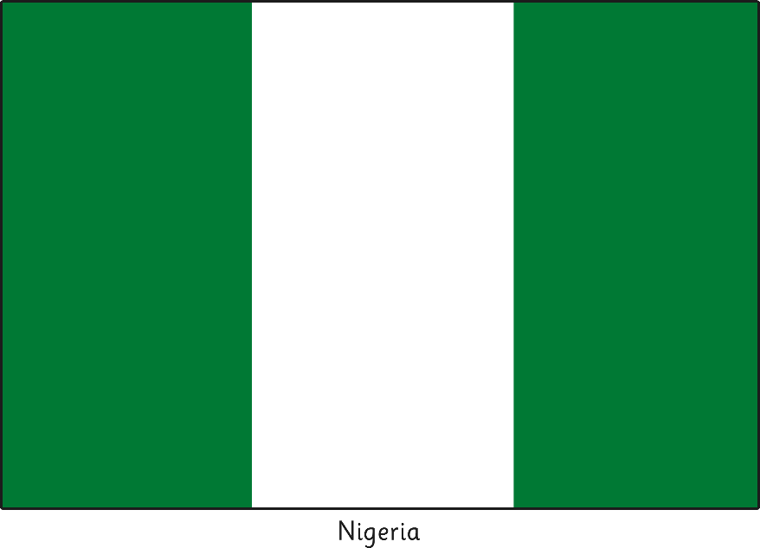
The National Flag of…
Do you know which country this flag belongs to?
Do you know the meaning behind it?
The green stripes of Nigeria’s flag represent their lush vegetation and its agriculture industry (that the Nigerians would call their natural wealth).
While the white stripe represents their desire for peace.
Nigeria

Slide 16
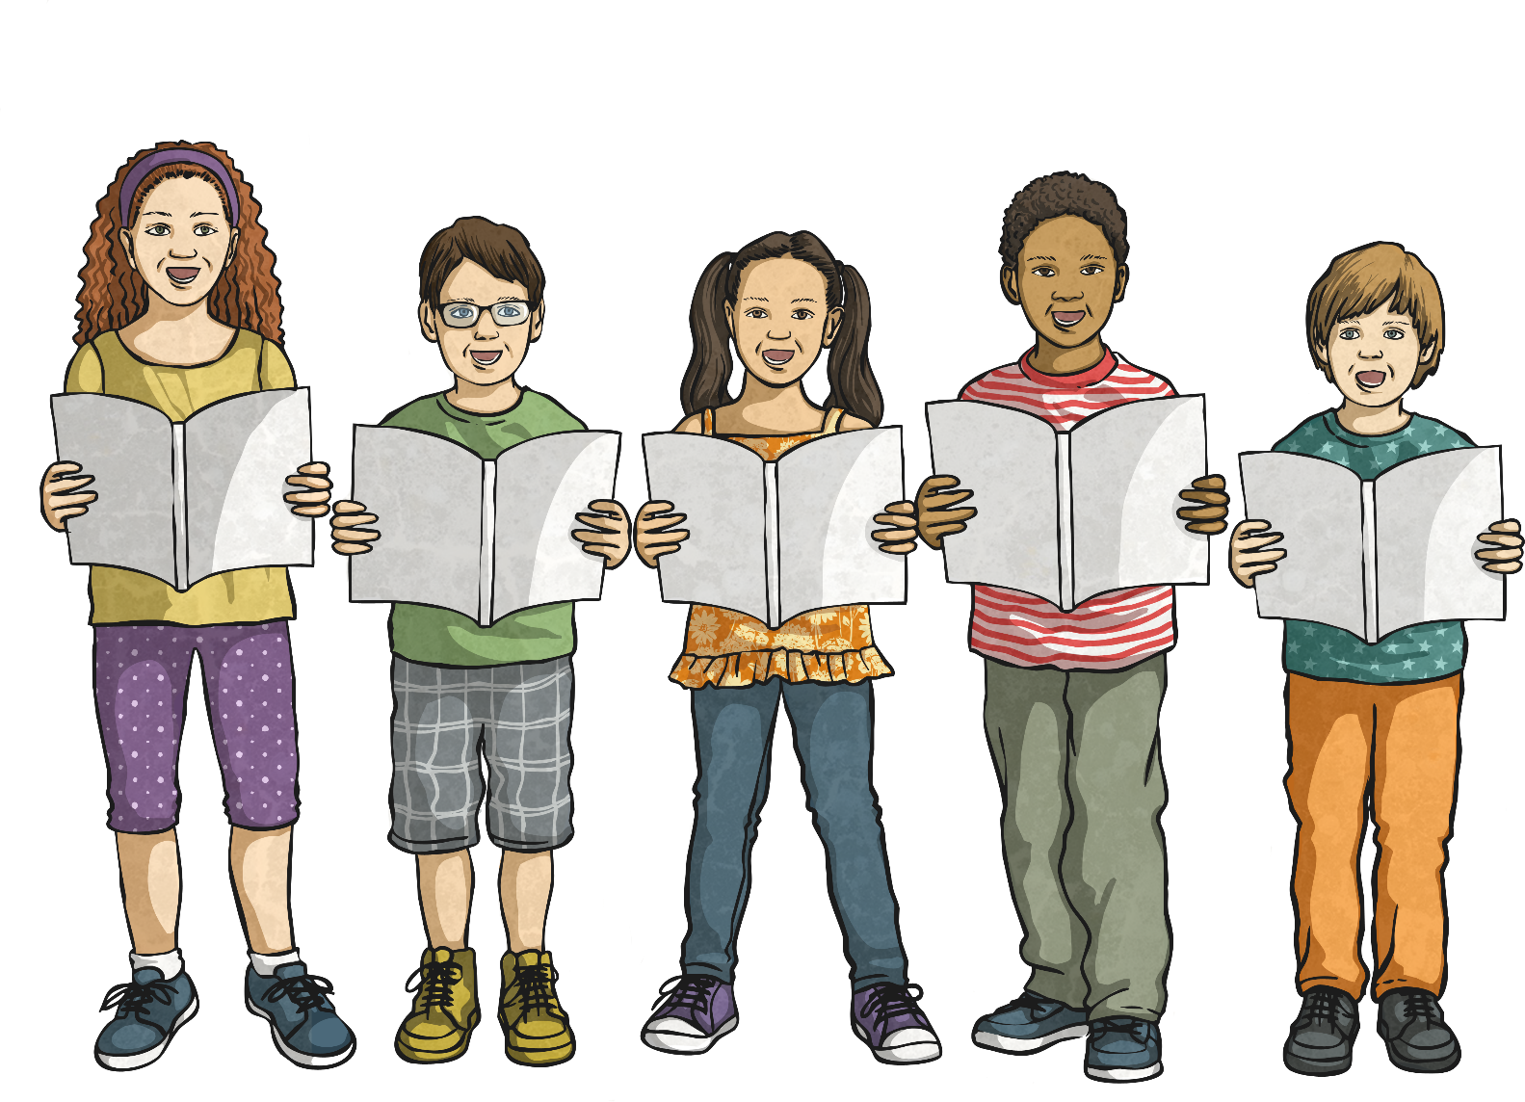
A National Anthem
A national anthem is a patriotic song that is officially adopted by a country as an expression of their national identity.
Do you know the national anthem for the country you live in?

Slide 17
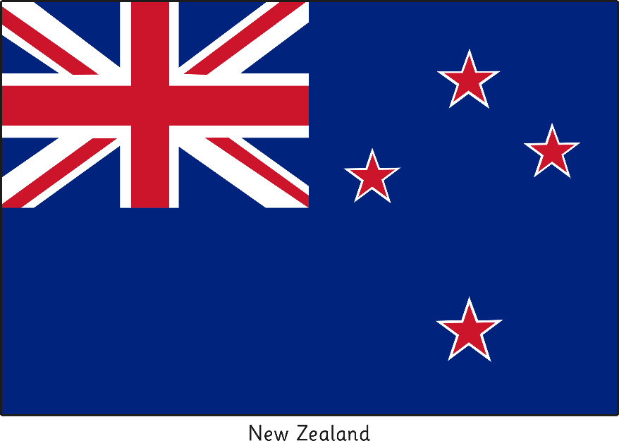
National Anthem Lyrics
The lyrics (words) of a national anthem often tell the story of a country’s history traditions and sometimes the struggles of its people.
Which country are these national anthem lyrics from?
Lord, God over yonder,
Of all our nations,
Listen to us gently,
With the infinite love,
May the goodness bear fruit;
May your kindness come;
Please give protection to
______________________.
New Zealand

Slide 18
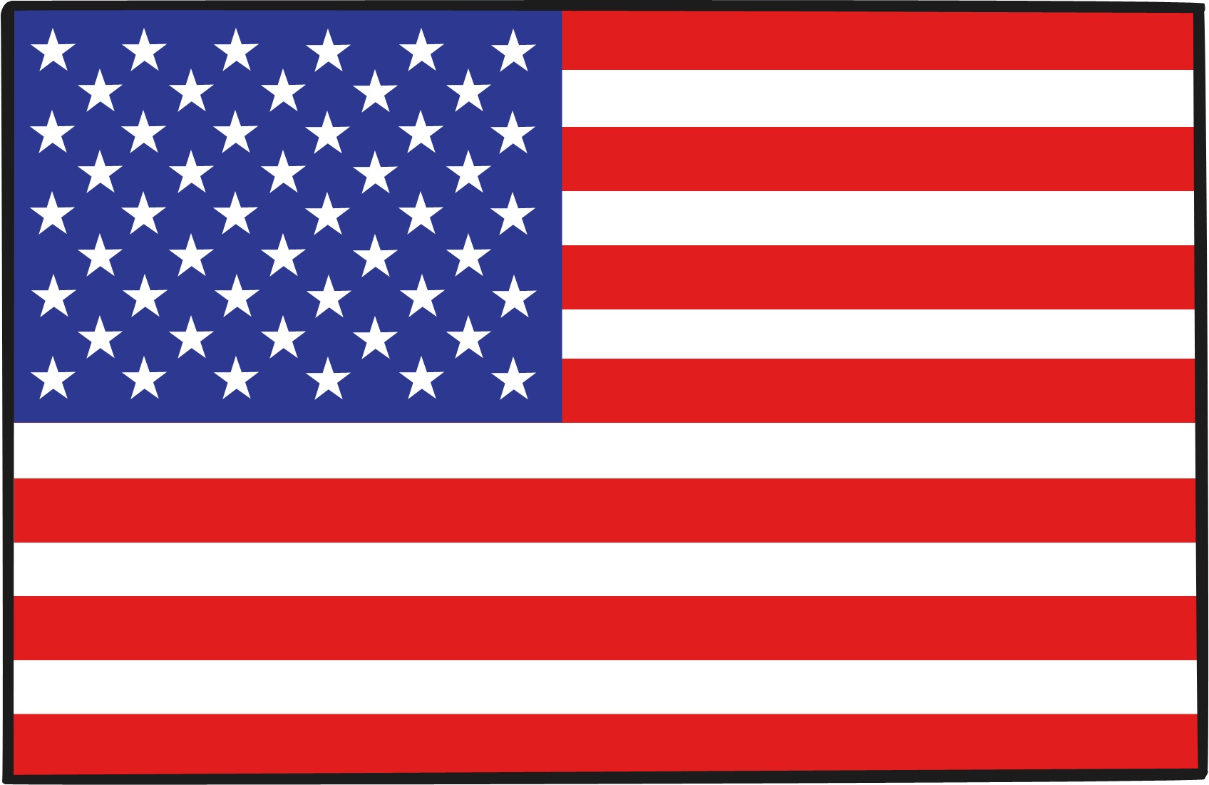
National Anthem Lyrics
Which country are these national anthem lyrics from?
What do you think they mean?
Oh, say! Can you see by the dawns early light
What so proudly we hailed at the twilights last gleaming;
Whose broad stripes and bright stars,
Through the perilous fight,
O’er the ramparts we watched were so gallantly streaming?
And the rocket’s red glare, the bombs bursting air,
Gave proof through the night that our flag was still there:
Oh say! Does that star-spangled banner yet wave
O’er the land of the free and the home of the brave?
United States of America

Slide 19
National Anthem Lyrics
Which country are these national anthem lyrics from?
What do you think they mean?
This land of my fathers is dear to me
Land of poets and singers, and people of stature
Her brave warriors, fine patriots
Shed their blood for freedom
Land! Land! I am true to my land!
As long as the sea serves as a wall for this pure, dear land
May the language endure forever.
Old land of the mountains, paradise of the poets,
Every valley, every cliff a beauty guards’
Through love of my country, enchanting voices will be
Her stream and rivers to me.
Wales

Slide 20
Composing Your National Anthem
You now need to think of some national anthem lyrics to symbolise your island.
They could relate to…
your island’s landscape;
your island’s history;
your island’s values or a country motto;
and/or
the person who discovered your island… you!

Slide 21
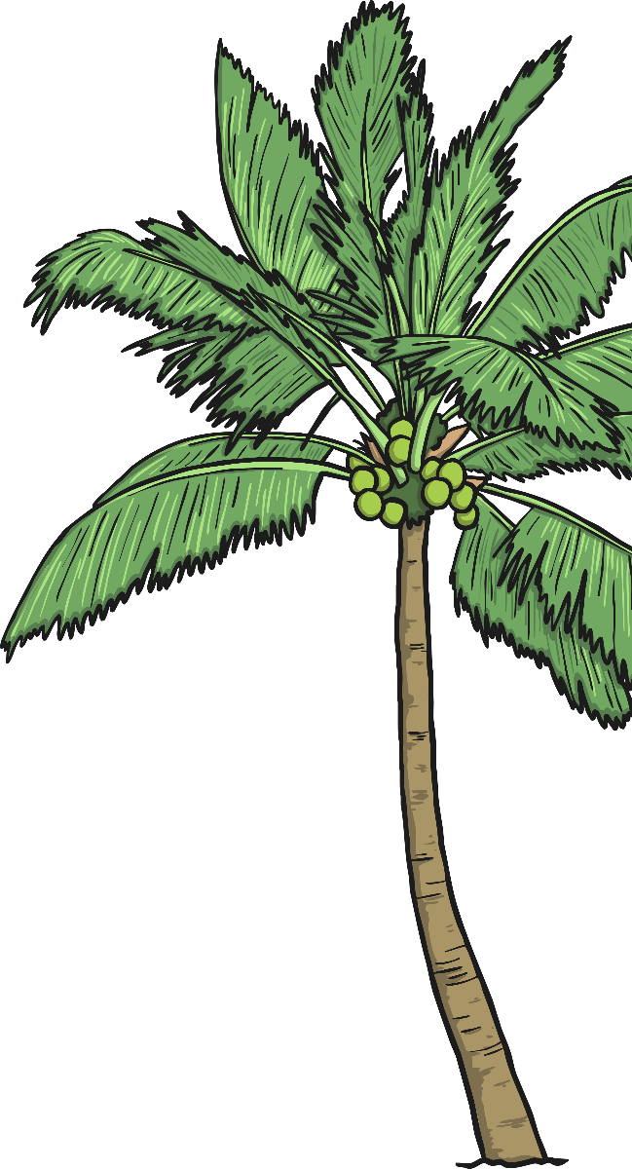
Your Nation’s Identity

