Slide 1
Adverbs
Describe the verb (add to the verb)
Tells you how, where or when a verb is performed
Find the verb, you find the adverb.
A lot of them end in ‘ly’ but there are plenty that don’t!
E.g. soon, yesterday, fast, almost.

Slide 2
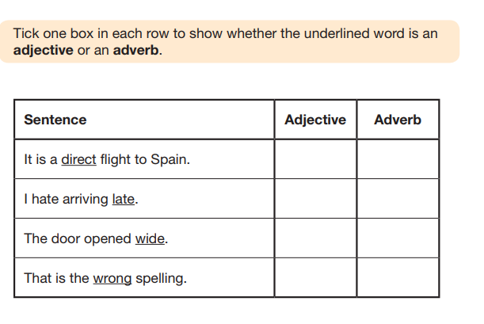

Slide 4
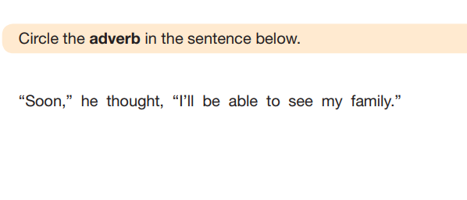
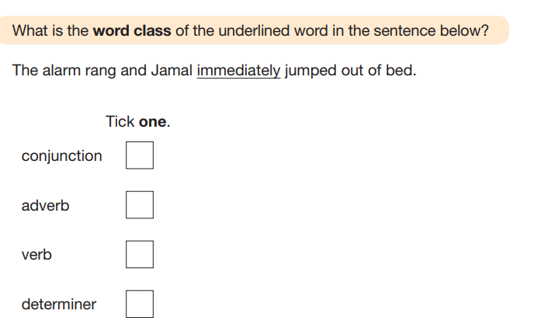

Slide 5
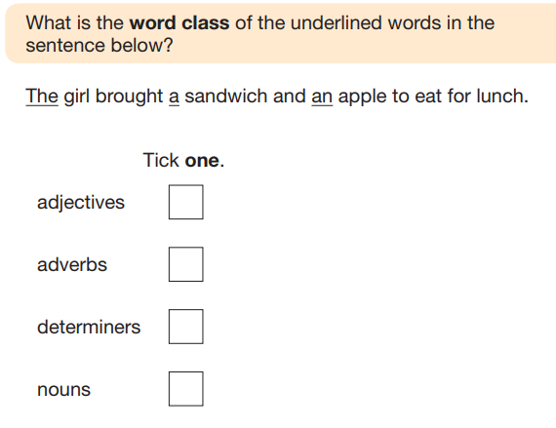

Slide 6
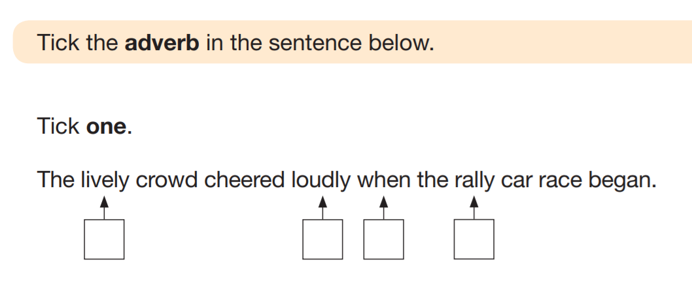
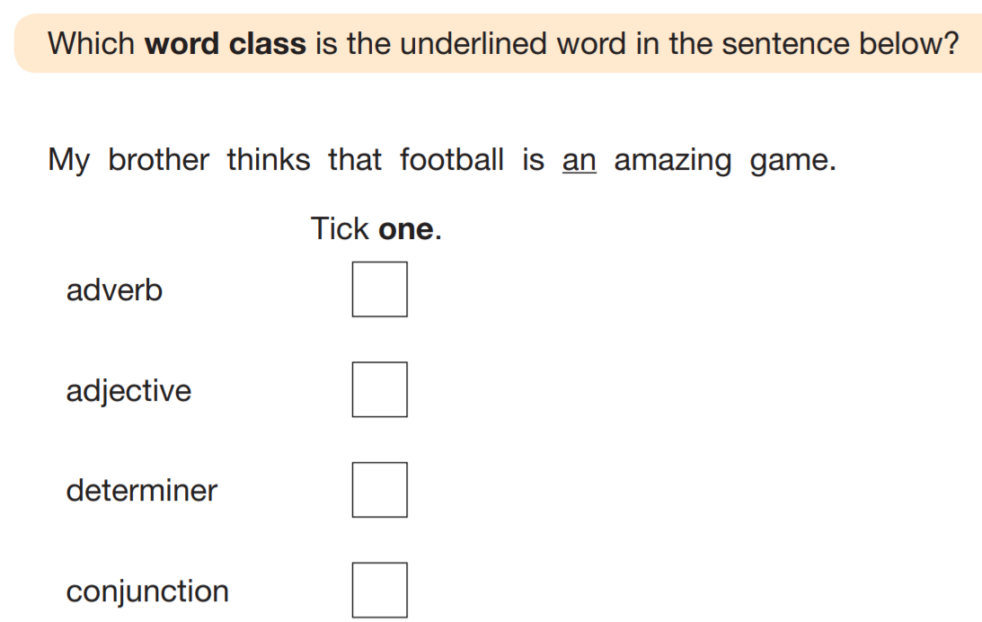

Slide 7
Nouns
A person, place or thing
Can include abstract nouns – nouns you can’t touch (love, joy)
Proper nouns are names and need capital letters (days of the week, months, countries, companies)

Slide 9
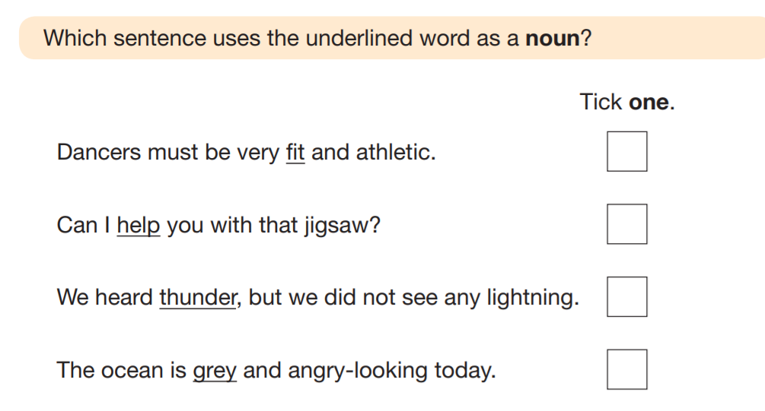

Slide 10
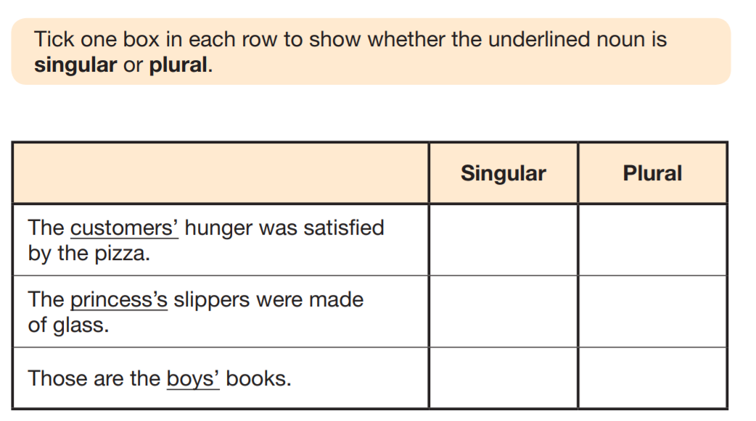

Slide 11
Adjectives
Adjectives describe a noun
Find the noun, find the adjectives!
They can go before or after a noun
E.g. The red pen or the pen is red.

Slide 12
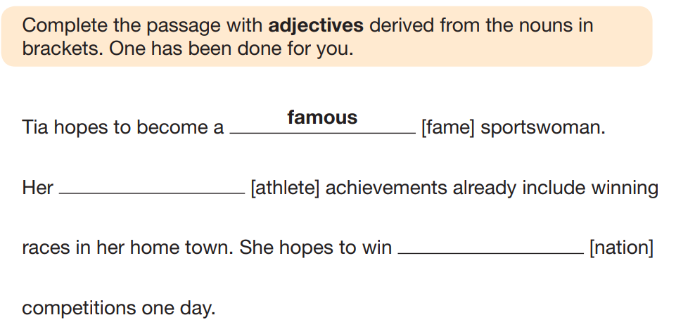

Slide 13
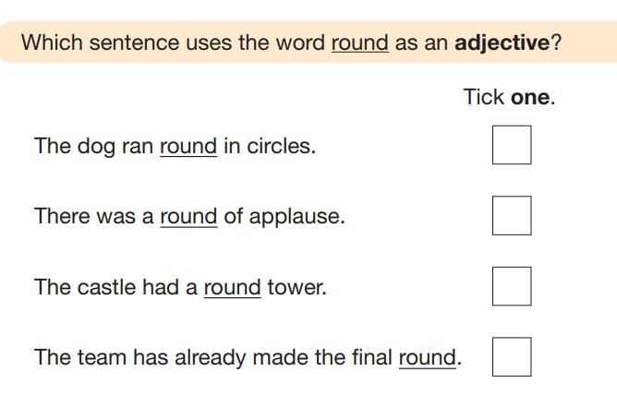
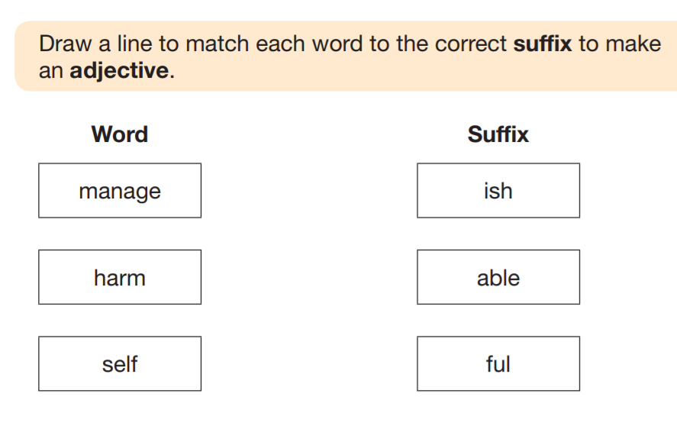

Slide 14
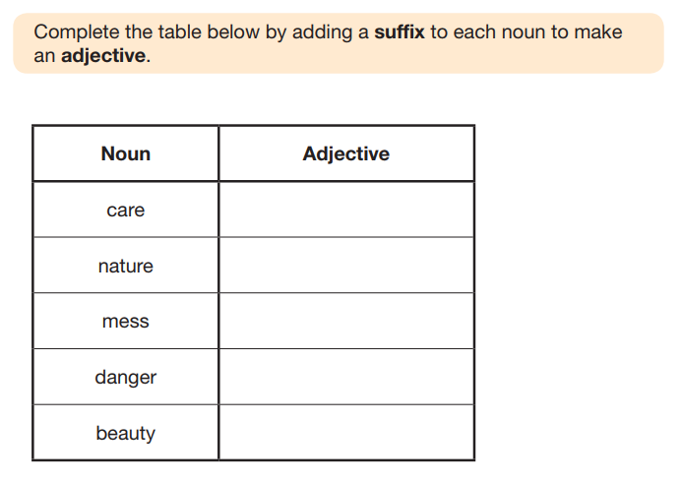

Slide 15
Verbs
They are doing words (jumping, throwing) or states of being (am, are, is, was, be)
A subject of a sentence performs the verb; find the subject, find the verb.
Tense questions are asking you about verbs – i.e. past tense, present perfect, progressive tenses
Verb form means the one or two words that form that tense!
E.g. verb form for past progressive =
He was jumping on the trampoline.

Slide 16
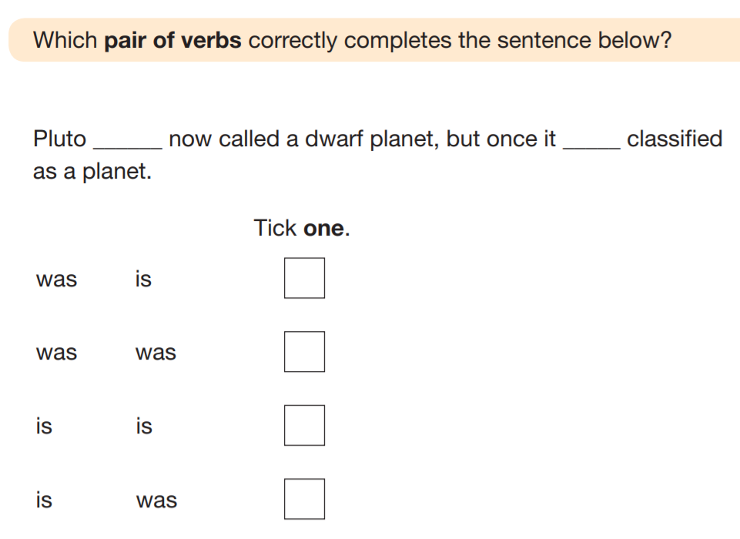
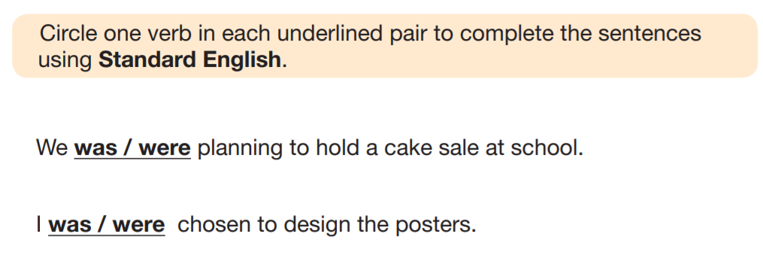

Slide 17
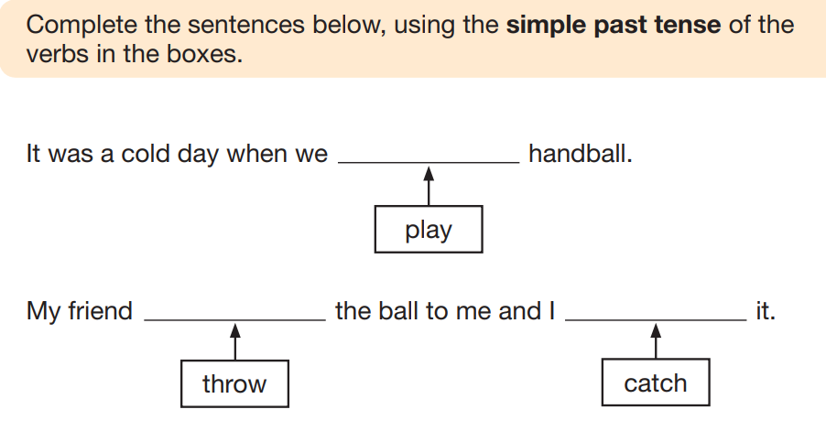

Slide 18
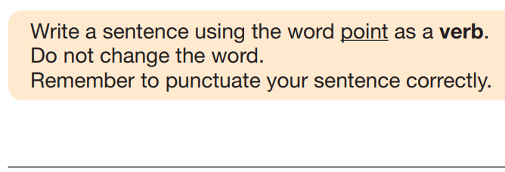
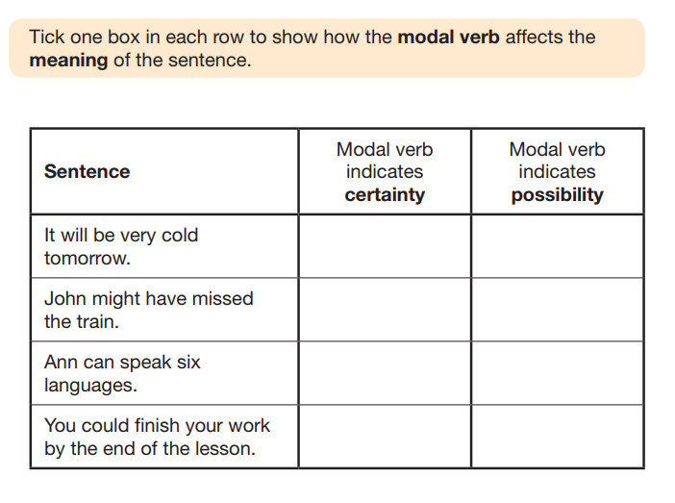

Slide 19
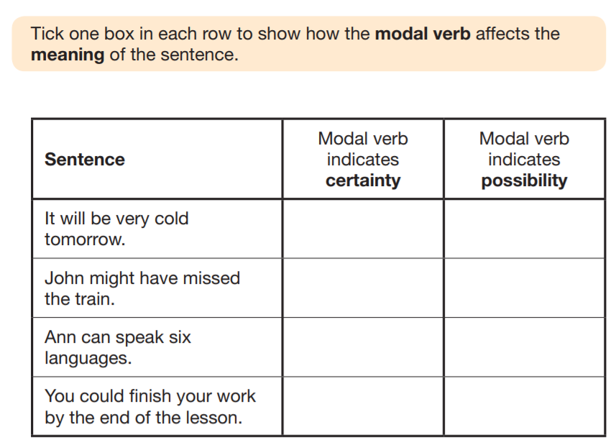

Slide 20
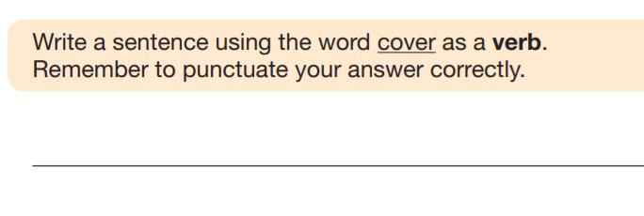
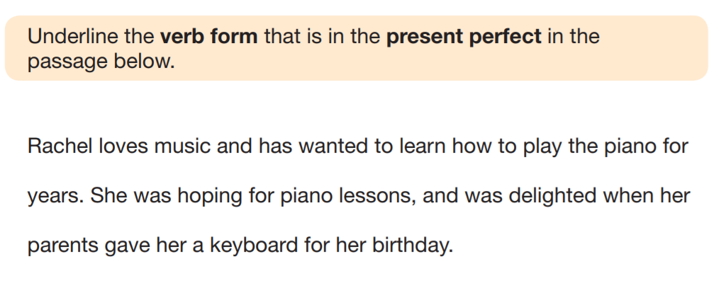

Slide 21
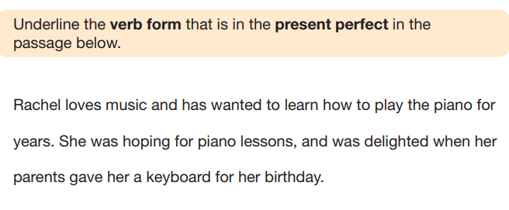

Slide 22
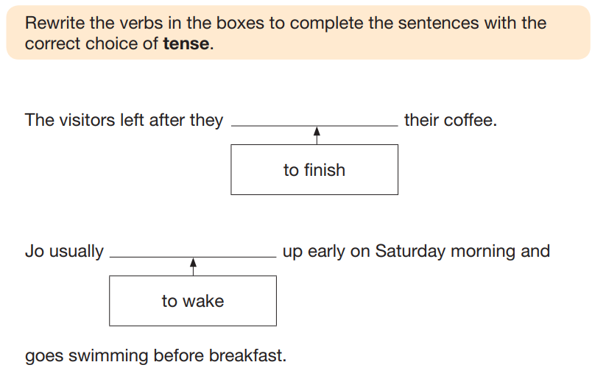

Slide 23
Pronouns
They replace nouns
There are three types:
personal (replace names)
possessive (show whose it is)
relative (start of relative clauses)

Slide 24
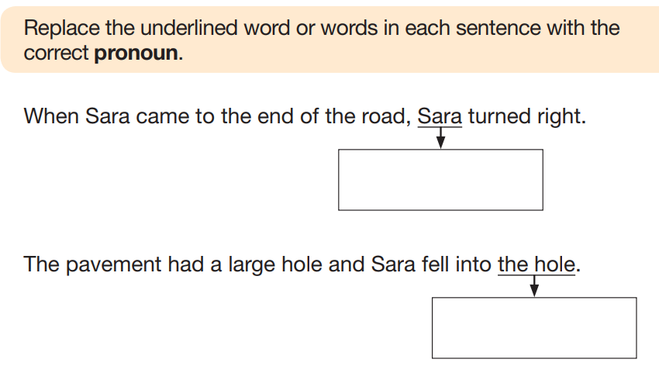

Slide 25
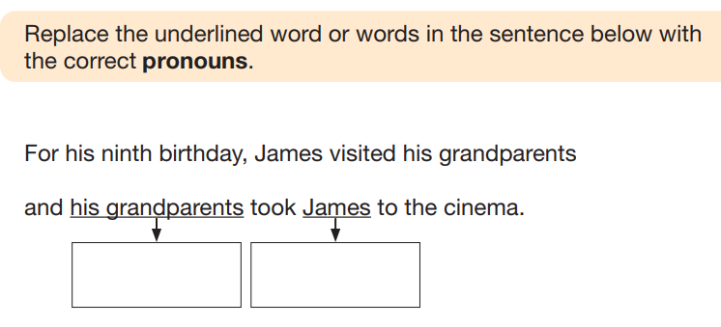

Slide 29
Prepositions
They link two things together through position or time
It is a prepositional phrase if it DOES NOT have a verb
Be careful – words like before and after can be prepositions and subordinating conjunctions!

Slide 30
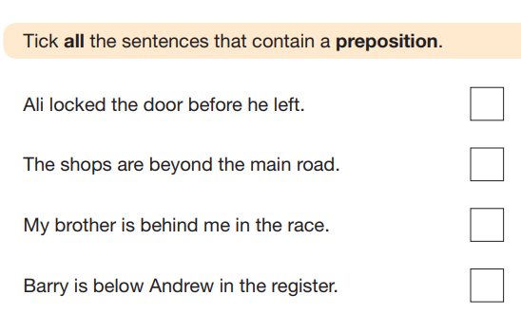

Slide 31
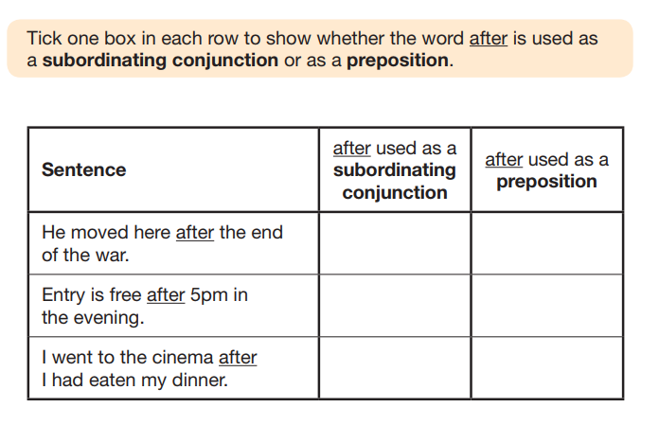

Slide 32
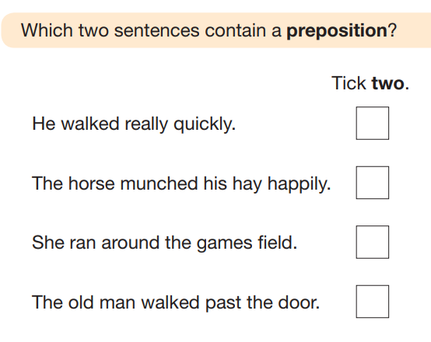

Slide 33
Determiners
They determine a noun – whose it is, how many there are, which one etc.
They go before a noun; find the noun, find the determiner!
Five types – quantifiers, articles, interrogatives, demonstratives and possessives
An is used before a word that starts with a vowel sound, not just a word that starts with a vowel
E.g. an hour (we don’t pronounce the ‘h’)

Slide 34
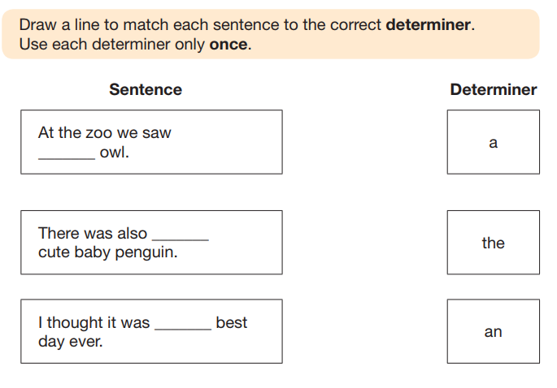

Slide 35
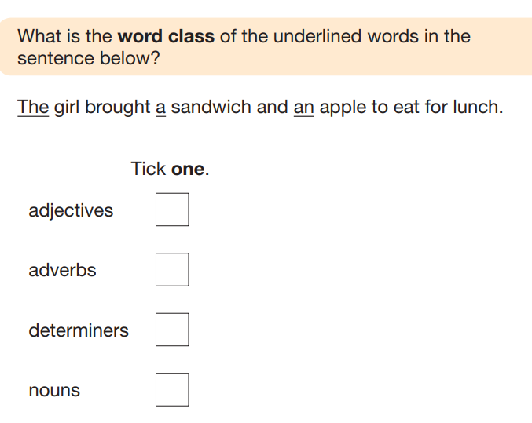

Slide 36
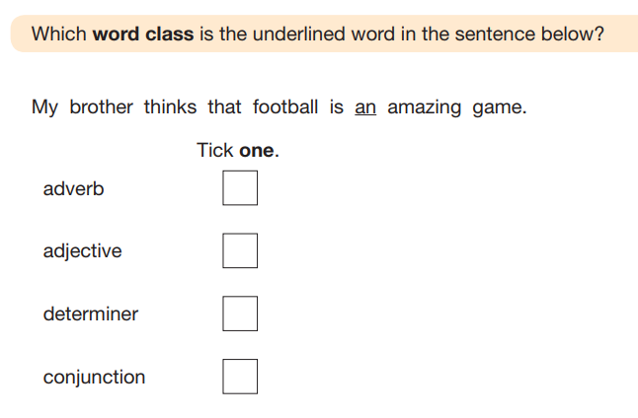

Slide 37
Conjunctions – 2 types
Co-ordinating – join two main clauses – sentences that make sense by themselves – FANBOYS
Subordinating – join a main and a subordinate clause – always go at the start of a subordinate clause – as, if, unless, until, when, since, before, after, because, although
(before and after can be used as prepositions too!)

Slide 38
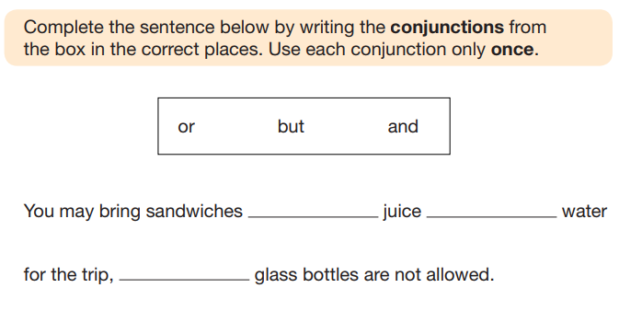
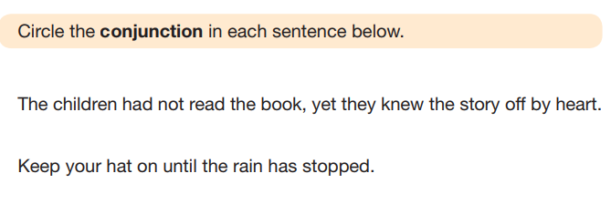

Slide 41
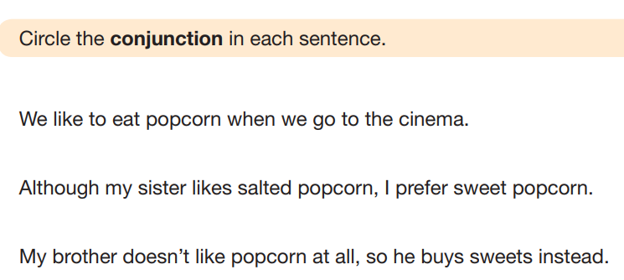

Slide 42
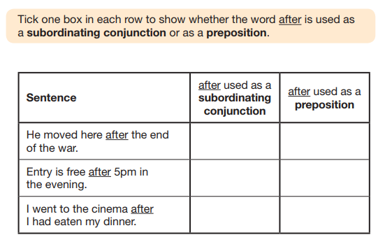

Slide 43
Subject and Object
Subject – performs the verb
Object – has the verb done to it
Both can go at the start or end of the sentence depending on whether it is active or passive
Active – SVO Passive – OVS
Label the S, V and O to determine whether it is passive or active

Slide 44
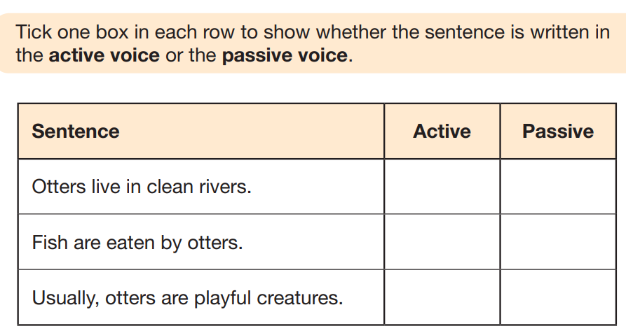
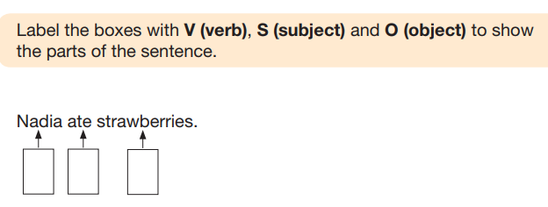

Slide 45
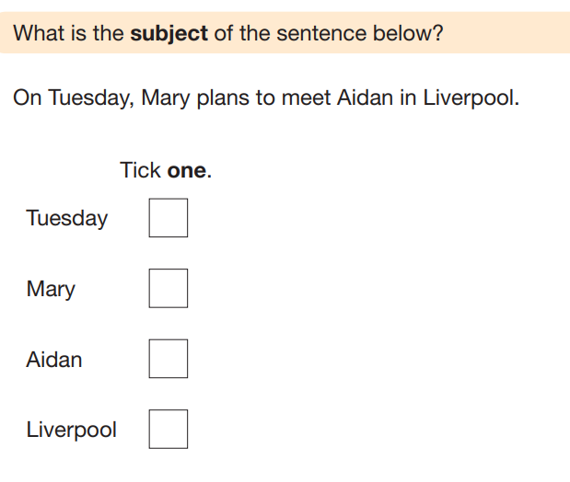

Slide 46
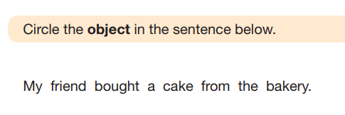

Slide 47
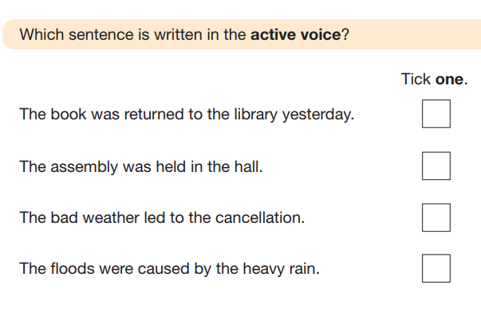
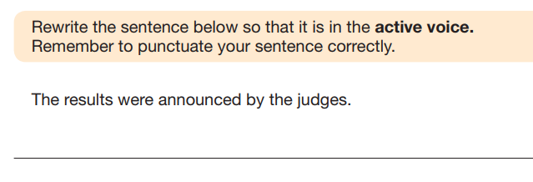

Slide 48
