Slide 1
Learning Objectives:
know the difference between primary
and secondary sources
use a source and its provenance to
gather information

Slide 2
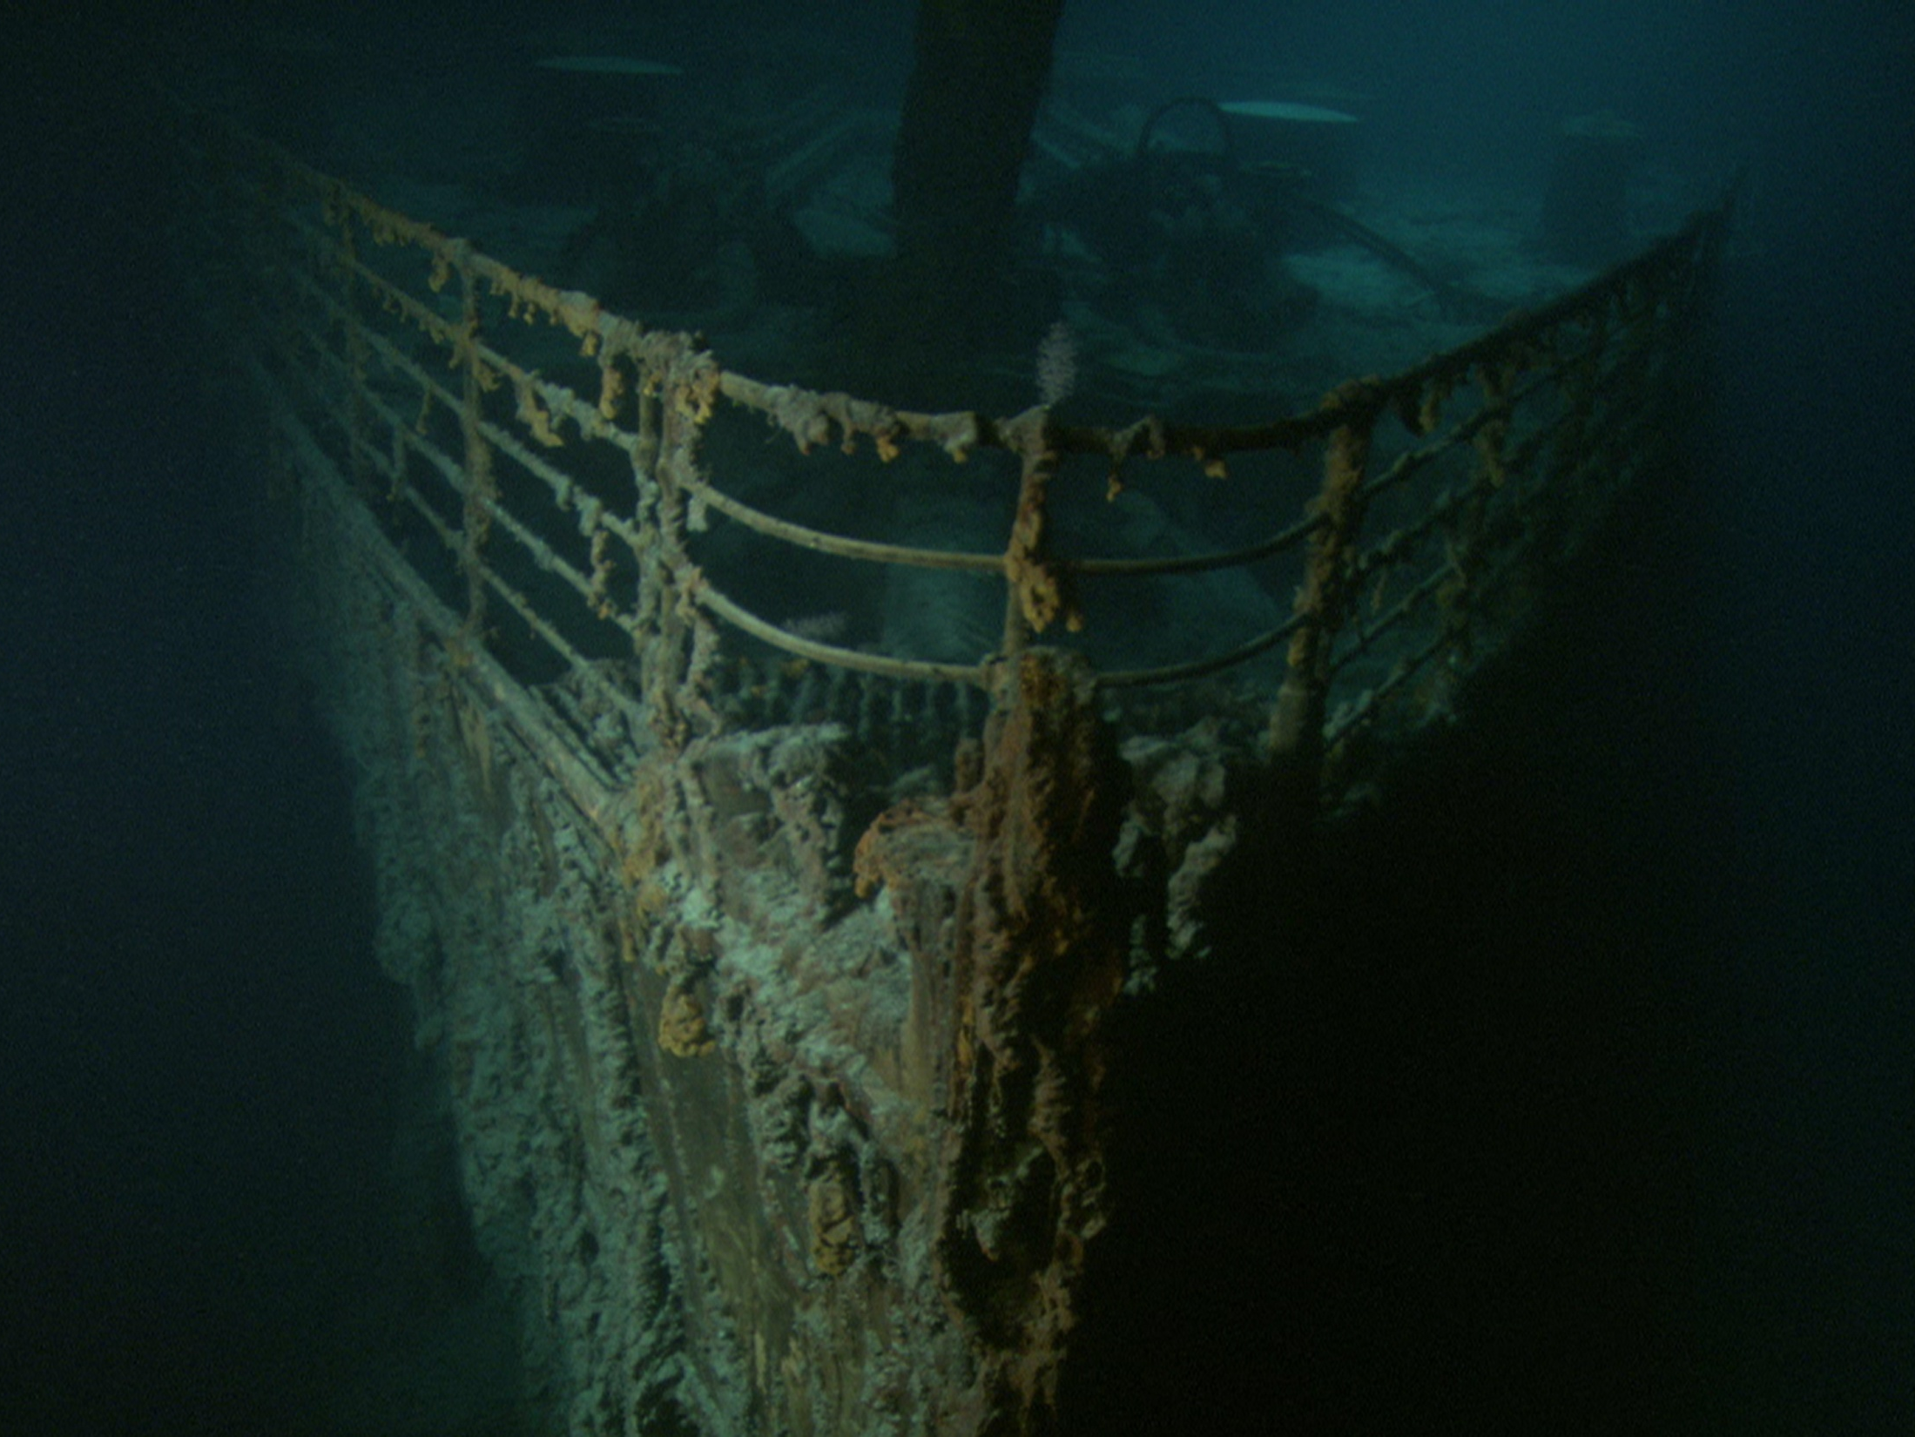
TITANIC
1912 - 2012
Notes:
Titanic lies 2 and a half miles below the surface of the Atlantic. It was discovered in 1986 by Robert Ballard. No attempts to raise the ship have ever been attempted. It is in two parts, each lying a mile apart with debris scattered over the ocean bed. The wreck is slowly being eaten away by rusticles and may collapse to the ocean floor within the next century.

Slide 3
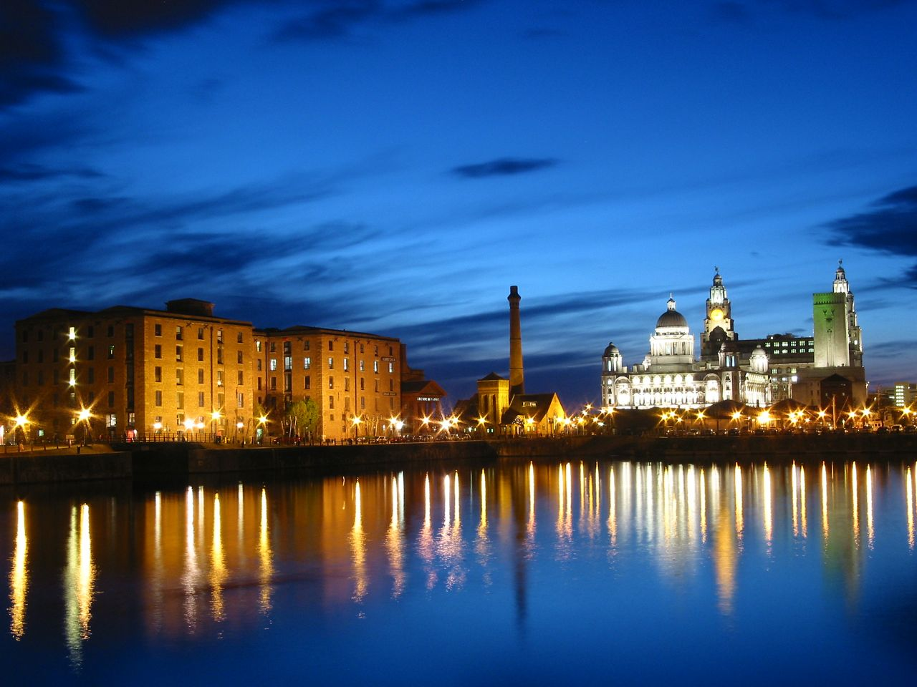
Liverpool Docks
Notes:
Titanic’s story begins in Liverpool.

Slide 4
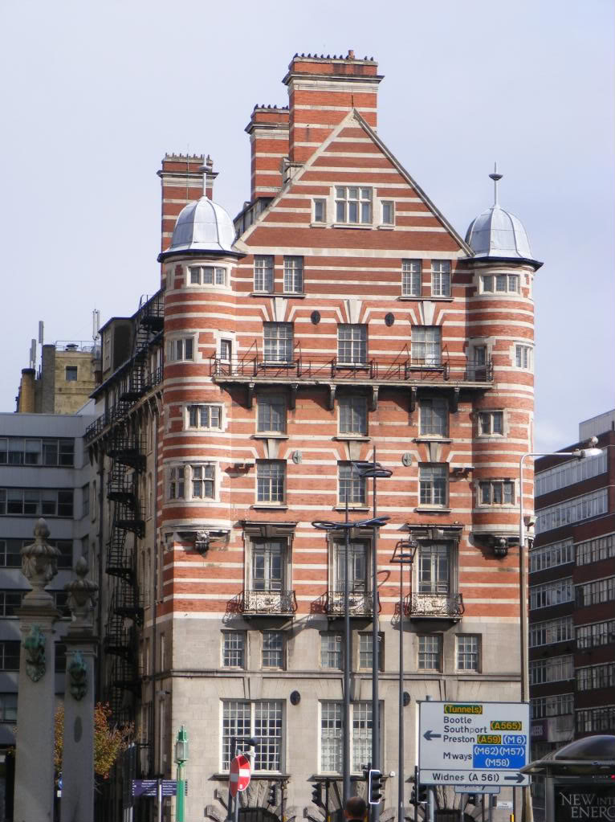
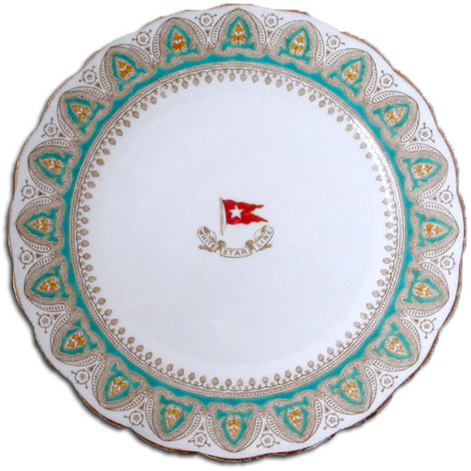
White Star Line
Notes:
The White Star Line was one of two major shipping companies in Edwardian Britain. Their offices still stand, though dormant, in Liverpool.

Slide 5
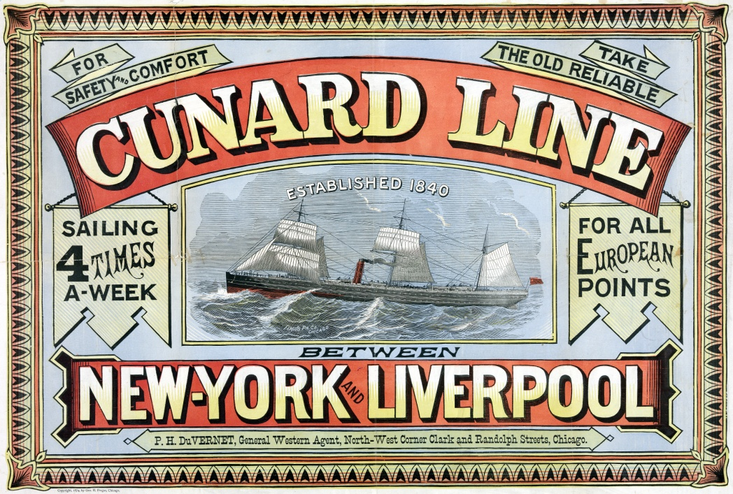
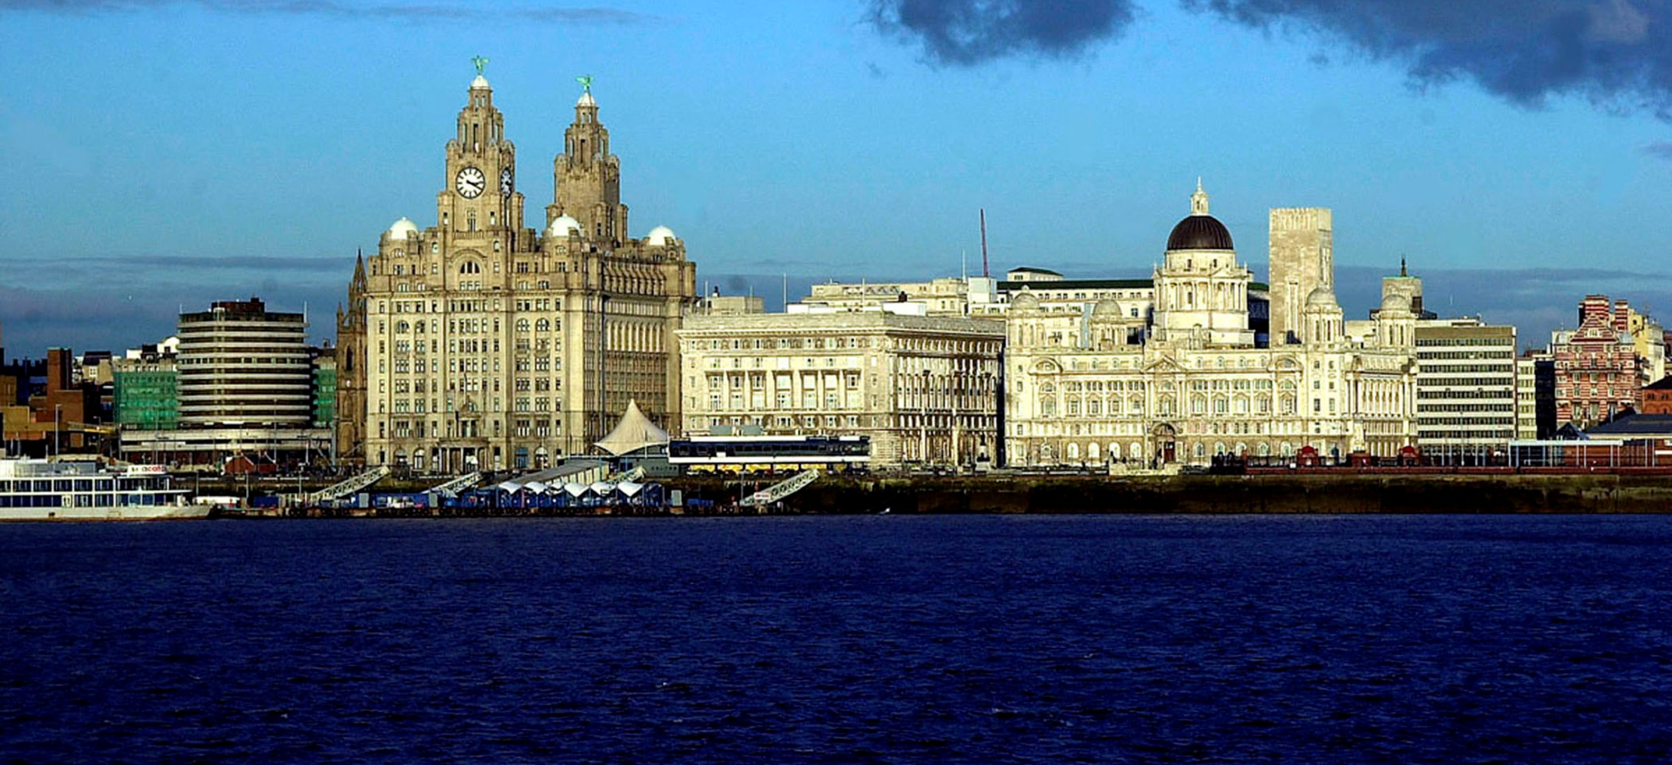
Cunard Line
Cunard Line
Notes:
White Star’s main rival was Cunard, whose flagships, Lusitania and Mauretania, held the Blue Riband for record speed crossing the Atlantic. They were the largest and most luxurious liners of their day. Likewise, the Cunard offices sit in the middle of the Three Graces on Liverpool’s waterfront, dormant.

Slide 6
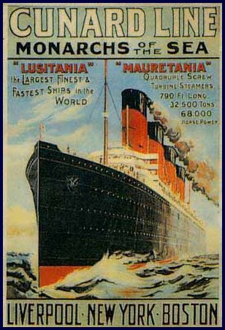
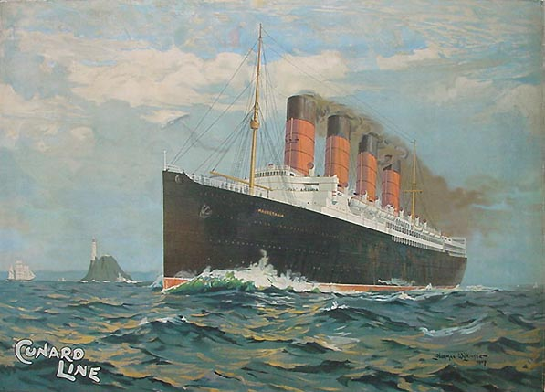
R.M.S. Mauretania
Notes:
R.M.S. Mauretania held the Atlantic crossing record until 1929.

Slide 7
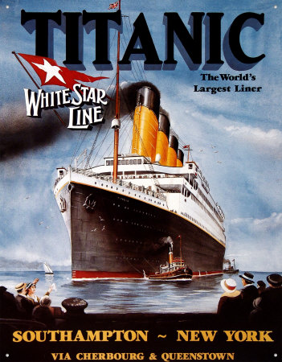
Notes:
In 1911, in a bid to out-do their rivals, White Star set about designing the largest set of ships in the world: three sister ships named after Greek Gods Olympic, Titanic and Britannic. Only Olympic survived past 1916.

Slide 8
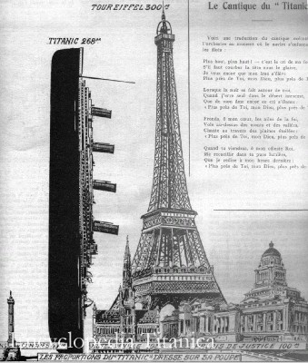
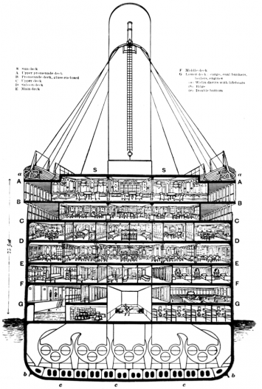
Notes:
The ships were set to be the largest moving structures ever built.

Slide 9
Notes:
Despite all the pomp that followed in advertising, the designs of the ships were fairly standard for the time. They were each sectioned into sixteen ‘watertight’ compartments.

Slide 10
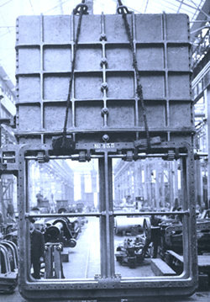
Watertight doors
Watertight compartments
Notes:
These compartments were connected to one another via a series of electronically operated doors which would close in the event of flooding. However, unlike Lusitania and Mauretania’s watertight bulkheads which went right up to the deck, Titanic’s only went up to E deck...

Slide 11
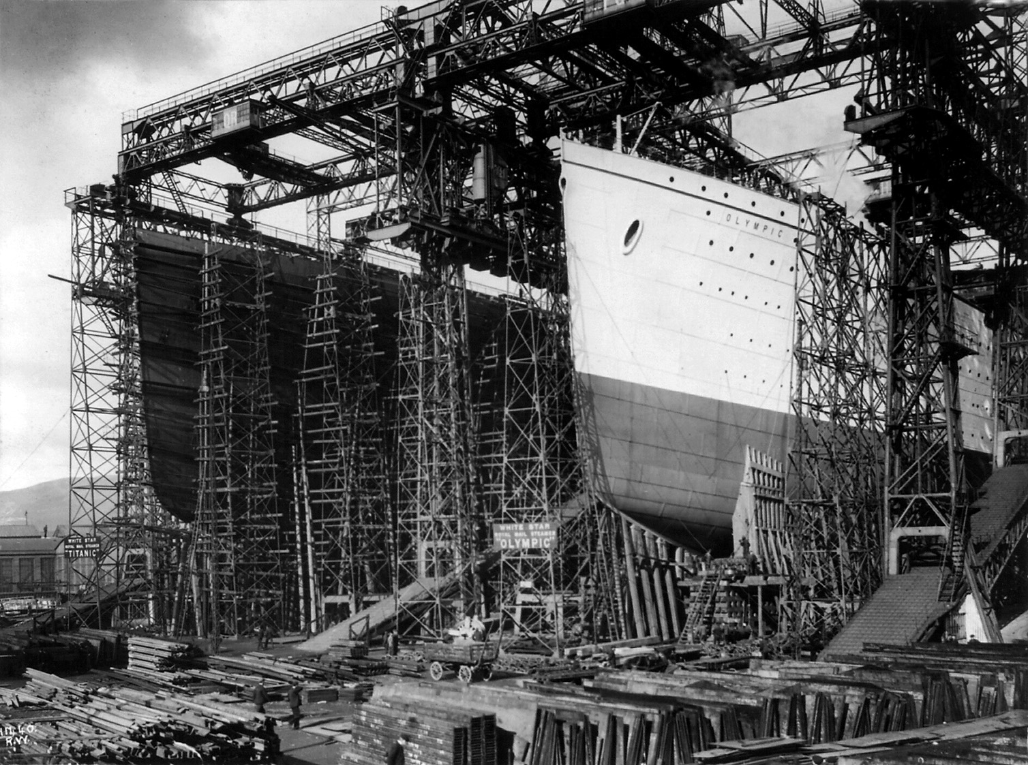
Titanic and Olympic
under construction
Notes:
The two sister ships were constructed side by side in Harland and Wolff’s shipyard in Belfast in 1911.

Slide 12
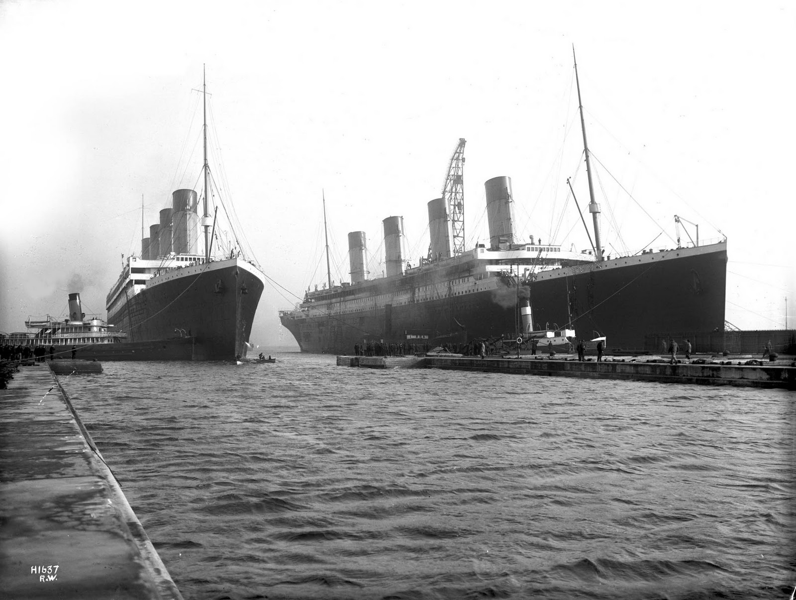
Titanic and her sister, Olympic.
Two nearly identical ships.
Notes:
Olympic set sail in 1911 and remained in service until 1935. She served as the ‘dry run’ for Titanic. Several improvements were made to Titanic after the Olympic’s first run, such as encasing the A deck in windows. Mainly though, they were identical.

Slide 13
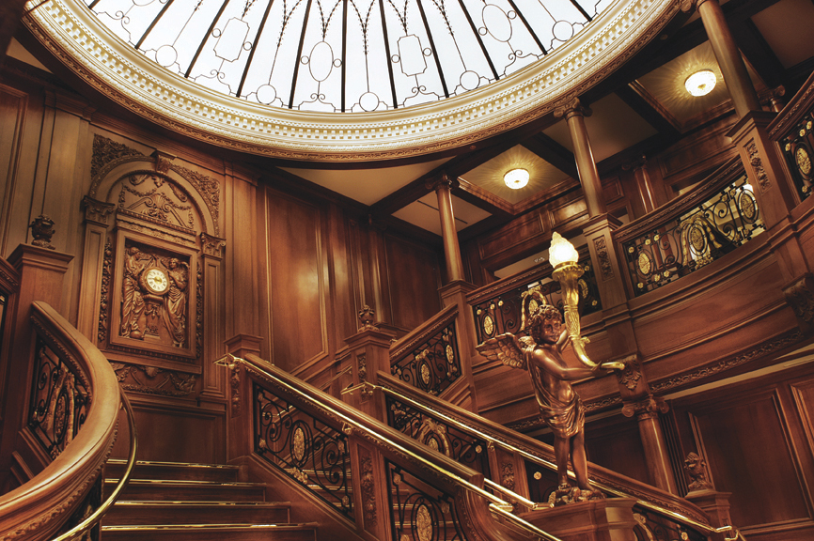
First class
‘grand staircase’
Notes:
Titanic’s interiors were fashioned after grand hotels.

Slide 14
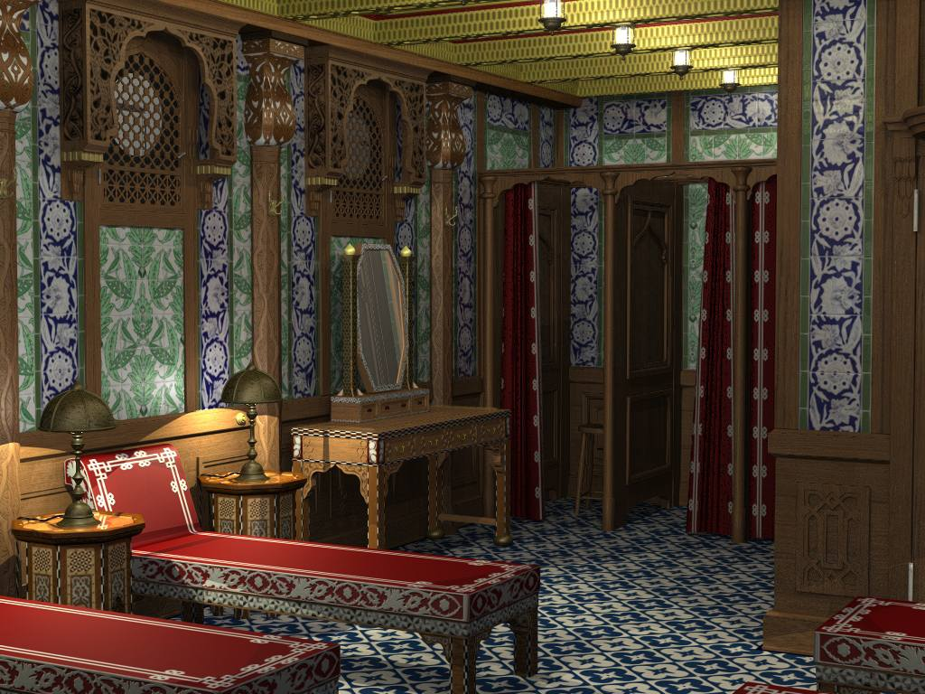
First class Turkish bath
Notes:
The ship had a Turkish steam bath, swimming pool, squash courts and reading room open for the recreation of first class passengers.

Slide 15
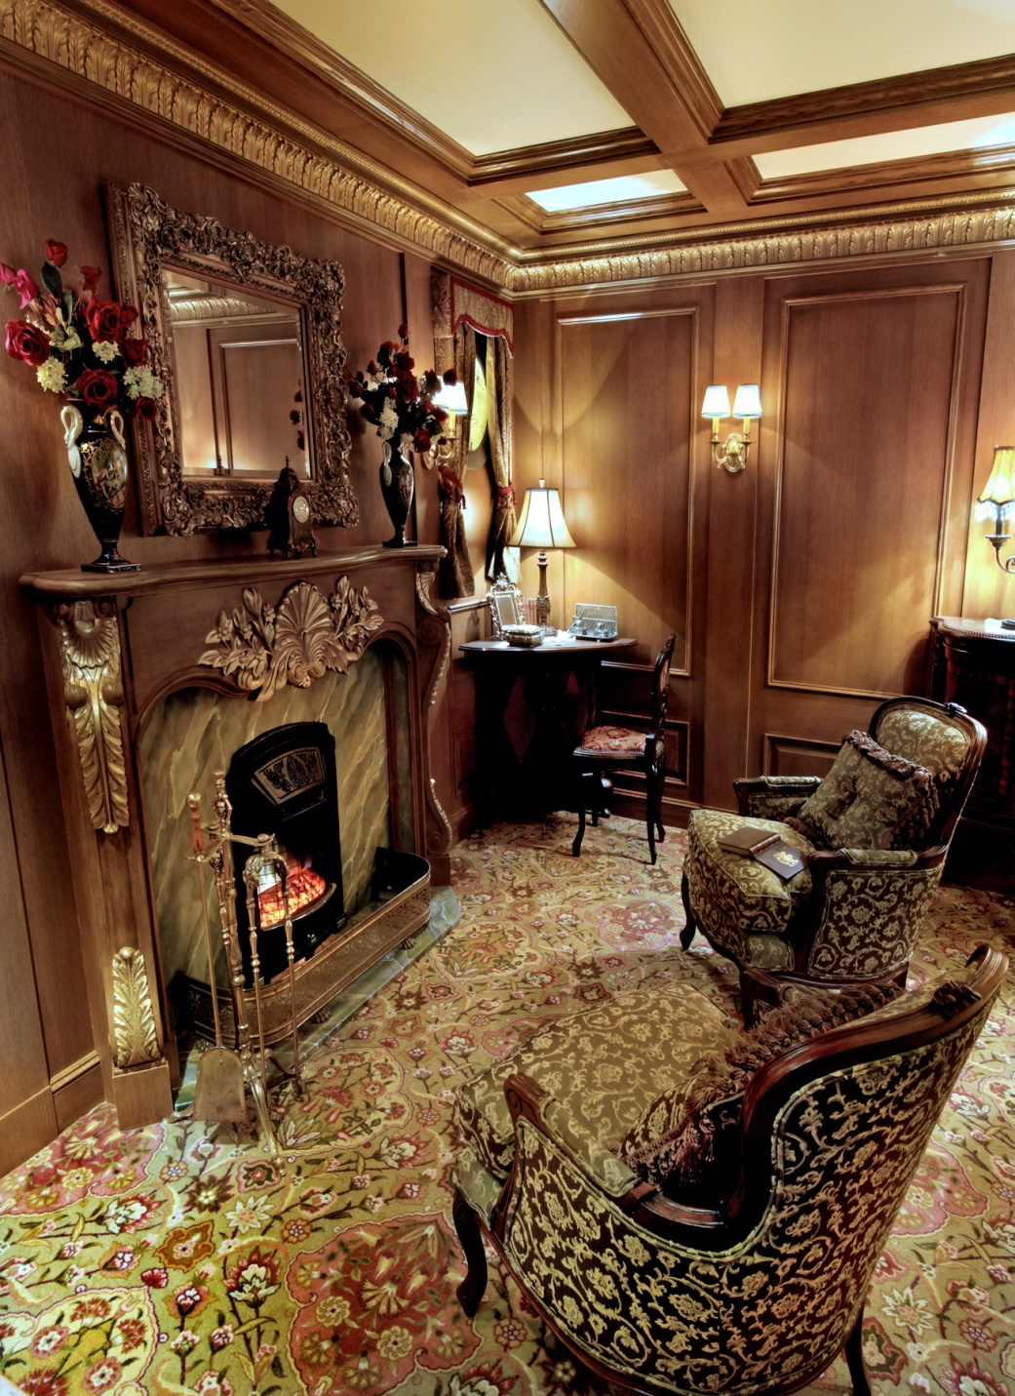
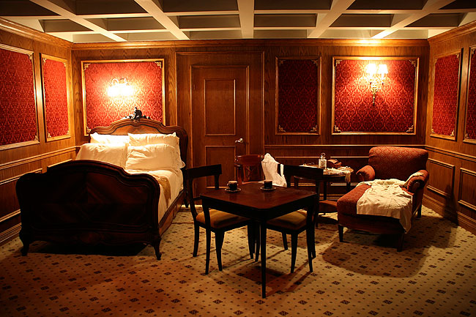
First class
cabins
Notes:
A first class ticket could cost around £80’000 in today’s currency.

Slide 16
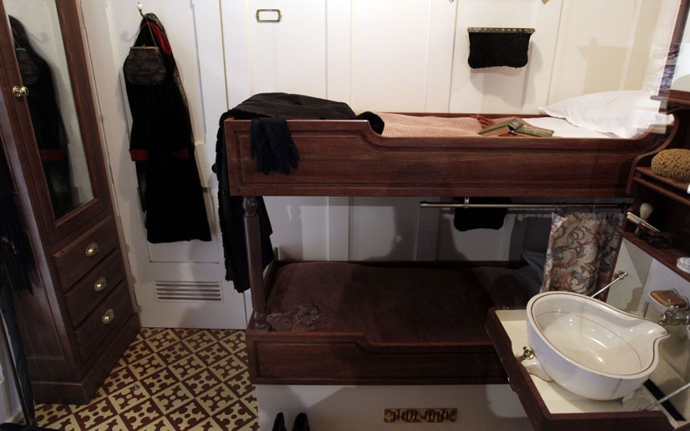
Second class cabin
Notes:
Second class cabins were similar to third class, but private. They were travelled in by the likes of teachers, lawyers and professionals. Titanic was the first ship to have an electric elevator in second class – a comparative luxury!

Slide 17
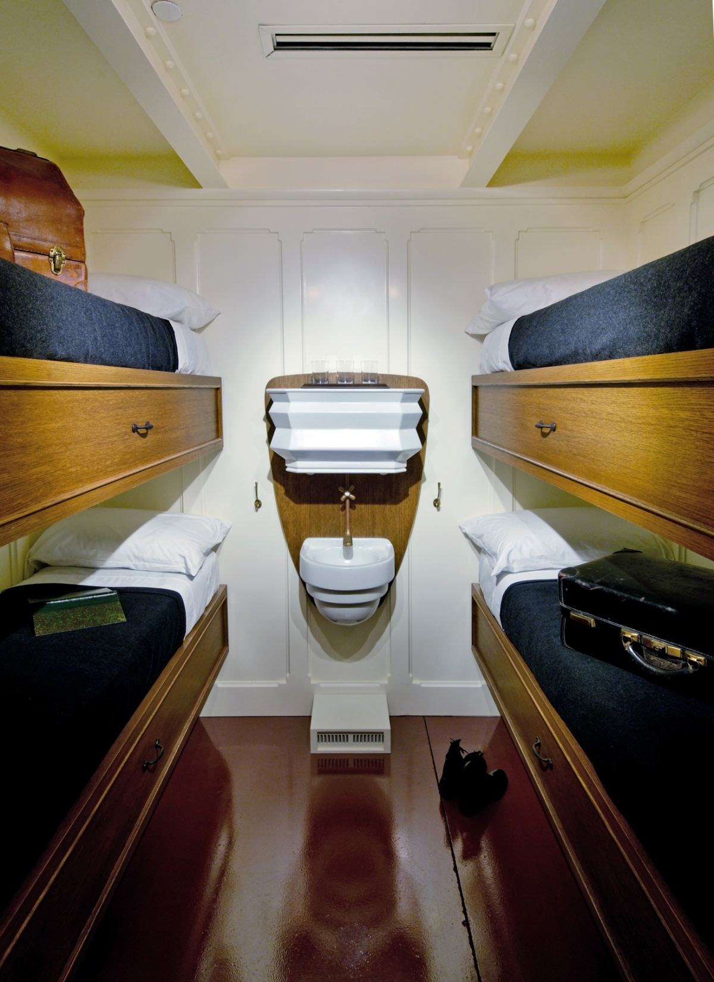
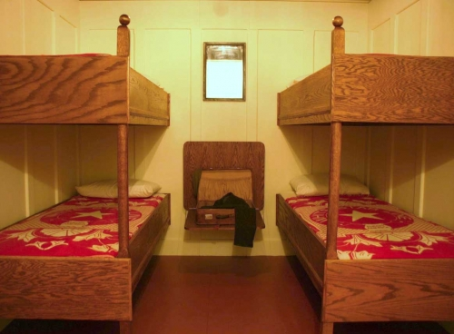
Third class
cabins
Notes:
Immigrants in search of a new life travelled in reasonable comfort in third class. Third class contained social areas and deck space, making the seven day trip manageable for families.

Slide 18
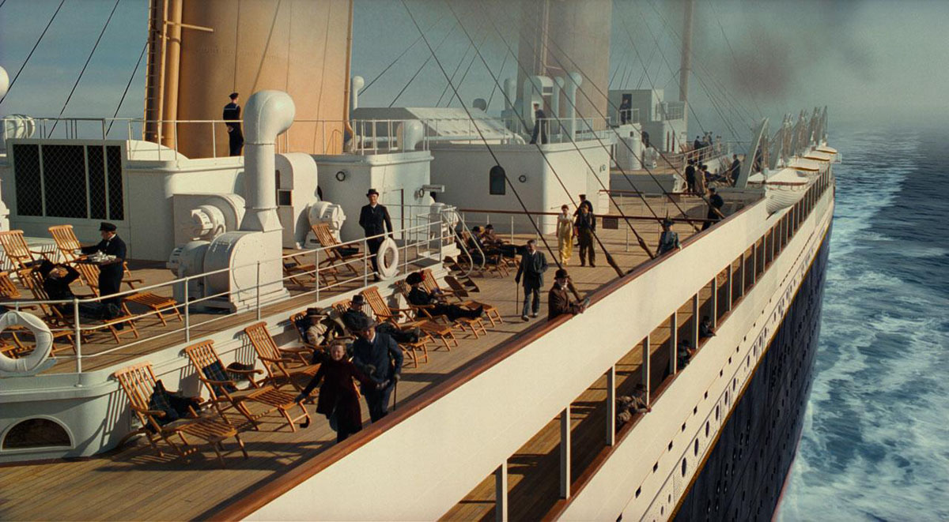
Prominade deck
Notes:
Titanic’s top deck was a half kilometre round walk.

Slide 19
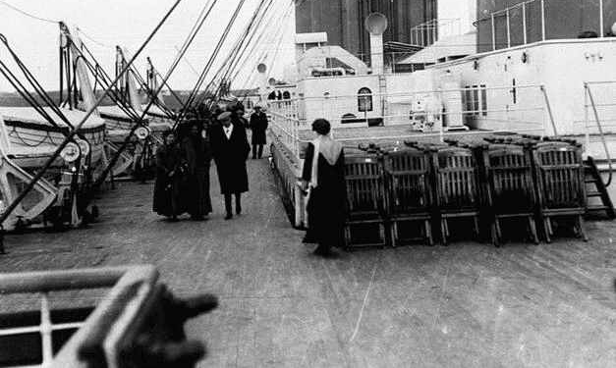
Lifeboats
Notes:
Although Titanic carried more lifeboats than she was required to, the total capacity would only carry 52% of passengers on a full cruise.

Slide 20
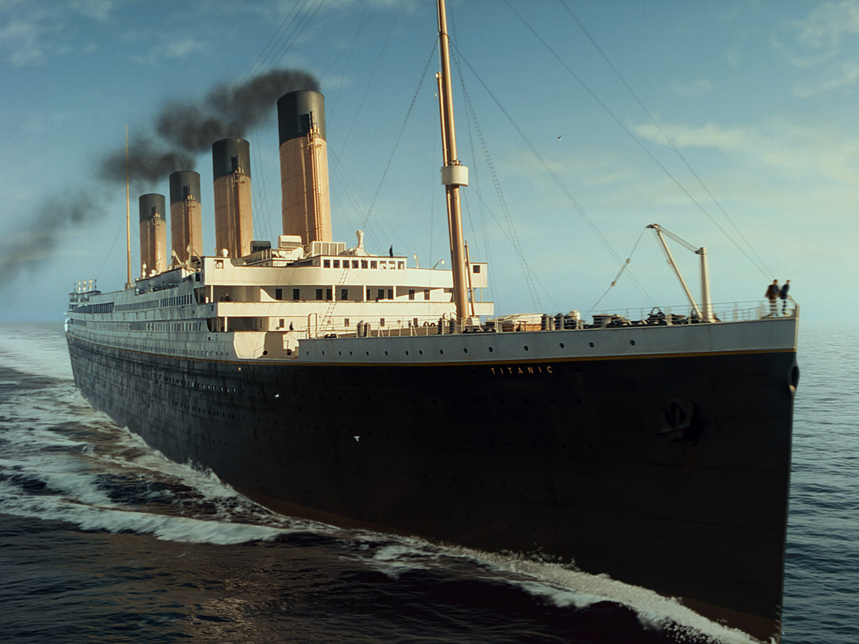
Titanic set sail from Southampton
on April 10th, 1912.
She called at France, then Ireland and
finally set sail for New York, America.

Slide 21
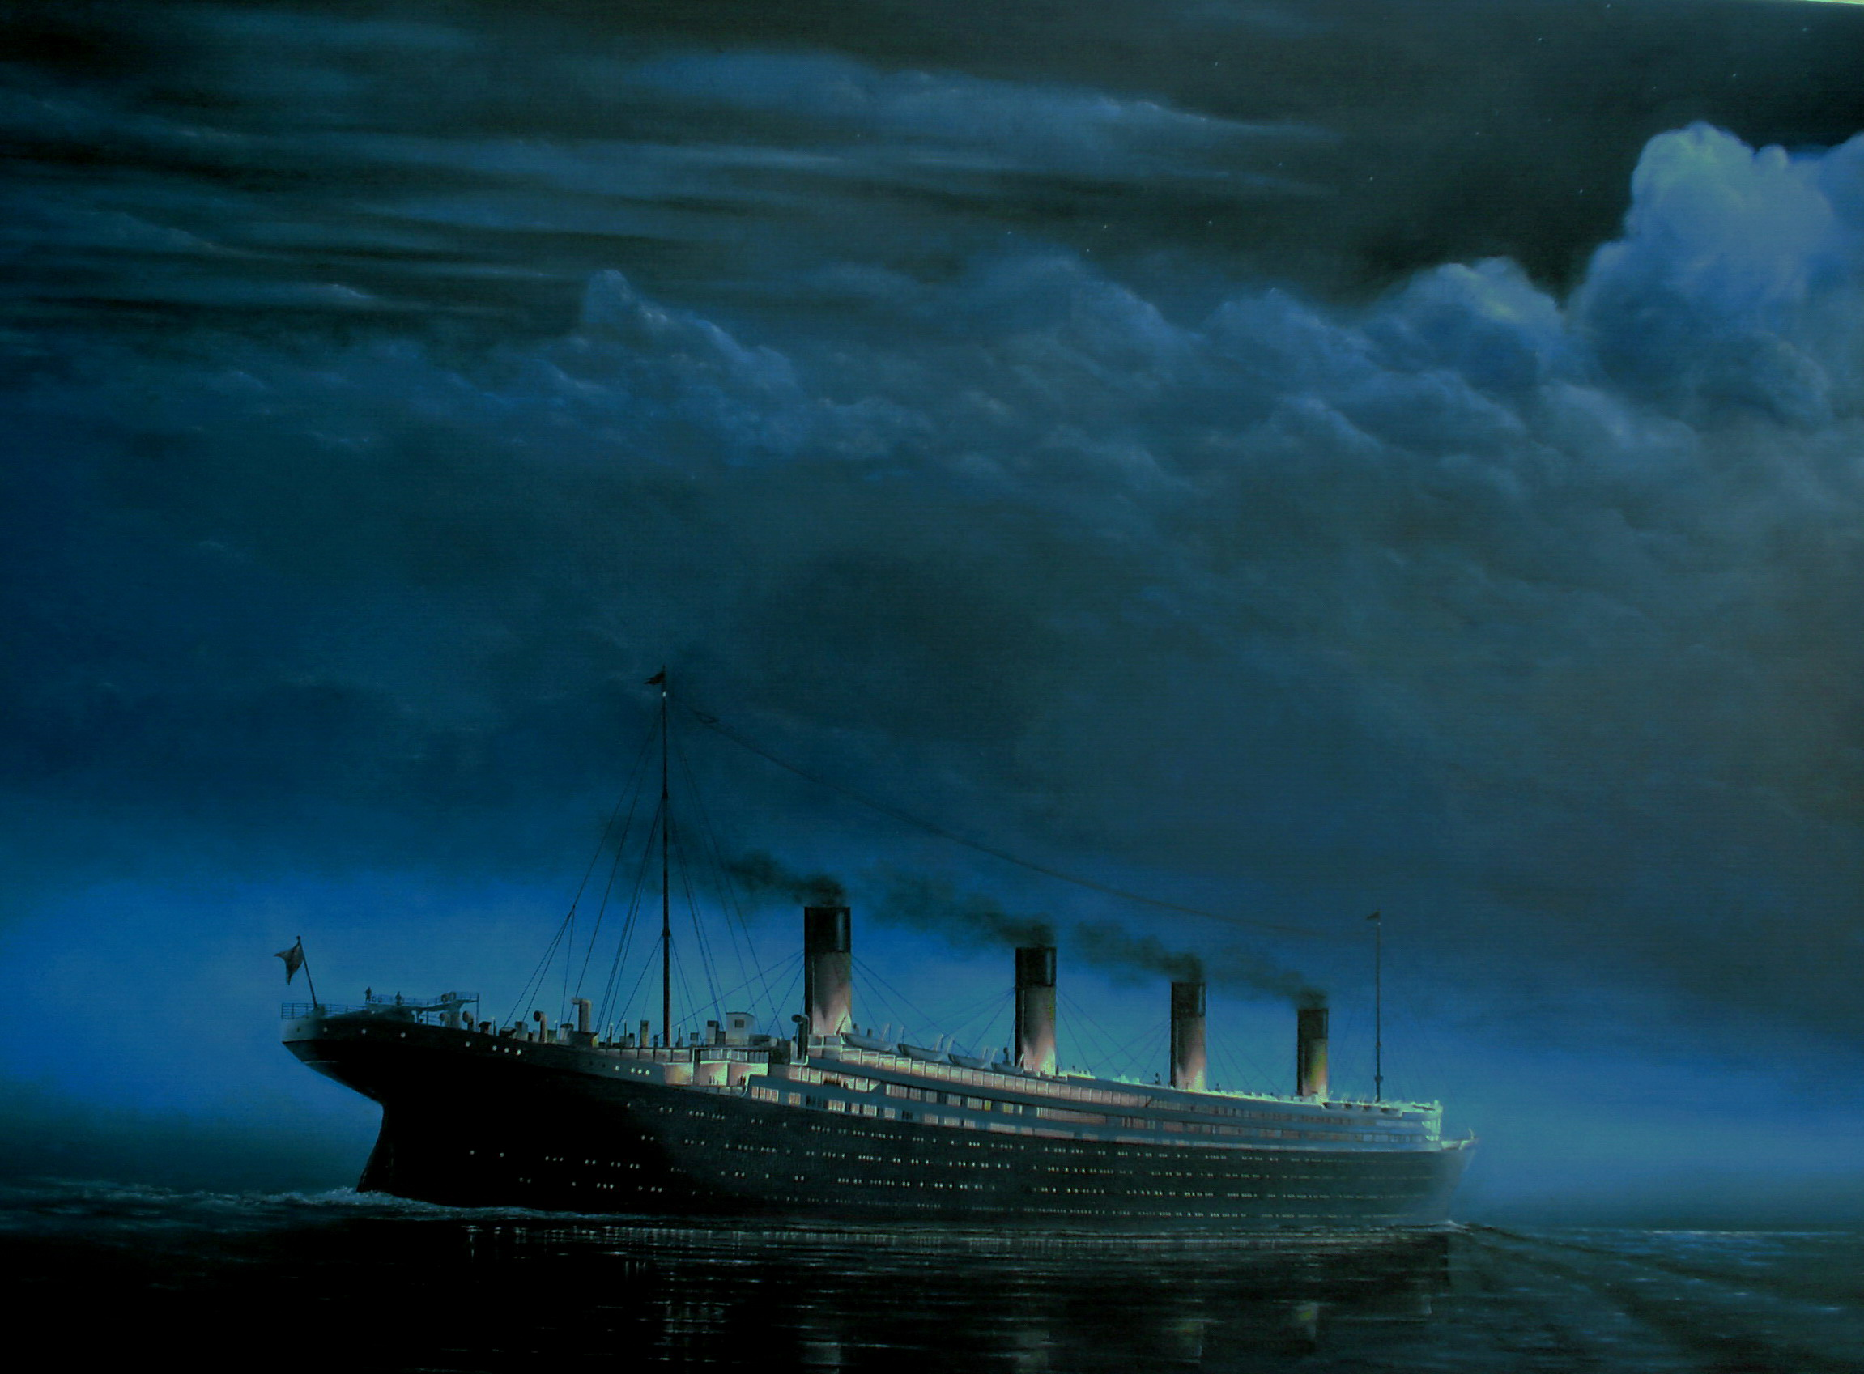
April 14th, 1912

Slide 22
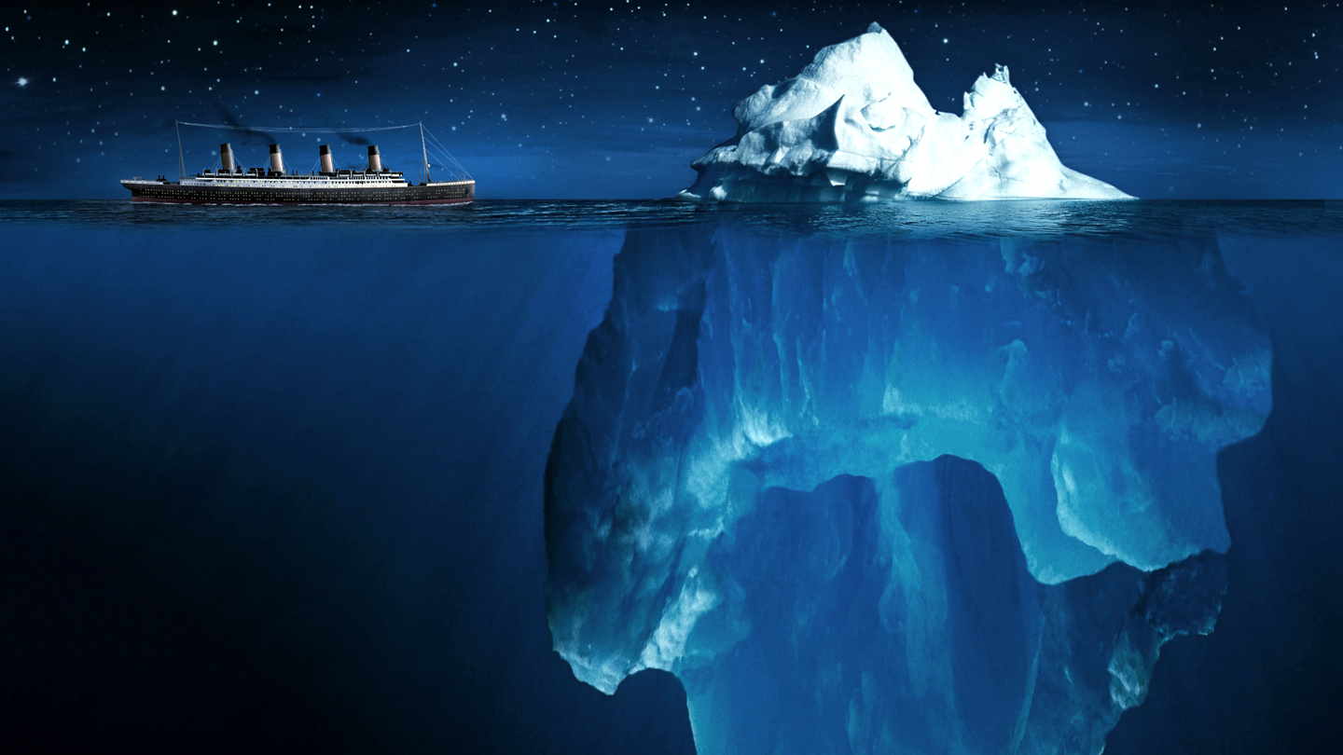
Notes:
Titanic hit the iceberg at 11:40 PM on Sunday 14th April, 1912. The berg did not cut a gash in Titanic’s side, but rather, the pressure split the metal plates on Titanic’s hull apart. The damage stretched for 300 feet.

Slide 23
Notes:
Water flooded five of the watertight compartments, one third of the ship. If it had been one less, the pumps may have been able to take effect. However, the water rose too quickly and spilled over the tops of the bulkheads into the other compartments, flooding the whole ship.

Slide 24
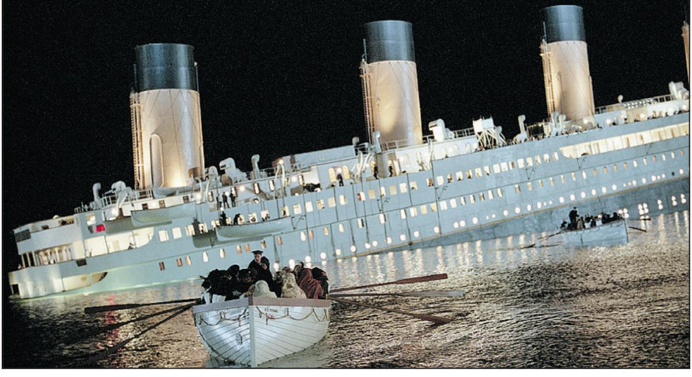
Notes:
Lifeboats were not filled to capacity in the rush to evacuate the ship.

Slide 25
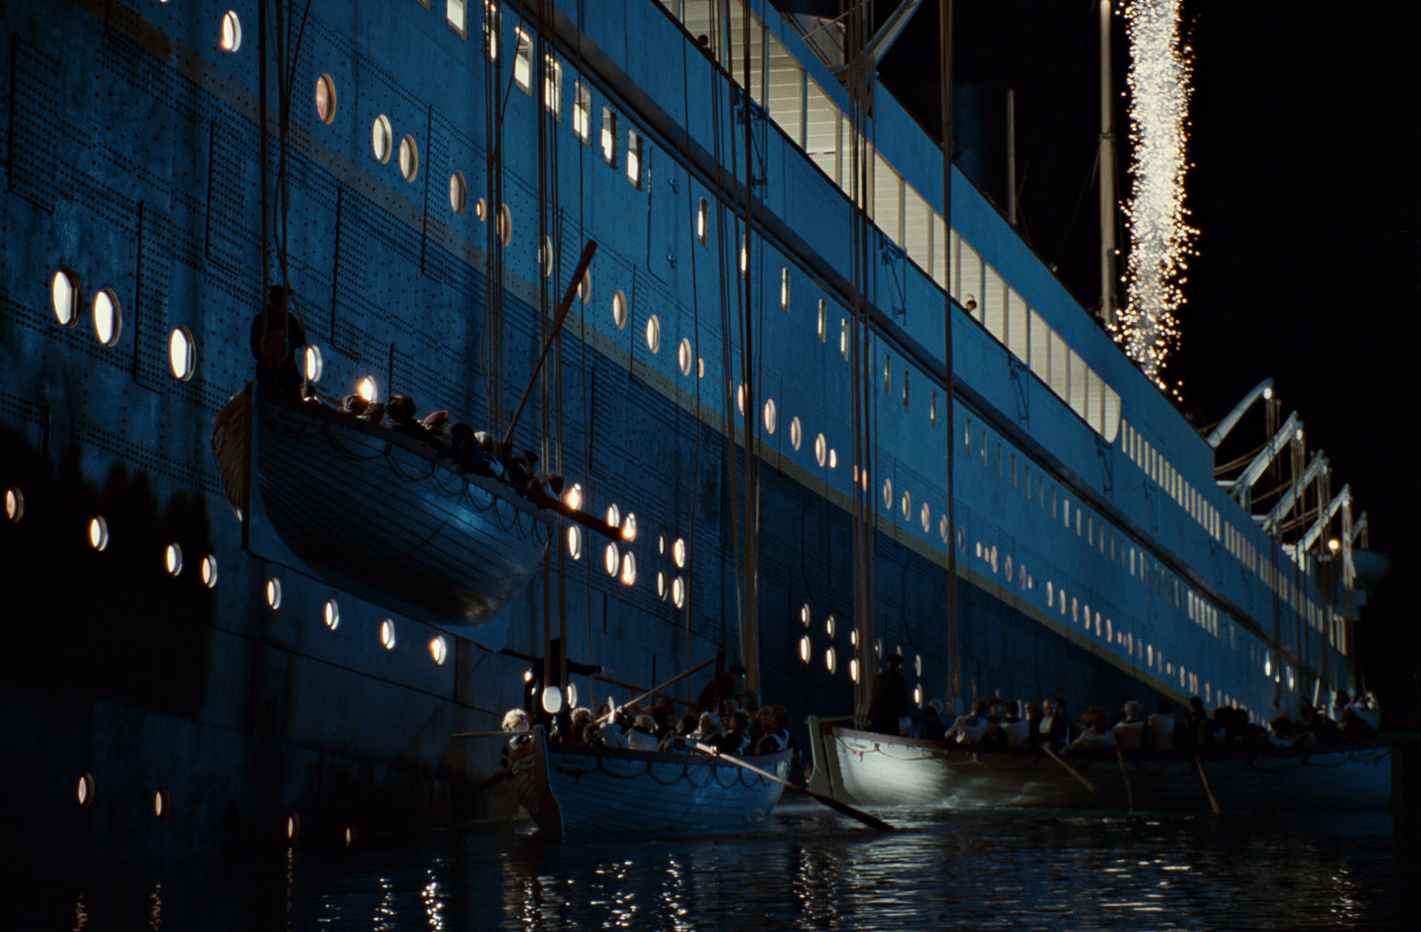
Notes:
CQD and the relatively new SOS were sent from the wireless room. Distress rockets were fired. A ship on the horizon noted the rockets being fired, but did not turn on its radio, as the operator was asleep. It could potentially have reached Titanic before she sank.

Slide 26
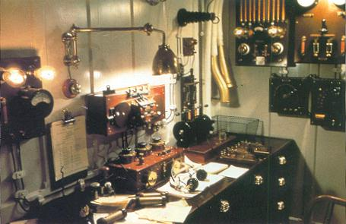
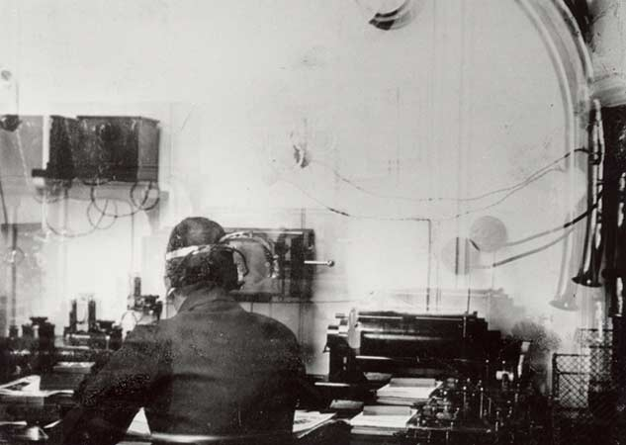
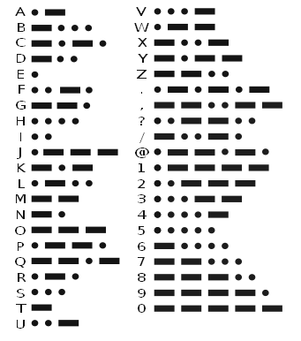

Slide 27
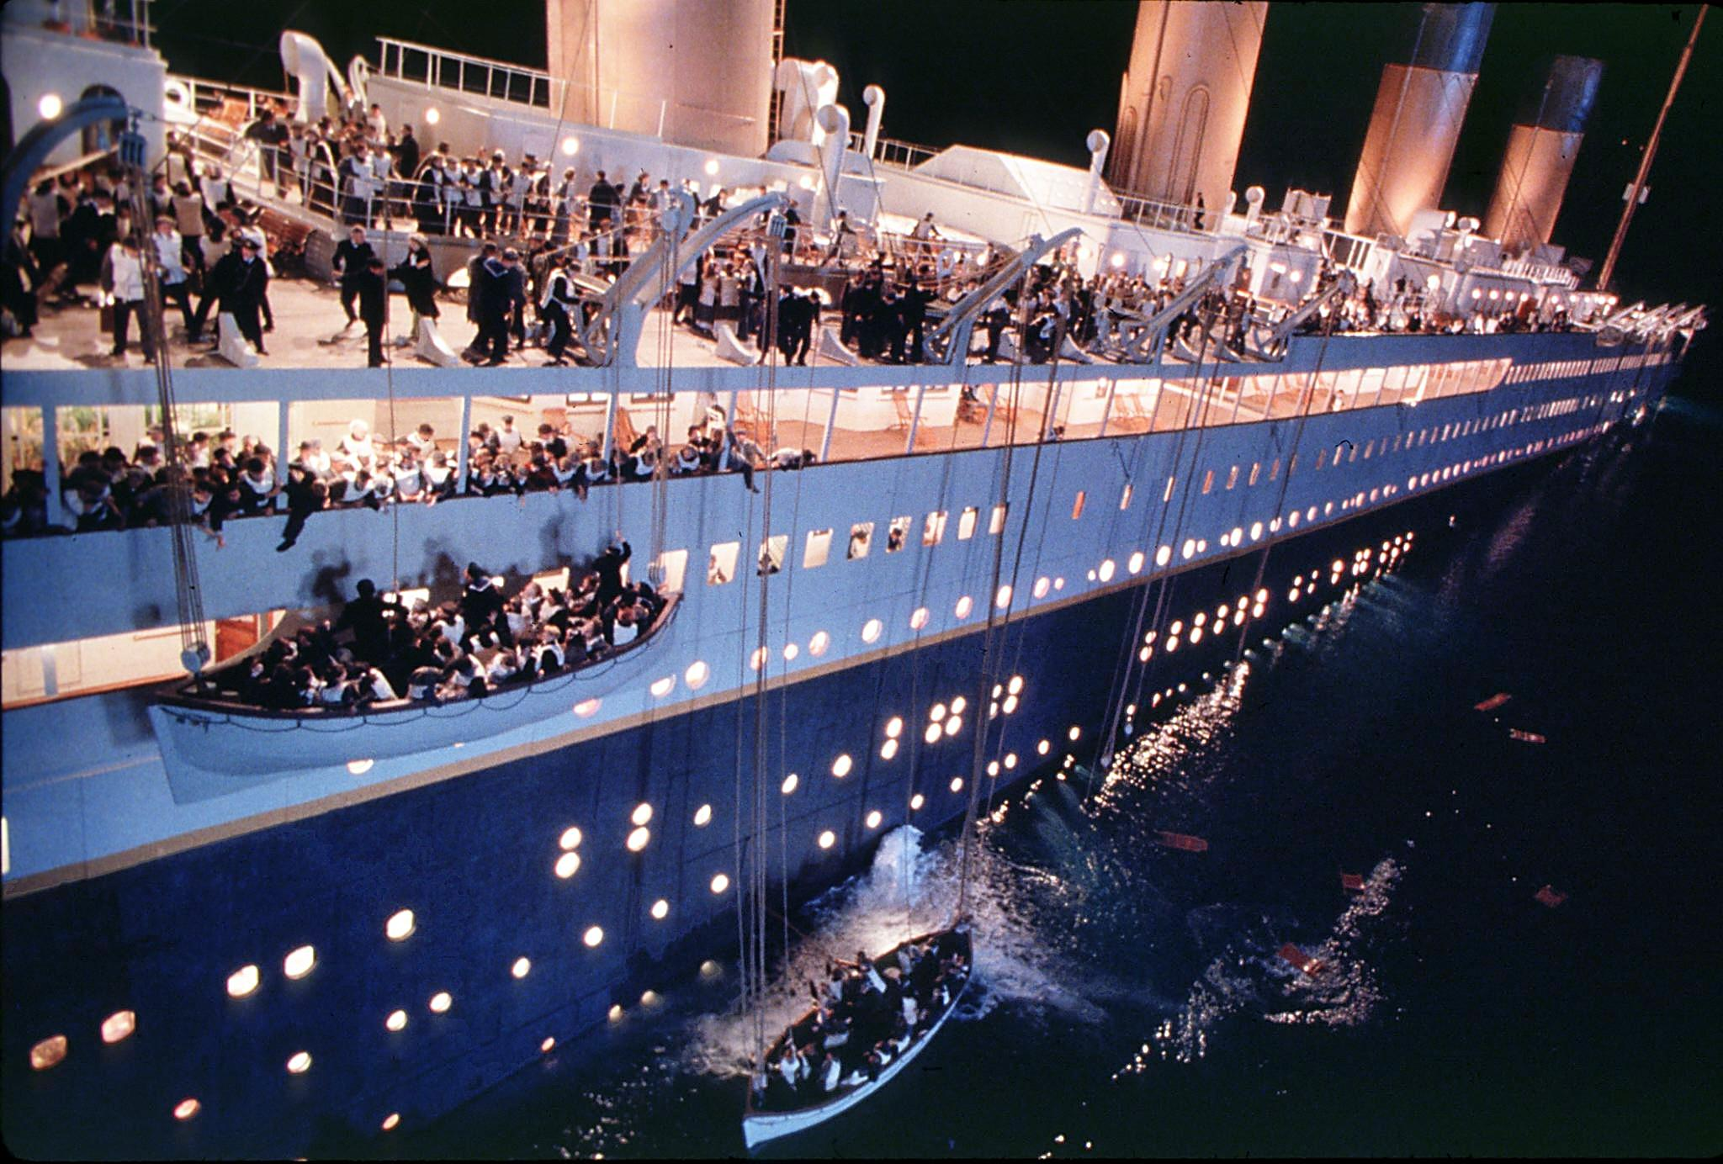
Notes:
As the angle grew steeper, lowering the boats became more difficult. Some lifeboats in the sea drifted underneath lowering boats, becoming entangled.

Slide 28
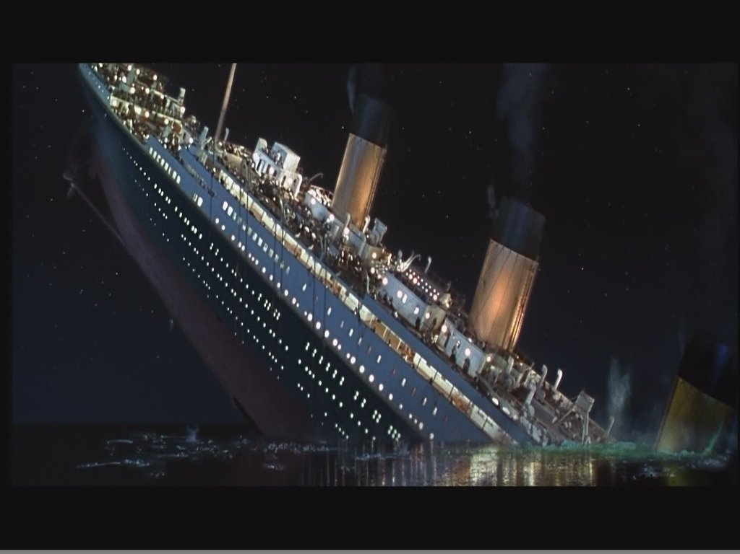

Slide 29
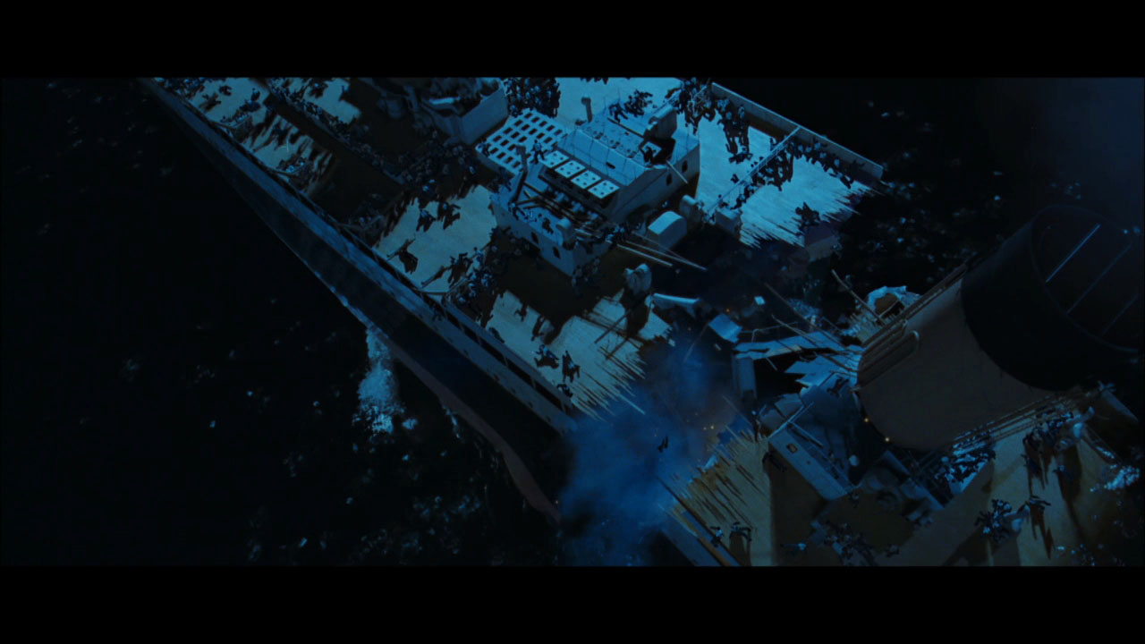
Notes:
Several survivors note the ship breaking in two, though we are not sure when this happened (above or below the water).

Slide 30
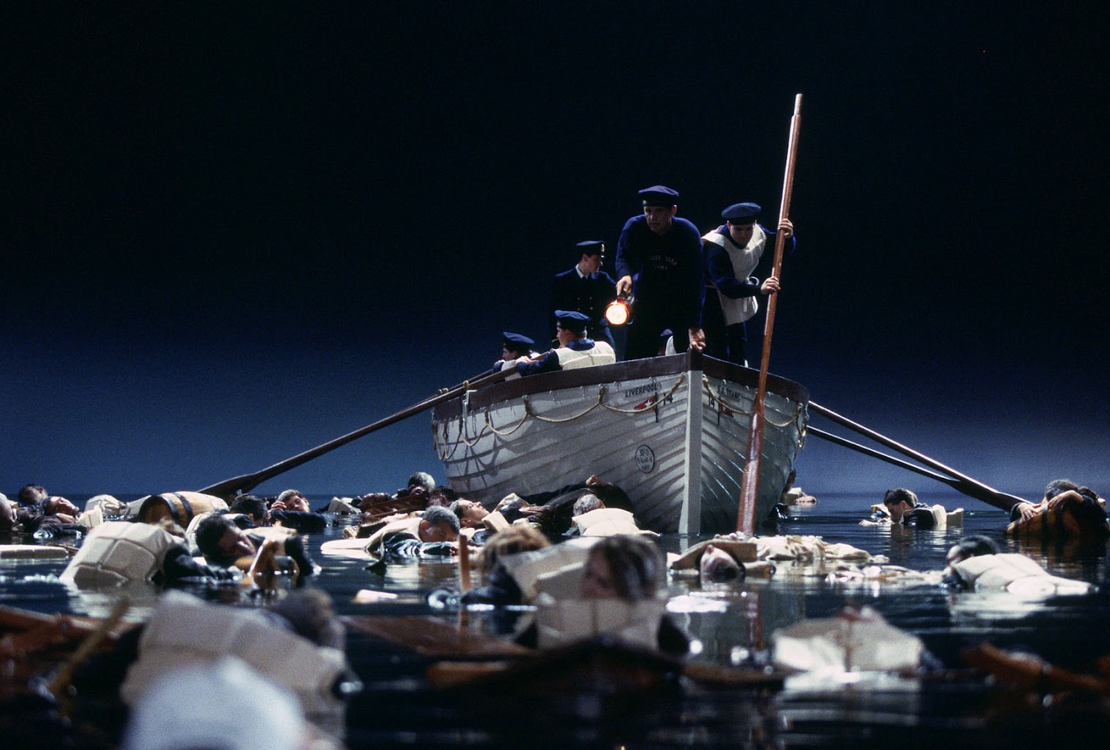
Who was to blame?
Notes:
The sea was -2 degrees. Submersion caused death in around 15 minutes. Only four people were rescued from the water out of 1’500. One was the ship’s baker, who had drunk whisky during the sinking. The alcohol helped to keep his blood circulating.

Slide 31
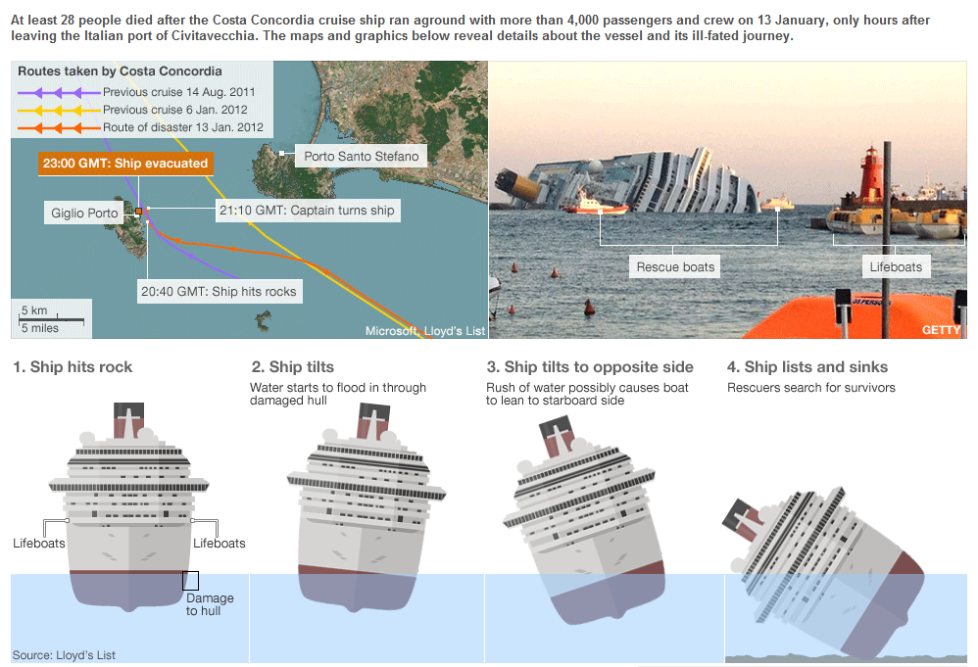
Notes:
Despite promises made to make ships safer after Titanic’s enquiry, cruise ships today are more susceptible to sinking than ever, owing to their size, poor manoeuvrability and high centre of gravity.

