Slide 2
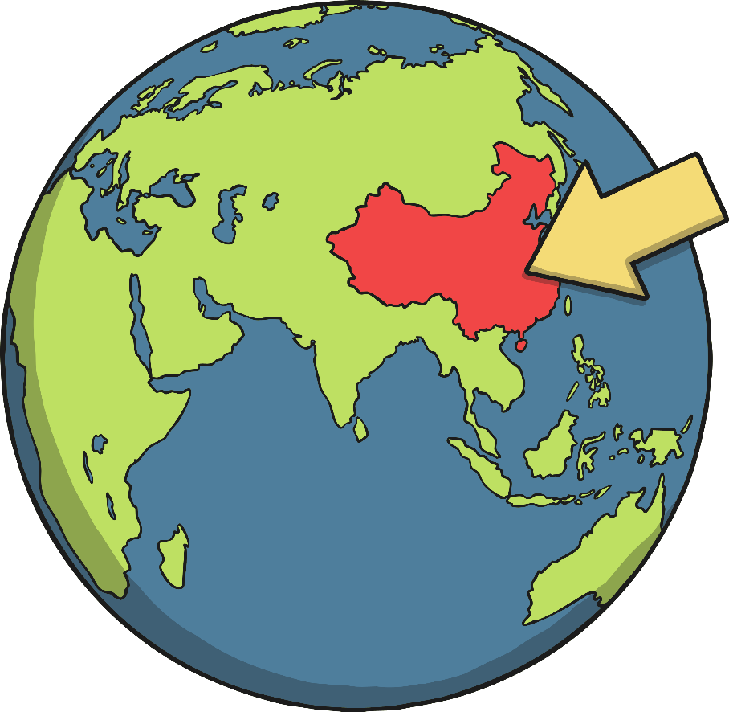
Where is China?
The country of China is in northeast Asia.
China is the fourth biggest country in the world.
China has the largest population in the world with over 1.3 billion people!
China is divided into provinces.
The capital city of China is Beijing.

Slide 3
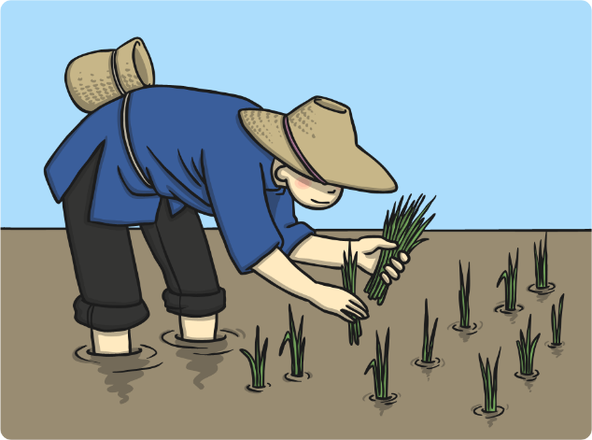
What is China like?
China has very diverse geography including deserts, mountains and fertile river basins.
In the north of China, there are mountains where it snows much of the year.
The south of China is filled with jungles and it is very hot and humid. Central China consists mostly of mountainous regions.
Most of Western China is Mountains, including the Himalayas.
Rivers are very important in China, both for transportation and for irrigation.
Rivers are very important because much of the wheat and rice fields in China rely on irrigation.

Slide 4
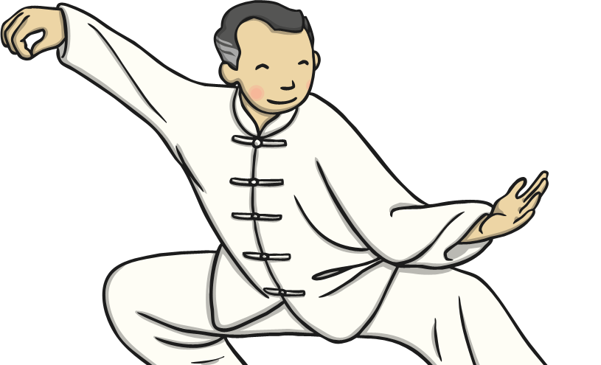
What are Chinese People Like?
China is home to people from lots of different ethnicities and cultures.
Chinese culture is very unique.
The Chinese calendar, architecture, food, handicrafts, dance, festivals and martial arts are very popular across the world.
Chinese people mainly speak Mandarin, but some also speak Cantonese, Hakka or Swatow, depending on which part of the country they
are from.
The staple food in China is rice and it is eaten with nearly every meal.
In the last 20 years China has changed more than any other country in the world.

Slide 5
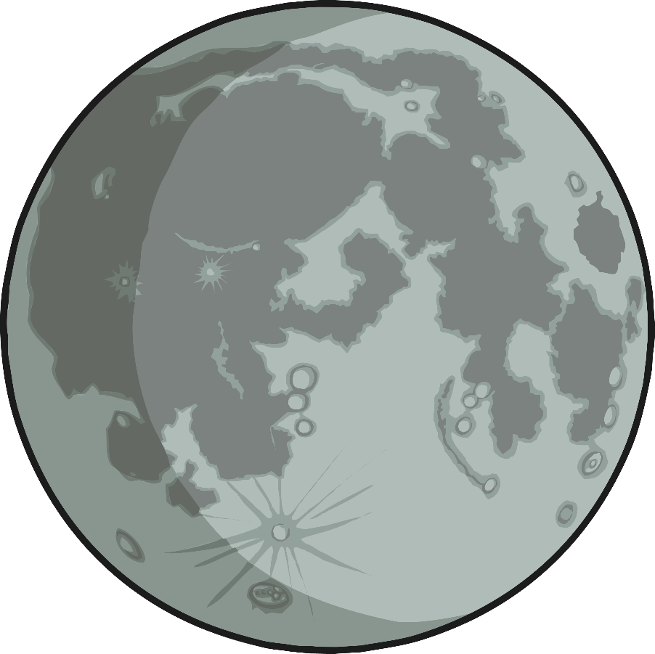
When is Chinese New Year?
Chinese New Year starts somewhere between late January and Early February.
The date changes from year to year because it follows an ancient farmer calendar which is based on phases of the moon.

Slide 6
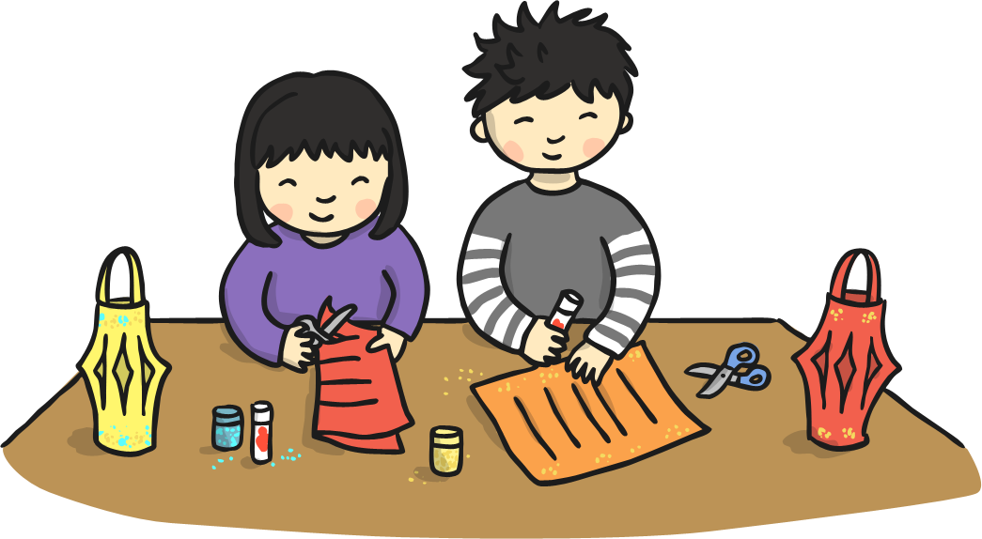
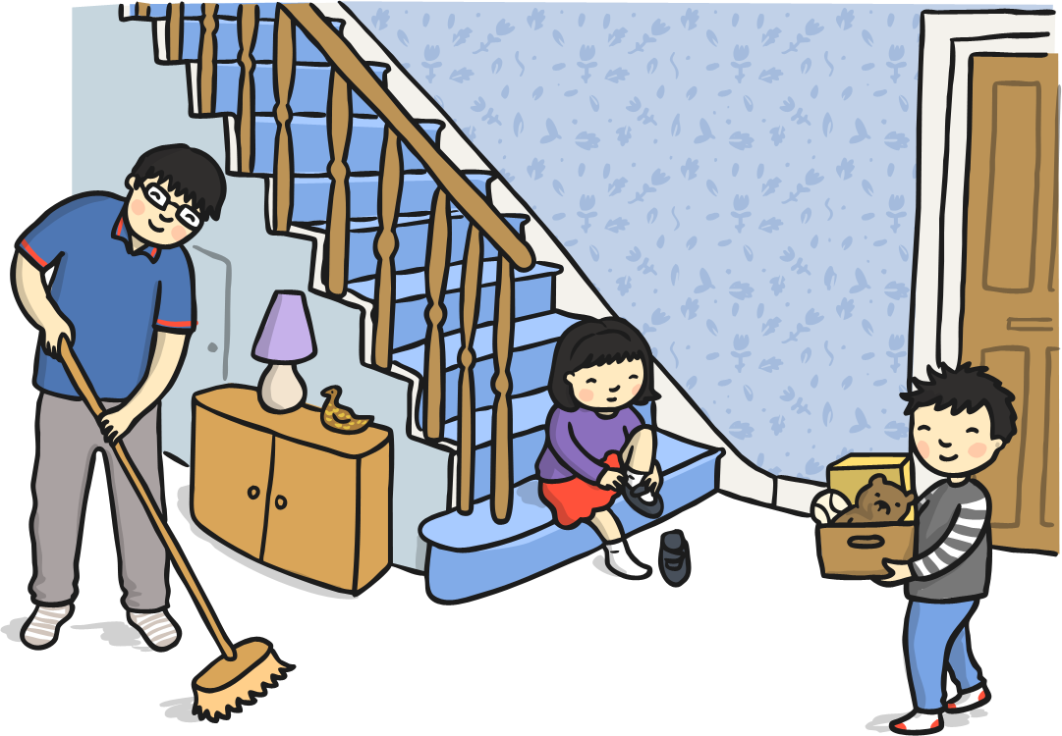
Preparing for the New Year
Chinese people spring clean their houses and gardens to sweep away any bad luck.
Houses are decorated with paper scrolls and lanterns with good luck phrases such as 'happiness' and 'wealth' on them.
All unfinished business is settled so there is a fresh start for the new year. Debts are paid, quarrels are resolved and any work is brought up to date.

Slide 7
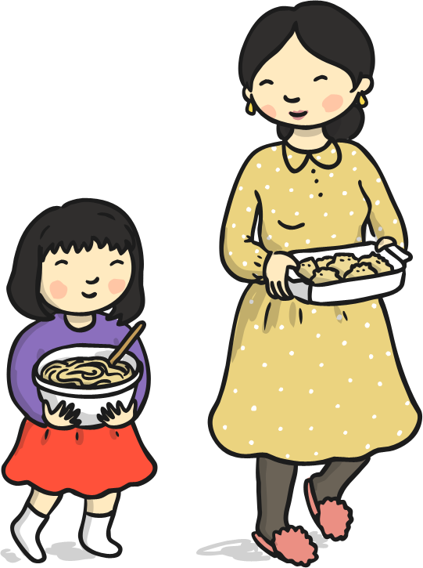
New Year’s Eve
Families gather together and have a large, traditional feast of fish and chicken.
In the North people eat jiaozi - a steamed dumpling.
'In the South people eat nian gao - a sticky sweet rice pudding.
People stay up till midnight setting off fireworks to scare evil spirits away.

Slide 8
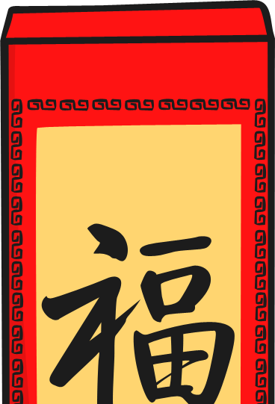
New Year’s Day
Children receive red envelopes filled with money and sweets from their parents and grandparents.
Every family member starts the day with brand new clothes from head to toe. Red is a very popular colour for clothing as it is considered lucky.
The first stop of the day is the temple to worship Gods and welcome the New Year.
Most Chinese families gather together for a New Year's Banquet. Each family has their own special dish they prepare for this time.

Slide 9
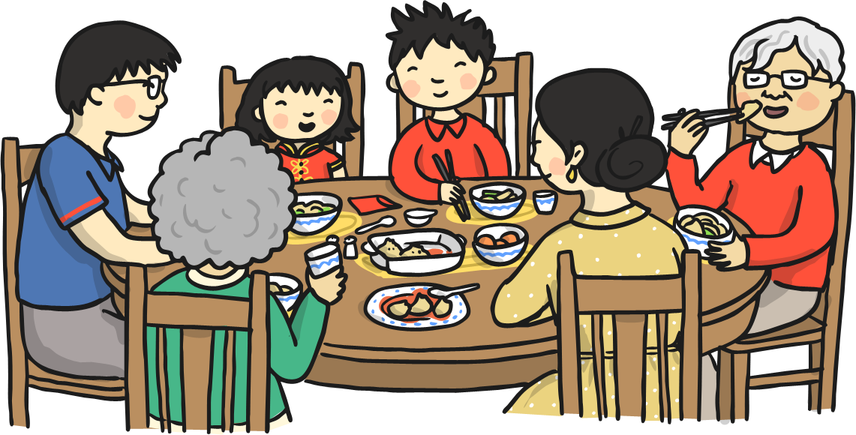
The Second Day
Cai Shen, the Chinese God of Wealth's birthday is celebrated. The Chinese pray to their ancestors as well as the Gods.
It is believed to be the birthday of all dogs so dogs are treated with special foods.
It is also a time for visiting families.

Slide 10
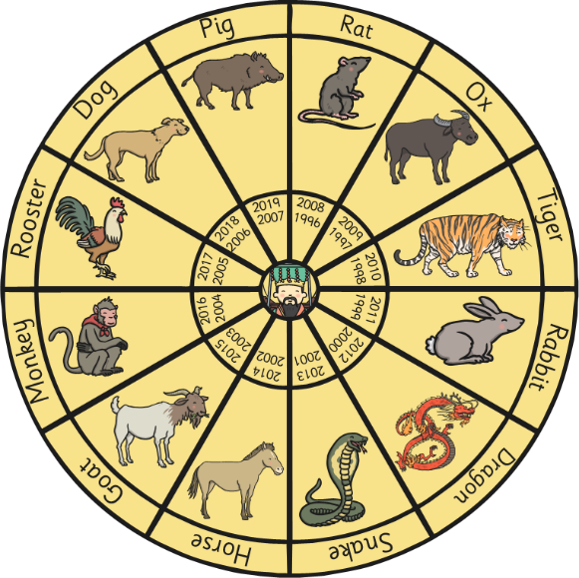
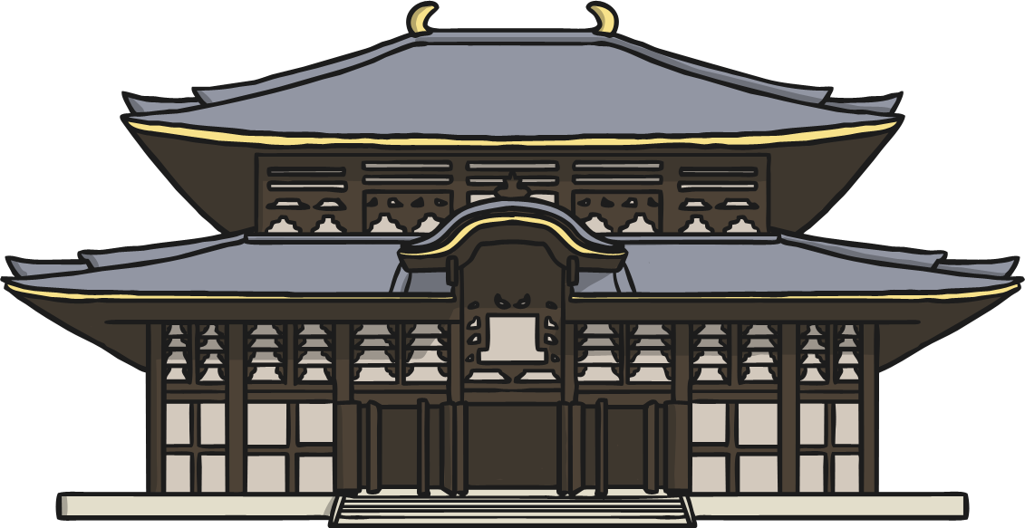
The Third and Fourth Day
The Third Day
Chinese people believe they should not visit friends and relatives on
this day.
Instead, they visit the Temple of Wealth and have their futures told.
The Fourth Day
Most people go back to work.
It is also the day of Spring Dinners. Businesses have department dinners or social events for their employees.

Slide 11
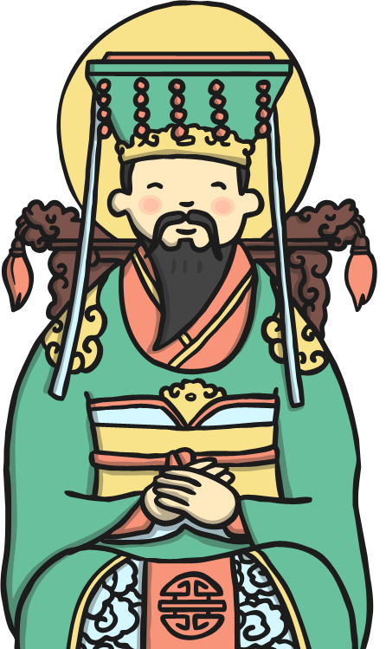
The 5^{th,} 6^{th,} 7^{th,} 8th and 9th Day
The 5th Day - Dumplings are eaten for good luck and some people shoot firecrackers to worship the God of War.
The 6th Day - families usually send away the ghost of poverty and welcome the beautiful days in the new year.
The 7th Day - Day 7 is considered everyone's birthday.
The 8th Day - This is the eve of the Jade Emperor's birthday. Special family dinners are held.
The 9th Day - The Jade Emperor's birthday. The Emperor is worshipped by lighting incense and offering prayers.

Slide 12
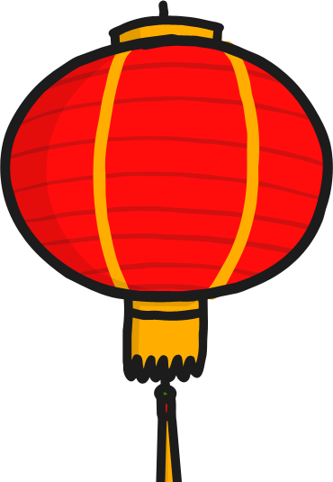
The 10^{th,} 11^{th,} 12^{th,} 13th and 14th day
The 10th Day - Recognition and offerings towards the Jade Emperor.
The 11th/12th Day - Family Dinners
The 13th Day - everyone converts to vegetarian on the thirteenth day to give their stomachs a rest!
The 14th Day - This day is spent resting and preparing for the lantern festival, the last day of Chinese New Year.

Slide 13
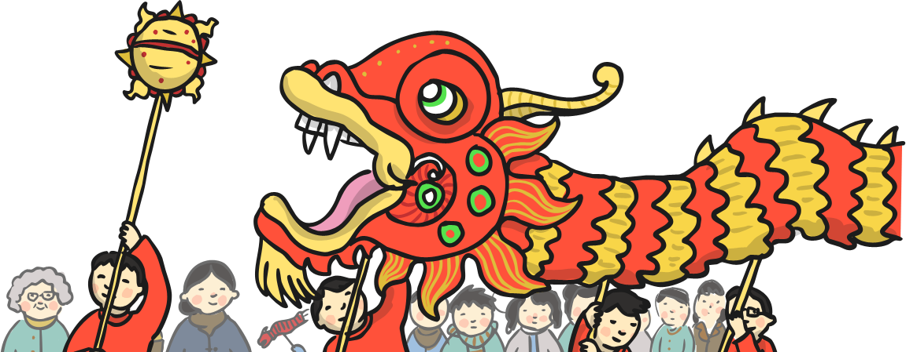
The 15th Day!
The 15th day is also known as the Lantern Festival.
There are dragon and lion dancing parades in the streets, and all the streets are crowded with people.
Families walk the streets carrying lit lanterns.
Candles are lit outside homes to guide wayward spirits home.
Rice dumplings are eaten on this day.
In Malaysia and Singapore, single women write their phone numbers on oranges and throw them into a river or lake. Single men eat the oranges and the taste of the orange (sweet or sour) represents good or bad fate.

Slide 14
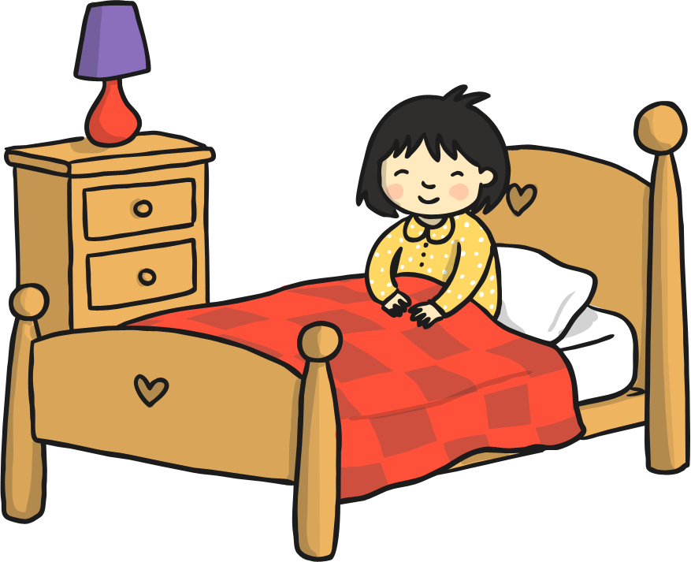
THE END

