Slide 2
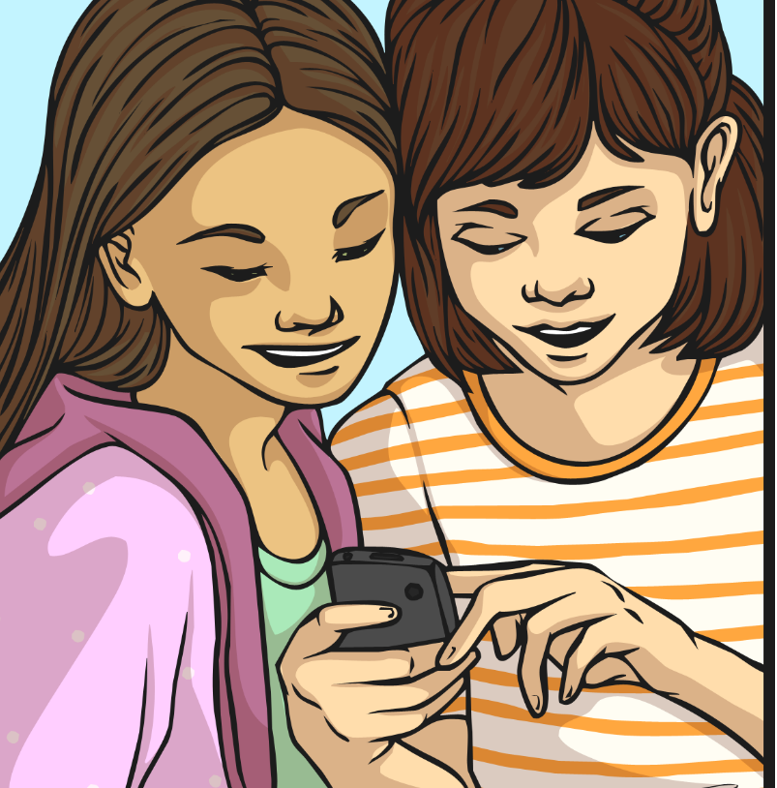
What Do We Know?
What is bullying?
Your answers might also include examples of types of bullying.
What is cyberbullying?

Slide 3
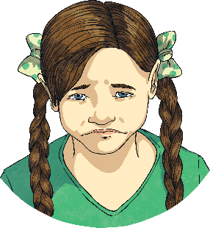
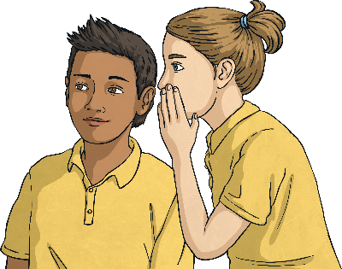
What Do We Know?
So, what is bullying?
Verbal bullying
This could be teasing, name-calling, making inappropriate comments, taunting or threatening to hurt someone.
Bullying is unwanted, aggressive or unpleasant behaviour towards someone which causes them any kind of harm. Usually, the behaviour is repeated over time, without provocation.
Social bullying
People not to be friends with the victim, spreading rumours, embarrassing someone in public on purpose.
Which types of bullying might happen in person?
Physical bullying
Sometimes the most obvious kind of bullying, this could be: hitting; kicking; pinching; spitting; tripping or pushing; breaking someone’s belongings; making rude gestures.

Slide 4
Cyberbullying
What do you think cyberbullying means?
One definition of cyberbullying is:
the use of electronic communication to bully a person, typically by sending messages of an intimidating or threatening nature.
Can you think of any other examples of cyberbullying?
On which websites or platforms could you witness or experience cyberbullying?

Slide 5
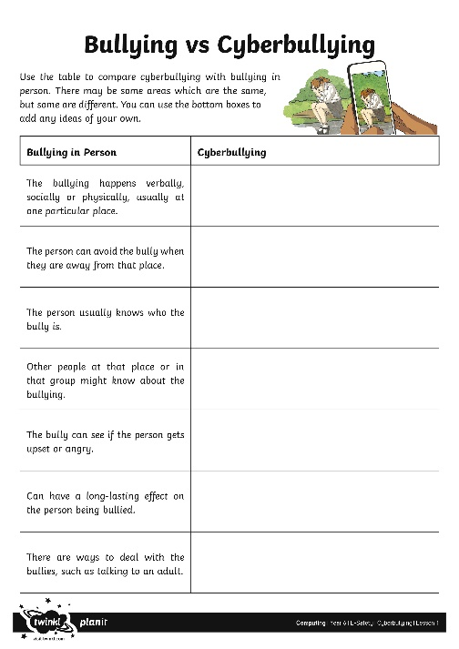
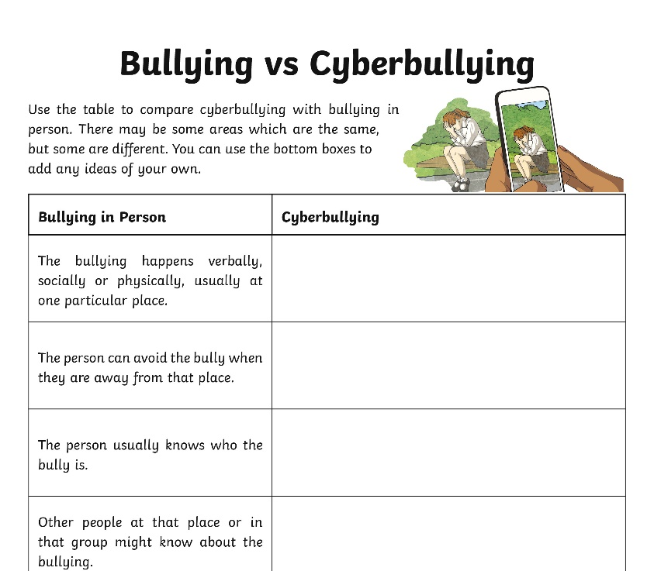
Bullying vs Cyberbullying
What are the similarities and differences between bullying in person and cyberbullying? Use the activity sheet in the blog to record your answers.

Slide 6
Bullying vs Cyberbullying
What similarities and differences did you come up with?
Bullying in Person
The bullying happens verbally, socially or physically, usually at one particular place.
The person can avoid the bully when they are away from that place.
The person usually knows who the bully is.
Other people at that place or in that group might know about the bullying.
Can have a long-lasting effect on the person being bullied.
The bully can see if the person gets upset or angry.
Cyberbullying
The bully cannot see the effect on the person and this means they are less likely to feel guilty. Other people can’t see that the victim is hurt, and they are less likely to intervene.
Can happen anywhere, anytime, even when the bully is not around.
Hard to get away from, even at a safe place.
The bully might choose to stay anonymous.
Anyone, anywhere in the world might find out, or have it shared with them.
Can have a long-lasting effect on the person being bullied.

Slide 7
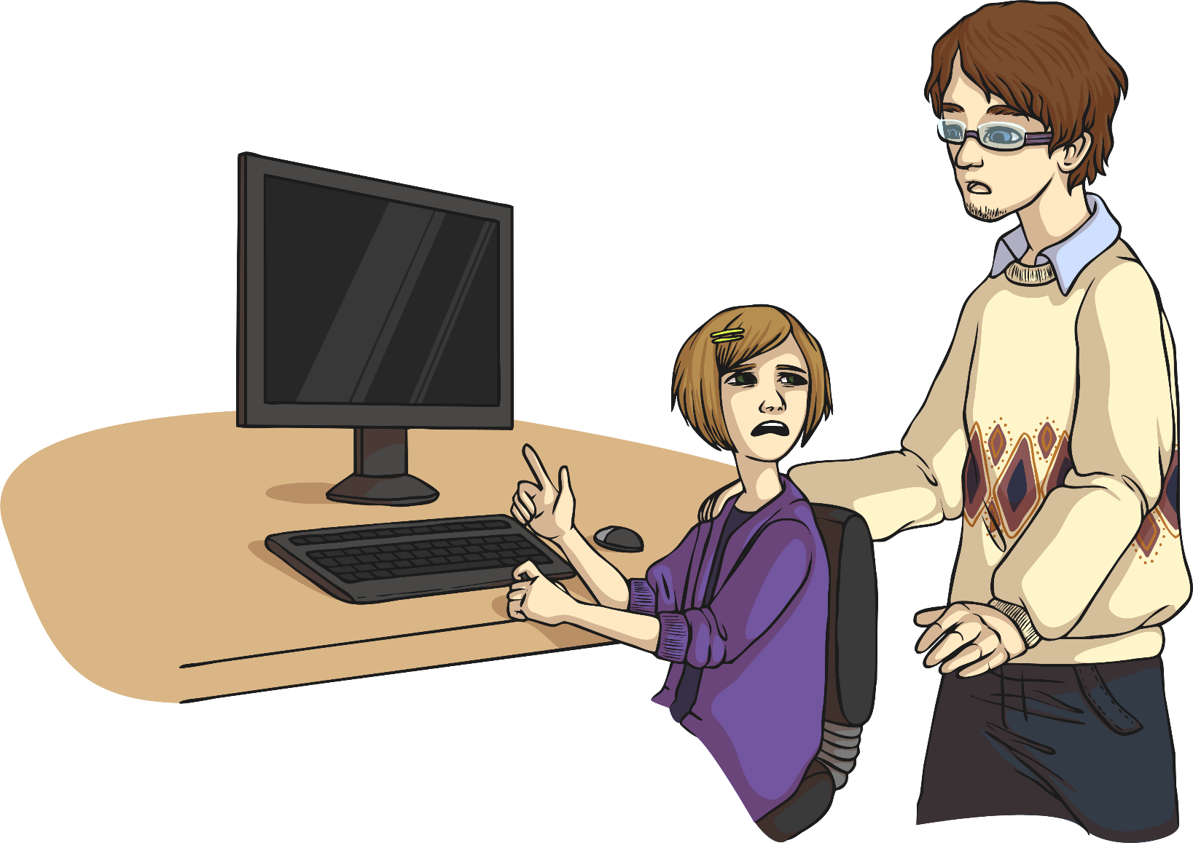
What Would You Do?
Look at the scenario cards on the following slides and think about how you think each person should deal with a cyberbullying dilemma.
You can give more than one answer.

Slide 8
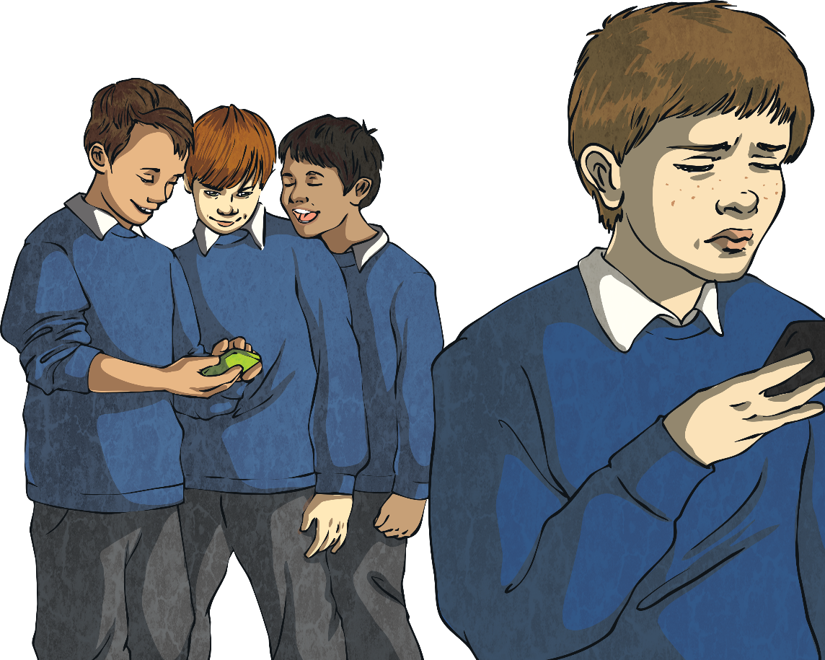
What Would You Do?
Tom has a social media profile, and likes to post photographs of his hobbies. Some children at his school have started to comment underneath the photos using rude language and making nasty remarks. Tom’s parents don’t use social media and don’t understand when he tries to explain.
What should Tom do?
He could tell an adult whom he trusts.
He could report the comments anonymously on the site himself.
He could report the bullies to school so that they can deal with those involved.
He could block the bullies on the site.
Is there anything you think that Tom should definitely not do?

Slide 9
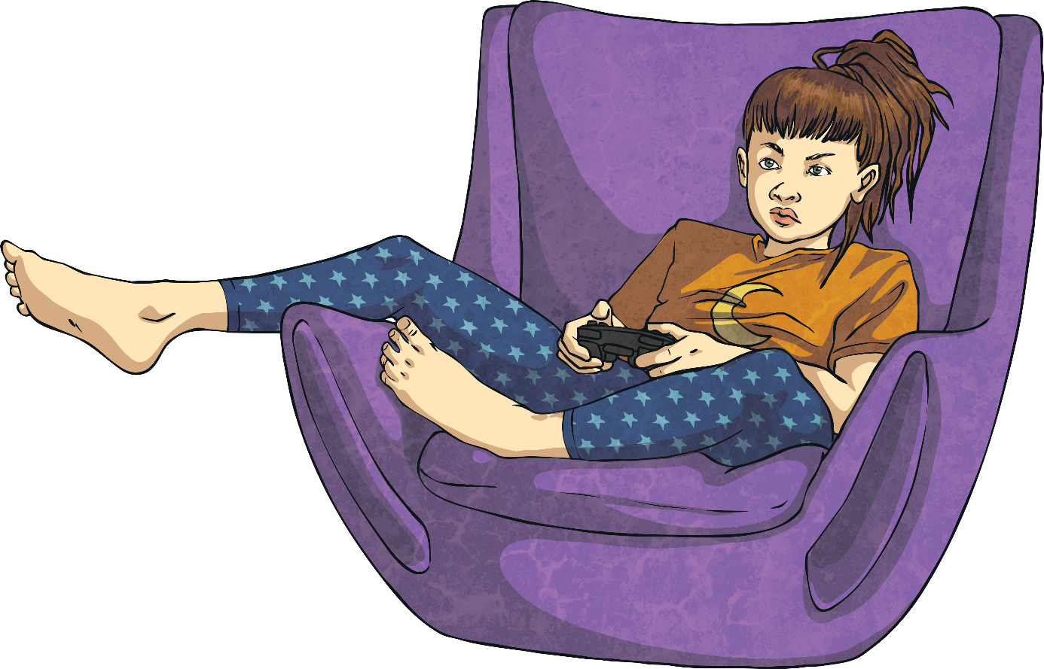
What Would You Do?
Ellie plays video games at home over the internet, using her games console and a headset. She plays with some of her classmates, but there are other players in the game who use very inappropriate language and make her feel uncomfortable.
What should she do?
She could tell an adult whom she trusts.
She could ask the players to stop using the language, and if they don’t, she could report the players to the game administrators, who will punish them or stop them from playing.
She could ask her friends to play without the bullies or to play a different game.
Is there anything you think that Ellie should definitely not do?

Slide 10
What Would You Do?
Some boys in another class have been making fun of Jamie: they have teased him at break times but he usually avoids them and stays with his friends. He has discovered that one of the boys has make a fake profile on a social media site pretending to be him. The profile has lots of pictures of Jamie and fake posts which make it look like Jamie has said horrible things.
What should Jamie do?
He could tell an adult whom he trusts so that they can request that it is removed.
He could report it anonymously on the site himself.
He could report it to school so that they can deal with the boy who made it.
Is there anything you think that Jamie should definitely not do?

Slide 11
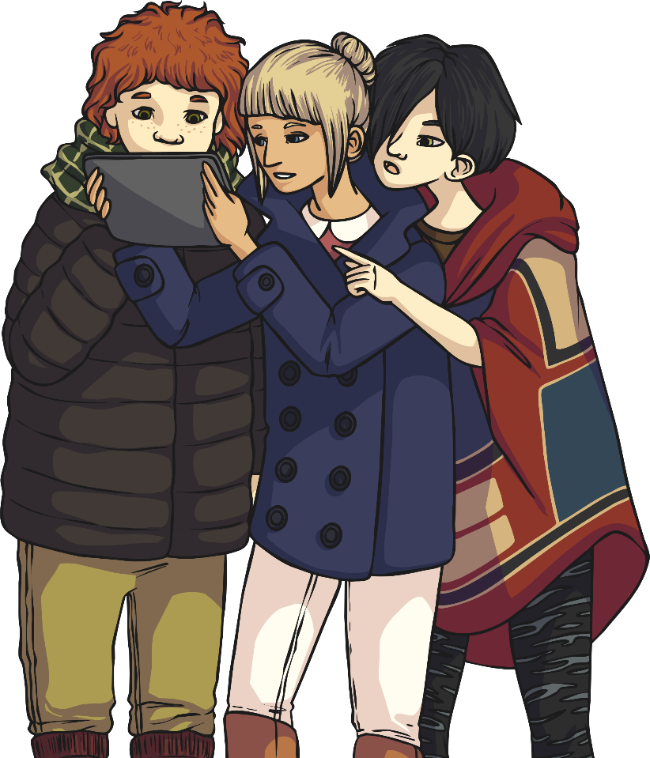
What Would You Do?
Zara has received a group message which makes fun of her friend. Lots of other people are involved in the group chat and are commenting on the way that her friend looks and dresses. At first, Zara joined in but now the texts are becoming really mean.
What should she do?
She could show the texts to an adult, even if she thinks that she might get in trouble for joining in.
She could remove herself from the chat so that the bullies have one fewer person to reach.
If they go to the same school, she could report it to a teacher.
Should Zara screenshot the chat?
Should she tell her friend?

Slide 12
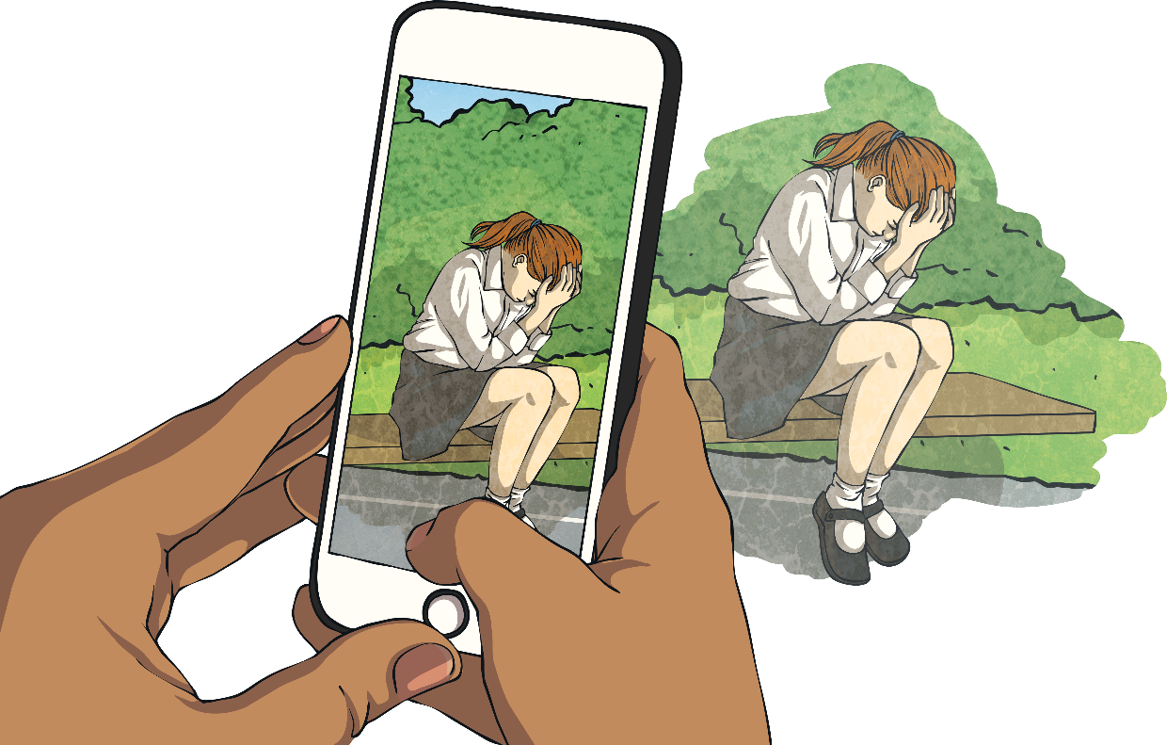
What Would You Do?
Some people at Lizzy’s school took a picture of her and posted them online with a nasty caption underneath. She has no idea who took the picture or who posted it first. Lizzy has seen that the picture has been shared by people at another school too.
What should Lizzy do?
Lizzy could anonymously report the original post to the site it was posted on.
Lizzy could tell an adult whom she trusts.
Lizzy could report it to her school, who would be able to contact the school of the other children involved.
Should Lizzy report this to the police?

Slide 13
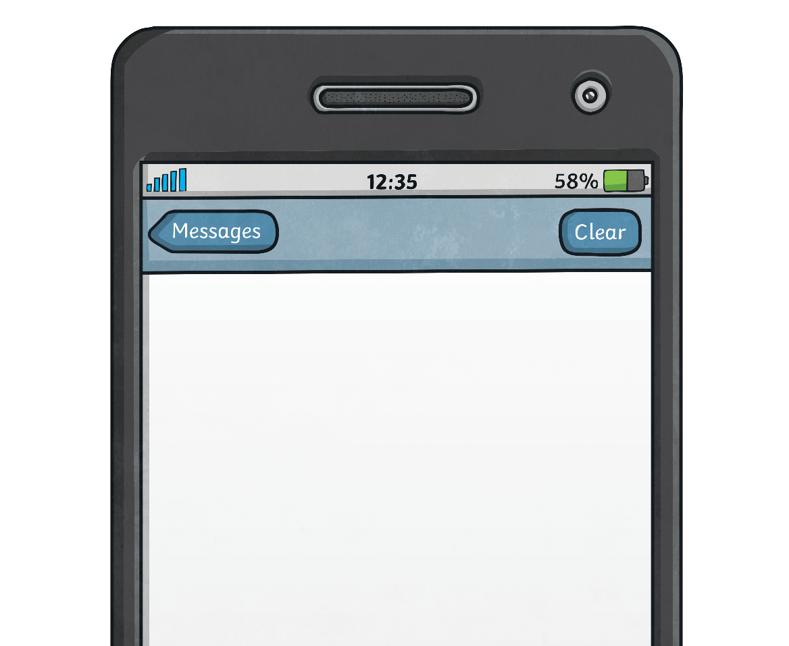
What Would You Do?
Kareem has received texts from a number that he does not know. The texts say that someone knows where he lives and is threatening to hurt him. He has shown his friends and they do not know who the number belongs to, either.
What should he do?
Kareem could tell an adult whom he trusts straight away.
He could tell someone at his school.
He could tell the police. His school or trusted adult might do this with him.
When do you think the police should be contacted for a cyberbullying incident?
Remember, anyone can make a complaint to the police about bullying (although reporting it to the school or another adult first may be all you need to do), especially if you are being threatened.

Slide 14
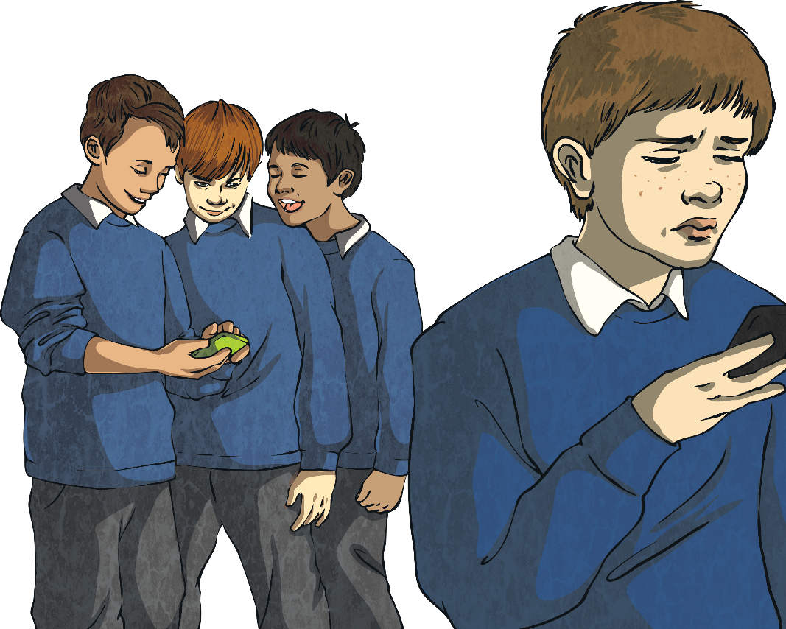
Reflection
Write a detailed answer to the following question:
Do you think that cyberbullying is as harmful as bullying someone in person? Give a reason for your answer.
What can we do as a school to prevent cyberbullying?
What can you do as an individual?
Remember that there is always something you can do to help if you are worried about anyone, including yourself, online.

Slide 15
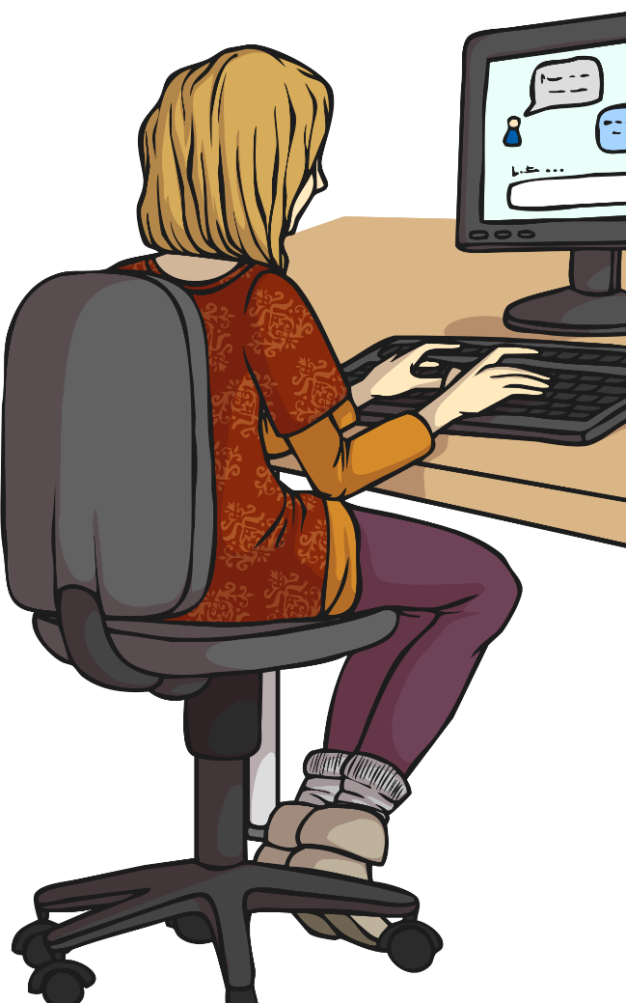
If You’re Worried….
If you are worried about cyberbullying, there are lots of good sources of advice online:
www.childline.org.uk
www.thinkuknow.co.uk
www.bullying.co.uk/cyberbullying
www.safekids.com/tips-to-stop-cyberbullying
www.childnet.com/young-people
If you want to talk to somebody about cyberbullying, then you can call Childline anytime, on 0800 1111

