Slide 1
Impressionism
© Copyright Kapow! 2017

Slide 2
Impressionism
Impressionism is the name given to a group of artists who painted in France in the late 19th Century.
They reacted to the invention of the camera and moved away from painting things realistically.
Impressionist artists liked to paint outdoors at the scene not from still life or models.
These artists were very interested in the way light affects things and used bright and vivid colours to highlight an object's natural colour.
They were less concerned with painting realistically and more interested in capturing the way light shines on objects and how colours change in the sun.
Their work was often painted quite quickly before the light changed, and this is shown in the use of heavy and loose brush strokes and the lack of fine detail.
Link to paintings:
Impressionism
Post-Impressionism
© Copyright Kapow! 2017

Slide 3
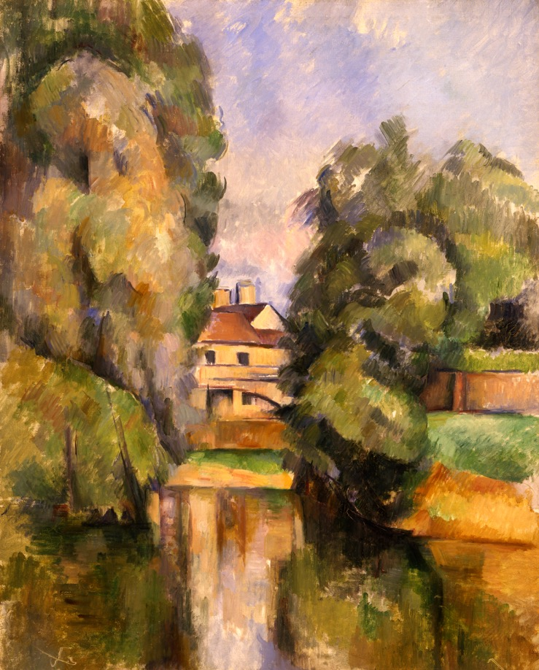
Paul Cézanne1839 - 1906
Paul Cézanne was a French artist and Post-Impressionist painter whose work laid the foundations for a new and radically different form of art.
Cézanne's brushstrokes are clearly recognizable. He used planes of colour and small brushstrokes to describe form.
Country House by a River, Paul Cézanne 1890
© Bridgeman
© Copyright Kapow! 2017

Slide 4
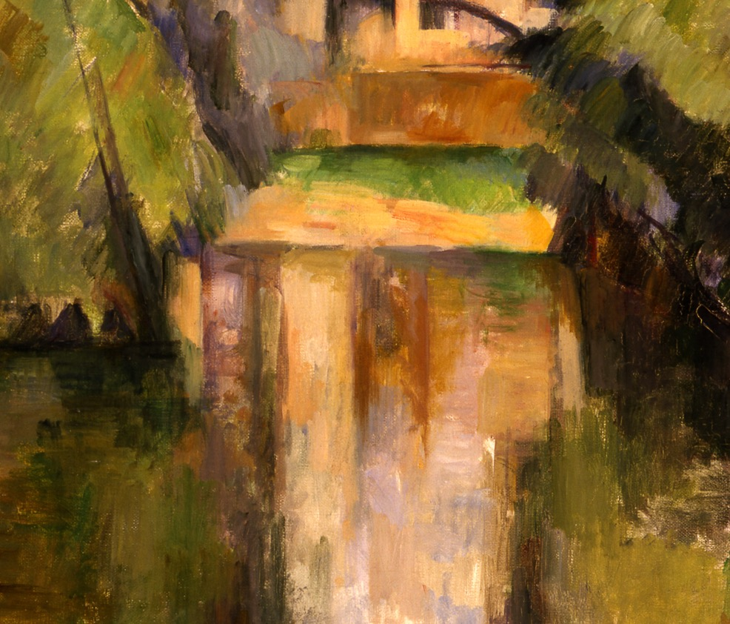
Detail - Country House by a River, Paul Cézanne 1890
© Copyright Kapow! 2017

Slide 5
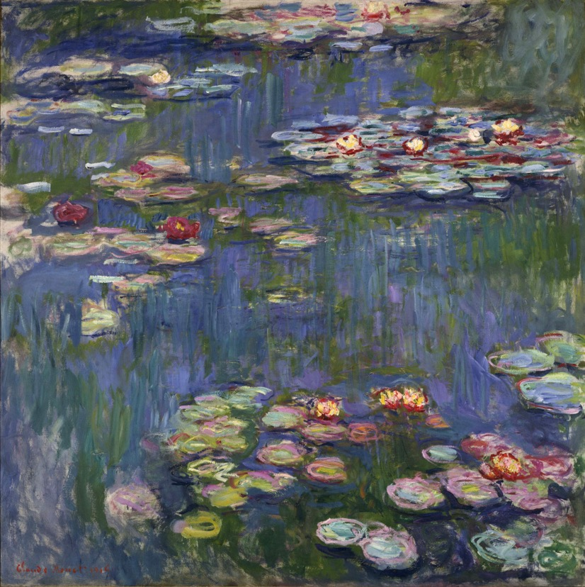
Claude Monet1840 - 1926
Claude Monet was a founder of French Impressionist painting.
The term "Impressionism" comes from the title of his painting Impression, soleil levant.
Monet developed a method of painting the same scene many times in order to capture the changing of light and the passing of the seasons.
Water Lilies, Claude Monet 1916
© Bridgeman
© Copyright Kapow! 2017

Slide 6
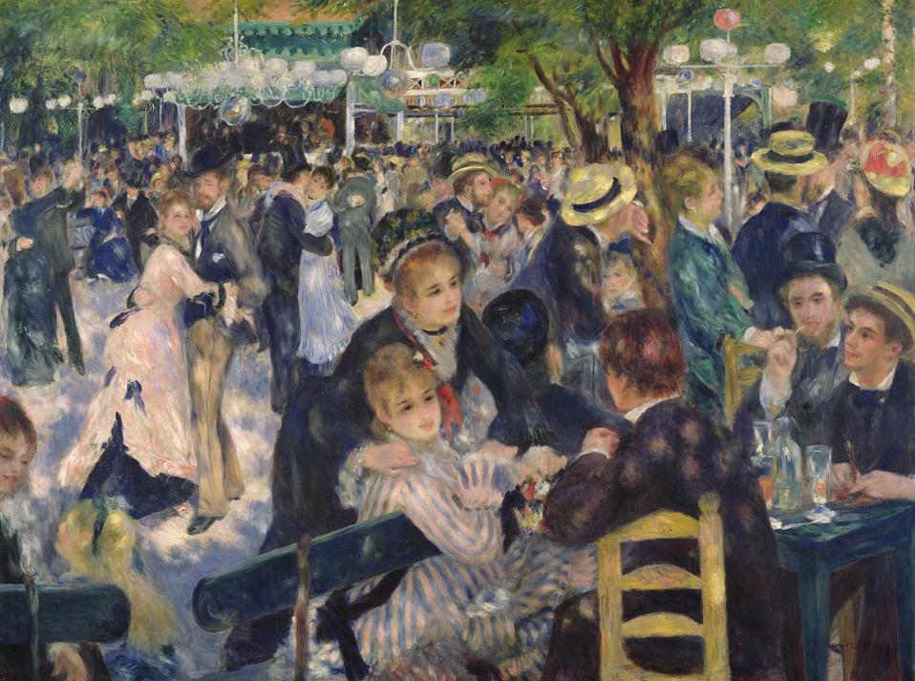
Auguste Renoir1841 - 1919
Auguste Renoir, was a French artist who was a leading painter in the development of the Impressionist style.
Bal du moulin de la Galette by Pierre-Auguste Renoir, 1876
© Bridgeman
© Copyright Kapow! 2017

Slide 7
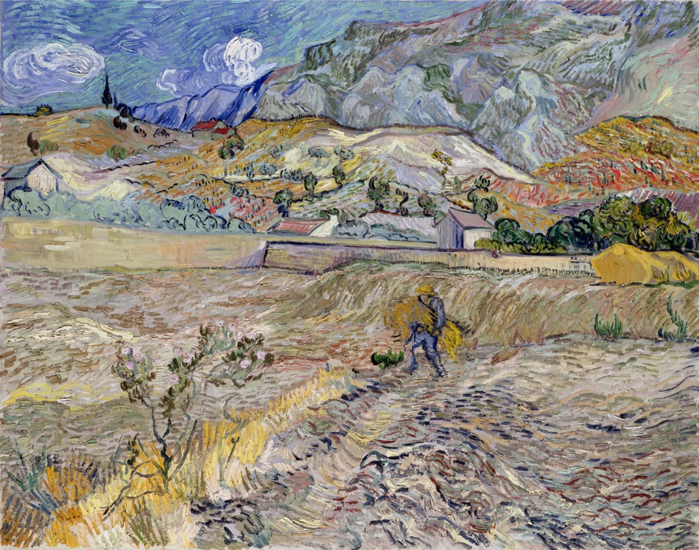
Vincent Van Gogh1853 - 1890
Vincent van Gogh was a Dutch artist whose work includes portraits, self portraits, landscapes and still life.
In just over a decade, he produced more than 2,100 artworks, including 860 oil paintings and more than 1,300 watercolors, drawings, sketches and prints.
Landscape at Saint-Rémy (Enclosed Field with Peasant) Vincent van Gogh 1889
© Bridgeman
© Copyright Kapow! 2017

Slide 8
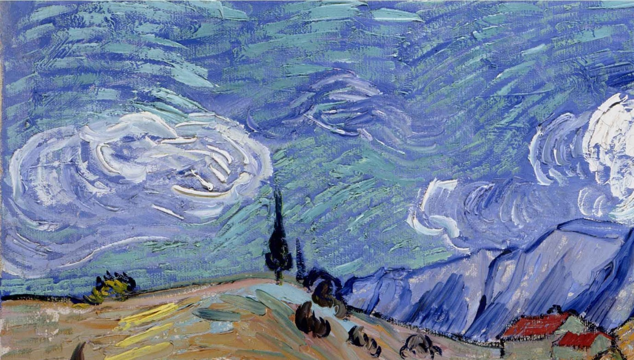
Detail - Landscape at Saint-Rémy (Enclosed Field with Peasant) Vincent van Gogh 1889
© Copyright Kapow! 2017

Slide 9
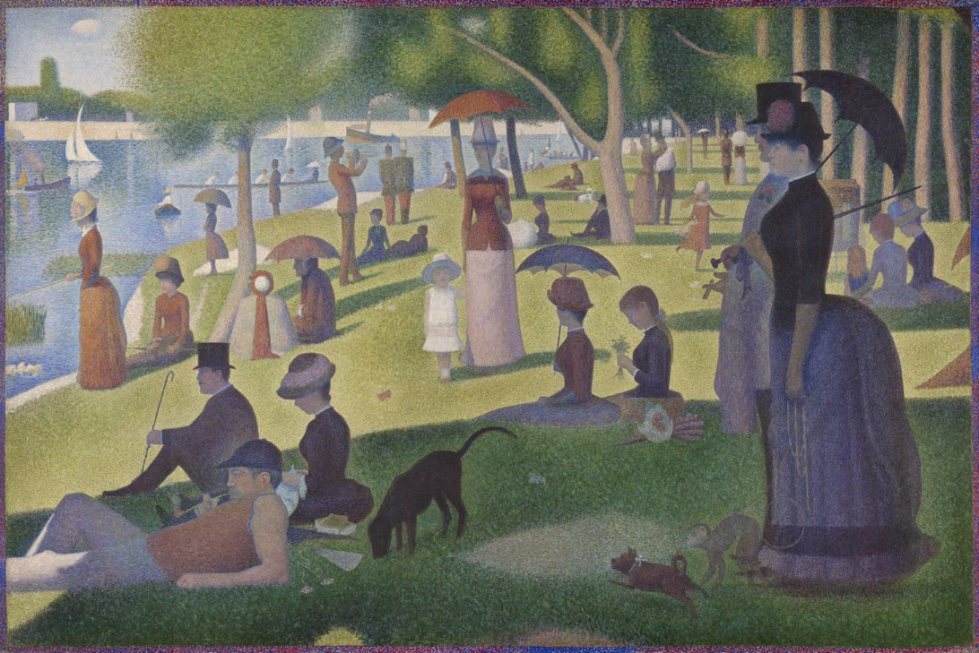
Georges Seurat 1839 - 1906
The painting depicts people relaxing in a park on an island in the Seine River called La Grande Jatte. The artist began the painting in 1884 with a layer of small horizontal brushstrokes of complementary colours. He later added small dots, also in complementary colours. It took him two years to complete.
A Sunday on La Grande Jatte, Georges Seurat 1884-1886
© Bridgeman
© Copyright Kapow! 2017

Slide 10
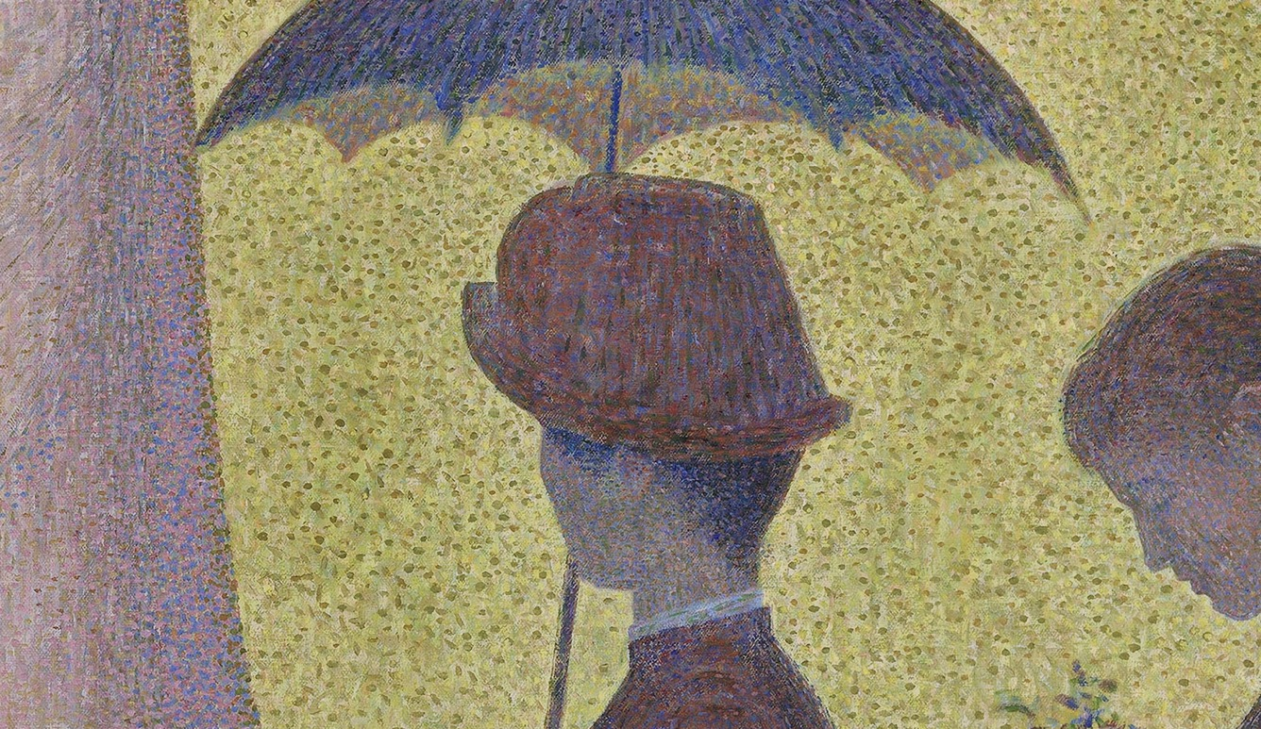
Detail - A Sunday on La Grande Jatte, Georges Seurat 1884-1886
© Copyright Kapow! 2017

Slide 11
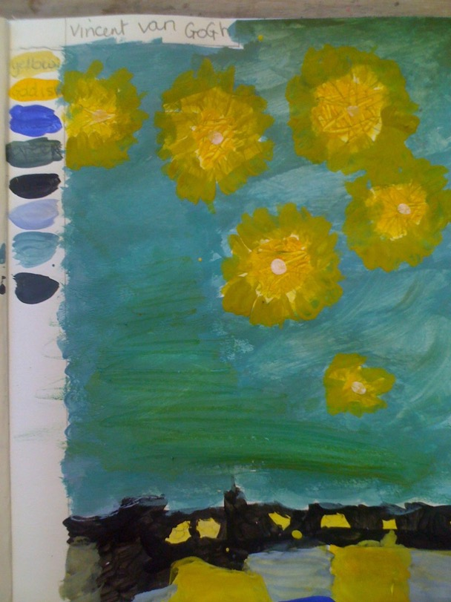
Impressionist Painting: Task
Now have a go yourself
© Copyright Kapow! 2017

