Slide 2
What Is Personal Hygiene?
Personal Hygiene is how we look after our bodies. Keeping ourselves clean and tidy makes us feel better about ourselves and also keeps us, and those around us, healthier!

Slide 3
What Does It Include?
Can you think what might be included in personal hygiene?
Brushing our teeth;
Washing our hands;
Wearing clean clothes;
Showering or bathing regularly;
Keeping fresh and clean;
Minimising the spread of germs where we can!

Slide 4
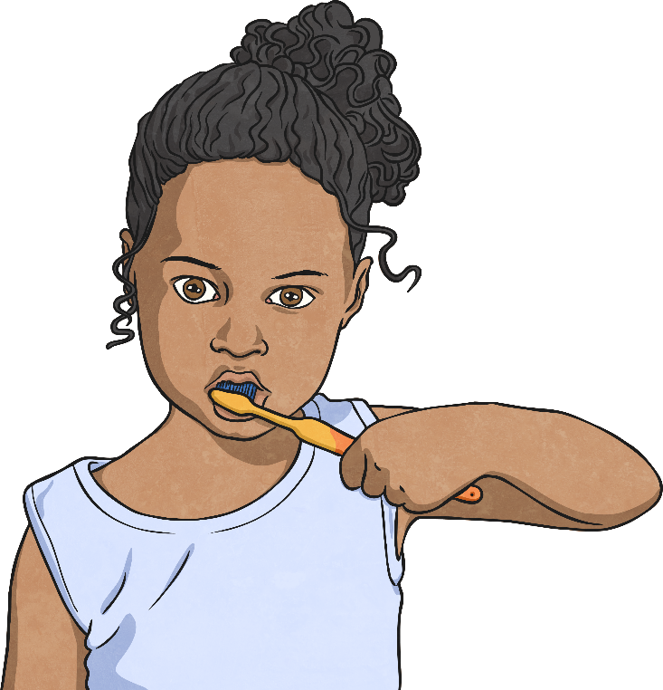
Brushing Our Teeth
It is recommended that we brush our teeth twice a day, for around
2 minutes.
We should visit the dentist every 6 months for a check up.
Brushing properly removes plaque which can cause cavities, tooth ache, gum disease and even our teeth falling out!
It also gives us lovely fresh breath!

Slide 5
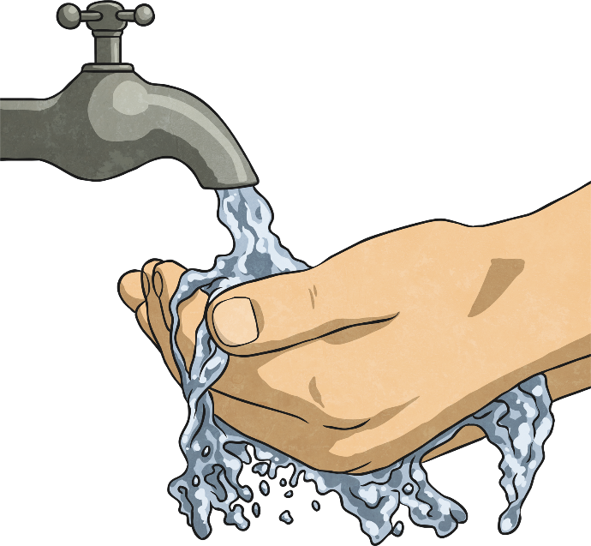
Washing Our Hands
Washing our hands is one of the simplest ways we can keep ourselves and those around us healthy.
Think about everything your hands touch in a day…
door handles;
stair banisters;
toilet flushers.
Think about how many other people have touched these things too!

Slide 6
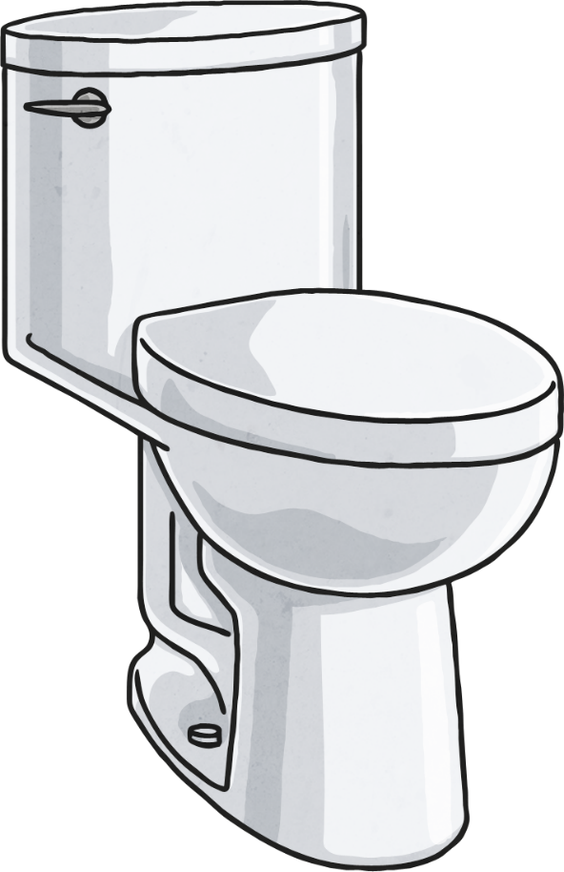
Dirtier Than a Toilet Seat?
A study from a University in Arizona claimed there were things that we touch that are actually dirtier than a toilet seat!
See if you can think of anything.
Remember: think of things that people touch regularly, not things we try to avoid!

Slide 7
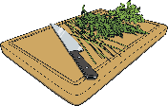
Dirtier Than a Toilet Seat!
Your pet’s food and water bowls
Your bathroom taps
Your smartphone or tablet screen
Chopping boards
All of these things were found to have more bacteria and germs than a household toilet seat!

Slide 8
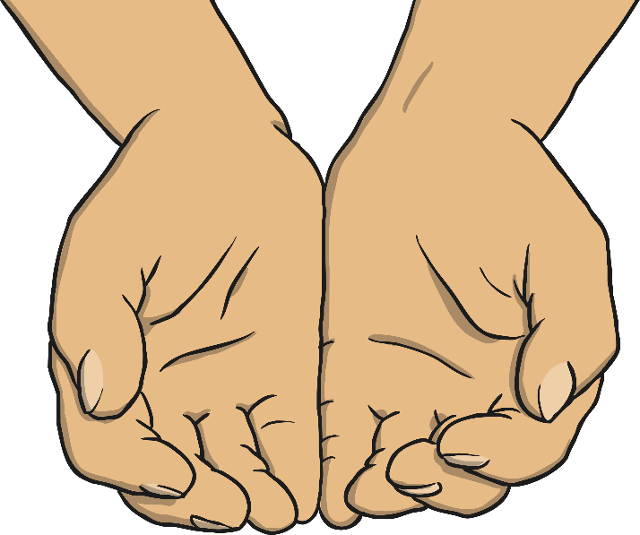
Handwashing
When we touch things we pick up germs, which we can then spread by rubbing our eyes, putting things into our mouths, etc.
We can even spread them to our friends and family without realising. Some germs can make us unwell, spreading everything from a cold to stomach bugs
(and much more).
Washing our hands with clean, warm water and soap will kill off the germs and keep our hands clean.

Slide 9
When Should We Wash Our Hands?
Can you think of times when its really important to wash your hands? Discuss!
When they are dirty;
Before we eat or help prepare food;
After petting animals;
After using the toilet;
After we sneeze, cough or blow our noses;
Before and after visiting someone who
is unwell.

Slide 10
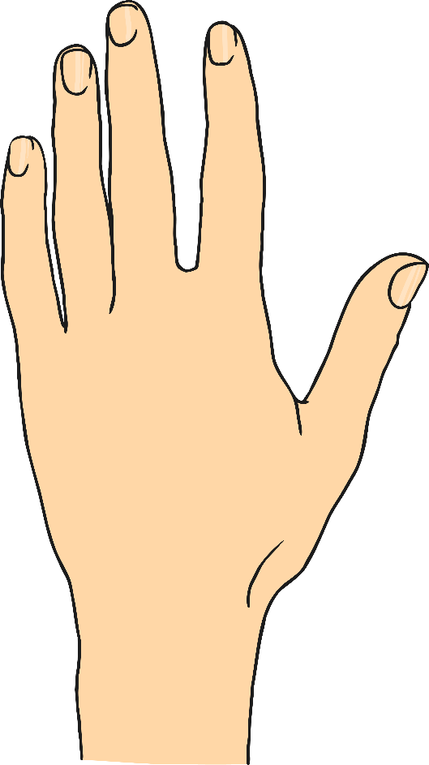
Don’t Forget About Your Nails
Can you think of times when its really important to wash your hands? Discuss!
It’s best to keep your nails neatly trimmed and clean.
And try not to bite them!

Slide 11
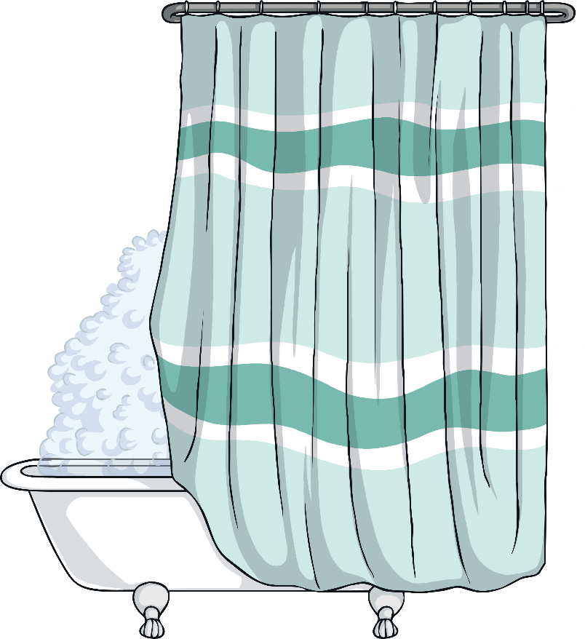
Showering or Bathing Regularly
As we get older and start to experience puberty it becomes important to shower and bathe more regularly.
Both boys and girls bodies change during puberty, but one of the main changes that we all experience is that our sweat glands grow and start to produce more sweat.

Slide 12
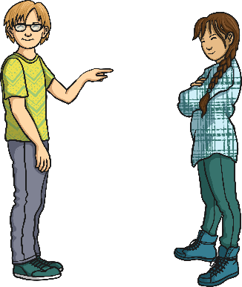
Hormones
During puberty, hormones kick in - different hormones for boys and girls - but they can both cause oily skin and more sweat. If we don’t wash regularly we are more likely to get spots and have BO (body odour).
Remember, sweat doesn’t smell…it is stale sweat that produces the body odour. You can keep yourself fresh by remembering to use deodorants but this is not a substitute for showers or baths!

Slide 13
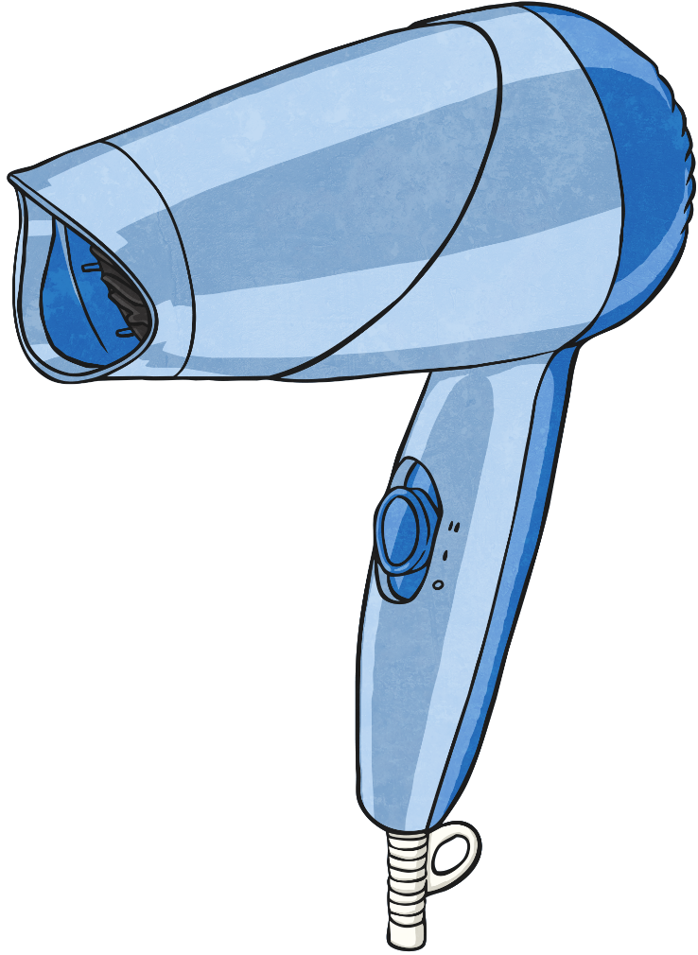
Hair
To keep your hair clean, use shampoo. If we don’t wash our hair regularly, it can look greasy as oils start to build up on our scalp. To keep hair nice and soft, some people also choose to use conditioner. There are millions of products that we can use in our hair! Gels, mousse, hairspray… just remember it needs to be washed out regularly!

Slide 14
More Hair
Another effect of puberty is the arrival of hair on other parts of
our bodies.
Girls
Girls notice hair beginning to grow around their pubic area and under their arms between the ages of 8 and 14. The hair on their legs
may thicken.
Boys
Boys will also notice more hair beginning to grow. Mainly around the base of their penis and under their arms. Leg hair also thickens. As they get older, facial hair will grow and hair continues to grow into adulthood, on their chest and backs, etc.

Slide 15
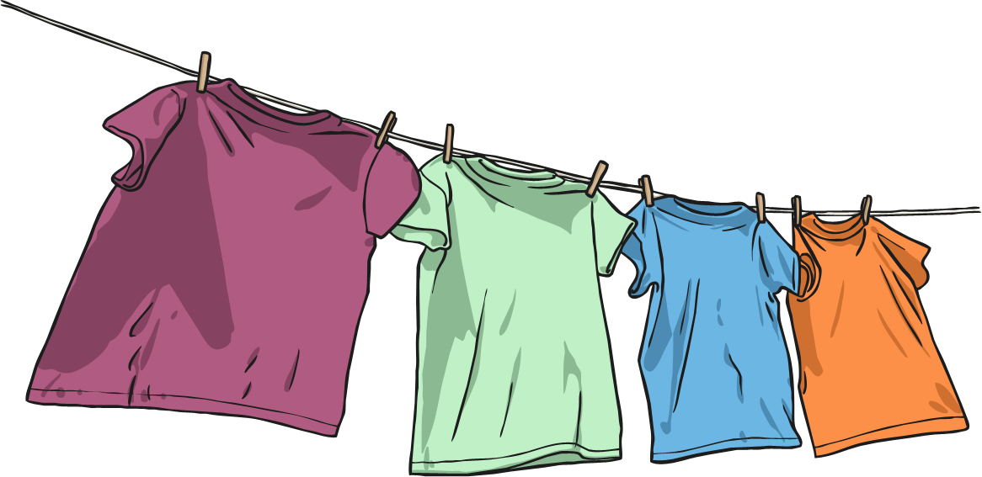
Clean Clothes
It is really important to wear clean clothes. If we wore the same thing all the time they would get dirty and start to smell. Even if it is the most fashionable thing you own…it will still need to be washed!
You don’t need to wear fresh, clean clothes every day, but if, for example, you wear the same trousers to school for a few days - make sure that you take them off as soon as you get home and let them air out for a while!

Slide 16
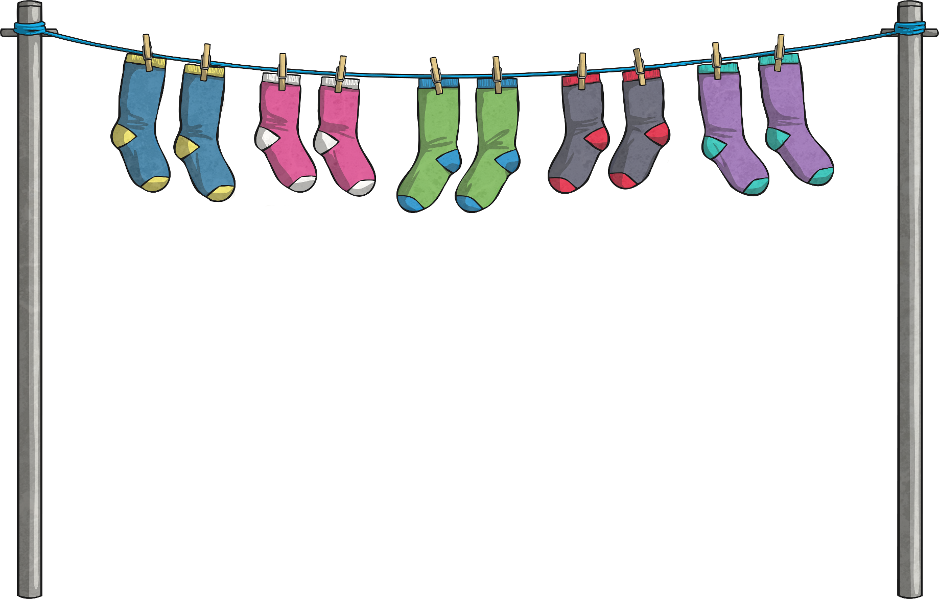
Don’t Forget Your Underwear!
Underwear is different. Underwear covers the parts which can get the most sweaty.
This includes socks! Our feet are covered in sweat glands and can get sweaty and smelly as we’re on our feet a lot.
Remember to change your socks and underwear every day! And put the dirty ones in the dirty washing basket - don’t leave them on your bedroom floor. Yuck!

Slide 17
Keep Our Noses Clean
Have you ever had a really runny nose? Or has it been really blocked and you feel like you can’t breathe through it?
It’s a horrible feeling, but we have all been there!
The only acceptable way of dealing with this is a tissue.
Sniffing, picking, wiping with sleeves… Yuck!

Slide 18
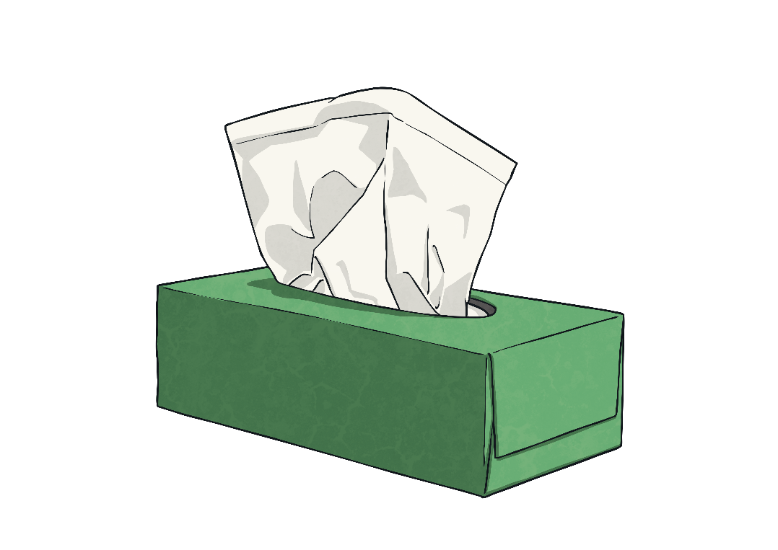
Using a Tissue
Bring a small packet of tissues with you to school. If you have a really bad cold, they can even stay at your desk!
However:
dirty tissues must be binned or flushed
down a toilet straight away;
don’t share used tissues with others;
wash your hands after using a tissue.

Slide 19
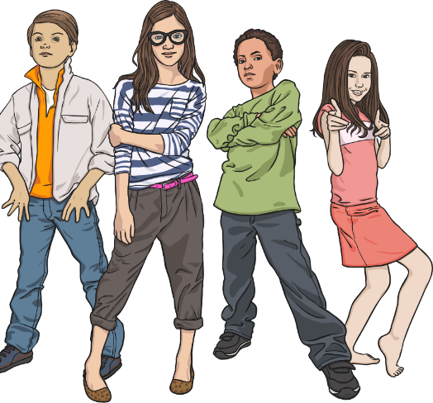
Spreading Germs
Germs and bacteria spread. It’s a fact and we can’t stop it, but we can try to minimise their spread. Following the tissue rules and washing our hands are really easy ways to minimise the germs we spread.
Can you think of any other ways?
Covering our mouths when we sneeze or cough.
Not sharing water bottles, etc.
Not coming to school if you have a stomach bug and have been sick or have diarrhoea.
Try not to touch our eyes, nose and mouth too much.

