Slide 1
Geography The Geography of Asia

Slide 2
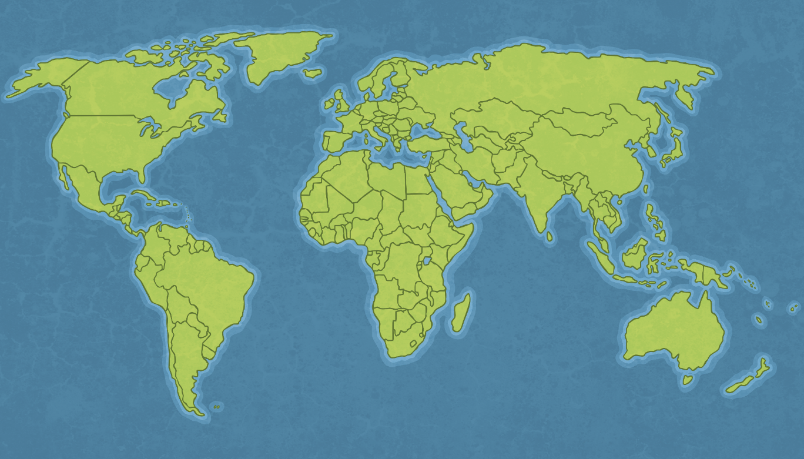
Where is Asia?
Asia is the largest of the world’s continents, covering about 30% of the Earth’s land area.

Slide 3
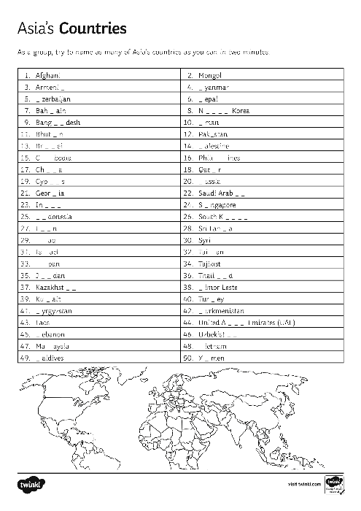
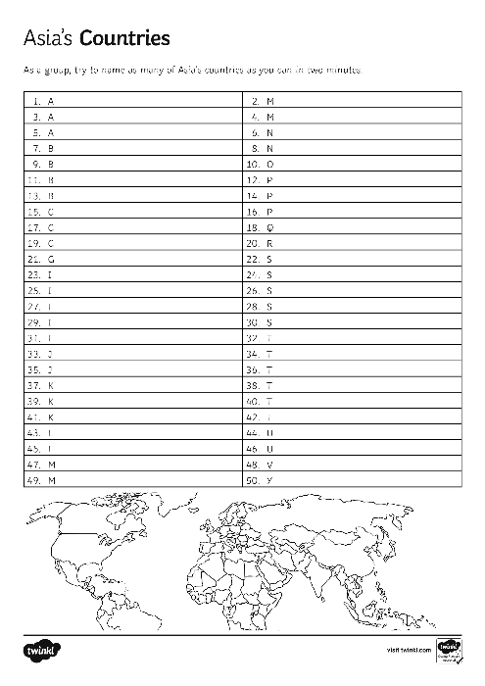
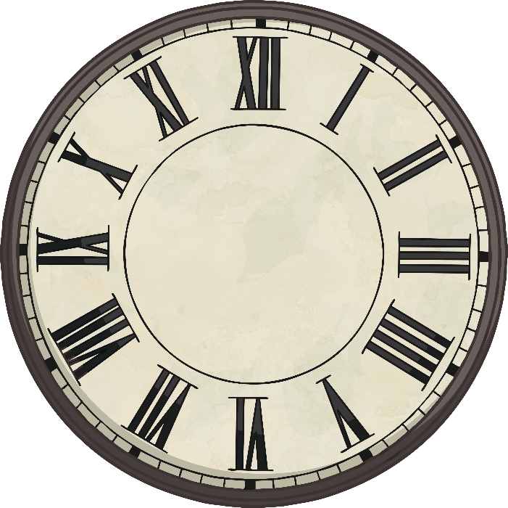
Asia’s Countries
Use the worksheet to name as many countries as you can in Asia. You have four minutes.
Start

Slide 4
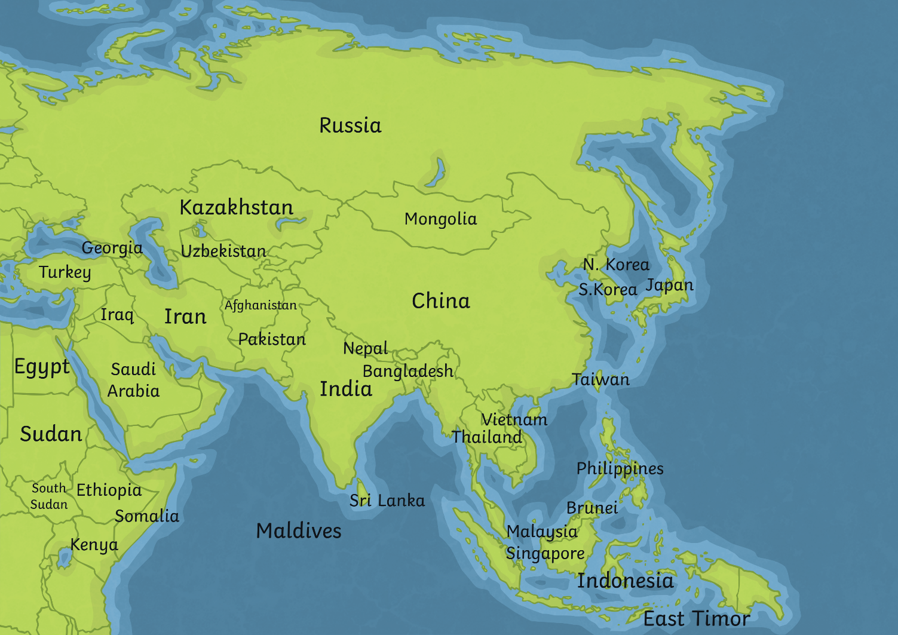
Asia’s Countries
Use the map to help you answer the following questions in your pairs.
Click on the area of the map
Which R has the largest land area?
Russia

Slide 5
Asia’s Countries
Which S is a small country to the south of Malaysia?
Singapore

Slide 6
Asia’s Countries
Which S is an island off India’s east coast?
Sri Lanka

Slide 7
Asia’s Countries
Which I is largest, Iran or Iraq?
Iran

Slide 8
Asia’s Countries
What is a group of four islands and begins with a J?
Japan

Slide 9
Asia’s Countries
Which P is between India and Afghanistan?
Pakistan

Slide 10
Asia’s Countries
What country is on the east coast and its name starts with a V?
Vietnam

Slide 11
Asia’s Countries
Which K is largest? Kazakhstan or Kyrgyzstan?
Kyrgyzstan
Kazakhstan

Slide 12
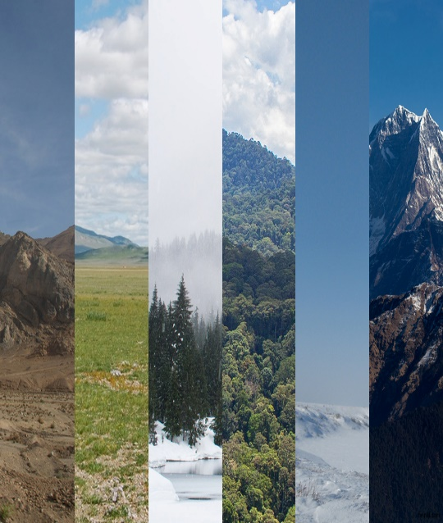
Asia’s Biomes
The world can be divided into biomes. Several different biomes can be found in Asia.
Key Terms
A biome is an area with a distinctive climate and vegetation.
Photos courtesy of A.Davey, Brian, Gido, Andrea Pokrzywinski, Ivan Komarov, (@flickr.com) - granted under creative commons licence – attribution

Slide 13
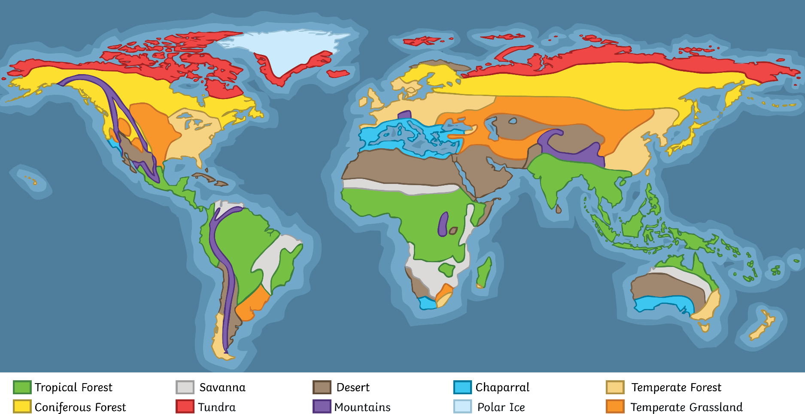
Asia’s Biomes
Which biomes are found in Asia?

Slide 14
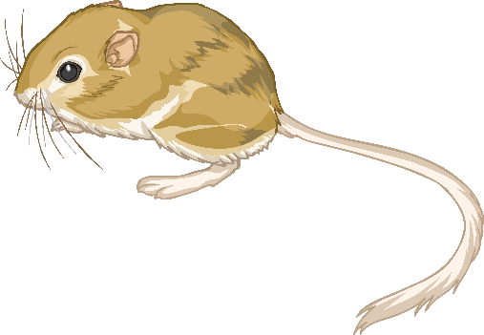
Asia’s Biomes – 1. Deserts
Asia contains several deserts. The largest is the Gobi Desert found between China and Mongolia. It is mainly made of rock, rather than sand, and parts of the Gobi Desert receive less than 100mm annual rainfall. Saudi Arabia, Yemen and Oman also have hot desert.
Photos courtesy of A.Davey, (@flickr.com) - granted under creative commons licence – attribution

Slide 15
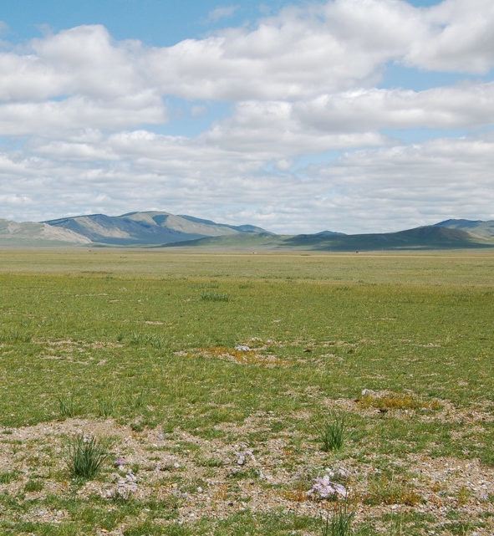
Asia’s Biomes – 2. Temperate Grasslands
Large areas of flat grassland and shrublands are known as plains or steppes. They have very few trees. The West Siberian Plain is in central Russia. It is one of the world’s largest areas of continuous flatland. It contains some of the world’s largest swamps and flood plains.
Photos courtesy of Brian (@flickr.com) - granted under creative commons licence – attribution

Slide 16
Asia’s Biomes – 3. Coniferous Forests
Also known as Taiga or Boreal. This forms a belt across the middle of Russia. Why do trees have:
A tall and conical-shape?
Short branches and wax-covered needle-shaped leaves?
Shallow roots to survive long cold winters?
To let snow slide off.
To reduce water-loss.
The ground will be frozen for more than six months of the year.
Tree species include fir, spruce and pine.

Slide 17
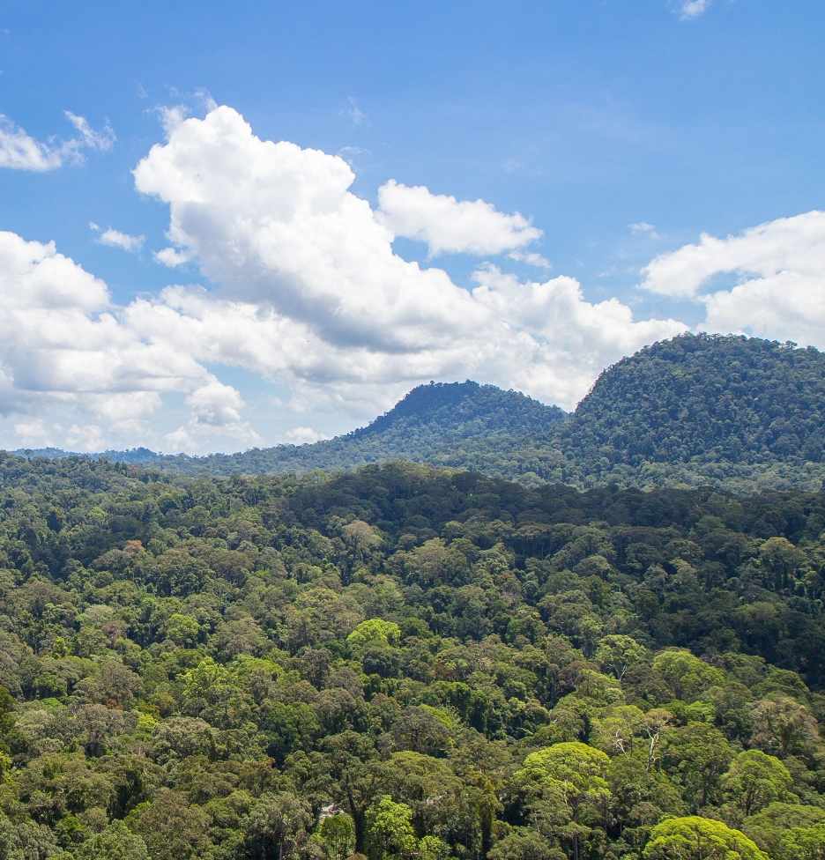
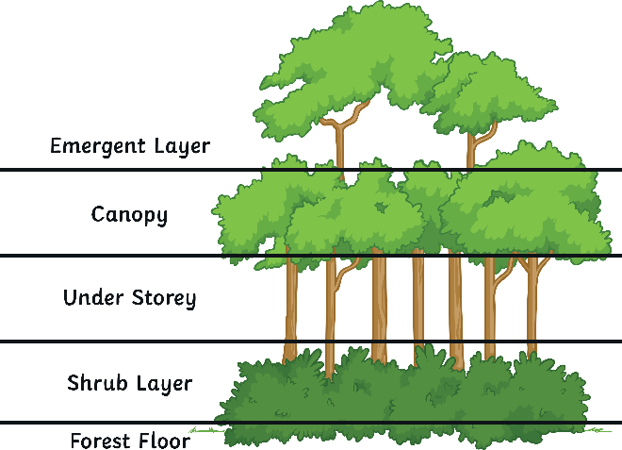
Asia’s Biomes – 4. Tropical Rainforests
Tropical rainforests are found in south-east Asia. They are warm and wet. Tropical rainforests contain thousands of species of plants, animals, insects and birds. They have five distinct layers of vegetation.
Photos courtesy of Gido (@flickr.com) - granted under creative commons licence – attribution

Slide 18
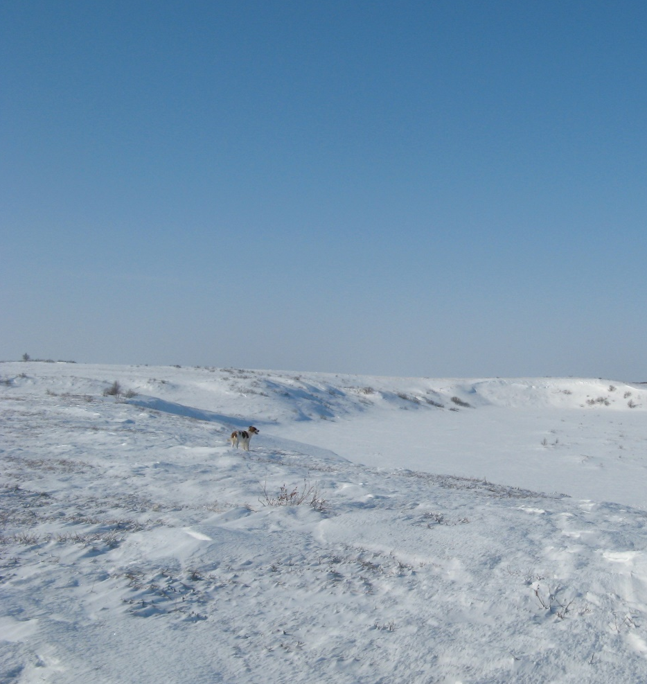
Asia’s Biomes – 5. Tundra
Tundra is found in northern Russia. Temperatures are very low and most of the ground is permanently frozen (permafrost). Surface water cannot drain away so land can be marshy. Precipitation is low and normally falls as snow. Plants are rarely taller than 30 centimetres and consist of moss, lichen and grasses.
Photos courtesy of Andrea Pokrzywinski (@flickr.com) - granted under creative commons licence – attribution

Slide 19
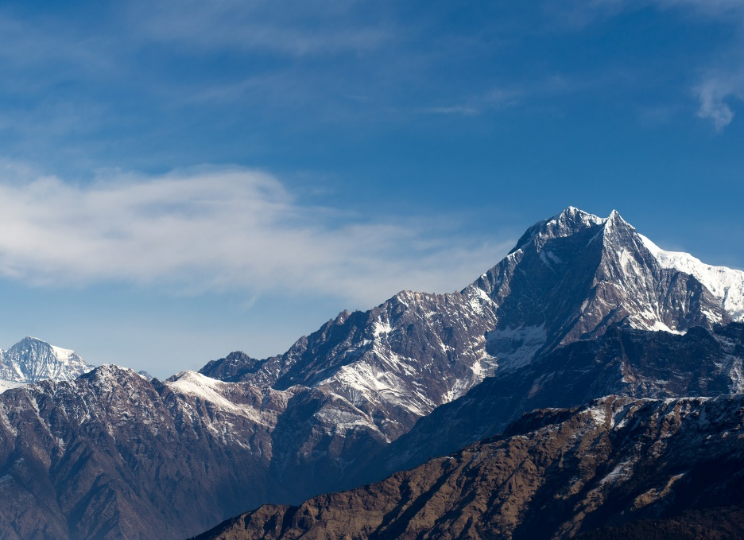
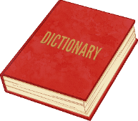
Asia’s Biomes – 6. Mountains
The largest mountain range is Asia is the Himalayas. They began forming when the Indian subcontinent collided with the Eurasian continent about 50 million to 55 million years ago. The Himalayas are still growing about 5 centimetres every year.
Asia is home to many plateaus. The Tibetan Plateau is the
Dictionary
A plateau is an area of relatively high land. However, the land at the top of a plateau is flatter, not mountainous.
Photos courtesy of Ivan Komarov (@flickr.com) - granted under creative commons licence – attribution
largest and highest area and is often called the “Rooftop of the World”. It has many important glaciers and about 2 billion people depend on the rivers fed by the plateau’s glaciers.

Slide 20
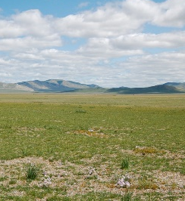
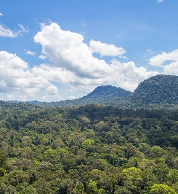
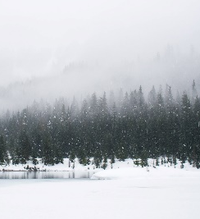
Asia’s Biomes – Individual Task
Complete the worksheet which summarises the key information about each of Asia’s biomes.
Include:
the names of each biome;
a small illustration to represent each biome;
three facts about each biome.

