Slide 1
Online safety
By Ernests
This Photo by Unknown Author is licensed under CC BY-ND

Slide 2
Only go on websites that are safe
This Photo by Unknown Author is licensed under CC BY

Slide 3
DON’T share personal information with strangers
This Photo by Unknown Author is licensed under CC BY-SA-NC

Slide 4
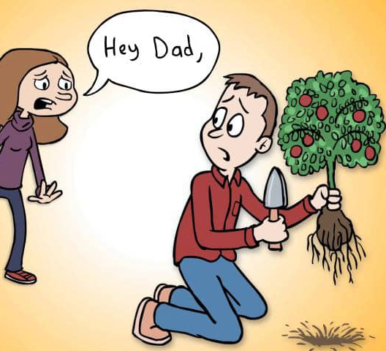
Tell your parents if anything online is upsetting you or if a stranger has contacted you
This Photo by Unknown Author is licensed under CC BY-NC-ND

Slide 5
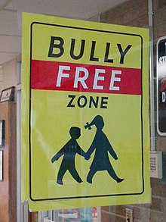
Do not bully others online and if someone bullies you, tell a trusted adult.
This Photo by Unknown Author is licensed under CC BY-SA

Slide 6
This Photo by Unknown Author is licensed under CC BY-NC

