Slide 1
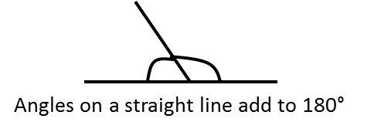
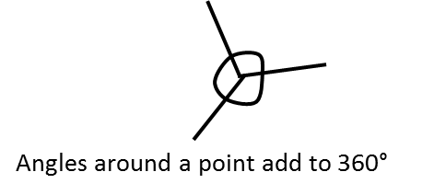
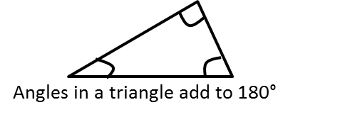
ANGLE FACTS
Notes:
1

Slide 2
EXAMPLES
Work out the missing angles below:
1)
120°
2)
150°
3)
4)
c
130°
60°
30°
b
30°
d
50°
90°
30°
a
e
120°
Vertically opposite angles are equal
Vertically opposite angles are equal
Angles on a straight line add to 180°
Angles on a straight line add to 180°
Angles on a straight line add to 180°
5)
6)
7)
8)
97°
130°
75°
k
130°
110°
40°
121°
f
102°
70°
78°
i
52°
h
g
62°
85°
j
90°
120°
52°
Angles around point add to 360°
Angles in a triangle add to 180°
Angles in a quadrilateral add to 360°
Vertically opposite angles are equal
Angles on a straight line add to 180°
Angles in a quadrilateral add to 360°
Notes:
2

Slide 3
ANGLES
TASK 1
Vertically Opposite Angles (Equal)
37°
120°
45°
25°
135°
40°
120°
145°
50°
140°
35°
60°
115°
130°
65°
Notes:
3

Slide 4
TASK 2
Angles on a straight line (180°)
130°
150°
40°
50°
65°
152°
145°
75°
115°
133°
108°
54°
117°
83°
22°
Notes:
4

Slide 5
ANGLES
TASK 3
Angles around a point (360°)
134°
153°
62°
133°
53°
37°
95°
52°
12°
44°
32°
73°
81°
35°
66°
38°
75°
99°
95°
Notes:
5

Slide 6
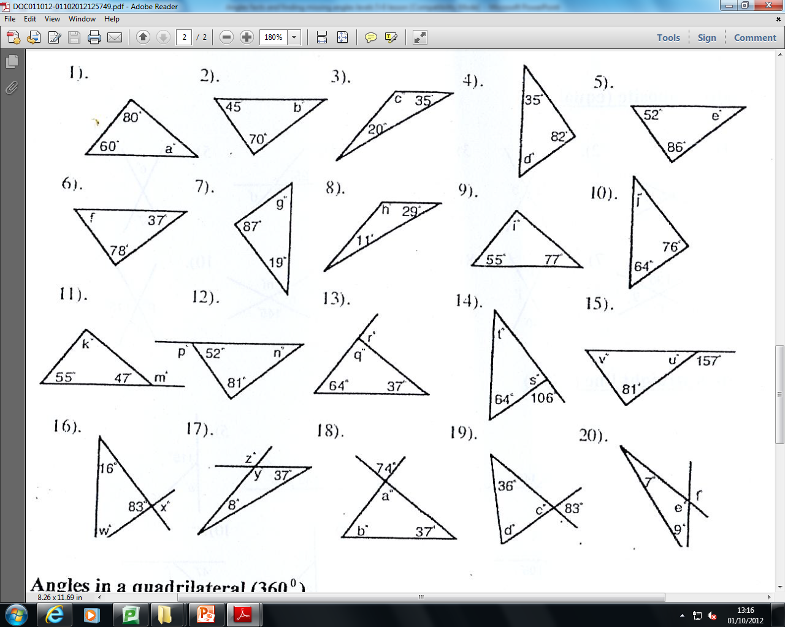
ANGLES
TASK 4
Angles in a triangle (180°)
65°
125°
42°
40°
63°
65°
74°
140°
40°
48°
101°
42°
78°
133°
128°
47°
76°
23°
79°
74°
135°
135°
164°
83°
74°
83°
164°
81°
69°
61°
Notes:
6

Slide 7
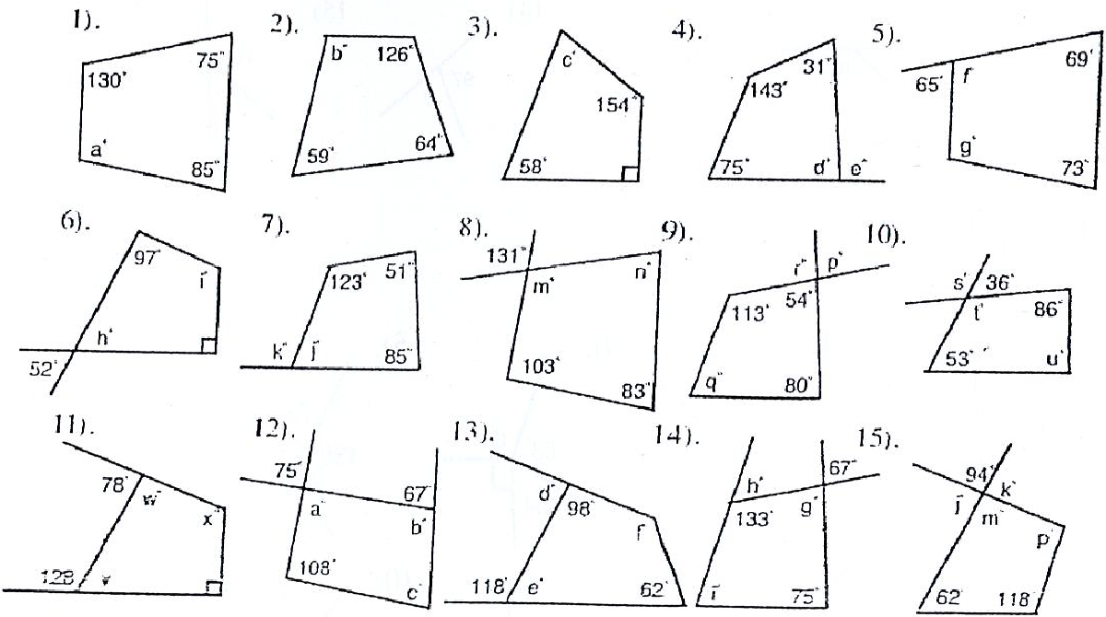
ANGLES
TASK 5
Angles in a quadrilateral (360°)
111°
58°
115°
70°
111°
69°
103°
126°
54°
144°
121°
131°
43°
52°
79°
144°
101°
77°
113°
47°
82°
86°
102°
86°
116°
75°
113°
138°
67°
94°
52°
86°
64°
62°
85°
Notes:
7

Slide 8
ANGLES
EXTENSION
1)
2)
3)
4)
5)
52°
116°
144°
64°
18°
60°
40°
36°
60°
104°
60°
100°
86°
116°
116°
162°
120°
80°
120°
85°
46°
88°
54°
Notes:
8

