Slide 1
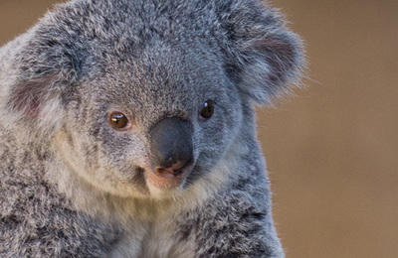
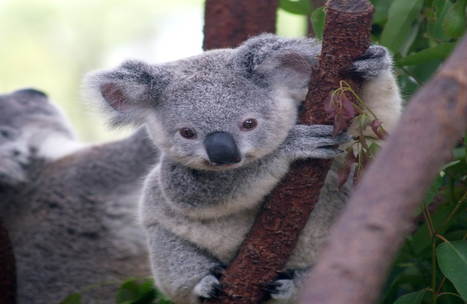
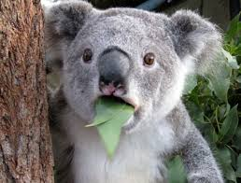
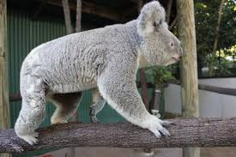
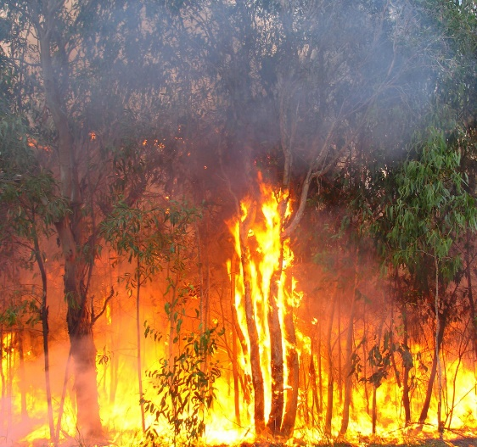
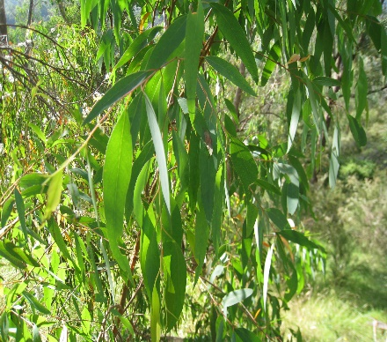
Do you know why koalas are my favourite animal?
What colours can Koalas be?
Koalas can be light grey to brown.
Koalas in the south end have darker and thicker fur.
INTRODUCTION
Their habitat is a dry forest.
They come from the eastern side of Australia.
The life span is up to 13 years to 18 years in captivity.
Koalas are calm animals that why I like them.
Do some koalas live on ground?
Koalas do not live on ground.
Koalas only go on the ground to move to a different tree.
What can baby koalas do?
It takes an adult Koala 34 to 36 days to have a baby.
Baby Koalas are blind when they are born.
They have no ears nor fur when they are born.
Isabelle's incredible facts
Baby Koalas are called joeys like Kangaroos.
80% of Koala habitats have been distraught by bushfires.
They are not dangerous unless they feel stressed or threatened.
What do they eat?
Koalas eat eucalyptus leaves.
An adult Koala eats between 200 to 500 grams of eucalyptus leaves a day.

