Slide 1
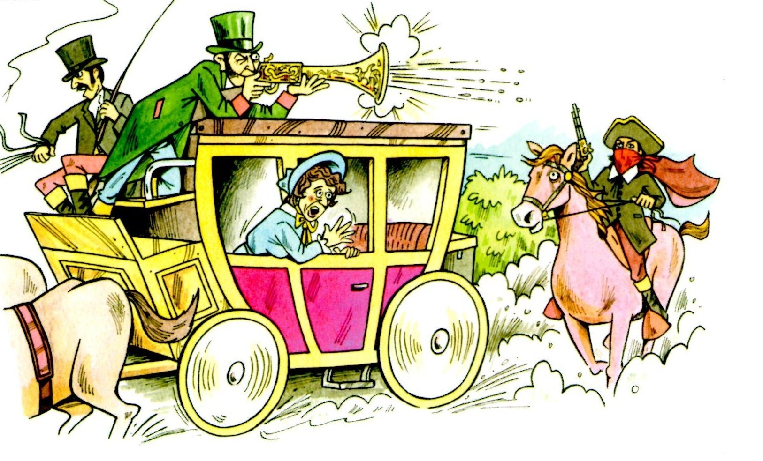
How did Highway men terrorise Britain’s roads?

Slide 2
Who was Dick Turpin
Richard ‘Dick’ Turpin was born around 1705 in Essex
He started his working life as a butcher, like his father, but soon became a deer thief.
He then committed more crimes including poaching, burglary, horse theft and murder.

Slide 3
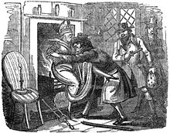
Turpin’s gangs
The Essex Gang
Turpin joined this gang of deer thieves in the 1730s.
As part of the gang he may have been involved in robbing people in their homes and threatening them with violence
Contemporary cartoon of the Essex gang threatening Widow Shelley with being put on the fire if she didn’t tell the gang where her money was

Slide 4
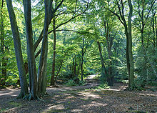
Highway robber
When the Essex Gang broke
up Turpin turned to highway
robbery.
He and his accomplices
often attacked travellers in
Epping Forest.
Soon he was supposedly working with two other highwaymen, Matthew King and Stephen Potter. The three of them were responsible for a string of robberies between March and April 1737

Slide 5
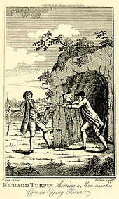
Murderer
King is the first person Turpin was rumoured to kill but this was probably an accident
Turpin’s next murder we can be more certain of.
While hiding in Epping forest he shot and killed Thomas Morris, a servant of one of the Forest's Keepers who had seen him hiding

Slide 6
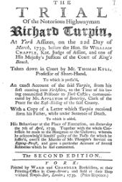
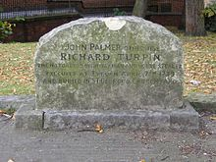
Trial
Turpin was put on trial in 1739 for his crimes.
On 22 March 1739 Turpin was found guilty on two charges of horse theft and sentenced to death. He was executed (by being hanged) on 7 April 1739.

Slide 7
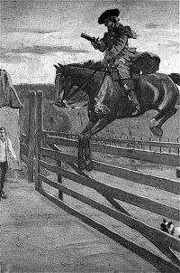
How did he become so famous
100 years after he had died an author called William Harrison Ainsworth wrote a story which included a fictional 200-mile overnight ride from London to York on his horse Black Bess.

