Slide 1
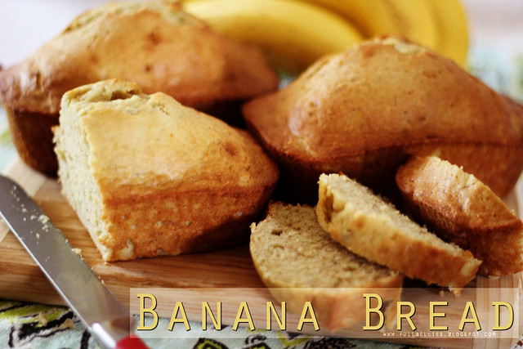
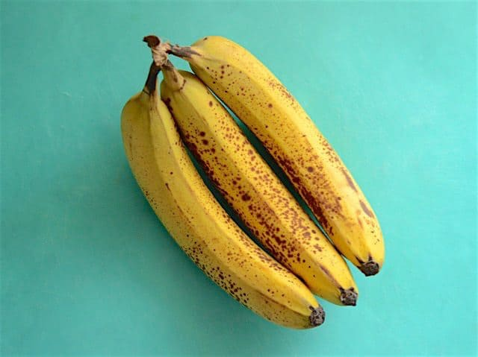
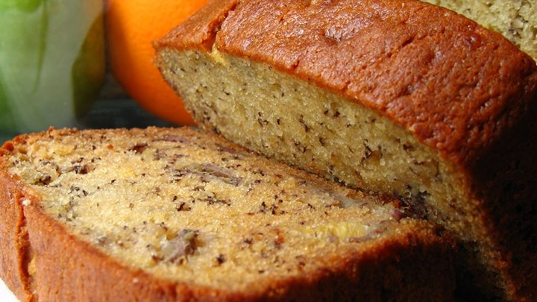
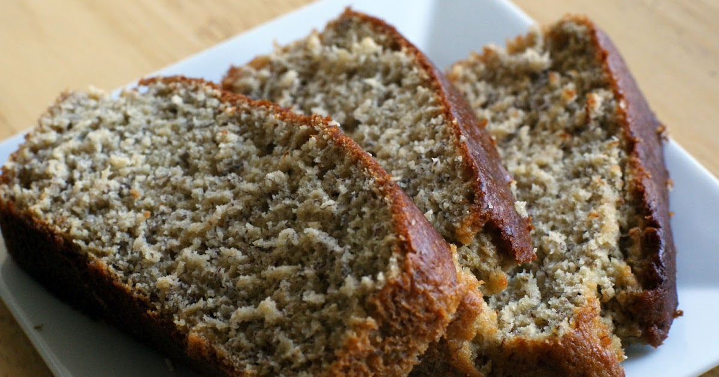
Method:
First you will have to turn the oven to 180C/160C fan gas.
Butter a 2lb loaf tin and line the base with grease proof paper ( you can use a bit of grease proof paper to help you).
Combine the 140g of softened butter and the 140g of caster sugar until light and fluffy followed by the two beaten eggs and some of the flour.
Fold in the remaining flour then add baking powder and the two mashed bananas. Combine until the mixture is creamy.
Pour the mixture into the tin and bake for approximately 30 minutes until a skewer comes out clean. Leave to cool.
How to make Bolton’s Banana Bonanza Bread
Ingredients
You will need:
140g of butter, softened (plus an extra tin)
140g of caster sugar
2 large eggs (beaten)
140g of self-raising flour
1 tsp of baking powder
2 very ripe bananas (mashed)
50g of icing sugar
Equipment:
A 2lb tin
A tsp spoon
A whisk
Measuring scales
Grease proof paper

