Slide 1
Hawking’s Maths Quiz!!

Slide 2
Round 1 Number and Place Value

Slide 3
1. What is the value of the underlined digit in this number?
345,689.097

Slide 4
2. Write ‘six million, two hundred and three thousand, seven hundred and twelve’ in numerals.

Slide 5
3. Use < > or = to compare the amounts on your answer sheet.

Slide 6
4. Round 1,234,545 to the nearest:
a. Hundred
b. Thousand
c. Hundred thousand

Slide 7
5. Write down the number which is 34 less than 3.

Slide 8
Round 2 The Four Operations

Slide 9
1. Harry goes to football training for 1 ½ hours a day. How many hours will he train for in 3 weeks?

Slide 10
2. A music arena can hold 4464 people. If there are 36 different sections that can each hold the same amount of people, how many can fit in each section?

Slide 11
3. 34+7x5-(18÷3)=

Slide 12
4. Find all of the common factors of 28, 56 and 70.

Slide 13
5. Write down all of the prime numbers between 40 and 80.

Slide 14
Round 3 Fractions, Decimals and Percentages

Slide 15
1. Order the fractions on your answer sheet from the smallest to largest.

Slide 16
2. Write down the missing equivalent fractions, decimals and percentages on your answer sheet.

Slide 17
3. Jane had ¾ of a bottle of water. Henry had ⁴/₅ of a bottle of water. What fraction do they have altogether?

Slide 18
4. ⁵/₉ of a class are boys. Of those boys, ³/₇ of them have glasses. What fraction of boys have glasses?

Slide 19
5. Tina has ⁴/₅ of a tub of popcorn left. She shares it between 5 friends. What fraction do the 5 friends get each?
Bonus Question: What is the percentage that each friend get?

Slide 20
Round 4 Measurement

Slide 21
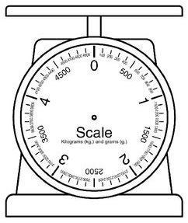
1. Read this scale and estimate the value that the arrow is pointing to.

Slide 22
2. A rectangular playing field has an area of 600m². One length is 24m. What is the other length?

Slide 23
3. How do you find the volume of a cube or cuboid?

Slide 24
4. 1 mile = 1.6km
Using this, work out how many km is equivalent to 13 miles.

Slide 25
5. Order the measurements on your answer sheet from largest to smallest.

Slide 26
Round 5 Geometry

Slide 27
Complete this sentence:
The diameter of a circle is… and to find it, I can…

Slide 28
2. Find all of the missing co-ordinates on your answer sheet.

Slide 29
3. Using the grid on your answer sheet, draw the net of a 3d shape which has 5 faces.

Slide 30
4. A quadrilateral has a 55° angle, a right angle and a 67 ° angle. What is the value of the missing angle?

Slide 31
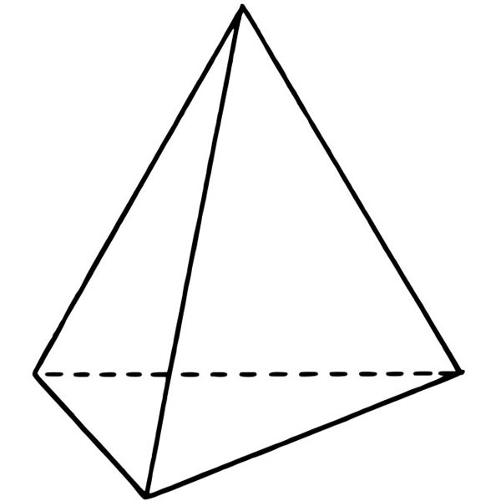
5. Write down the mathematical name for this shape:

Slide 32
Round 6 Statistics, Ratio, Proportion and Algebra

Slide 33
1. Tim needs 20ml of squash and 70ml water to make enough for one drink. How many ml of water would he need for 8 drinks?

Slide 34
3. A quiz team get the following results in each round:
Round 1 = 4
Round 2 = 7
Round 3 = 9
Round 4 = 4
Round 5 = 6
Round 6 = 6
What is their mean score?

Slide 35
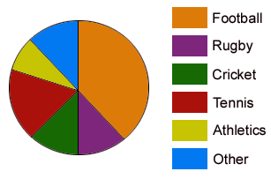
4. If 40 people were asked, estimate the number of people who chose Football.

Slide 36
5. In a school with 500 children, 48% are girls. How many are boys?

Slide 37
Round 7 Arithmetic

Slide 38
1. 1278÷100=

Slide 39
2. ¾ x ⁶/₇ ₌

Slide 40
3. 134,500 – 24,568=

Slide 41
4. 6.8+9.03=

Slide 42
5. √64

Slide 43
Bonus Round

Slide 44
2. What is 34.678 rounded to the nearest 2dp, 1dp and whole number?

Slide 45
3. How many minutes are there in 2 days?

Slide 46
4. Write 765 in Roman Numerals.

Slide 47
5. To find the cost of a bag of pick and mix sweets, you have to multiply the number of sweets by 12p and add 26p for the bag.
What is the formula for finding the cost of a bag of pick and mix sweets?

Slide 48
Round 1 Number and Place Value
Answers

Slide 49
1. The value of the digit is ⁹/₁₀ or nine tenths.
2. Six million, two hundred and three thousand, seven hundred and twelve in numerals:
6,203,712
3.
4. Round 1,234,545 to the nearest:
Hundred: 1,234,500
Thousand: 1,235,000
Hundred Thousand: 1,200,000
5. 34 less than 3 is -31

Slide 50
Round 2 The Four Operations
Answers

Slide 51
1. Harry will train for 31.5 hours.
2. Each section of the music arena can hold 124 people.
3. 34+7x5-(18÷3)=63
34+35-6=63
4. The common factors of 28, 56 and 70 are:
1, 2, 7, 14
5. All of the prime numbers between 40 and 80 are:
41, 43, 47, 53, 59, 61, 67, 71, 73, 79

Slide 52
Round 3 Fractions, Decimals and Percentages
Answers

Slide 53
From smallest to largest:
¼ ³/₇ ²/₃
2. Write down the missing equivalent fractions, decimals and percentage:
3. ¾ + ⁴/₅ = ³¹/₂₀ = 1 ¹¹/₂₀
4. ⁵/₉ x ³/₇ ₌ ¹⁵/₆₃ ₌ ⁵/₇
5. ⁴/₅ ÷ 5 = ⁴/₂₅
Bonus: 16%

Slide 54
Round 4 Measurement
Answers

Slide 55
1. The scale was showing approximately 2350g (2.35kg). Any answers between 2320g (2.32kg) and 2370g (2.37kg) will be accepted.
2. A rectangular playing field has an area of 600m². One length is 24m.
The other length is 25m.
3. To find the volume of a cuboid, you multiply the length by the width, by the height (V=LWH)
4. 1 mile = 1.6km
13miles = 20.8km
5. From largest to smallest:
666ml, 0.66l, 0.606l, 66ml, 60ml, 0.006l

Slide 56
Round 5 Geometry
Answers

Slide 57
1. The diameter of a circle is the distance from one edge of a circle to the opposite, running through the centre and to find it, I can double the radius or measure the distance from one edge to the opposite edge, going through the centre.
2. Find the missing co-ordinates on your answer sheet.
(2,7)
(10,10)
(6,3)
(3, 3)

Slide 58
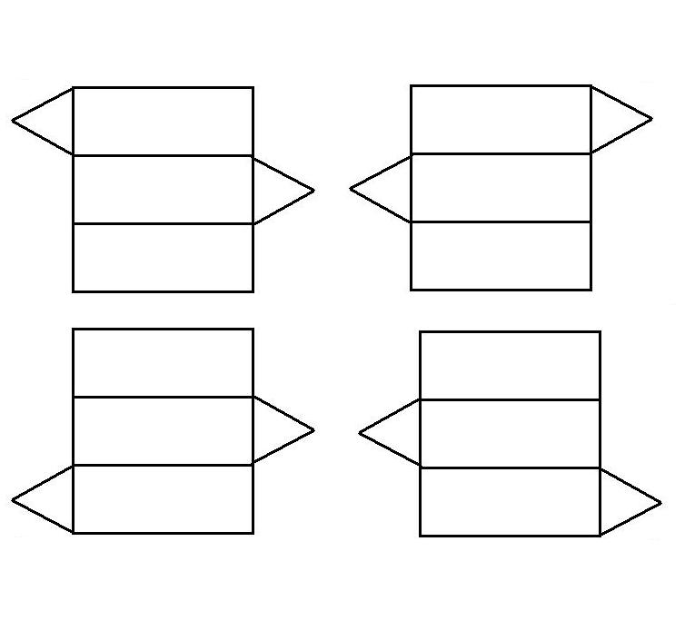
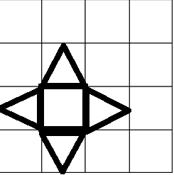
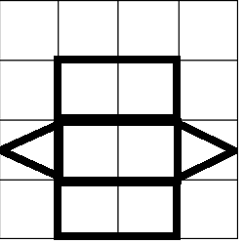
3. Using the grid on your answer sheet, draw the net of a 3d shape which has 5 faces.
4. A quadrilateral has a 55° angle, a right angle and a 67 ° angle.
The missing angle is 148°
5. This is called a tetrahedron.

Slide 59
Round 6 Statistics, Ratio, Proportion and Algebra
Answers

Slide 60
1. Tim needs 560ml of water.
2. The quiz team’s mean score was 6.
3. Between 14 and 16 people chose football.
4. In a school with 500 children, there are 260 boys.

Slide 61
Round 7 Arithmetic
Answers

Slide 62
1. 1278÷100= 12.78
2. ¾ x ⁶/₇ ₌ ¹⁸/₂₈ ₌ ⁹/₁₄
3. 134,500 – 24,568= 109,932
4. 6.8+9.03= 15.83
5. √64 = 8

Slide 63
Bonus Round
Answers

Slide 64
1. What is 34.678 rounded to the nearest
2dp = 34.68
1dp = 34.7
Whole number = 35
2. There are 2880 minutes in 2 days.
3. 765 in Roman Numerals is DCCLXV
4. To find the cost of a bag of pick and mix sweets, the formula is C=12n+26

